Slide 1

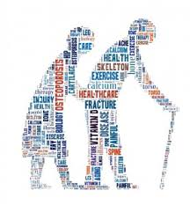
‘Stand up for your bones’ Age Friendly Academy webinar June 2020
Tutor: Dr Alexandra Mavroeidi
Senior Lecturer, School of Psychological Sciences & Health
Facilitator: Mrs Gemma Gilliland
Age-Friendly Academy Manager

Slide 2
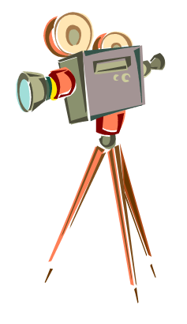
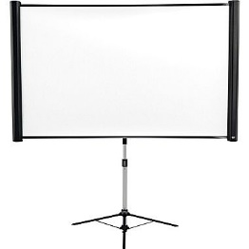

Housekeeping
Today’s webinar is being recorded. We will share a link with you after the event is complete.
We will also share these slides with you afterwards. You will be able to access these slides using a code.
I invite your comments and questions. For recording purposes everybody will be on mute during this presentation, but feel free to share your questions using the Q&A section. I will respond to these at the end of session .

Slide 3
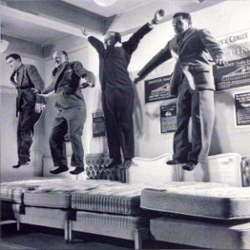
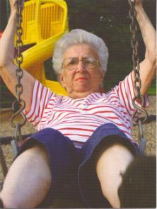
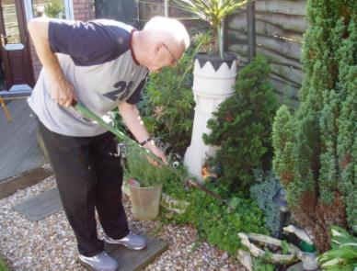
“Life in your years” Requires more than just stamina and energy, requires strength and balance to feel confident in all other activities you go on to do.... It’s never too late!
Slide courtesy of DA Skelton

Slide 4
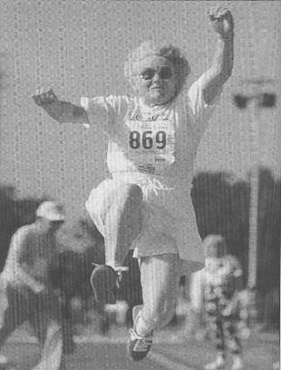
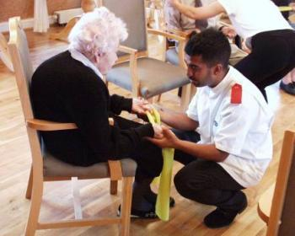
Strength and balance ability over the life course - potential ages or events that may change the trajectory of decline with ageing
Skelton & Mavroeidi, JFSF, 2019

Slide 5
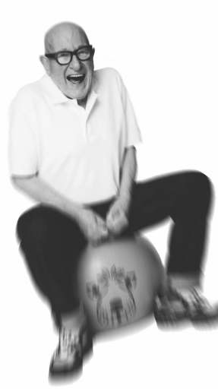
Summary of session
Exercise is important! Avoidance of activity is common
Emerging evidence on inactivity/sedentary behaviour on bone health
CMO PA Guidelines for older people
Exercise in the COVID-19 era

Slide 6
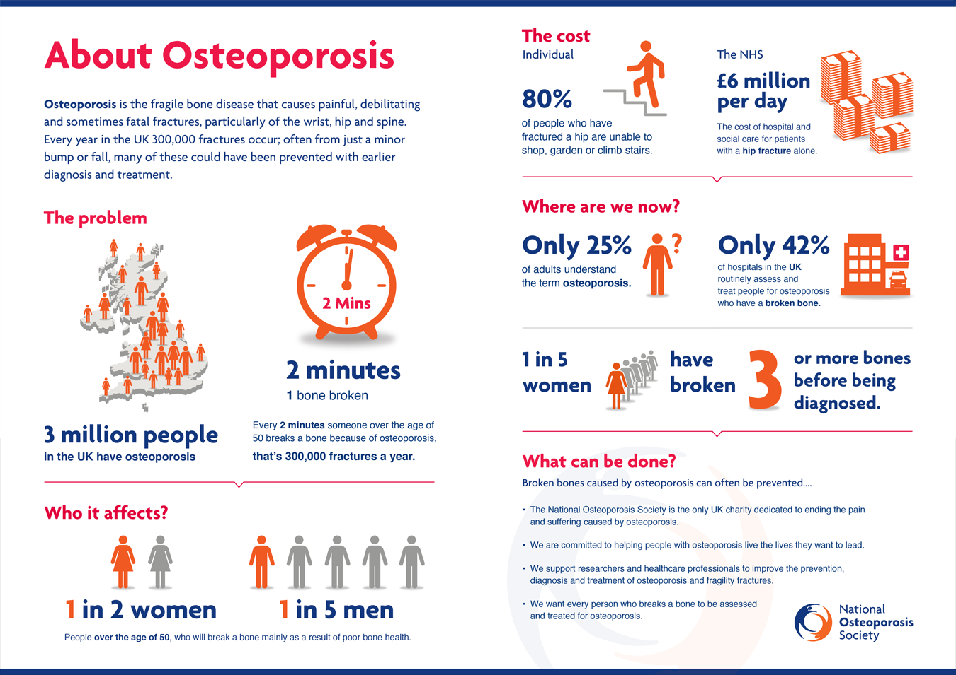

Slide 7
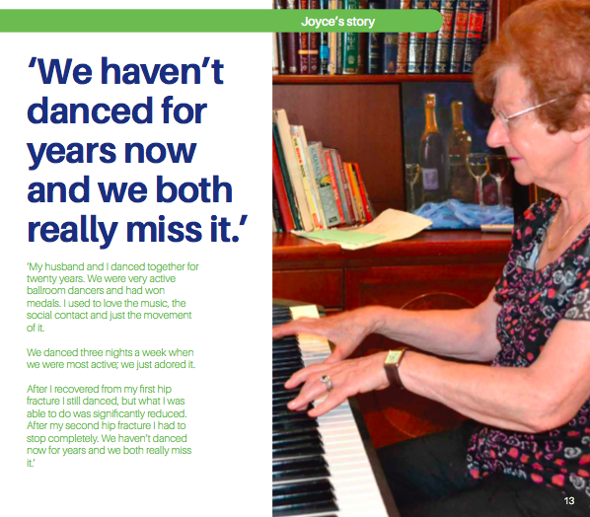

Slide 8
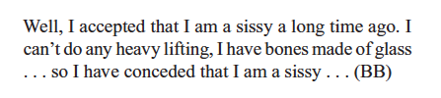

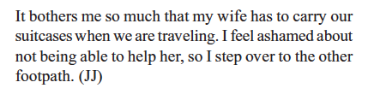
Men: Incorrect perceptions & assumptions?
Nielsen et al. Am J Mens Health, 2011

Slide 9
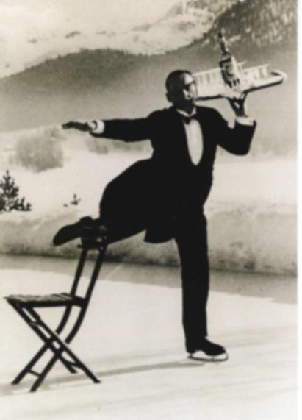
Fear of Falling
Fear and lack of confidence in balance predict
Deterioration in physical functioning
Decreases in physical activity, indoor and outdoor
Increase in fractures
Admission to Institutional Care
“It’s the fear that restricts me. In my mind I know that I can’t [walk outside]. The fear of falling and not having the strength to go out, that stops me from going out…”
(Female, 60yrs)
(Arfken 1994, Vellas 1997, Cumming 2000, Horne 2011)
Slide courtesy of DA Skelton
Notes:
Fear of falling has been documented as 29-55% in the home dwelling elderly and may be as high as 50-65% among people who have previously fallen (Tinetti 1994). This could be understated as many older people will not admit to being fearful, only concerned.
Fear of falling, and loss of confidence in balance capabilities, predict deterioration in physical functioning (Arfken 1994; Vellas 1997), decreases in activity, fractures (Arfken 1994). Fear of personal injury is often cited as a reason for people not taking part in regular indoor and outdoor physical activity (Finch 1997). Up to 40% of admissions to institutional care are as a result of falls, postural stability and concern from the person or their family about falls (Cumming 2000;Vellas 1997).

Slide 10
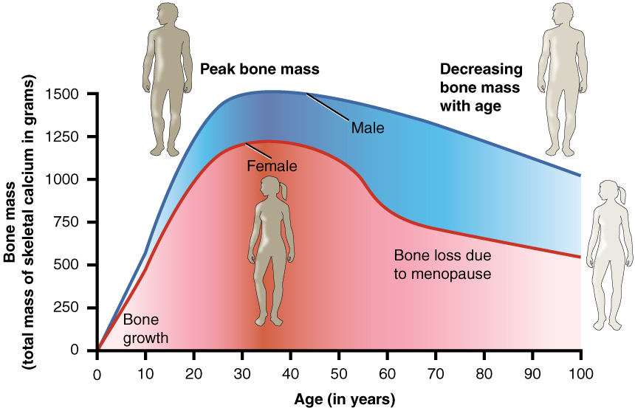
Relationship Between Age and Bone Mass
Relationship Between Age and Bone Mass

Slide 11
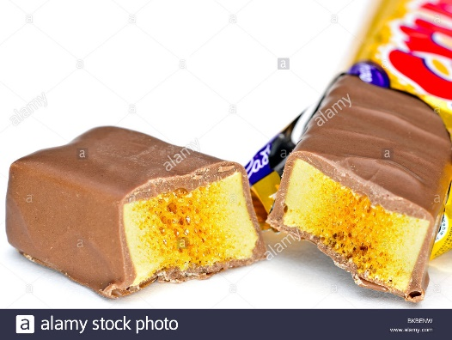
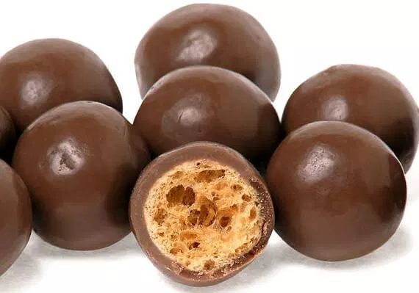
Osteoporosis
Normal Bone
Osteoporotic Bone
Loss in
Bone Mass

Slide 12
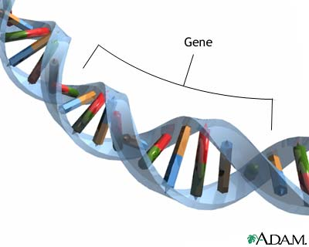
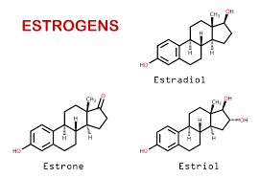
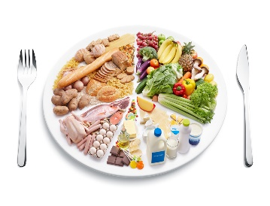
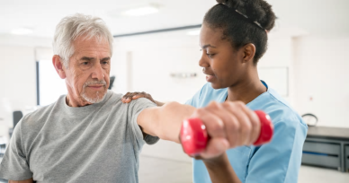
Influences on bone
Interdependence of factors
Genetics
Hormonal
BONE HEALTH
Lifestyle:
e.g. Nutrition &
Physical Activity

Slide 13
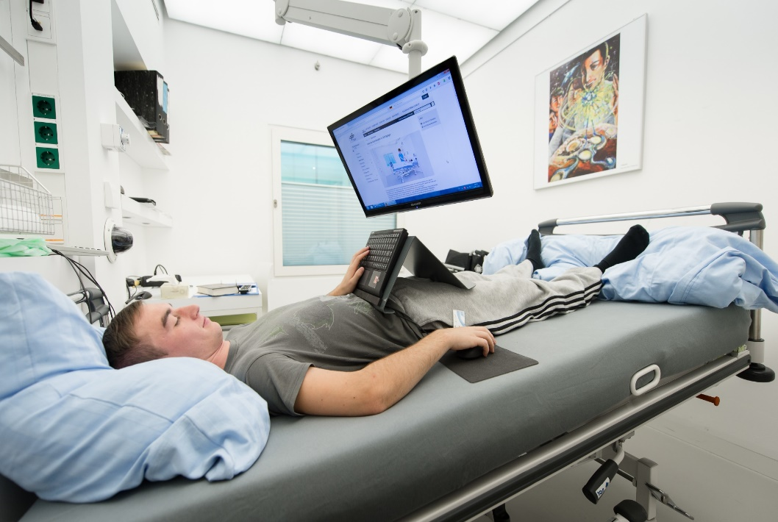
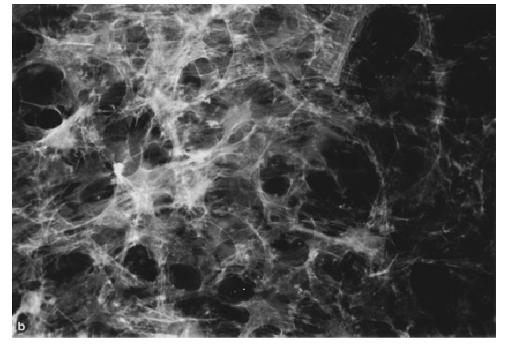
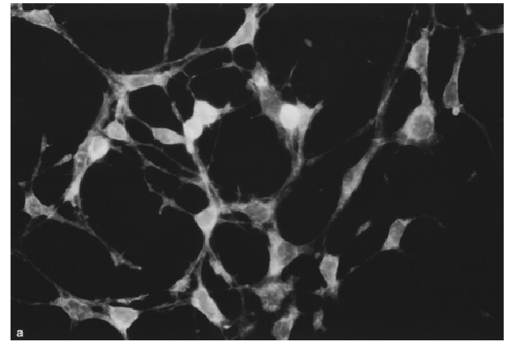
12 wks of immobilisation
3-5% loss in BMD
10y of normal ageing bone loss
O'Flaherty, E.J., Toxicol Sci, 2000. LeBlanc, A.D., et al., J Musculoskelet Neuronal Interact, 2007
Bone cell after space flight
Control cell
Hughes-Fulford & Lewis Exp Cell Res 1996

Slide 14
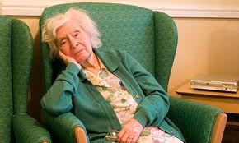
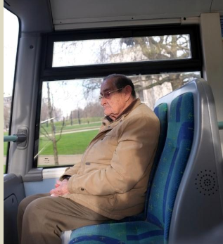
Sedentary behaviour in older adults
Older adults spend 80% of their waking day in sedentary activities
This represents 8-12 hours/day
Matthews et al. Am J Epidemiol. 2008. Davis et al. Med Sci Sports Exerc. 2001

Slide 15
Sedentary behaviour health risks
In older adults (>60 years old), sedentary behaviour has been found to be significantly associated with:
Sedentary behaviour is also linked to musculoskeletal pain and can affect quality of life, social inclusion and engagement
Higher plasma glucose and cholesterol
Higher BMI and waist: hip ratio
Reduced muscle strength
Reduced bone density
Gennuso et al (2013); Skelton (2001), Chastin et al. (2014),
WHO (2010) Global Recommendations on Physical Activity for Health.
Notes:
Plasma glucose and BMI (Gennuso et al)
Muscle strength and bone density (Skelton et al; Chastin et al)
Pain (WHO)

Slide 16
Sedentary Behaviour (SB) and Bone
WOMEN
SB associated with reduced BMD of the total femur and of all hip sub-regions in women, independent of the amount of time women engage in moderate and vigorous activity
MEN
No association with SB and femur BMD but better BMD in those who did regular MVPA
SPINE
No associations were found between SB or PA and spinal BMD for either men or women
Chastin et al.. Bone 2014

Slide 17
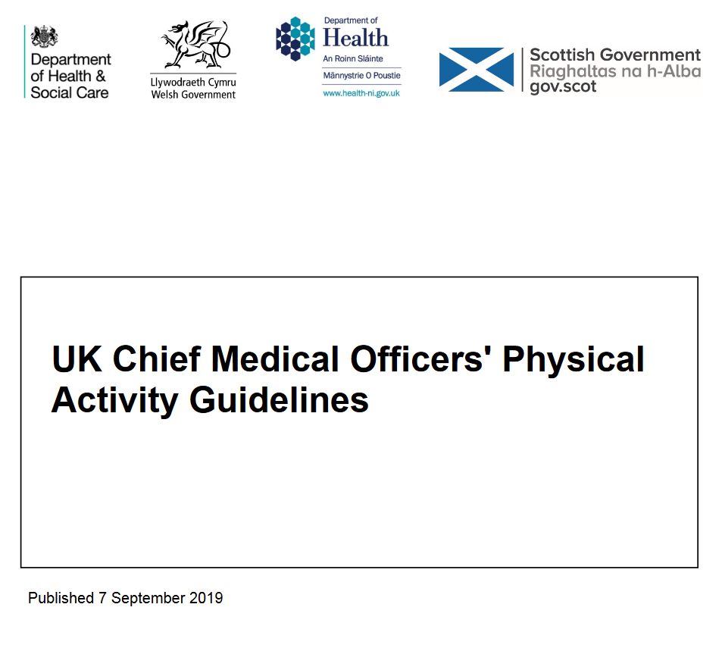
Why focus on Sedentary Behaviour?
Physical inactivity is the fourth leading cause of death worldwide
2019 CMO guidelines for physical activity and older people to improve public health recommend breaking up prolonged periods of sitting
“All Older adults should minimise the amount of time spent being sedentary (sitting) for extended periods”

Slide 18
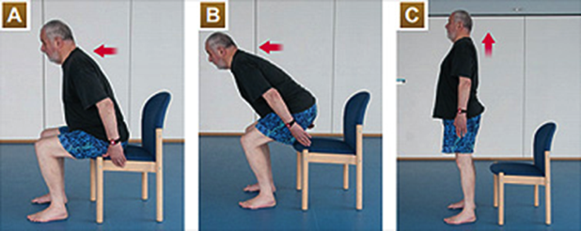
Intervening on sitting time
Two ways of thinking about ‘sitting less’
Reduce time spent sitting
Break up periods of sitting (‘sitting bouts’)
SOS Study – over 10 weeks, adding 10-15 sit to stands a day improved timed up and go (-3 sec) and 30s chair rise (+2) in sheltered housing residents
Harvey et al. J Frailty Sarcopenia Falls 2018

Slide 19
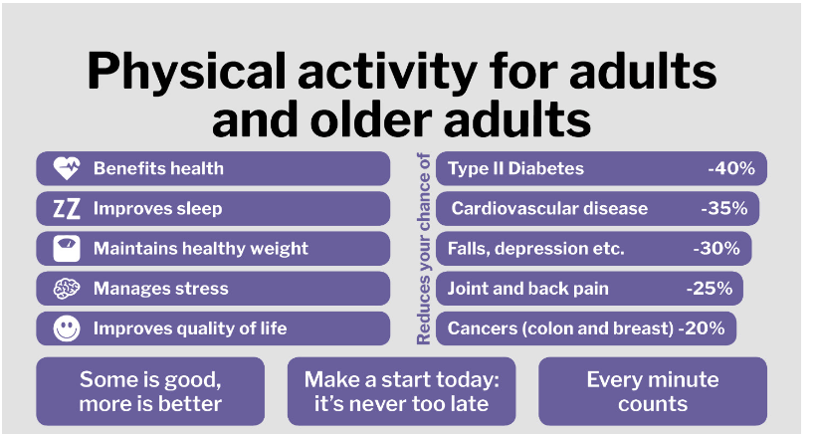

Slide 20
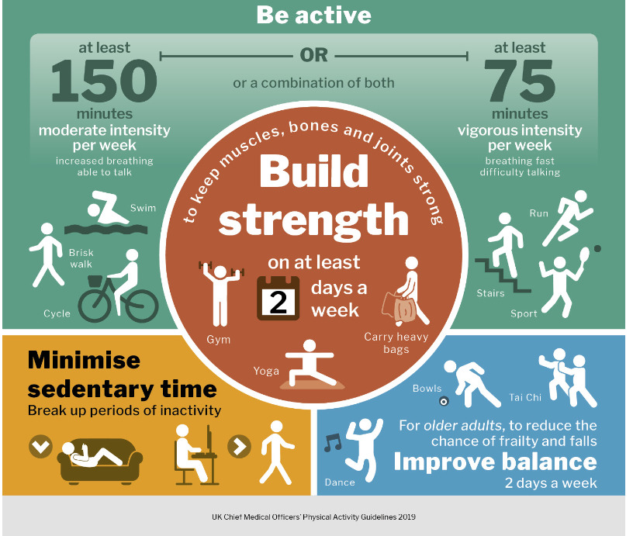

Slide 21
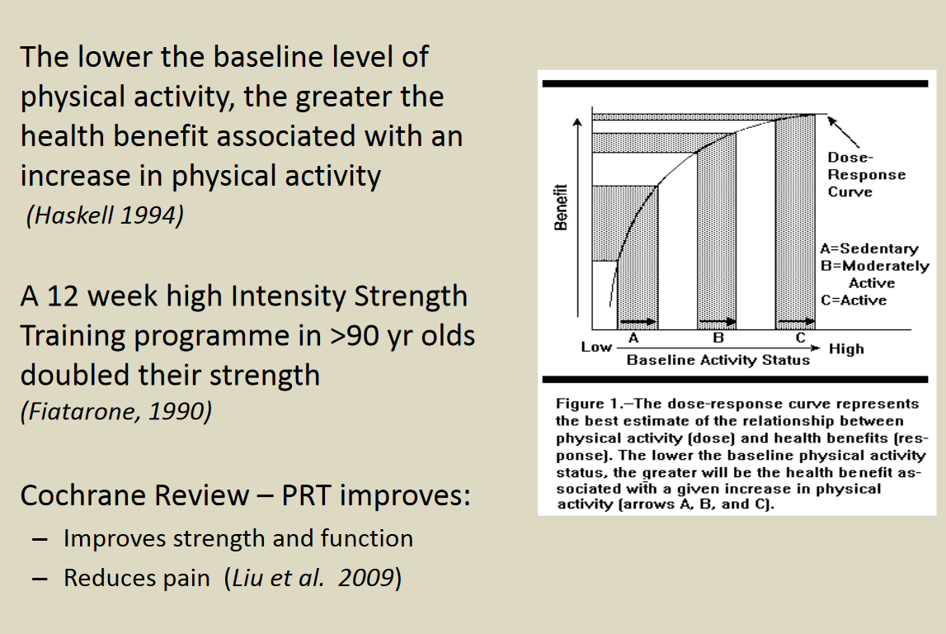
It’s never too late
Slide courtesy of DA Skelton

Slide 22
Working towards achieving the guidelines
Moving
Moving More Often
Moving regularly and frequently
Increased benefits
Meeting the guidelines
Sedentary
Increased physical activity

Slide 23

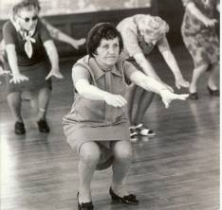
Exercise for Bone Health
43 RCTs considered, 4320 participants
Small but significant improvement in BMD (spine, total hip and trochanter)
Combination exercise - Effective on NOF, Trochanter and Spine
Jogging, vibration and jumping - Effective on Total Hip and Trochanter
Strength training (high load, low rep) - Effective on NOF and Spine
Single Leg Standing - Effective on Hip
In combination with drugs (HRT, Ca etc) – generally better than exercise alone but small numbers
Non-significant reduction in fractures
Dose response on duration
Falls most prominent adverse effect!
Howe et al. Cochrane Review 2011.
Slide courtesy of DA Skelton

Slide 24
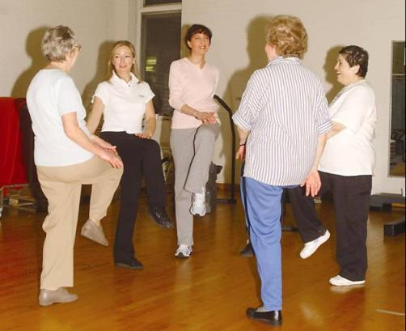
Effective Falls prevention exercise
All exercise studies (17% reduction)
Greatest effects (38% reduction):
Challenging balance component
Dosage >50 hours
Progressive Strength training included
No walking programmes
Trained instructors
Different programmes for different populations
Primary prevention – Tai Chi, FaME etc.
Secondary Prevention – Otago, FaME etc.
Strength and balance exercise reduces fear of falling
Slide courtesy of DA Skelton
Sherrington et al. 2011; Skelton et al. 2005; Campbell et al., 1997;
Wolf et al. 1997; Iliffe et al. 2014; Kendrick et al. 2014

Slide 25
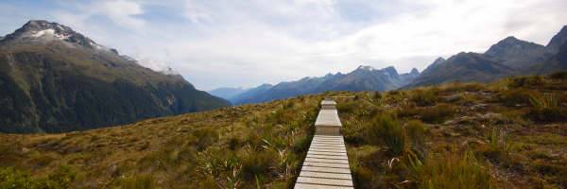
Walking has many benefits
But, generally DOES NOT improve strength, power or bone density
Unless brisk (beware fallers), with added weight
Slide courtesy of DA Skelton

Slide 26
Digital interventions in light of current COVID-19 crisis
Websites (with demonstrations of evidence-based exercise programmes)
profound.eu.com
betterhealthwhileaging.net
allsassistant.org.uk (high number of behaviour change techniques that might support engagement and adherence)
Apps available for public download
Otago Exercise Programme
LifeCurve
WyseFit
Exercise videos aimed at older people (via YouTube or similar)
Later Life Training
Chartered Society of Physiotherapists
Todd C, McGarrigle L. Rapid review of reviews of promotion of exercises and activity amongst older people using mHealth technologies. Unpublished report Healthy Ageing Research Group: University of Manchester. 2020

Slide 27
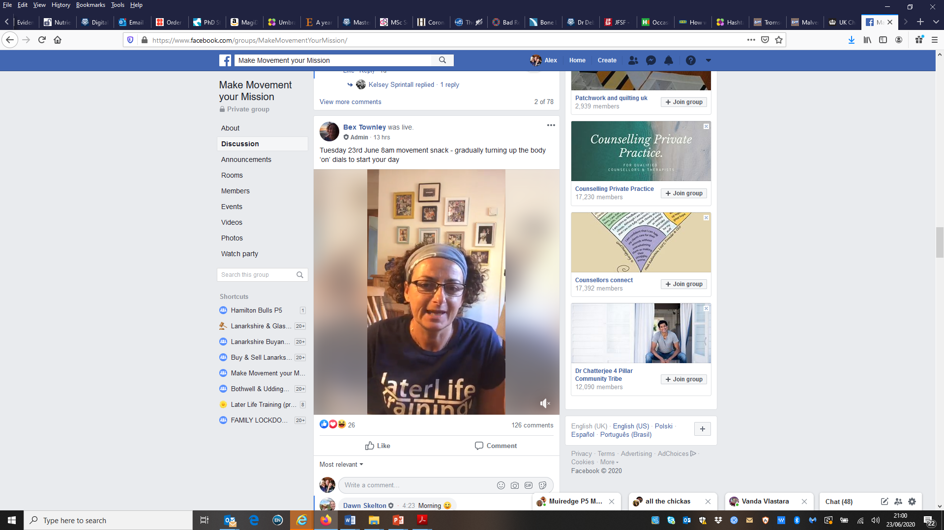
Make movement your mission by LLT

Slide 28
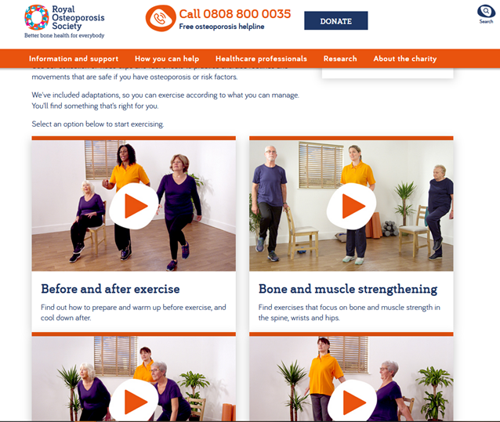
https://theros.org.uk/information-and-support/living-with-osteoporosis/exercise-and-physical-activity-for-osteoporosis/

Slide 29
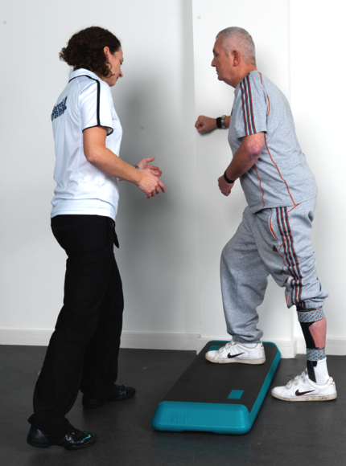
Consistent Messaging
You are never too old
Pain is NEVER good but muscle discomfort after exercise is
We need strong muscles to
Maintain independence
Care for someone / Play with our grandchildren
Fight infection / Stay warm
Protect our joints and bones
Protect our brains and memory
Take regular breaks from sitting
Some is good, more is better
Use it or lose it!
Slide courtesy of DA Skelton
Acknowledgment: John Sheerin

Slide 30

Any Questions?
Alexandra.Mavroeidi@strath.ac.uk

