Slide 1

GLASGOW 2017

Slide 2
INADR Philosophy
As we travel around the world conducting mediation tournaments, we see the use of mediation expanding (at various stages) everywhere. It is a major objective of the InterNational Academy of Dispute Resolution that students leave this competition with an enhanced vision of what mediation is and can be. We try to vary the types of case scenarios to allow the students to experiment with as many different techniques and styles as possible. While there may be different approaches and philosophies adhered to or taught by professional mediators, college and law school professors, and mediation trainers, we believe there is no one right way to mediate in general or in any specific dispute. A good mediator will be flexible and open to using the best approach and applying the best principles relevant to the specific dispute s/he is mediating. Professional mediators often start by taking a 40-hour training course to become certified by various sanctioning bodies. Law students often spend an entire semester merely learning about the breadth and scope of mediation. The brief training presented in conjunction with out tournament is provided as a basic introduction to the wide world of mediation. While we hope you find it helpful, it is certainly not as comprehensive or expansive as the many fine courses and textbooks currently available on the subject. It is our desire by offering some training along with the competition to whet your appetite and start you on your journey into the world of mediation with a very basic overview.

Slide 3
Who Are We?
Mediators/Trainers/Teachers/Lawyers
Board Members INADR
Richard Calkins, Dennis Favaro, Nancy Schultz, Case Ellis
For bios see www.inadr.org

Slide 4
Who Are You?
    Schools from 15 countries
    8 schools from India
    9 UK schools (England, Northern Ireland & Scotland)
    US schools from 9 states and the District of Columbia
    8 EU countries

Slide 5
Dealing With Conflict
Conflict arises (two or more parties)
Options – Fight/flight, suffer in silence, argue, negotiate , complain to authority, finally to lawyer – litigation/arbitration ensues
In today’s world, at some point, “mediation” becomes an option
“Time-out” in formal proceeding while parties go to mediation - “Christmas Armistice”

Slide 6
Law School Training
HOW ARE YOU DOING?

Slide 7
A New Tool in the lawyer’s toolbox
Learn the difference between ADVOCATING and COLLABORATING when representing clients
The future’s best lawyers will master the traditional skills to zealously promote their client’s interests in negotiations or court AND the ability to peacefully resolve their client’s case in a most favorable manner
Train and become a mediator

Slide 8
What is Mediation?
Simply stated, mediation is a non-binding process for resolving disputes between adverse parties with the assistance of a trained and experienced neutral third-party.

Slide 9
Breadth and Growth of Mediation
Concept as old as the first societies – tribal elders
King Solomon – split the baby
In later half of Twentieth Century found its way into the “Legal System” –began to expand exponentially
Acceptance by Courts, Lawyers, Businesses and Social Institutions
School and Faith based programs
Grown in virtually all types of legal and quasi-legal settings
Peer mediation in school…and growing

Slide 10
The Language of Mediation
Conference/Joint | In the presence of all parties and advocates (joint session)
Caucus/Private | Private session by mediator with one party/advocate
Facilitative | Mediator acts as bridge or conduit between the parties
Evaluative | Mediator opines if requested
Restorative | Evolution of “Restorative Justice” principles
Transformative | Empowerment & recognition trumps “settlement”
Collaborative | Four way contract to work cooperatively
And ever growing… | (Narrative etc.)

Slide 11
Chief Justice
In the 1980s, Chief Justice Warren Burger of the United States Supreme Court observed that “the American judicial system is too costly, too lengthy, too destructive, and too inefficient for a civilized people.” Mid-Year Meeting of the American Bar Association, 52 U.S.L.W. 2461, 2471 (Feb. 28, 1984).

Slide 12
Abraham Lincoln
Nearly 150 years ago, Abraham Lincoln gave this sage counsel to attorneys: “Persuade your neighbor to compromise whenever you can. Point out to them how the nominal winner is often a real loser—in fees, expenses, and waste of time.”

Slide 13
Mahatma Gandhi
There is a higher court than courts of justice and that is the court of conscience. It supersedes all other courts.
Culture of the mind must be subservient to the heart.

Slide 14
Mediation Procedure Overview (one model )
Pre-mediation Preparation: Mediator reviews submissions, Advocates/clients prepare
2. Opening session ( usually in conference)
Mediator’s opening remarks – set tone, review process
Parties’ Opening Remarks (advocate AND party encouraged to participate)
5. Problem Solving Phase – issues and areas of agreement/disagreement identified, Mediator decides to move to caucus or remain in conference session.
6. Process continues- in conference and/or caucus
7. Re-convene everyone - formalize agreement, suspend, or terminate

Slide 15
Cases mediated now in US Courts
Family Probate
Commercial Chancery
Tort Transactional
Class Actions Employment
Appellate
SMALL CLAIMS
At the request of US judges in many jurisdictions, judges in virtually ALL civil divisions (other than Juvenile) may now refer cases to mediation

Slide 16
Spreading Worldwide
EU Mandates not only Rules for Court Mediation in all member states, but also mandates Rules for ODR
Australia, Asia, are developing programs
In its “infancy” in South America and Africa but interest is growing rapidly - all starting to develop rules and programs to implement mediation programs

Slide 17
Drop the “A”
A new worldwide view of dispute resolution is emerging

Slide 18
Advantages of Mediation
It is Not Binding
Does NOT deprive the parties of their right to a trial
May result in a “binding” agreement, fully enforceable in a Court of Law
Usually VOLUNTARY (Sometimes Mandatory)

Slide 19
  Speed of Resolution
  People do not like being in conflict. It is troublesome, time consuming, and a drain on both financial, emotional and management resources. Mediation sessions can be set up quickly – unlike disputes working their way through the judicial system or arbitration. In commercial disputes it can be most important that the normal flow of business continues.
  Backlog, “justice delayed is justice denied,” peace of mind restored sooner rather than later.

Slide 20
Cost Savings
This is a fairly obvious and a major advantage. Because cases can be settled quickly, legal costs and time costs are kept to a minimum.
Voltaire “I was never ruined but twice … Once when I lost a lawsuit and once when I won one.

Slide 21
Don’t be this lawyer!
Bleak House

Slide 22
Improves/Restores Communication
The filing of a lawsuit or arbitration action usually cuts off all direct communication between the parties. The face-to-face meeting which occurs at a mediation’s joint sessions allows open communication directly between the parties again. The mediator can oversee the discussion to make sure passions and emotive language do not interfere with the settlement process.

Slide 23
Improves/Restores Communication
Divorce – still will be raising children together
Business breakup & other commercial disputes may have future business relationship – or at least travel in the same business circles
Probate – may bring families back together-can affect generations

Slide 24
Confidentiality
It is a confidential proceeding!!!!!!!!
Reputations may be saved from the adverse publicity resulting from a public (as in Court) airing of the dispute
Binding precedent avoided

Slide 25
It’s Simple!
Easily explained procedure with few “rules”
Limited “paperwork” or “procedures”
Relatively short duration and conclusion

Slide 26
However……….
The process is capable of handling the most complex cases, for example…
Class Actions
Multi Party Litigation
Multi Issue Litigation where not all parties involved in all issues
Sensitive issues dealing with peoples’ private lives

Slide 27
Sample Confidentiality Agreement
IN THE CIRCUIT COURT OF THE TWENTY-SECOND JUDICIAL CIRCUIT
MCHENRY COUNTY, ILLINOIS
Plaintiff, Case No: _______________
vs.
Defendant.
CONFIDENTIALITY AGREEMENT AND
NONREPRESENTATION ACKNOWLEDGEMENT
IT IS HEREBY AGREED by and between the mediation participants and Mediator, that all matters discussed during any and all mediation sessions shall be confidential and shall not be disclosed by the participants or the Mediator in any court of law. It is further acknowledged by the parties to this lawsuit that the Mediator Nancy Jones is not representing any party to this lawsuit and is not affording or providing any legal advice to any such party.
Dated: _________________________
______________________________ _____________________________
Mediator, Nancy Jones
___________________________________ _______________________________

Slide 28
It's Flexible
Mediation has few formal rules or procedures, so the mediator can use the process’ flexibly to suit the circumstances of the dispute.
Options for resolution – not available in court/arbitration . . . split the baby, apology, reframed working relationship, recognition and public acknowledgement of wrong, pick of the litter…etc., etc.,etc. . .

Slide 29
Allows parties to Control Their own Destiny
Third party decision maker is replaced by self determination by the parties
Issues regarding Judge, Arbitrator*, JURY (USA) are eliminated
*Sometimes multiple (2 biased) arbitrators

Slide 30
Reviewing courts favor mediation
Arbitration Clauses vs Mediation Clauses

Slide 31
It Addresses Unreasonable Claims and Expectations
People who believe they are in the right very often become self-righteous, and get an inflated perception of their position. A skilled mediator will succeed in getting the party to view the case from the other party’s point of view.
Constant development is the law of life, and a man who always tries to maintain his dogmas in order to appear consistent drives himself into a false position. MG

Slide 32
It Works!
Mediation operates under the Rule of Common Sense/Social Living rather than the Rule of Law, because the aim of mediation is to solve problems, not assess fault.
A word about “real world” and practice/mock mediations (Charlie’s Nigerian student)
It allows each party the opportunity to “get things off their chest” (vent) and tell the other party “face-to-face” their perception of what has occurred and the effect it has had on them (and possibly others).

Slide 33
It Works!
It provides the equivalence of a party’s day in court - the mediator's mere presence as an outside party can fulfill that emotional need.
It gives people a chance to see their advocates in action (that they are prepared and concerned)
It is a chance to hear ALL the issues and facts – some of which they may be completely unaware and MANY of which may be inadmissible in Court due to evidentiary rules

Slide 34
It Works!
It unearths the real issues – not just those falling within the “framework” of legally enforceable (relevant, admissible) causes of action. (Remove attorney focus on legally significant elements of case)
It allows a party the opportunity to briefly “walk in the other parties’ shoes” (develop empathy).
It’s about HUMAN needs and interests
It knows no CULTURAL boundaries

Slide 35
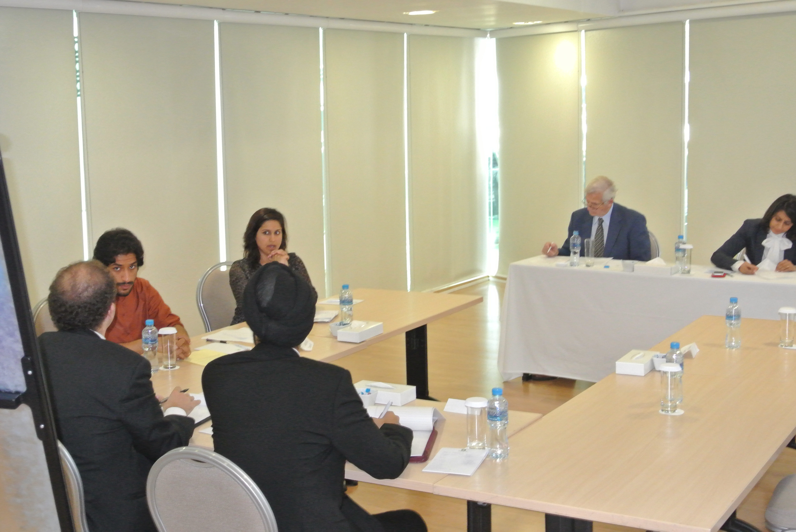
4 countries/cultures-1 solution

Slide 36
Replace Dispositional Attribution with Empathy
“When I was five years old, my mother always told me that happiness was the key to life. When I went to school, they asked me what I wanted to be when I grew up. I wrote down "happy". They told me I didn't understand the assignment, and I told them they didn't understand life.”
….JL

Slide 37

Magic Mirror

Slide 38
It Works!
It provides BOTH parties with a high degree of “self determination.” They can participate in shaping the outcome rather than leaving their fate to a disinterested third party.
Can a Judge possibly know your children, your business, your emotional needs etc as well as YOU?
Mediation COMPLIANCE rates exceed compliance with Court ordered outcomes

Slide 39
It Eliminates Risk
The WORST that can happen may very well be the outcome ordered by a third party.
Provides a forum for a RISK/BENEFIT analysis that is fluid, flexible, and current.

Slide 40

“It’s not a justice system – it’s a legal system”…Chief Wiggums

Slide 41
“Justice”
Mediation provides not only “substantive justice” but also provides “procedural justice”
England/Wales Small Claims mediation program “favorable” rating

Slide 42
ADVOCATING AT MEDIATION
Mind shift from Negotiation/Advocacy to Collaboration
Encourage your client to be sincere, discourage them from destructive conduct but don’t discourage genuine emotion
If caucusing, have a “team” mindset –you, the client, and the mediator are a team with a common goal – to reach a resolution acceptable to the client.

Slide 43
SAMPLE MEMORANDUM OF AGREEMENT
STATE OF CONFUSION
IN THE CIRCUIT COURT OF THE NINETEENTH JUDICIAL CIRCUIT
COUNTY OF BEDLAM
)
Hillary Trump, Plaintiff )
v. ) NO.
Donald Clinton, Defendant )
MEMORANDUM OF AGREEMENT
We, the undersigned, having participated in a mediation session on this 15th day of October, 2016, and being satisfied that the provisions of the resolution of our dispute are fair and reasonable, hereby agree to abide by and fulfill the following:
________________________________________________________________
________________________________________________________________
__________________________________________________________________
________________________________ _______________________________
Mediator
__________________________________________ ______________________________

