Slide 1
University Procurement
Fiona Hughes, Deputy Director of Finance, Procurement

Slide 2
How Does Human Trafficking Affect Higher Education?
HT is a risk in all of our supply chains! Contracts and contract management must mitigate the risk of this where possible.
However, it is closer to home than we think!
Students are at risk of trafficking and exploitation right here and right now.
In 2022 there have been over 580 potential victims of trafficking were notified to Police Scotland, 184 of who fell into the age 17-24 years age group.
With the promise of a UK Education, students from countries with limited opportunities for them are lured here. Often incurring debt to study, in figures between 35k-£100k.
Victims have no choice about how to pay the money back and often find themselves trapped in destructive cycles unable to study or attend university.
The potential exploiter uses the threat of outing the student as an immigration offender, in the UK in contravention of their VISA as a threat or hold over them.
UK nationals can also be victims of trafficking in the UK and throughout the world, most commonly in drugs production and supply and prostitution or other sexual exploitation.
Indicators something is wrong are, disengagement from a course, going missing from studies for periods of time, isolation from staff and other students, unexplained pregnancies and injuries.
Notes:
In 2022 there have been over 580 potential victims of trafficking notified to Police Scotland, 184 of who fell into the age 17-24 years age group. Young people are at risk of trafficking and exploitation right here and right now.
The promise of UK education is too strong a lure for many students to resist particularly where opportunities are limited in their home country. People from Vietnam, Afghanistan, India, Pakistan and African countries report travelling to the UK to study and have found themselves in exploitation once they get here.
Often they have incurred a debt to study in the UK, figures of between £35,000- £100,000 are commonly reported, which they are threatened or forced into paying back often with crippling interest with no hope of ever repaying. Trafficking and exploitation goes beyond money lending. Victims have no choice about how to pay the money back and often find themselves trapped in destructive cycles unable to study or attend university. The potential exploiter uses the threat of outing the student as an immigration offender, in the UK in contravention of their VISA as a threat or hold over them.
Others are lured into thinking they can make easy money while they study by dealing drugs, engaging in sexual services or moving money through their bank accounts for serious and organised crime groups (money laundering or money mules). Once in these activities, the student becomes trapped in a vicious cycle unable to break away from their exploiters who use threats to out the student to police, future employers or family and friends.
UK nationals can also be victims of trafficking in the UK and throughout the world, most commonly in drugs production and supply and prostitution or other sexual exploitation. Work is currently being undertaken by organisations including Police Scotland and the Crown Office Procurator Fiscal Service to recognise offenders who may have committed crime as a result of being a victim of trafficking and to safeguard them.
Victims may try to continue with studies while in these situations but find they are more and more under the influence of the exploiter. Indicators something is wrong are disengagement from a course, going missing from studies for periods of time, isolation from staff and other students, unexplained pregnancies and injuries.

Slide 3
What will this guide cover
Introduction to Human Trafficking (HT)
What is considered as HT
The Act
Why do individuals get involved with Traffickers?
Types of Exploitation
Labour Exploitation
Service and Benefits Exploitation
Indicators of HT
Initial Response Guide
Where to report any suspicions

Slide 4
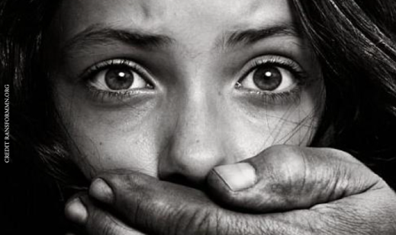
Introduction to Human Trafficking
Human Trafficking is the trade and exploitation
of human beings for profit.
It is happening in Scotland here and now.
The National Referral Mechanism ( NRM ) is a framework for identifying and referring potential victims of modern slavery and ensuring they receive the appropriate support.
Over 400 NRMs were received by Police Scotland for investigation in 2020.
Watch this short video which uses experiences with real human traffickers to illustrate the methods they use and the lengths they will go to exploit workers for profit.
Though the voice used is that of an actor, the content is drawn from very real examples of cases encountered by officers.

Slide 5
Human Trafficking – Essential Elements
It is an offence to;
Recruit
Transport or transfer
Harbour or receive
Exchange or transfer control over another person
Arrange or facilitate any of the above
With the expectation or knowledge that the person will be or is likely to be exploited;
It is irrelevant whether or not a person has consented to any part
Threats, force or coercion is not always required.
Often involves children and/or vulnerable adults,
A child is a person under 18 years - A child CANNOT consent to being exploited
Can include Sexual Exploitation

Slide 6
Human Trafficking and Exploitation (Scotland) Act 2015
This legislation came into force 31/05/2016
It covers 2 main offences-
- Trafficking for exploitation
- Slavery, servitude and forced or compulsory labour
The University publishes a Modern Slavery Statement Annually in response to the Act and this can be accessed in the “Quick Links” of the University homepage.

Slide 7
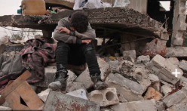
Why get involved with traffickers? (Push & Pull Factors)
Why and how do individuals get involved with traffickers? Often they are misled and/or in a vulnerable situation.
The main reasons are outlined below:
Escaping Poverty
War / Disaster / Abuse
Lure of easy money
Families want their children to have better life
Family/Friends already in UK
Established trafficking groups – funding, illegal documents, experience
Debt Bondage for travel to UK

Slide 8
Types of Exploitation
Modern slavery exists in many forms in the UK and across the World, including trafficking into criminal activities like cannabis farming, sexual exploitation, domestic slavery and organ removal and sales.
Labour Exploitation
For example - forced labour on farms, in construction, shops, bars, nail bars, car washes or manufacturing.
Services and Benefits Exploitation

Slide 9
Labour Exploitation
The University of Strathclyde’s
Modern Slavery statement
highlights some of the ways the University Procurement and other departments try to manage and mitigate these risks in our contracts.

Slide 10
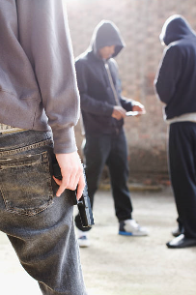
Services and Benefits Exploitation
Securing services and benefits includes forcing someone to commit a criminal act such as using someone for fraud, to launder money, in a cannabis cultivation, to deal drugs or forcing them to shoplift.
An example is where an
individual is debt bonded.
Notes:
Debt Bonded is an example that has included students.
Often the student comes from a deprived background/ country and is recruited by the lure of University tuition fees being paid with prospects of a better future.
Depends if the person is
A. Under 18
B vulnerable or
C has been threatened, forced or deceived into the act. ­
They must not be able to resist the compulsion because of age vulnerabity or by force.

Slide 11
Indicators of Trafficking
Be aware of cultural differences- this does not mean that there are not HT indicators in the background.
Control over children and family members exerted by others.
Fear expressed by individuals either for a person, authority or in going back to their circumstances.
Difficulty in describing ‘family’ relationships
Cultural terms such as uncle, auntie, brother, sister may not relate to familial ties.
If something doesn’t feel right ......trust your instincts and ask for guidance or help.
Watch this video on the top 5 signs of exploitation to look out for.

Slide 12


Initial Response Guide
First contact must be victim focussed – what are their needs/requirements.
Medical assistance takes primacy.
Contact the Police- pass on details of what you suspect, what you know and if there are any other possible victims.
Consider if the Victim is safe
Consider an official Interpreter- don’t let others interpret for the victim.
Please consider early reporting of concerns.
This can be done using 101, 999 to contact the police
Modern Slavery helpline 08000 121 700
Unseen App – can be downloaded and provides a guide and confidential helpline.
Crimestoppers 0800 555 111

Slide 13
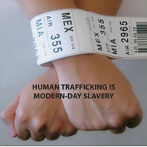
Initial Response Video
Watch the following video on what not to do and what the correct course of action would be in reporting your suspicions:
Do the Right Thing
Further links for information:
https://www.gla.gov.uk/publications/resources/glaa-videos
https://www.scotlandagainstmodernslavery.co.uk/
http://www.antislaverycommissioner.co.uk/media/1061/transparency_in_supply_chains_etc__a_practical_guide__final_.pdf

Slide 14

Contacts
scdnationalhumantraffickingunit@scotland.pnn.police.uk
National Human Trafficking Unit
Telephone: 01236 818479

