Slide 1







WP 2: zero-drift contact temperature sensors
Claire Elliott
2nd EMPRESS Workshop (18th Apr 2018) claire.elliott@npl.co.uk
Notes:
We all worked together

Slide 2

Talk overview
Our tasks in EMPRESS (WP2)
Before EMPRESS…
Integrated self-validating thermocouples (with 7mm OD)
Ultra-stable MIMS thermocouples
Industrial trials
Summary

Slide 3
EMPRESS WP2
Our tasks:
To design, test & trial integrated self-validating thermocouples to be suitable for industrial use (i.e. same shape, size as standard)
To test & validate ultra-stable MIMS thermocouples with the 2-layer sheath design in industrially relevant (simulated) conditions
Demonstrate both in real industrial conditions

Slide 4
Before EMPRESS…
Integrated self-validating (inseva) thermocouples had been shown to work (by various groups), but were generally ‘intrusive’ and fragile.
Notes:
Add pictures

Slide 5
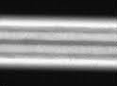
Before EMPRESS…
Integrated self-validating (inseva) thermocouples had been shown to work (by various groups), but were generally ‘intrusive’ and fragile.
The 2-layer sheath (double wall) design of MIMS thermocouples had been developed – but not optimised for operation up to 1350 °C
Double wall
Thermocouple wires
Double wall
Notes:
Add pictures
Introduce Inseva & double wall

Slide 6
Inseva thermocouple
NPL, with the assistance of CCPI Europe, have successfully developed a design which can be used with:
Type S thermocouple wires (and in principle others too)
7 mm OD alumina sheath
pure-metal temperature-reference ingots e.g. Cu (1084 °C)
eutectic (high temperature) reference ingots e.g. Co-C (1324 °C)
and Ni-C (1329 °C)

Slide 7
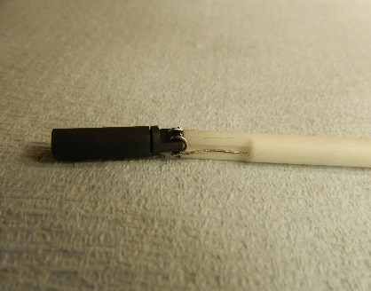
Inseva thermocouple
Tasks complete:
Prototypes designed, built and tested (4 mm x 16 mm)
Notes:
Add results graph

Slide 8
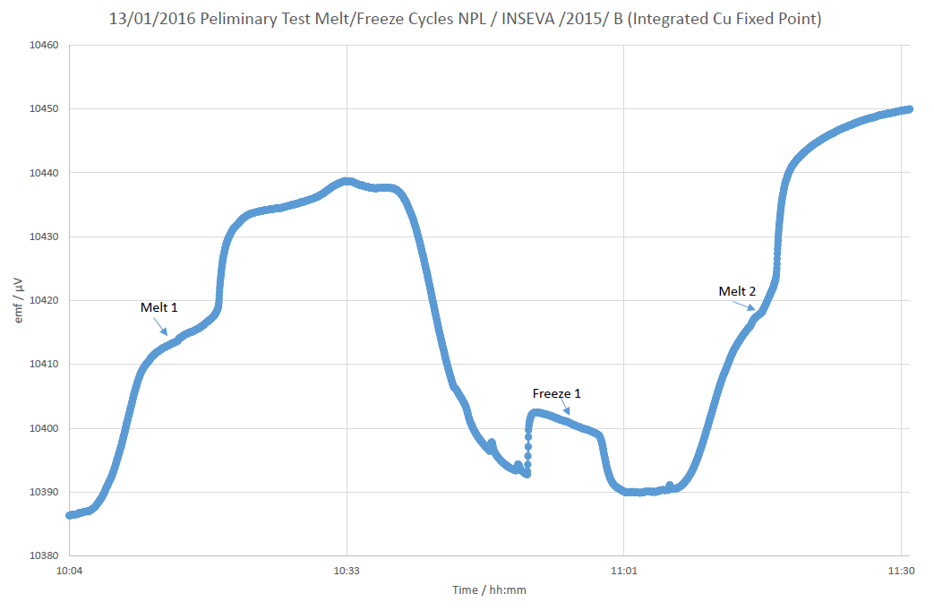
Inseva thermocouple
Tasks complete:
Prototypes designed, built and tested (4 mm x 16 mm)
1 ºC
Cu
Cu
10 min
Notes:
Add results graph

Slide 9
Inseva thermocouple
Tasks complete:
Prototypes designed, built and tested (4 mm x 16 mm)
Issues identified (and solutions)
1 ºC
Cu
Cu
10 min
Notes:
graphite oxidation & wire embrittlement
Inert coatings

Slide 10
Inseva thermocouple
Tasks complete:
Prototypes designed, built and tested (4 mm x 16 mm)
Issues identified (and solutions)
Improvements made
and tested
1 ºC
Cu
Cu
2 ºC
10 min

Slide 11
Inseva thermocouple
Tasks complete:
Prototypes designed, built and tested (4 mm x 16 mm)
Issues identified (and solutions)
Improvements made
and tested
Publications:
Elliott, IJT, 38:141 (2017)
Greenen, MSA Conference Proceedings, Queenstown (2015)
1 ºC
Cu
Cu
2 ºC
10 min

Slide 12

Industrial trials
Tasks complete:
Inseva thermocouples sent to industrial partners
Notes:
Add pictures of actual facilities

Slide 13
Industrial trials
Tasks complete:
Inseva thermocouples sent to industrial partners
Both tested the Cu (1084 C) inseva thermocouple
Notes:
Add pictures of actual facilities

Slide 14
Industrial trials
Tasks complete:
Inseva thermocouples sent to industrial partners
Both tested the Cu (1084 C) inseva thermocouple
Dec 2016 – Oct 2017 Mar 2017 – Oct 2017
5386 h 377 h
33 melting plateaus observed 2 melting plateaus observed
Drift: up to 30 µV from calibration value Drift: up to 40 µV from cal. value
Notes:
Add pictures of actual facilities

Slide 15
Industrial trials
Notes:
Actually AFRC instead

Slide 16
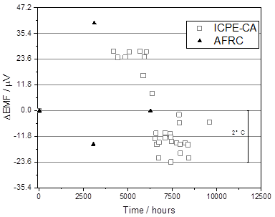
Industrial trials
Neither thermocouple differed by more than 5 µV (<0.5 ºC) upon recalibration
Notes:
Actually AFRC instead

Slide 17
Industrial trials
Heating elements changed
Calibrations at NPL
Neither thermocouple differed by more than 5 µV (<0.5 ºC) upon recalibration
Notes:
Actually AFRC instead

Slide 18
Testing Ni-C
As we had issues early on with the Co-C thermocouple, tests using Ni-C were started.
Ni-C (1329 ºC) has been found to be more robust than Co-C (1324 ºC)
Notes:
Add pictures of actual facilities
Paper states: (±2.0 °C, k = 2)

Slide 19
Double wall MIMS
University of Cambridge, with the assistance of PTB, have begun evaluating MIMS (double wall) thermocouples
Type K (4.5 mm OD) - optimised for use at 1350 °C
  Lab tests, using industrially relevant thermal cycle
  Revealed issues with batch 1.
Notes:
Intended to do only 1350 – but issues…

Slide 20
Double wall MIMS
University of Cambridge, with the assistance of PTB, have begun evaluating MIMS (double wall) thermocouples
Type K (4.5 mm OD) - optimised for use at 1350 °C
  Lab tests, using industrially relevant thermal cycle
  Revealed issues with batch 1.
  Plan B:
Type N (3.0 mm OD) - optimised for use at 1200 °C
Lab tests, using industrially relevant thermal cycle
Notes:
Intended to do only 1350 – but issues…

Slide 21
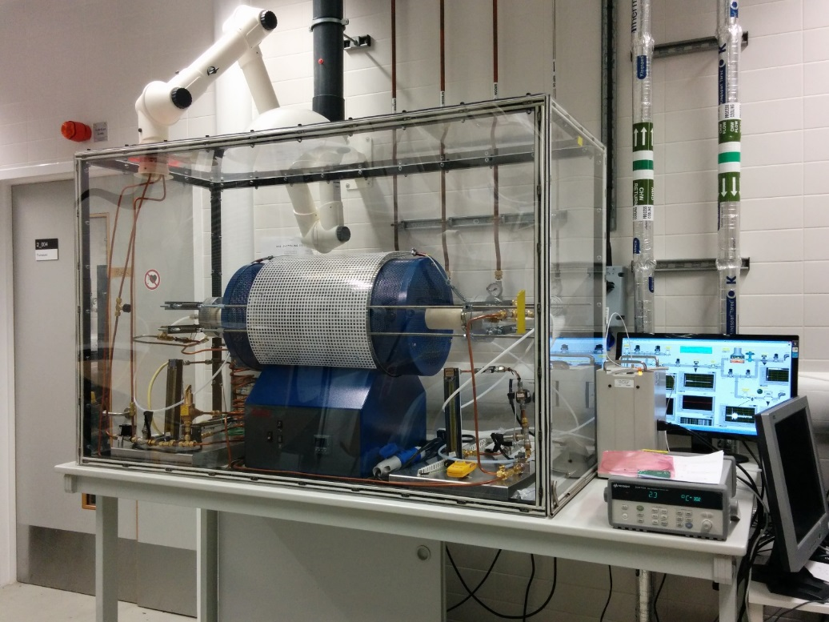
Double wall MIMS – N @ 1200 °C
Tasks complete:
New lab facility installed
Notes:
Significant scattering in the behaviour of thermocouples obtained from the same cable (cable1)

Slide 22
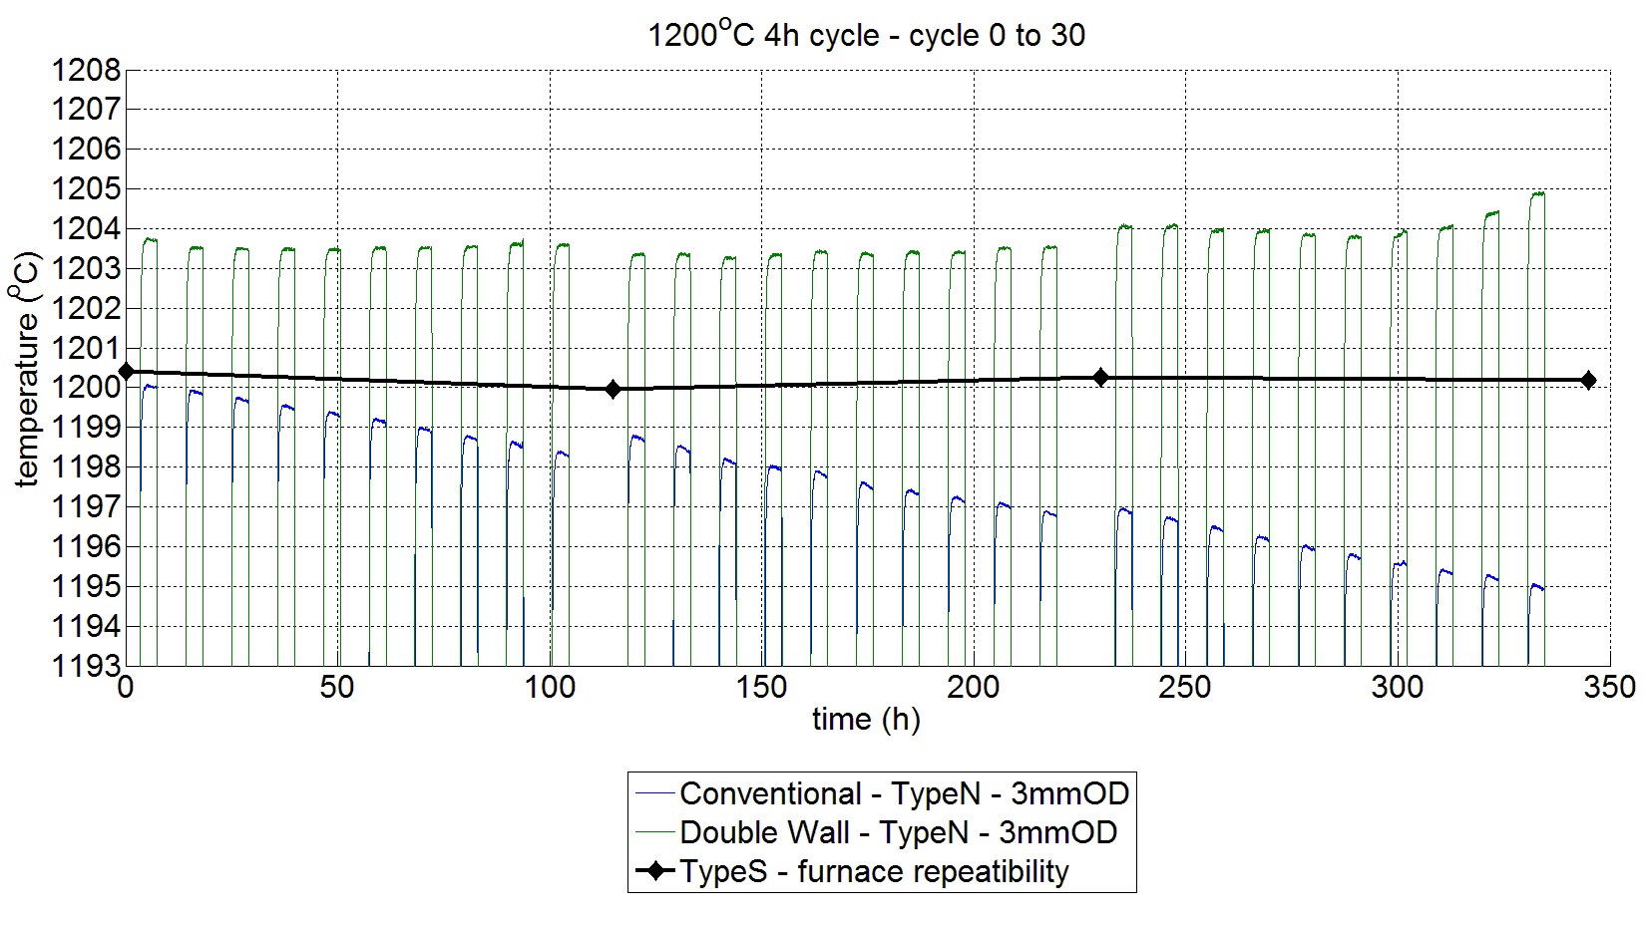
Double wall MIMS – N @ 1200 °C
Tasks complete:
New lab facility installed
Industrially-relevant cyclic testing
Notes:
Significant scattering in the behaviour of thermocouples obtained from the same cable (cable1)
Batch 2 ordered. Only delivered Feb 2018

Slide 23
Double wall MIMS – N @ 1200 °C
Tasks complete:
New lab facility installed
Industrially-relevant cyclic testing
Notes:
And thermometers delivered to AFRC and Bodycote – for industrial trials

Slide 24

Industrial trials – N @ 1200 °C
Tasks complete:
Short term test in vacuum furnace at AFRC
Tests at Bodycote UK in vacuum furnaces at 1200°C
In-house tests started in October/November 2017
Installation at Bodycote ongoing
Notes:
Add pictures of actual facilities

Slide 25
Industrial trials – N @ 1200 °C
Tasks complete:
Short term test in vacuum furnace at AFRC
Tests at Bodycote UK in vacuum furnaces at 1200°C
In-house tests started in October/November 2017
Installation at Bodycote ongoing
Type K (Batch 2) - Thermal cycle tests have been started (Mar 2018)
Notes:
Add pictures of actual facilities

Slide 26
Industrial trials – N @ 1200 °C
Tasks complete:
Short term test in vacuum furnace at AFRC
Tests at Bodycote UK in vacuum furnaces at 1200°C
In-house tests started in October/November 2017
Installation at Bodycote ongoing
Type K (Batch 2) - Thermal cycle tests have been started (Mar 2018)
Unfortunately – the results are not quite analysed yet…
Notes:
Add pictures of actual facilities

Slide 27
Summary
Designed and tested integrated self-validating thermocouples
Notes:
Although results only available for the inseva!

Slide 28
Summary
Designed and tested integrated self-validating thermocouples
Notes:
Although results only available for the inseva!

Slide 29
Summary
Designed and tested integrated self-validating thermocouples
Tested & Validated (some) ultra-stable double walled MIMS thermocouples
Notes:
Although results only available for the inseva!

Slide 30
Summary
Designed and tested integrated self-validating thermocouples
Tested & Validated (some) ultra-stable double walled MIMS thermocouples
Notes:
Although results only available for the inseva!

Slide 31
Summary
Designed and tested integrated self-validating thermocouples
Tested & Validated (some) ultra-stable double walled MIMS thermocouples
Tested both in real industrial conditions
Notes:
Although results only available for the inseva!

Slide 32


Thank you
The National Physical Laboratory is operated by NPL Management Ltd, a wholly-owned company of the Department for Business, Energy and Industrial Strategy (BEIS).

