Slide 1
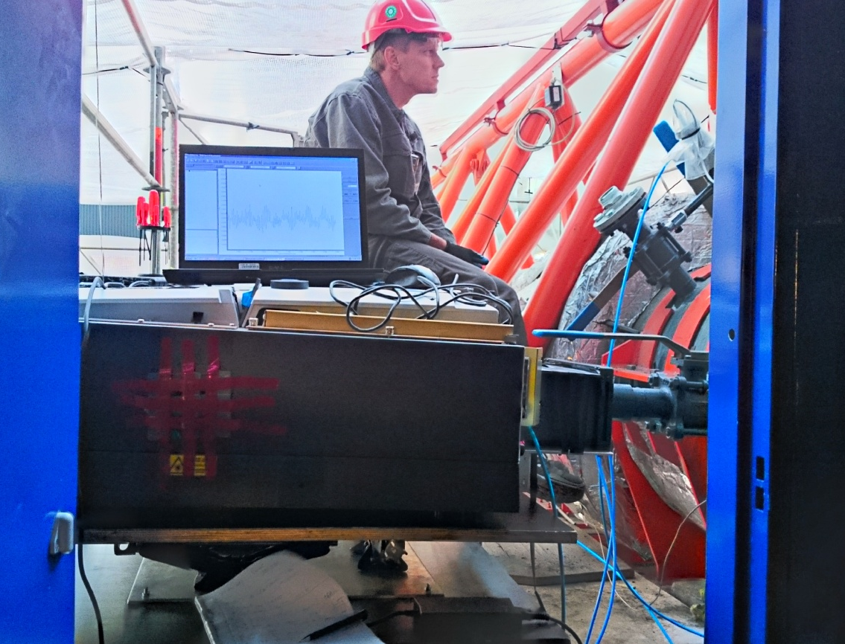
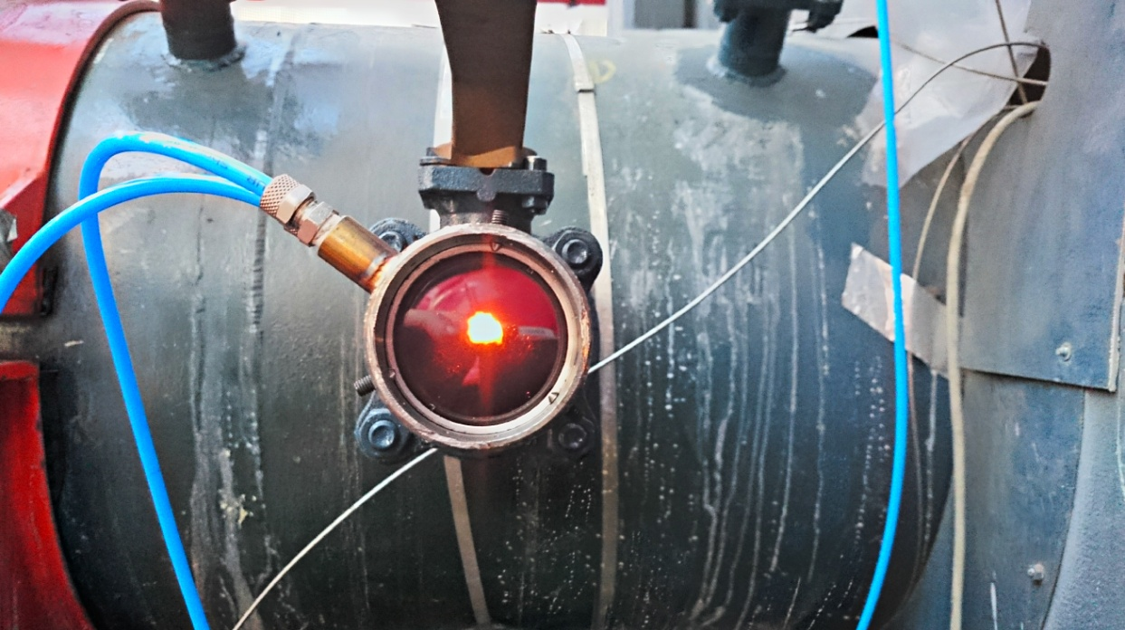
2nd EMPRESS Workshop 18-04-2018 | In situ temperature measurements by optical spectroscopy from lab to industrial scale
Senior Scientist Alexander Fateev (alfa@kt.dtu.dk)

Slide 2
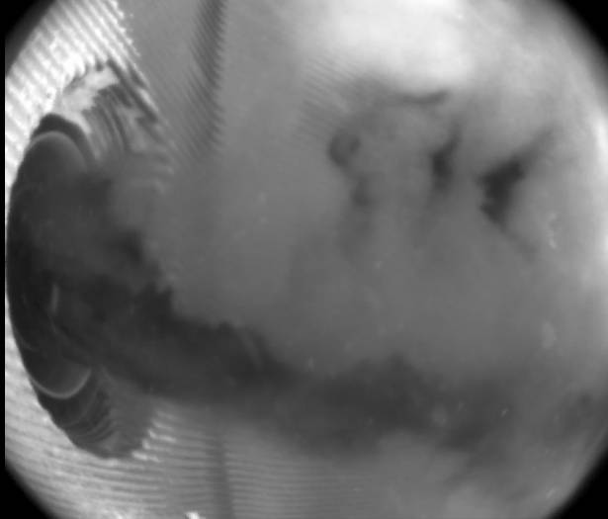
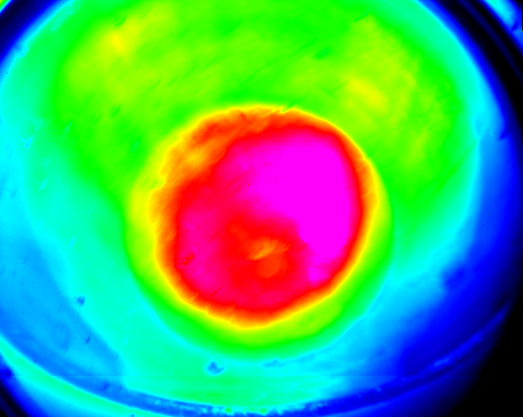
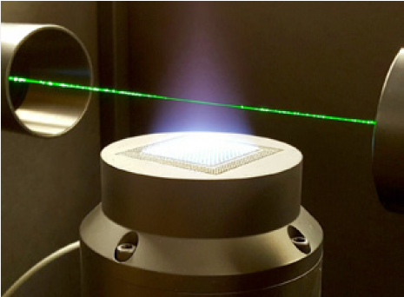
2nd EMPRESS Workshop| Outline
Background
Worse case scenario: large scale measurements (power plants and ship engines)
Best case scenario: lab scale (WP4 NPL standard burner)
Conclusions so far

Slide 3
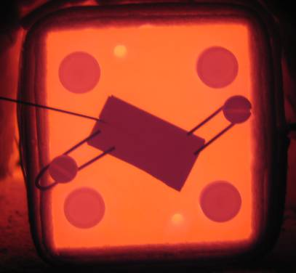
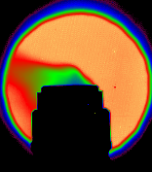
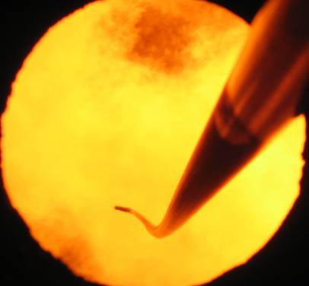
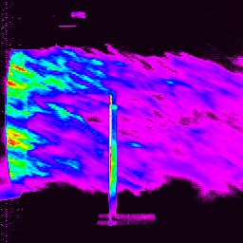
Background | Broad range of Applications…
Bring university or research skills together
with practice
Advanced, Fast, Precise measurements New insights on processes
Emission from surfaces Leak valve bottle Extractive probe boiler Exhaust air craft engine
Heat transfer,
energy balance
IR & video imaging
Gas composition,
temperature
Mixing, flows and properties

Slide 4

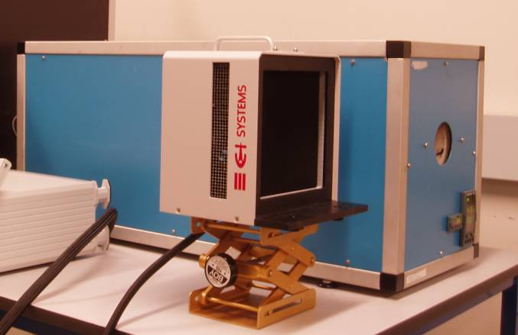
Background | Temperature Laboratory
Temperature
Emissivity
External service
Customer problems
(plastic, light sources, sensors, heat transfer,…)
ISO 17025
NMI, National Reference Laboratory for non-contact Temperature
State-of-art instruments
European cooperation, Courses for industry
High international standard of services
Range: -196C to 1600C accredited, largest Danish Temperature Lab.

Slide 5
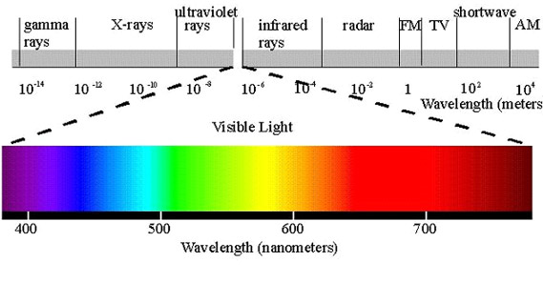
Background | Optical Spectroscopy
Light source (a lamp, hot gas) → Medium ((hot) gas) → Detector
Spectral range: 180 nm – 400 cm⁻¹
Detector: spectrometer with grating (UV/VIS/IR) or FTIR (IR)

Slide 6
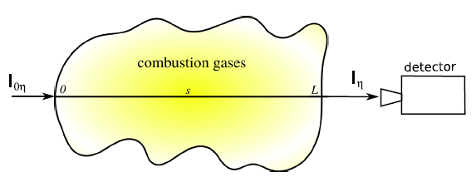
Background | Optical Spectroscopy
Emission spectroscopy:
EMS = I_{n}= L_{b} x (1 – e^{[-σ(λ) x CONC x L]})
If σ(λ) x CONC x L >> 1 then EMS → L_{b} and T_{gas} can be found from CO₂ band radiance saturation at 2340 cm⁻¹
Absorption spectroscopy:
ABS = ln[I_{0n}/I_{n}] = σ(λ) x CONC x L
Fine structure of ABS gives T_{gas}
where
L_{b} = Planck's function (black body curve)
σ(λ) = absorption cross section
CONC = concentration
L = pathlenght

Slide 7
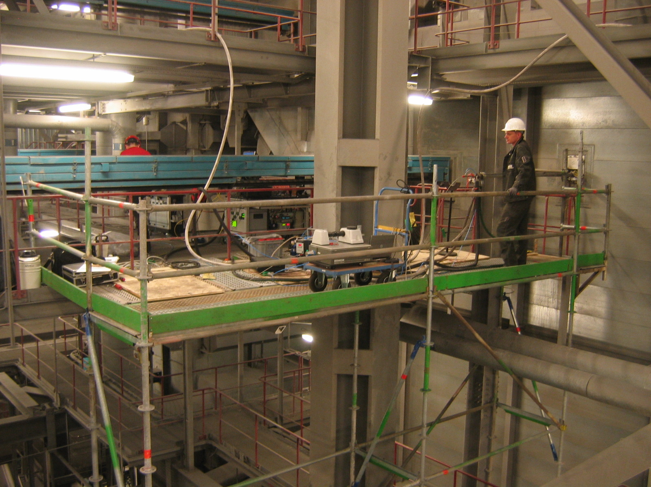
Complexity | Large Scale Measurements
Complexity:
get results first
trustful system
1500C is not uncommon
Expensive:
access possibilities
man power
time
Campaign at Block 7 Fynsværket (Denmark)

Slide 8
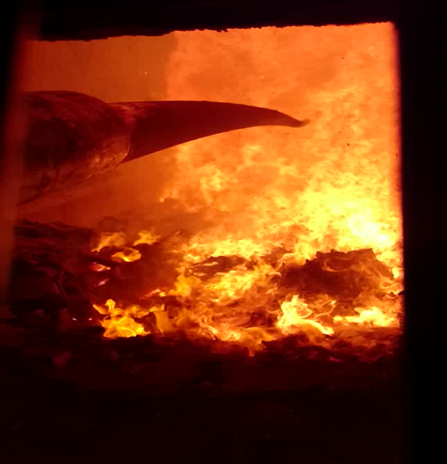
Needs | Large Scale Measurements
Boilers,
Flames (oil, gas, bio-masses),
Engines (ships, jets),
Field campaigns (explosions)
VIS image grade flame (waste)
IR image wood dust flame (video fuel mixing)

Slide 9
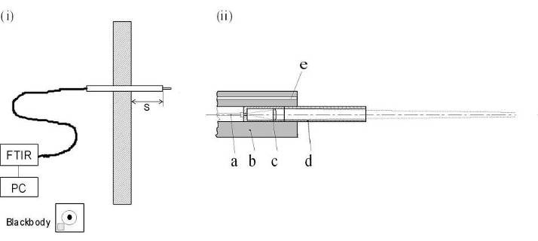
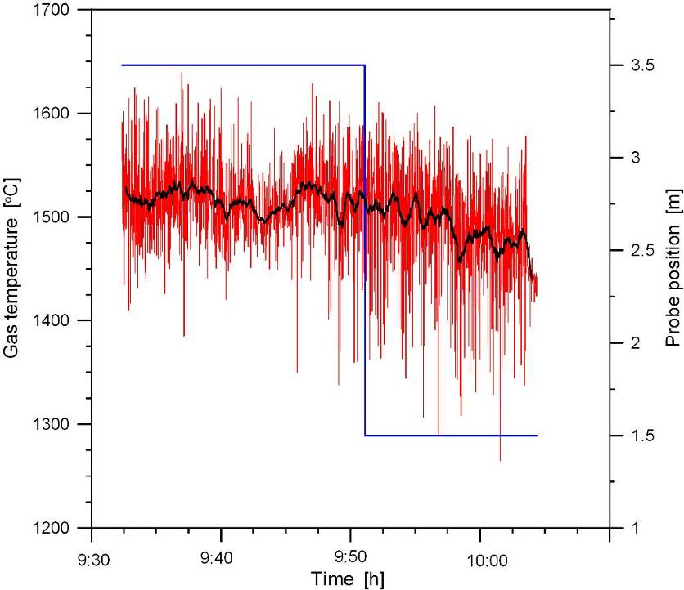
LSM | Temperature from IR measurements
Burner region. Red: snap-shot,
Black: running average over 40 s
Methods: Suction pyrometers (TC), FTIR (intensity), UV (shape features)

Slide 10
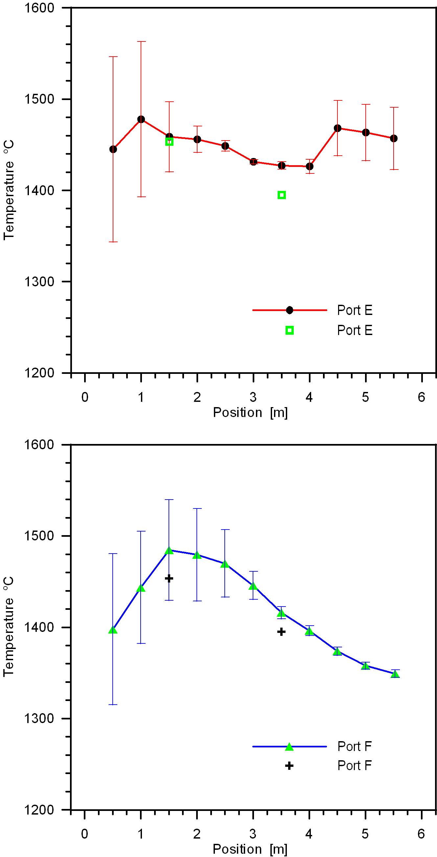
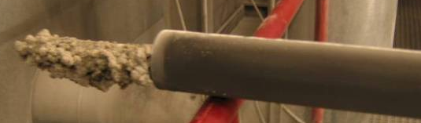
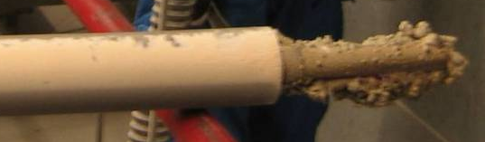
LSM | Flame Gas Temperature

Slide 11
LSM | Thermal Radiation Heat Transfer
Gas Temperature and major gas composition
Thermal radiation from gas
Thermal radiation from particles/walls
Total heat flux: Heat flux = εσT⁴
BB: 280 kW/m²
GB: 144 kW/m²
Spectral Intensity
Red: HITRAN 8.7% H₂O at 1200C and over 15 m path Blue: Measured spectrum, Grey body 1186C and ε=0.562, Blackbody 1218C.

Slide 12
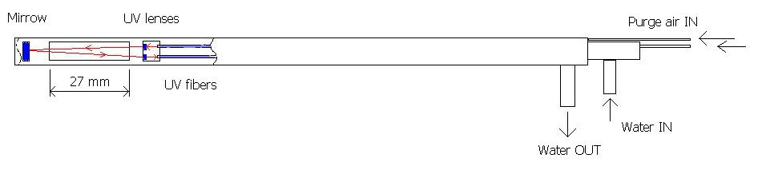
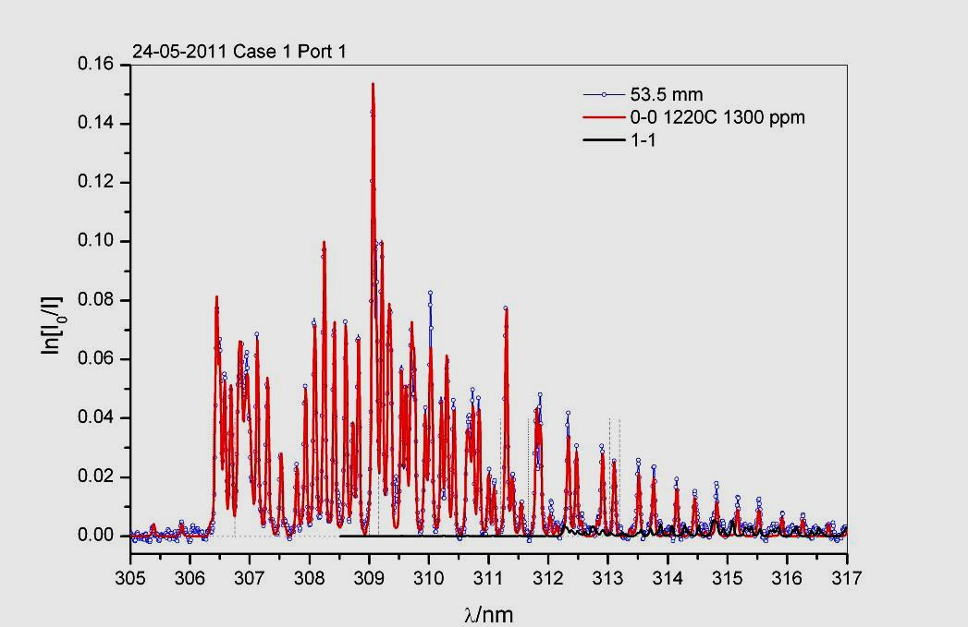
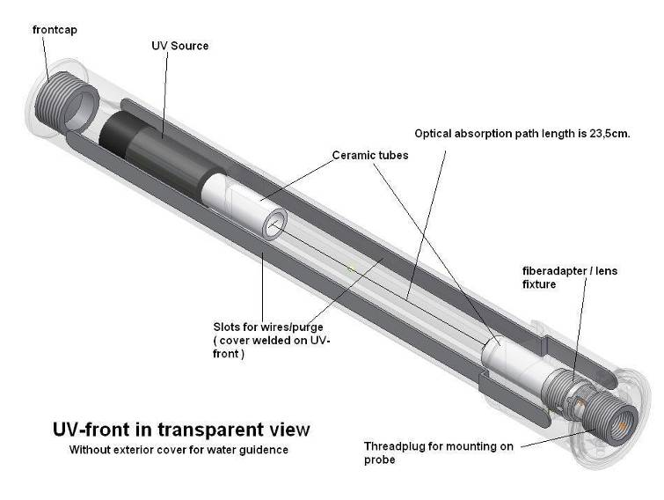
LSM | Temperature from UV measurements
Miniature UV probe (Ø10 mm)
Spectrum of OH
UV head, boiler measurements
(Ø64 mm)

Slide 13
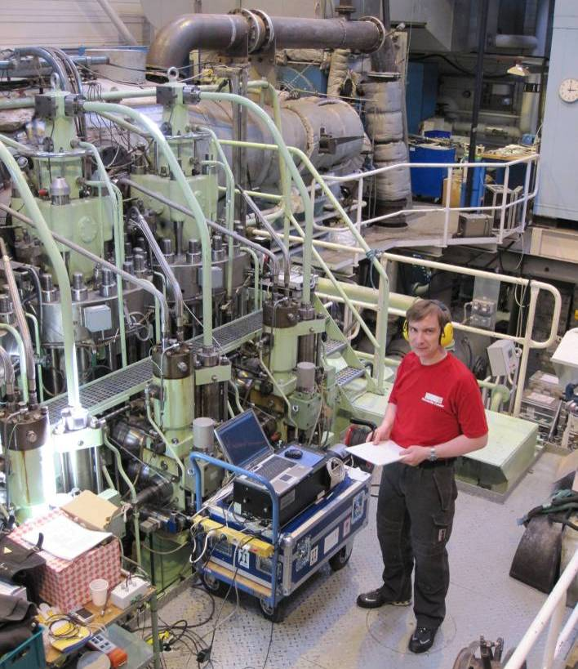
LSM | Fast optical measurements
Combine partner data with optical measurements with perfect synchronisation
Imaging: Video and IR-camera (7 μs)
UV and IR Spectroscopy (1 ms)
Velocity, particle sizing (1 ns)
EU Hercules β: MAN Diesel 75% Load

Slide 14
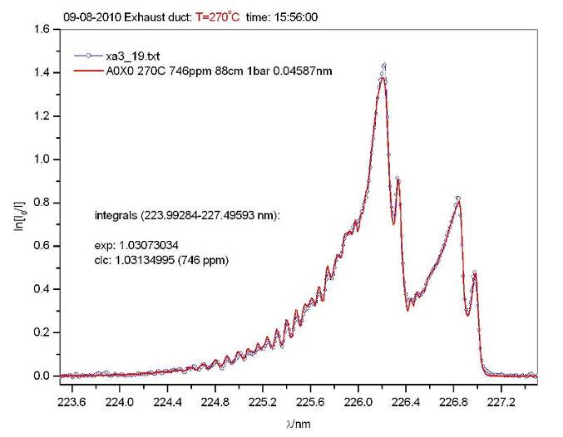
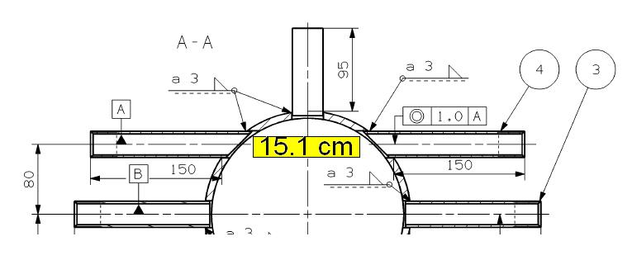
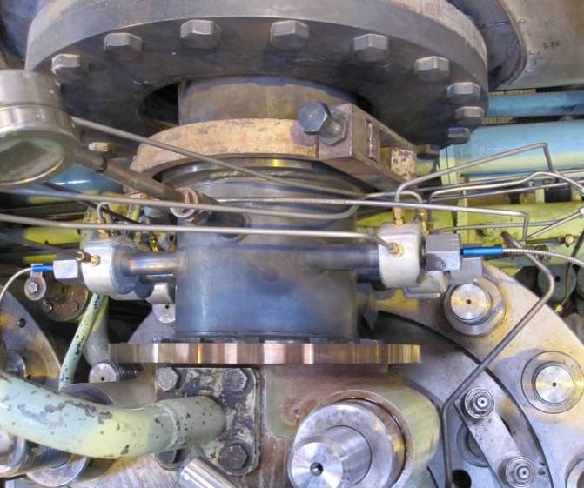
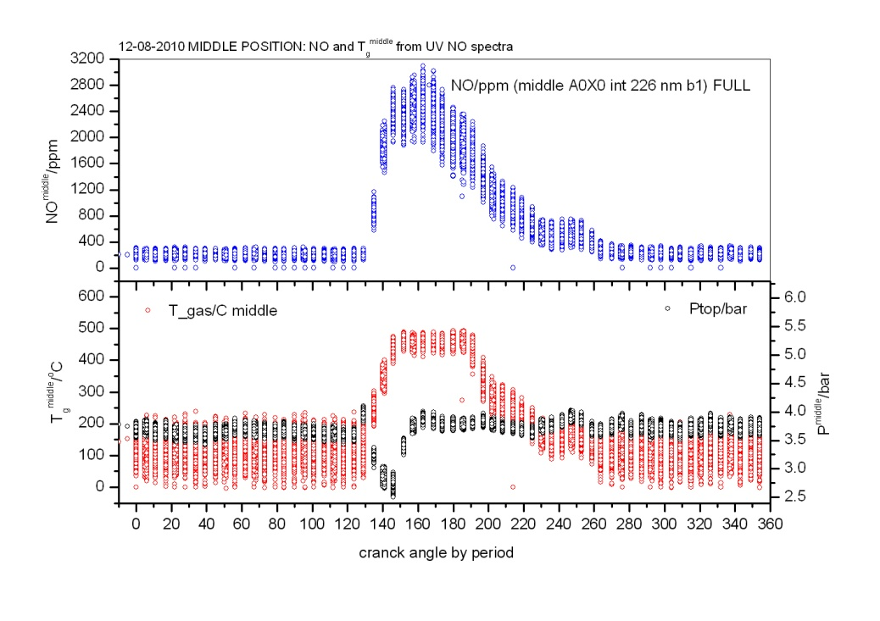
LSM | Fast gas concentration measurements (UV)
gas temperature
gas concentration
UV fiber optics for dynamic NO meas.

Slide 15
LSM | Fast gas temperature measurements (IR)
Combination of
fast IR camera (640x512), InSb
grating IR spectrometer
3x optical IR fibers
→
3x simultaneous fast line-of-sight measurements (down to 7μs)

Slide 16
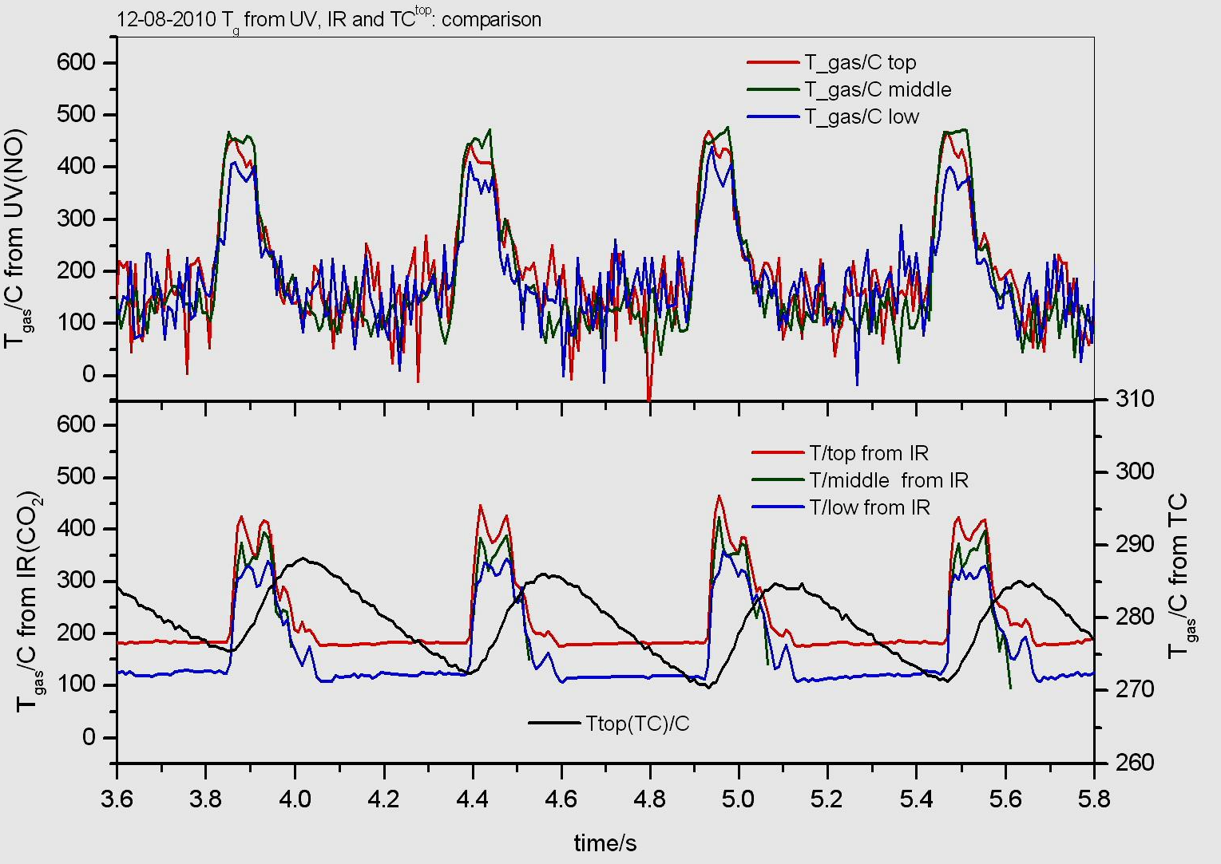
LSM | Fast temperature measurements UV vs IR
Top
Middle
Bottom
very good agreement between IR(CO₂ emission) and UV(NO absorption)
IR: less noisy data
wrong choice of TC (too slow)

Slide 17
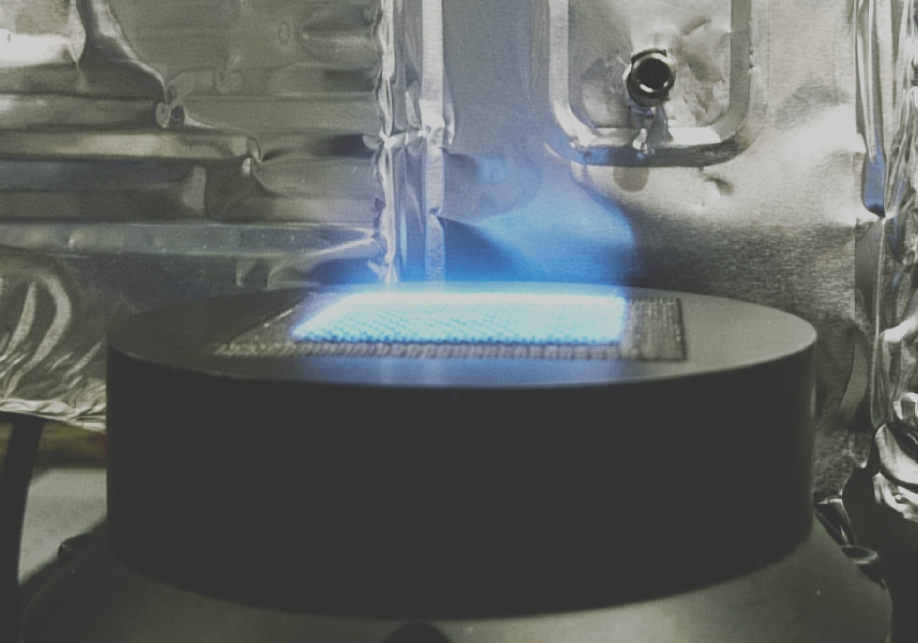
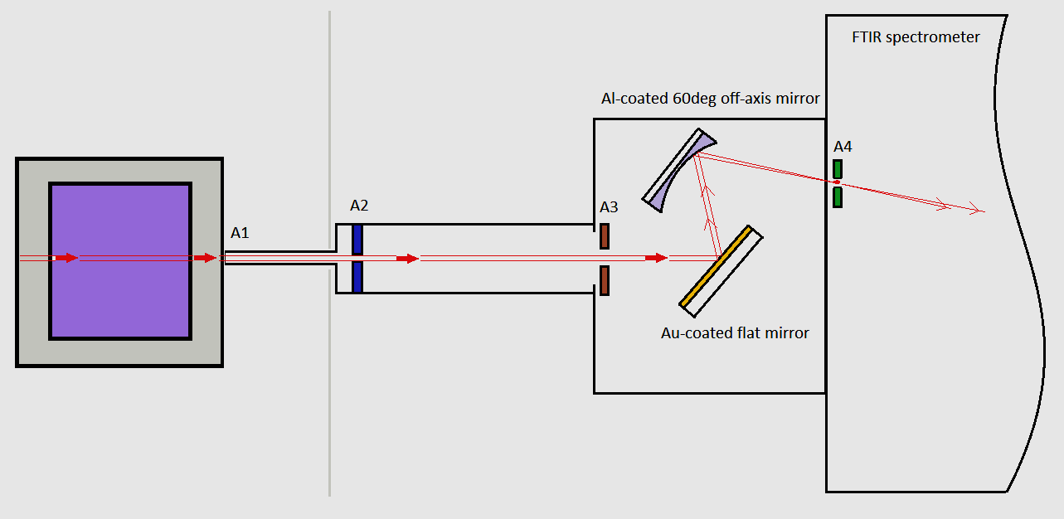
LSM | Best case scenario: lab scale in EMPRESS(WP4)
Optical set Up:
gas radiation optical measurements with a FTIR spectrometer;
Rx- single line-of-sight set Up purged by N₂;
scanning in Rz and Ry-directions;
no CO₂ self-absorption: full CO₂(2340cm⁻¹) band coverage (+ CO + H₂O bands);
650-6000 cm⁻¹ spectral range with linearized high-sensitivity MCT;
fast FTIR scanning, moderate spectral resolution (1cm⁻¹ is enough, work with 4cm⁻¹ and 8cm⁻¹ as well);
spectra in W m⁻² sr⁻¹ (cm⁻¹)⁻¹ calibrated with portable BB at 796.1C (BB calibrated at DTU).
Z
Y
X
Modelling
use HITEMP2010 spectral database for CO₂/H₂O/CO modeling in 1500-2400 cm⁻¹;
major isotopologues, Lorentz line shapes for single lines, cut off at ±8 cm⁻¹ from line centers;
RHT emission spectra forward calculations with NPL’s Tgas profiles;
emission spectra calculations at selected Tgas and CO₂ concentrations;
machine learning approach for Tgas profiles retrievals from single line-of-sight measurements tested.

Slide 18


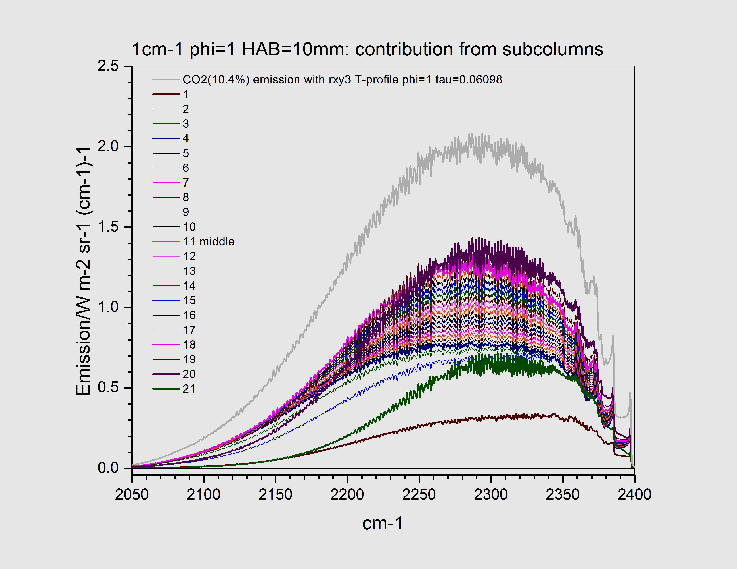
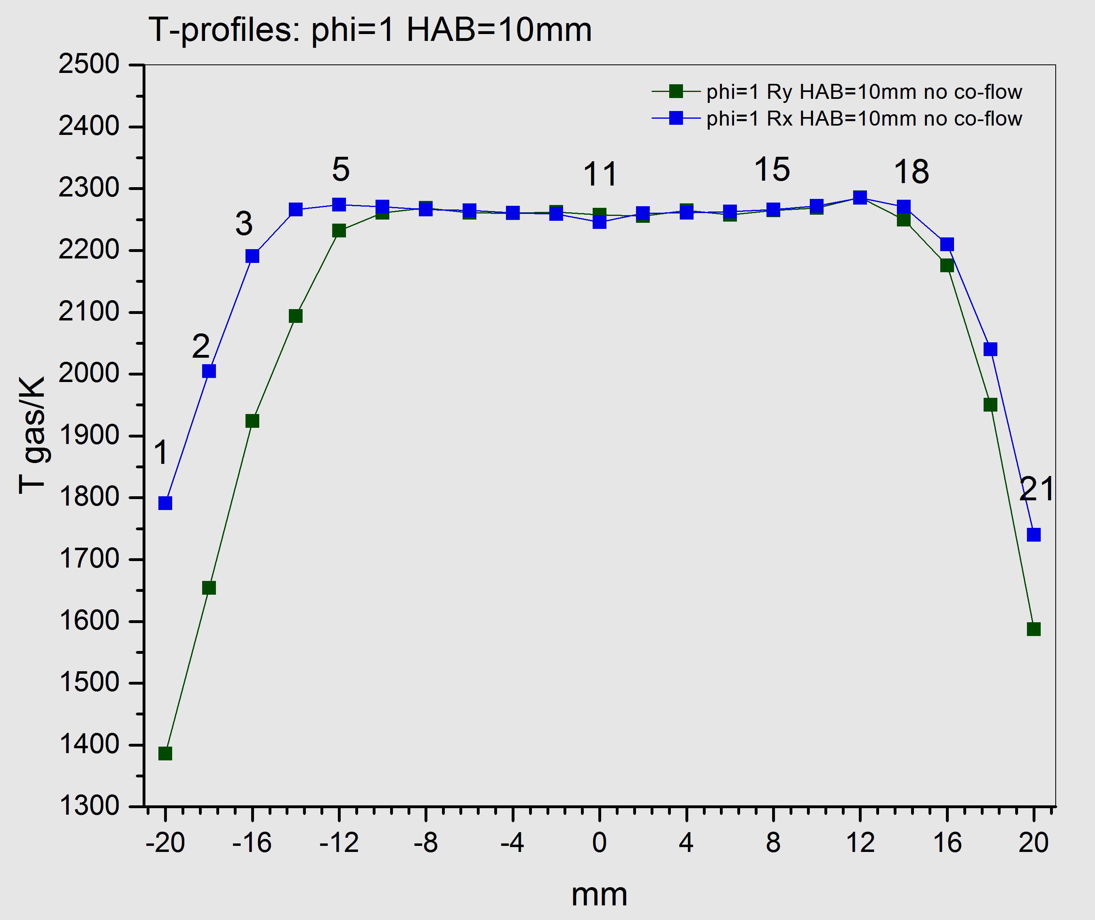
LSM | Emission spectra calculations
RHT forward calculations:
(MF Modest, Radiative Heat Transfer, 3rd , 2013)
CO₂ example:
contribution from sub-columns in total emission

Slide 19
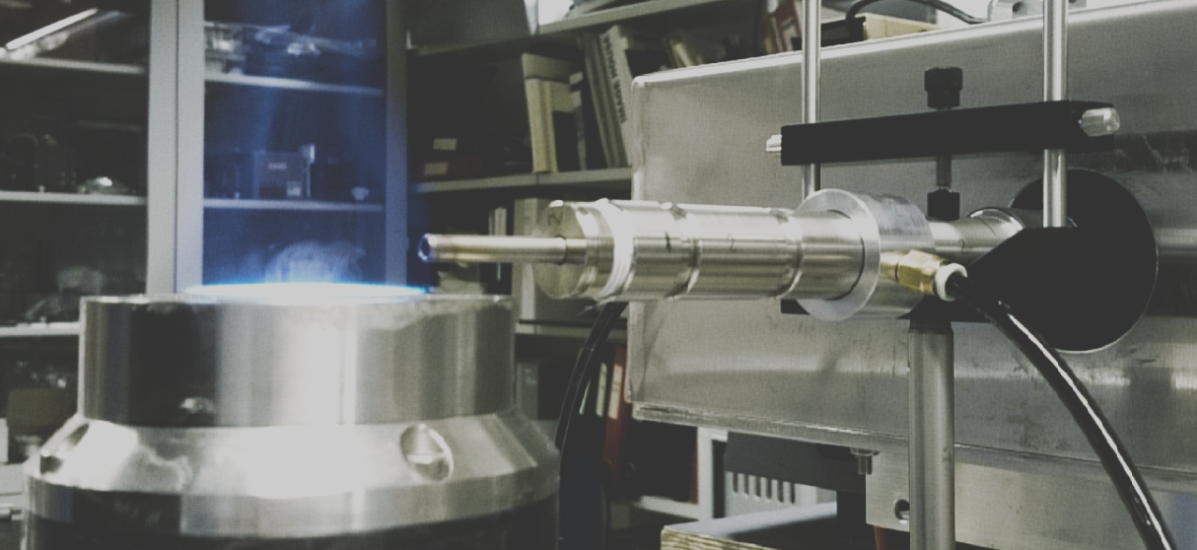
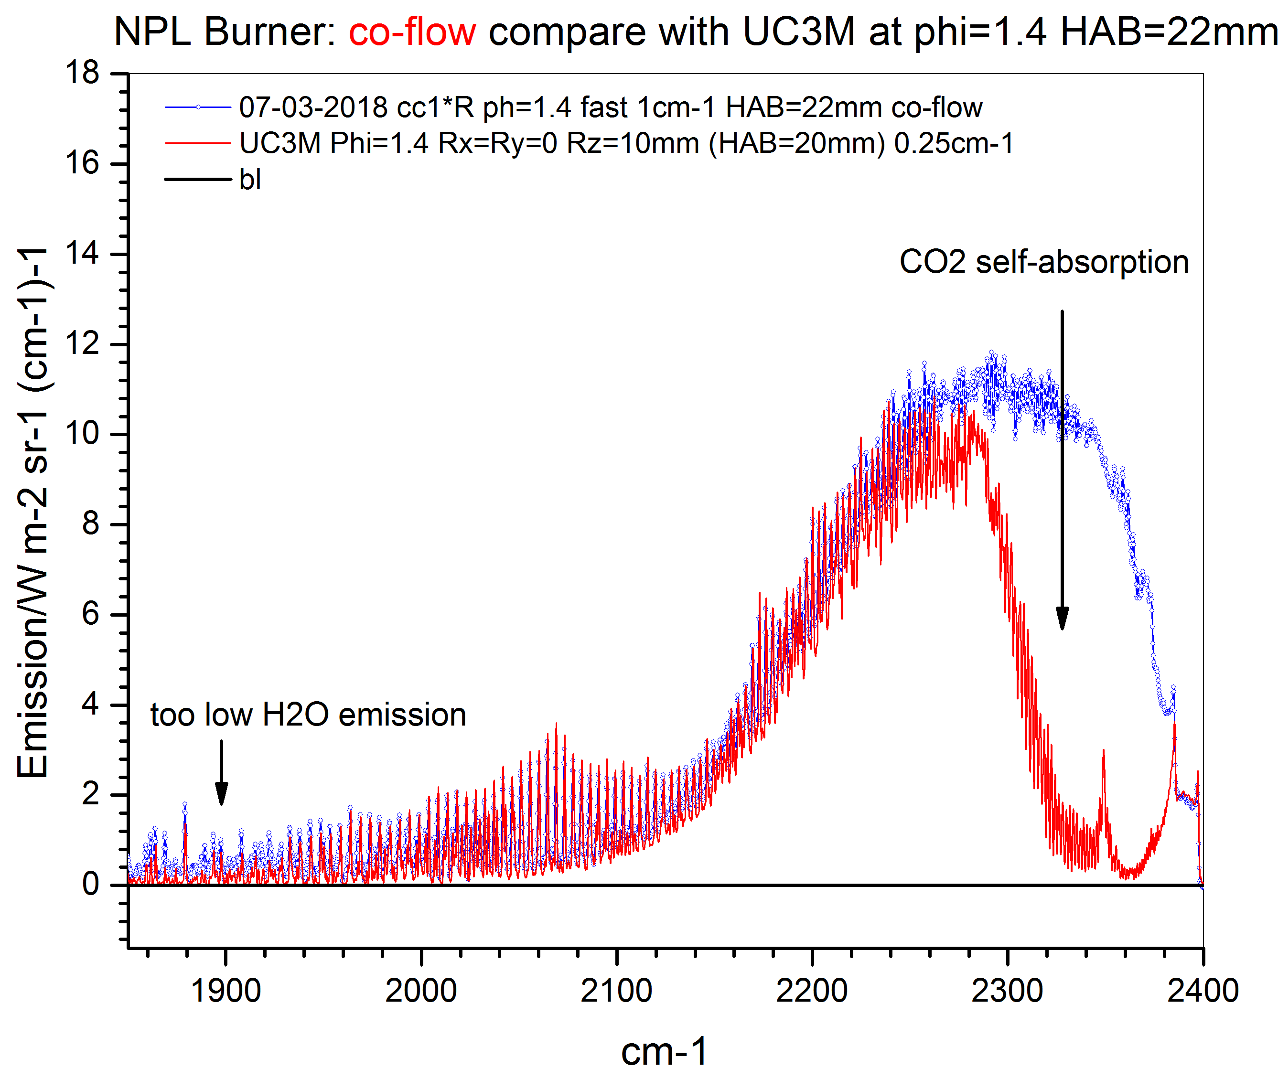
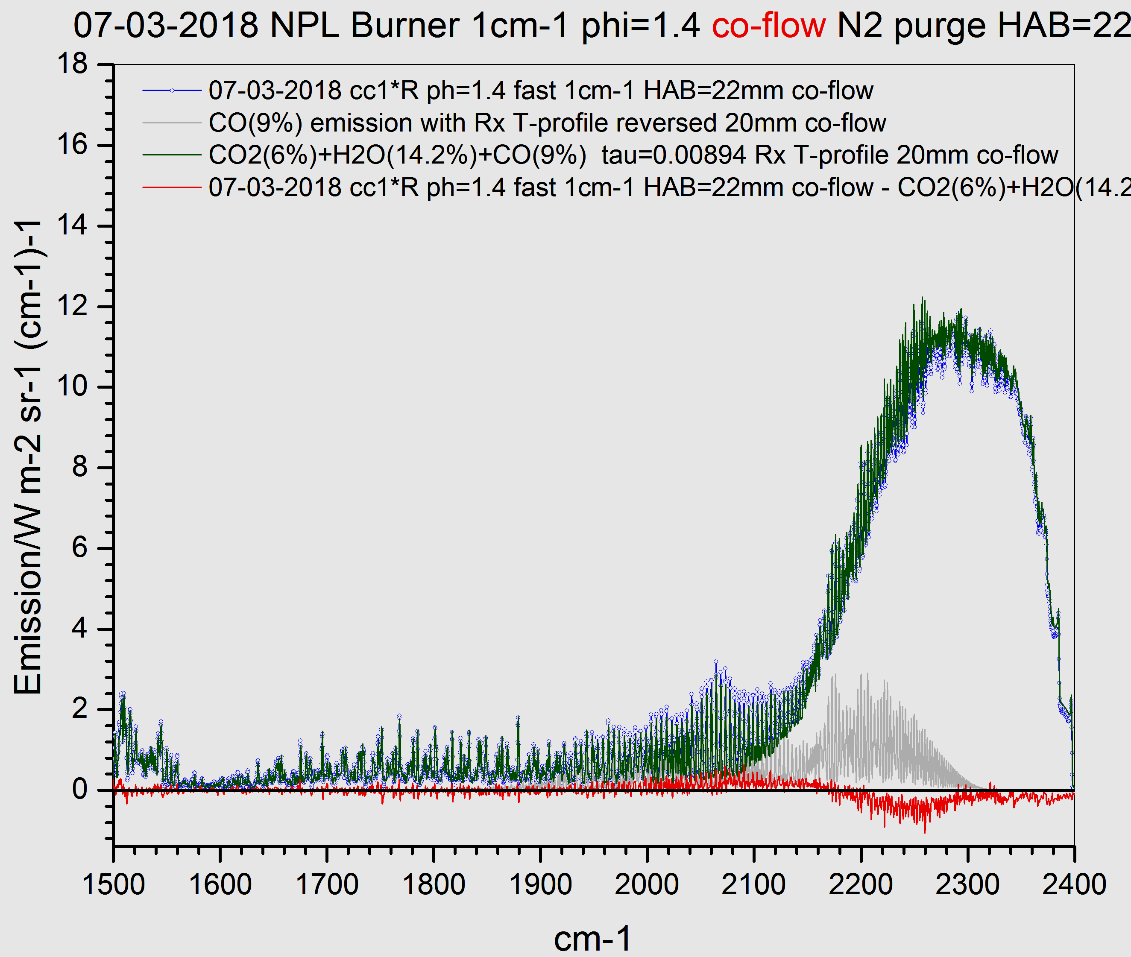
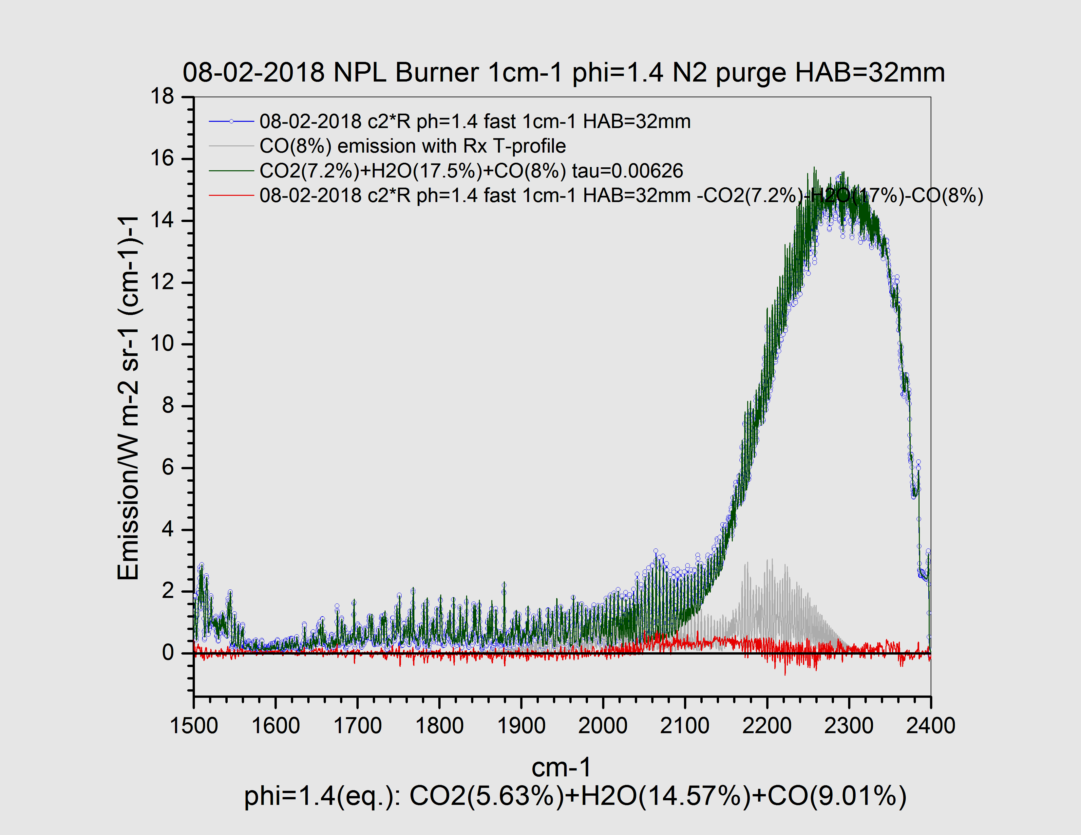
LSM | Some results in EMPRESS (WP4): IR
Most difficult case (high CO concentration):
phi=1.4
no/with N₂ co-flow
HAB=22mm and 32mm
experimental data (blue), modeling (olive)
Hyperspectral measurements underestimate H₂O emission and show strong CO₂ self-absorption from ambient air
N₂ co-flow: UC3M data (red)
N₂ co-flow fit with NPL’s T-profile
no N₂ co-flow, fit with NPL’s T-profile fit

Slide 20
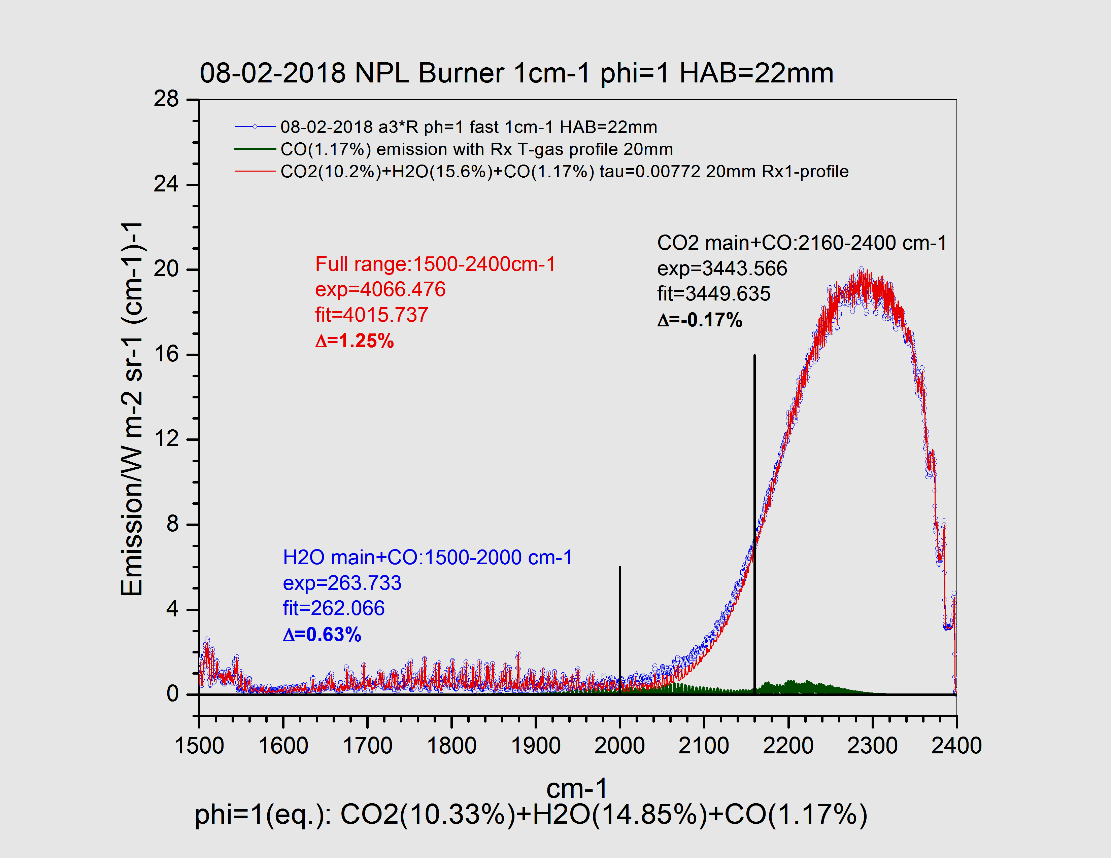
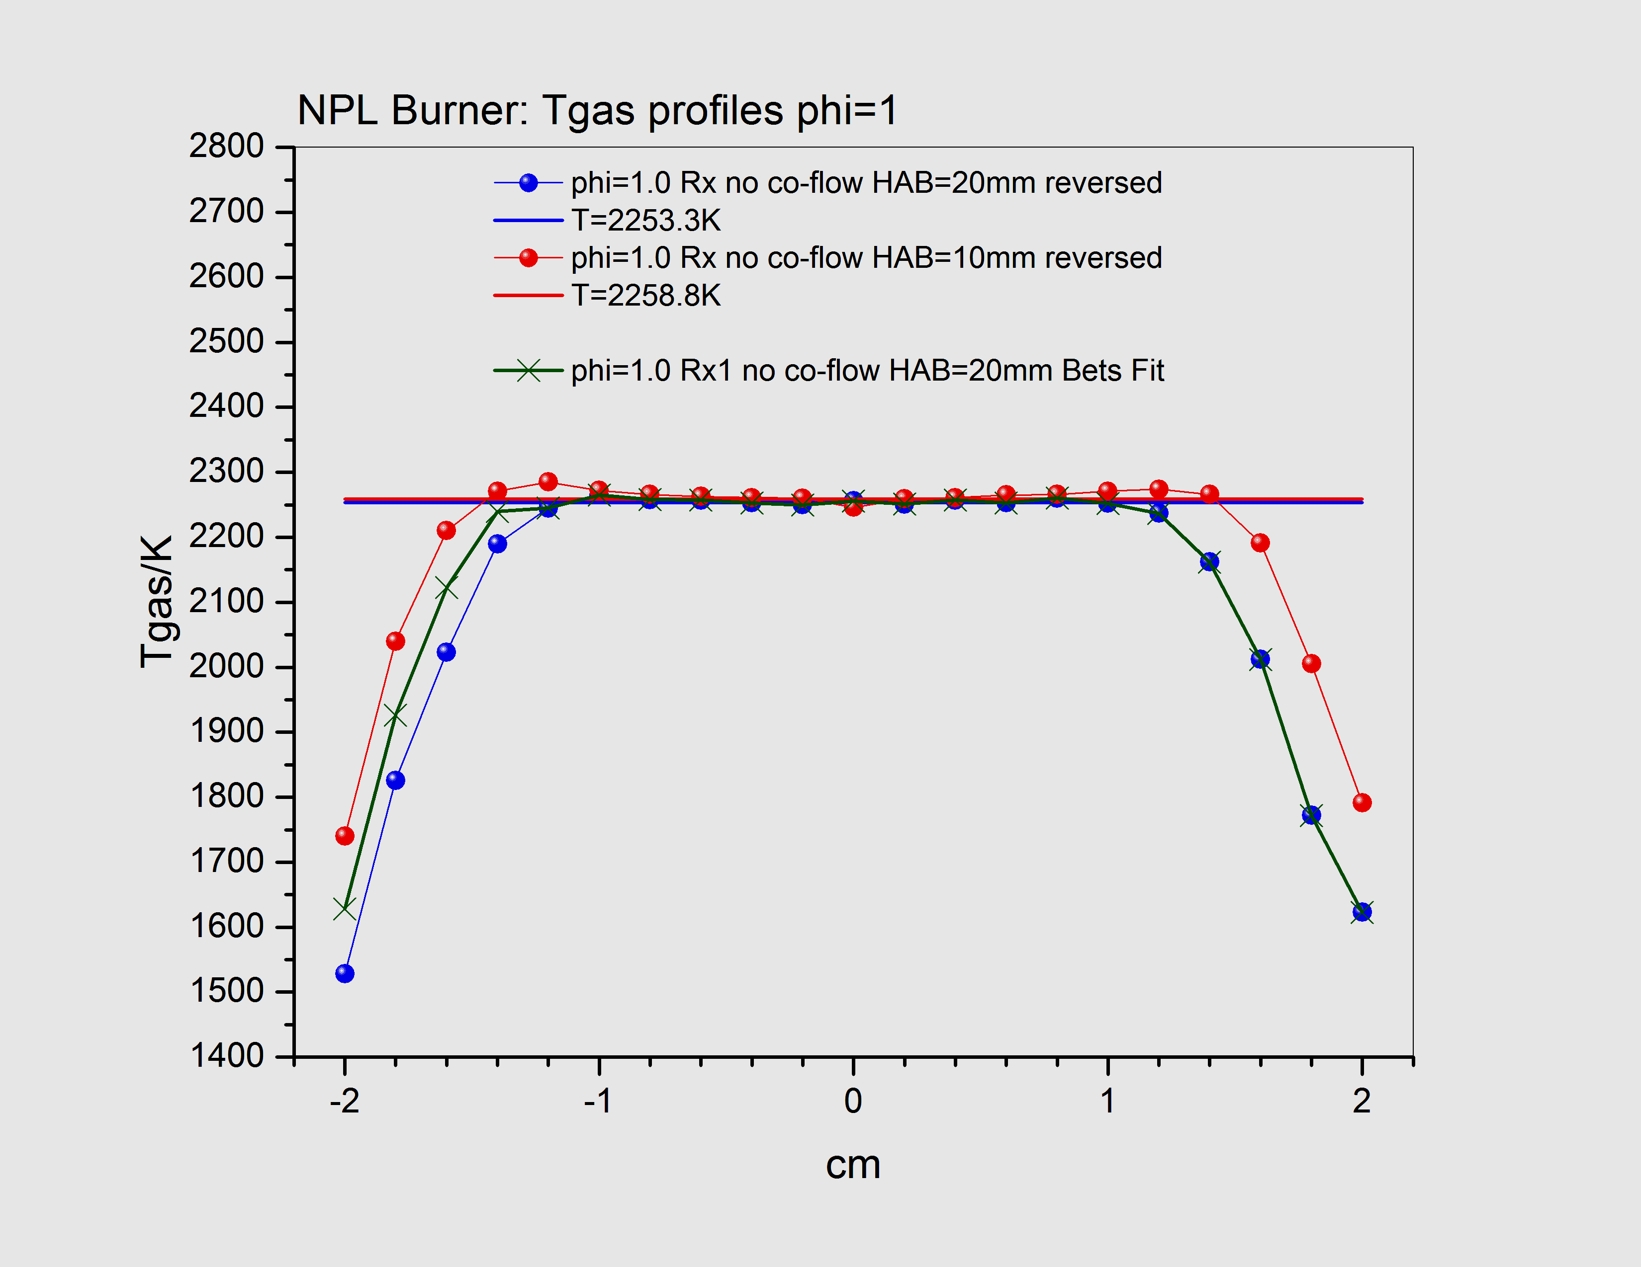
LSM | Some results in EMPRESS (WP4): IR
HITEMP2010: quality of the database
HITEM2010 is very good for major part of CO₂(-0.17%), H₂O(0.63%) and CO bands (T≈2259K);
very good agreement with NPL’s T-profile;
no CO₂ self-absorption;
experimental spectrum (blue) fitted with CO₂(10.2%)+H₂O(15.6%)+CO(1.17%) (red), phi=1, HAB=22mm;
Possibility to improve NPL’s temperature profiles:
original (blue) and corrected (olive) T-profiles at phi=1 HAB=20mm;
red: T-profile at HAB=10mm, phi=1.

Slide 21
LSM&LSM | Conclusions so far
Optical spectroscopy is a powerful tool for in situ and on-line temperature measurements;
Broad application range: from lab to large scales;
No potentially upper limit for temperature measurements;
It can be used in various difficult environments;
2D and 3D measurement are possible;
Fast accurate measurements are possible at moderate equipment costs/size/weight;
In many cases gas composition can also be obtained;
Combination of modern spectral databases and powerful mathematical models (various temperature retrieval methods and machine learning approaches) give wide opportunities for new applications where temperature measurements are essential.

Slide 22
Thank you for your attention

