Slide 1

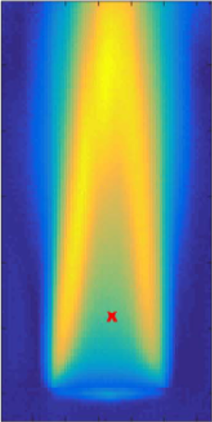
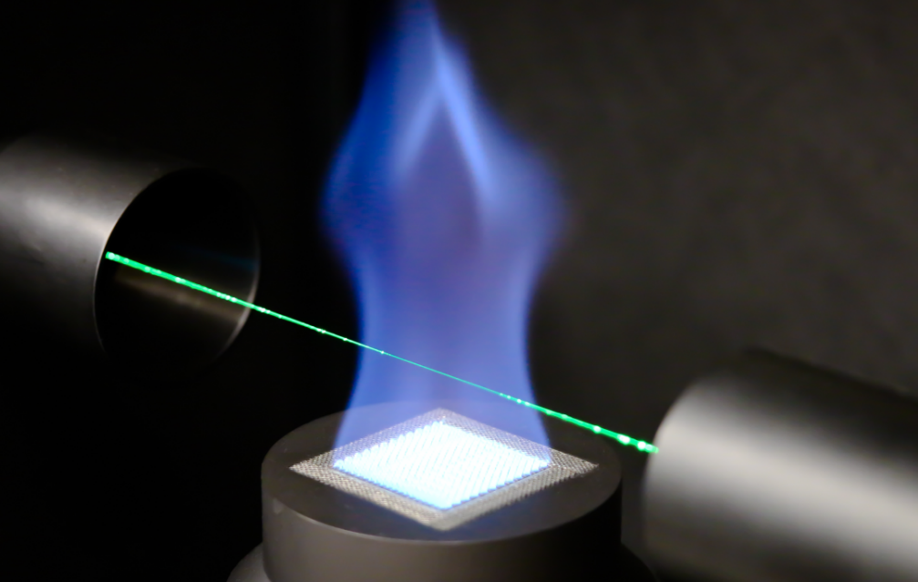

WP4: Traceable combustion temperature measurement
EMPRESS 2nd Workshop
18th May 2018
NPL
Teddington
UK
Gavin Sutton NPL
Adam Greenen NPL
Juan Meléndez, Guillermo Andrés Guarnizo Herreño UC3M
Maria Jose Martin Hernandez, José Manuel Mantilla CEM
Alexander Fateev, Sønnik Clausen DTU
Paul Ewart, Anna-Lena Sahlberg UOX
Welcome to the National Physical Laboratory

Slide 2
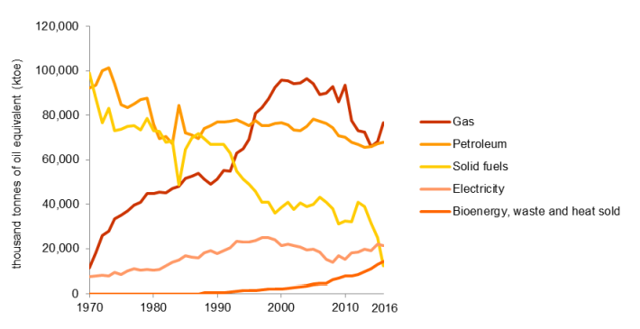
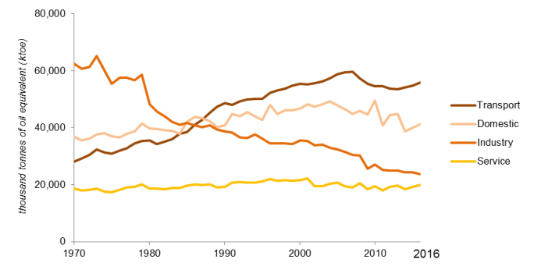
WP4: Traceable Combustion Temperature Measurement
Why are combustion temperatures important?
Energy Consumption in the UK July 2017
By fuel type
By sector
Combustion is the primary conversion process
https://assets.publishing.service.gov.uk/government/uploads/system/uploads/attachment_data/file/633503/ECUK_2017.pdf

Slide 3
WP4: Traceable Combustion Temperature Measurement
Why are combustion temperatures important?
The temperature of any combustion
process critically affects:
  Chemical reaction rate
  Process efficiency
  Pollutant levels
  Product quality
  Rate of failure mechanisms
Qu: Why aren’t combustion temperatures routinely measured?
  Extremely harsh environment
  Probe survivability
  Flame evolution easily perturbed
  Access is challenging
  Model combustion process
  Validate model – test rig
    Scaled down
    Probe access
    Heavily instrumented
Achieving the correct temperature is critical
This is where we can help – good metrology: standards and instrumentation

Slide 4
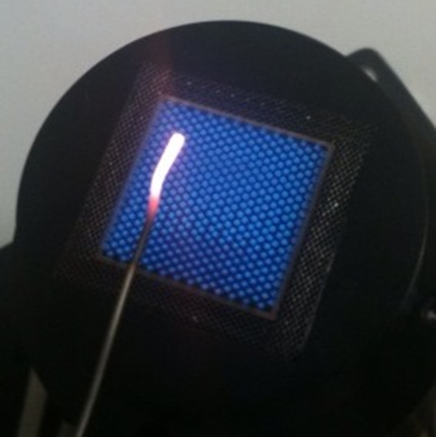
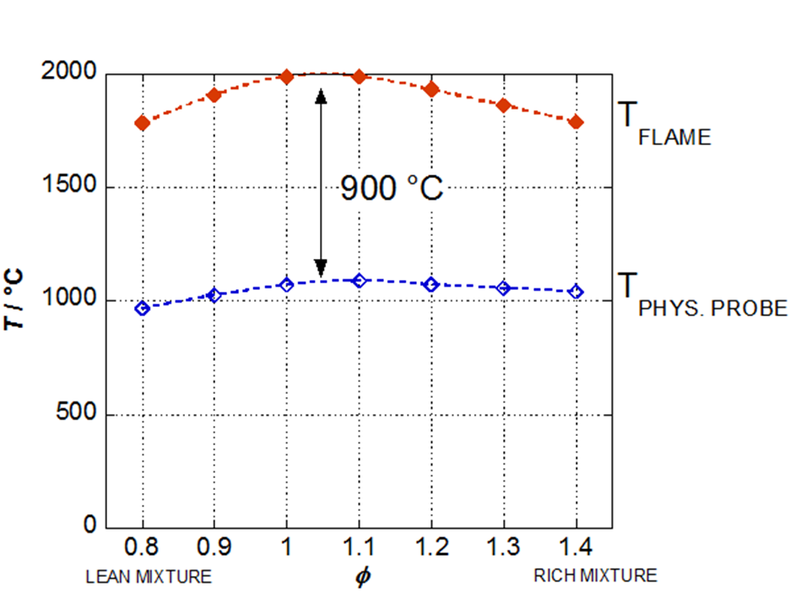
WP4: Traceable Combustion Temperature Measurement
Physical and optical probes
Physical probes:
  Perturb the flame
  Give probe T not flame T
  Don’t last very long
  Access is challenging
  Slow response speed
Example
Optical probes:
  Emitted light can give T information
  Depends on ‘type’ of excitation
  Non-intrusive
  High response speed
  Access is still challenging
  Technically complex
  Needs calibration
Calibration source:
Region of hot gas of known T and composition traceable to ITS-90
Calibrate optical probe by measuring in this region

Slide 5
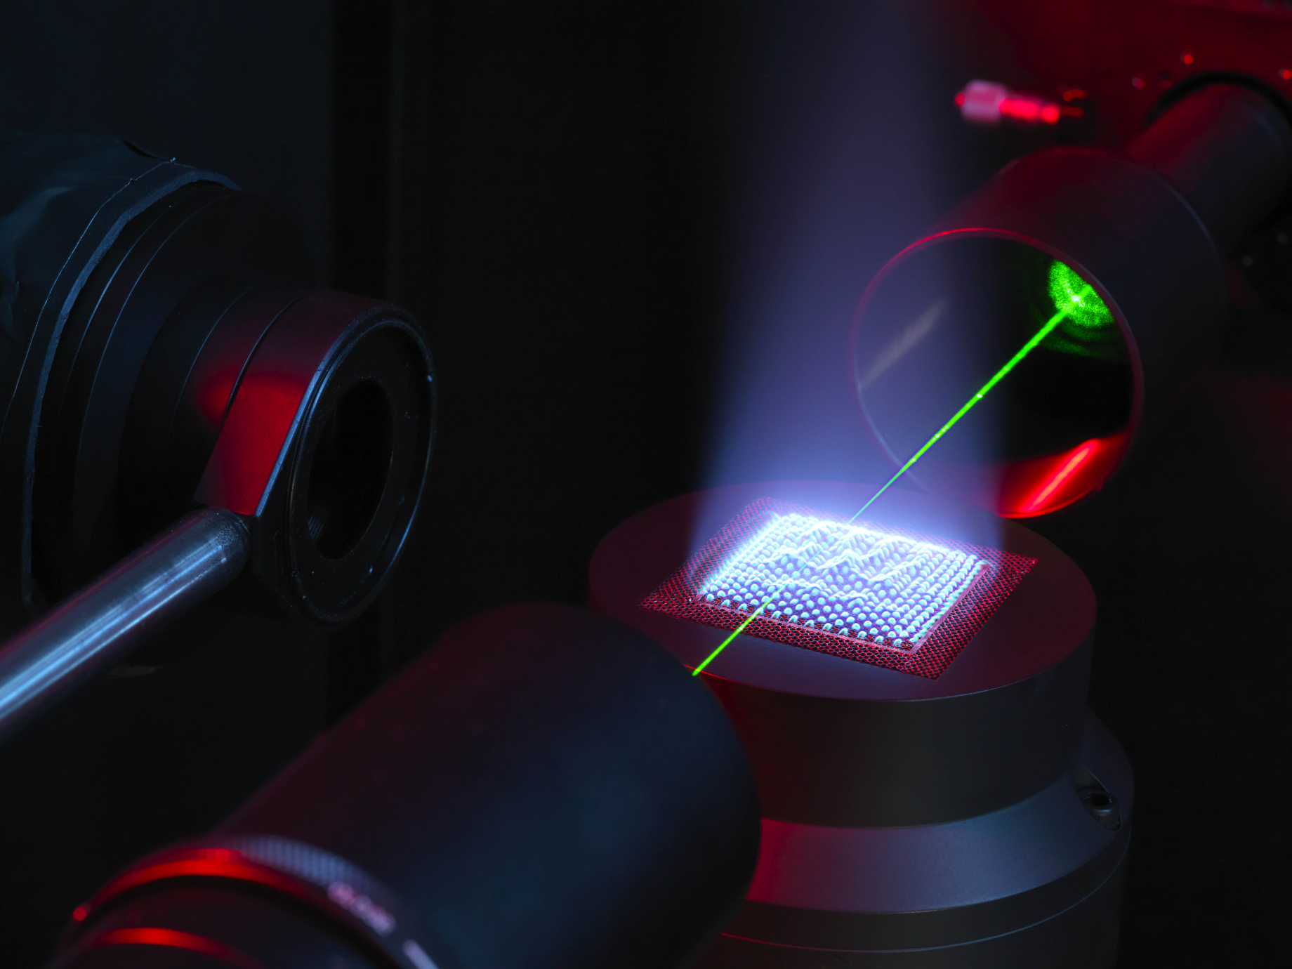
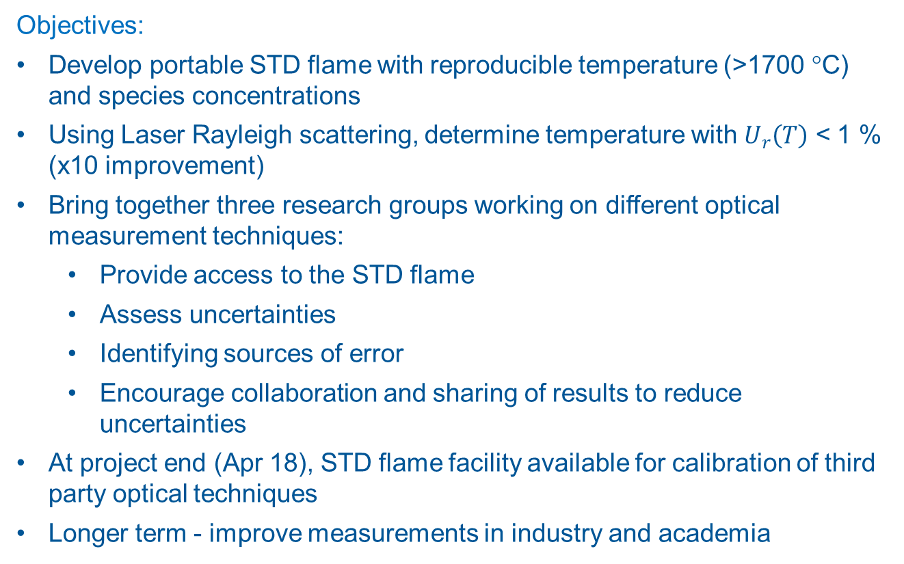
WP4: Traceable Combustion Temperature Measurement
WP4: Traceable Combustion Temperature Measurement
Objectives:
Develop portable STD flame with reproducible temperature (>1700 °C) and species concentrations
Using Laser Rayleigh scattering, determine temperature with $U_{r}\left(T\right)$ < 1 % (x10 improvement)
Bring together three research groups working on different optical measurement techniques:
  Provide access to the STD flame
  Assess uncertainties
  Identifying sources of error
  Encourage collaboration and sharing of results to reduce uncertainties
At project end (Apr 18), STD flame facility available for calibration of third party optical techniques
Longer term - improve measurements in industry and academia
NPL STD flame under laser interrogation

Slide 6






WP4: Traceable Combustion Temperature Measurement
European project to enhance process efficiency through improved temperature measurement:
STD flame calibrated at NPL
Partner organisations – developing novel optical combustion thermometers
STD flame – circulated to partners
Comparison of techniques – publication
NPL facility available for others
IR/UV spectroscopy
Portable STD Flame
Rayleigh scattering
IR hyperspectral imaging
DFWM / LIGS

Slide 7
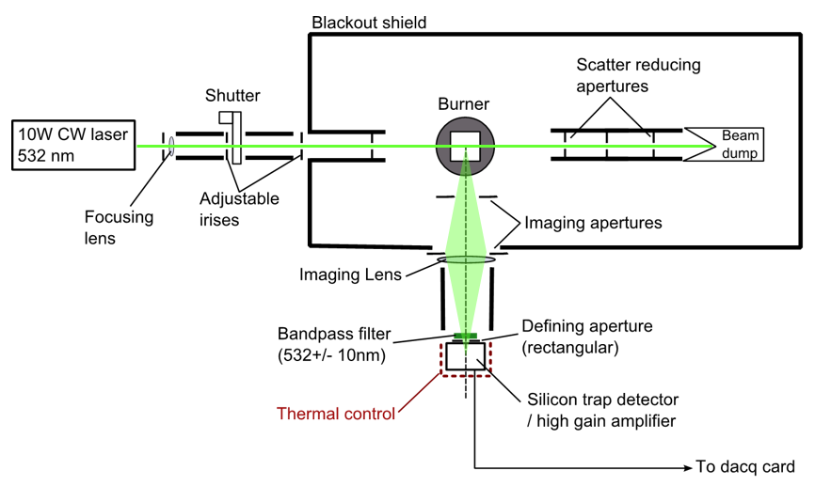
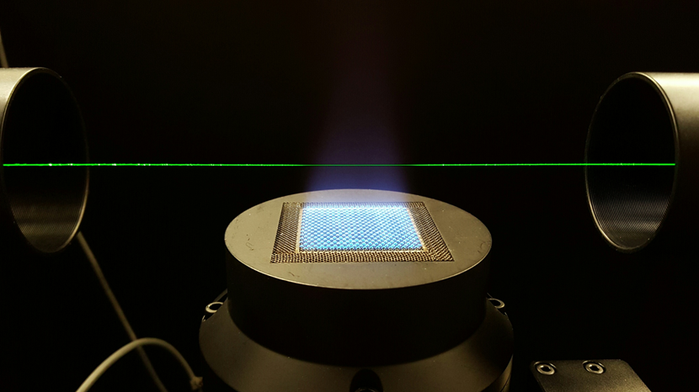
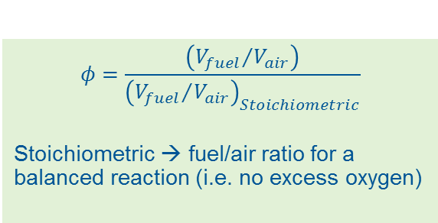
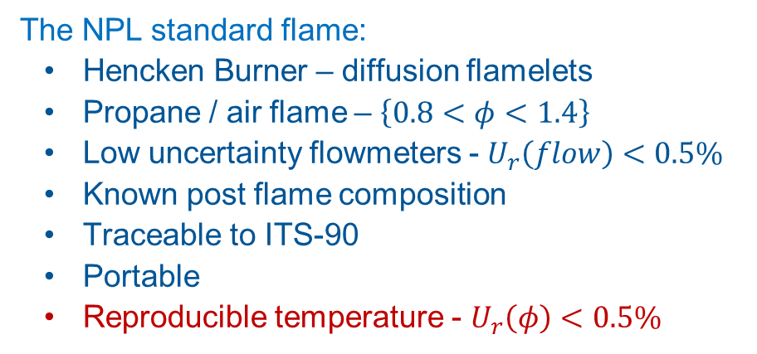
WP4: Traceable Combustion Temperature Measurement
The NPL standard flame:
  Hencken Burner – diffusion flamelets
  Propane / air flame – $\left\{0.8<φ<1.4\right\}$
  Low uncertainty flowmeters - $U_{r}\left(flow\right)<0.5\%$
  Known post flame composition
  Traceable to ITS-90
  Portable
  Reproducible temperature - $U_{r}\left(φ\right)<0.5\%$
$$φ=\frac{\left({V_{fuel}}/{V_{air}}\right)}{{\left({V_{fuel}}/{V_{air}}\right)}_{Stoichiometric}}$$
Stoichiometric → fuel/air ratio for a balanced reaction (i.e. no excess oxygen)

Slide 8
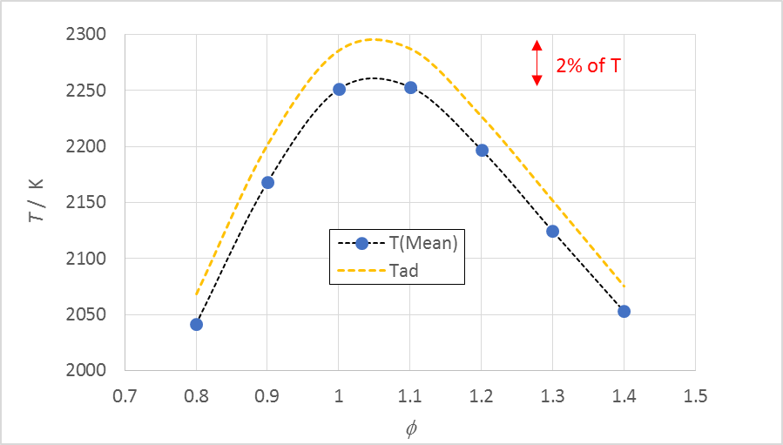
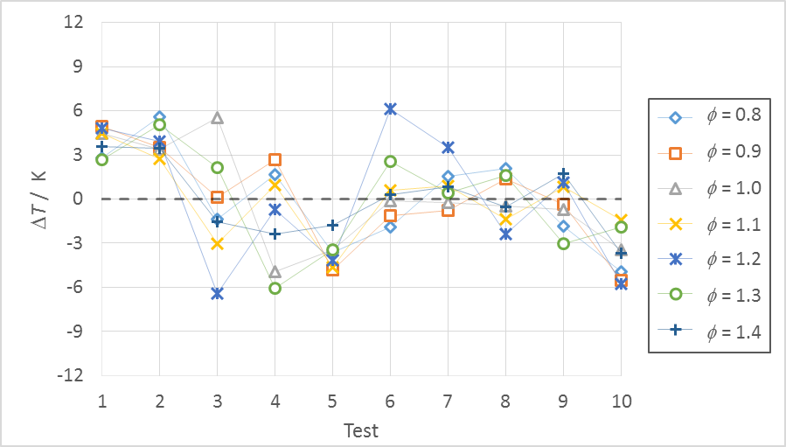
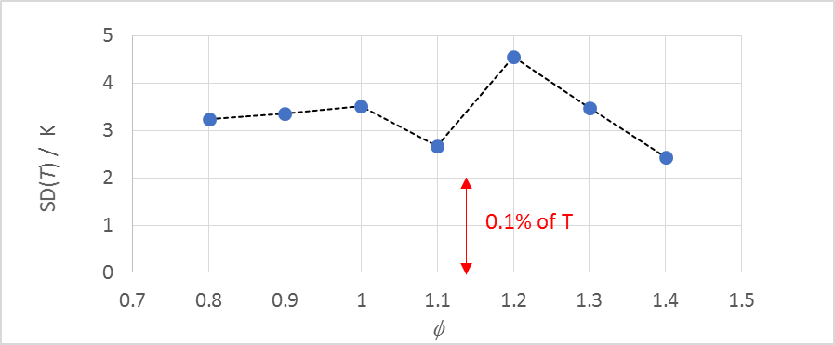
WP4: Traceable Combustion Temperature Measurement
The NPL standard flame - performance
a) Post-flame temperature: mean of 10 tests over 3 months
b) Change in post-flame temperature relative to mean over 3 months
c) Post-flame temperature: Standard deviation of 10 tests over 3 months
Summary:
Temperatures lower than theoretical maximum due to heat loss to the burner surface
Reproducibility over 3 months ≤ 0.2 % of T
Suitable for use as a standard

Slide 9
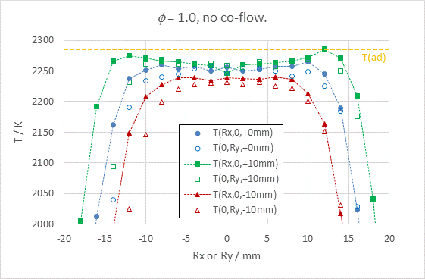
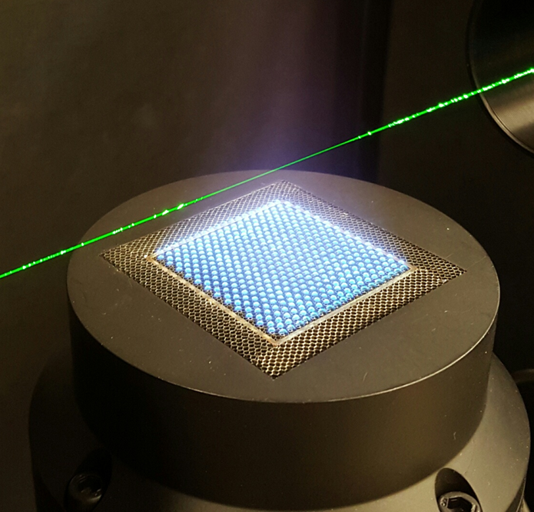
WP4: Traceable Combustion Temperature Measurement
The NPL standard flame - performance
Example of temperature profile above the burner: ϕ = 1.0
z
y
Green – HAB = 10 mm
Blue – HAB = 20 mm
Red – HAB = 30 mm
Laser
x
spot on burner showing
laser entry orientation
HAB = Height Above Burner

Slide 10
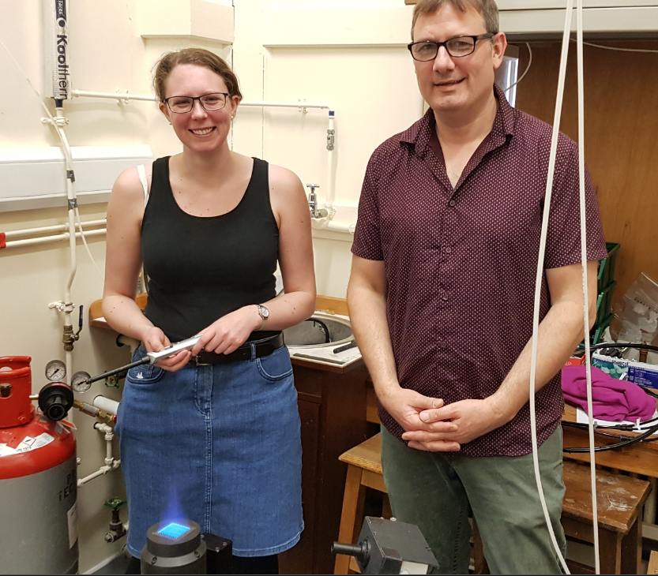
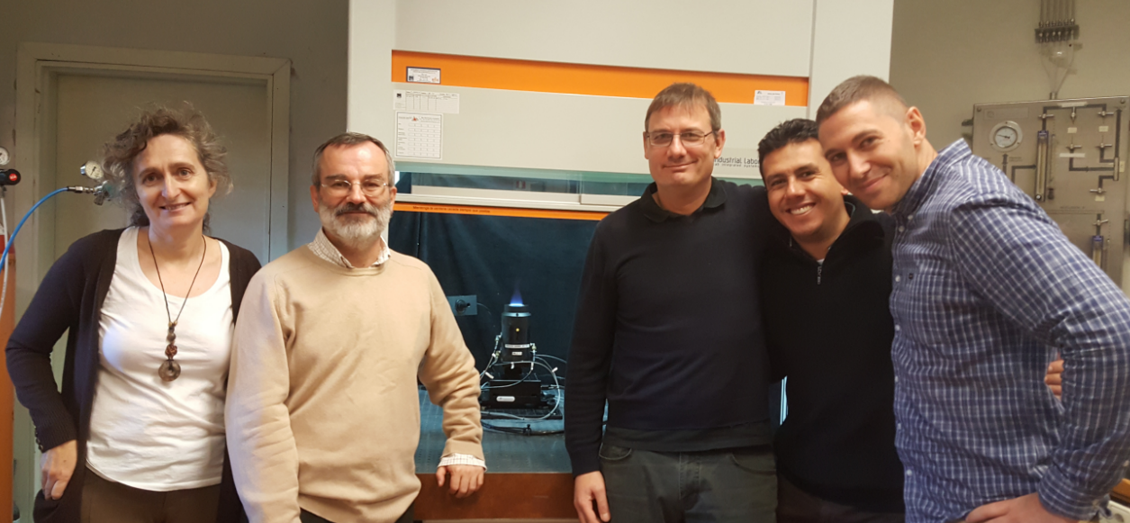
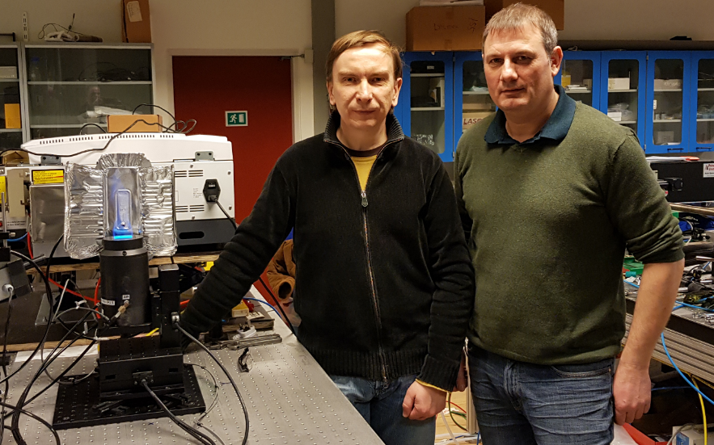
WP4: Traceable Combustion Temperature Measurement
STD flame circulated to partners:
UC3M/CEM measurements completed May 17
UOX measurements completed Dec 17
DTU measurements: started Jan 18, ongoing (NPL will re-calibrate on return)
UOX measurements – completed Dec17
UC3M/CEM measurements – completed May 17
DTU measurements – started Jan 18

Slide 11
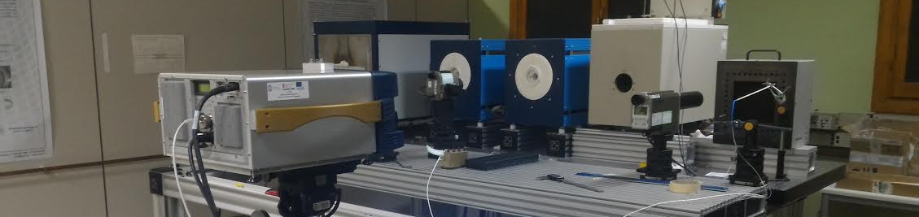
WP4: Traceable Combustion Temperature Measurement
UC3M/CEM: Hyper-spectral imaging (1)
Measurement method applied to NPL standard flame presented at 18th International Metrology Congress (September 2017, Paris - France) - “Measurement of temperature and gas concentration in a flame using a FTIR imager”
CEM Blackbodies were used for radiance calibration of the instrument for flame temperatures up to 2400 ºC
Uncertainty in ε: 0.002 (k =2) → 0.12 ºC at 180 ºC and 0.26 ºC at 400 ºC (k = 2)
Final uncertainty of the black body temperature: 0.5 ºC
Ø 70 mm aperture blackbodies at 180 ºC and 400 ºC
Plane radiator
Hyperspectral Imager IR
Reference standard radiation thermometer

Slide 12
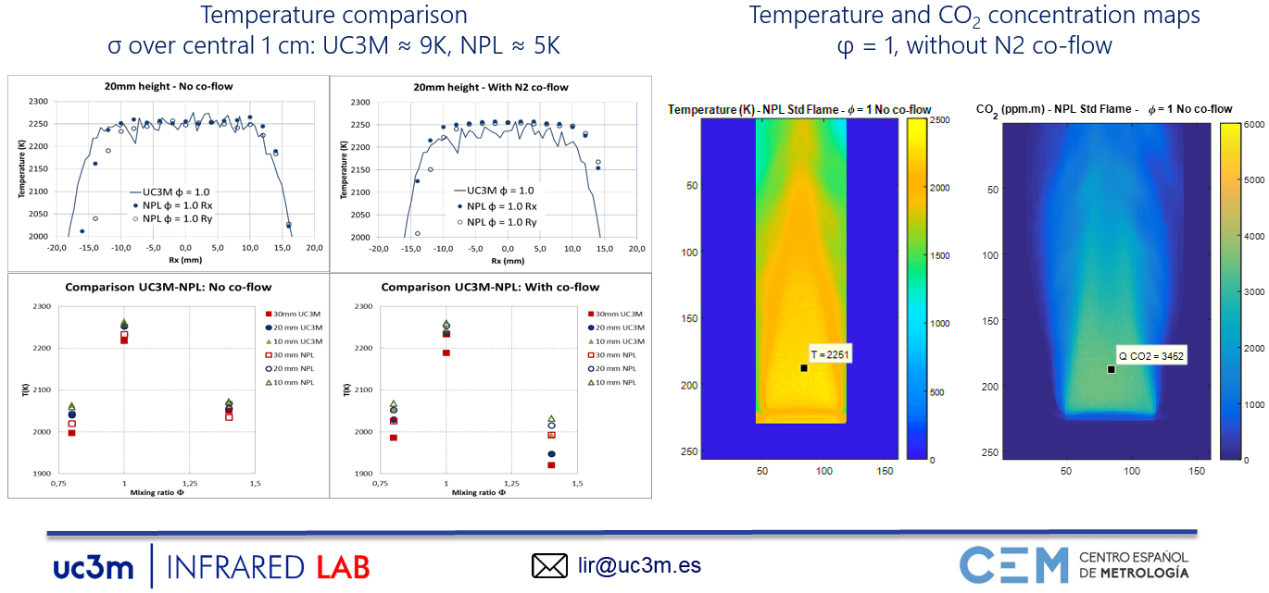
WP4: Traceable Combustion Temperature Measurement
UC3M/CEM: Hyper-spectral imaging (2)
2 %
2 %

Slide 13
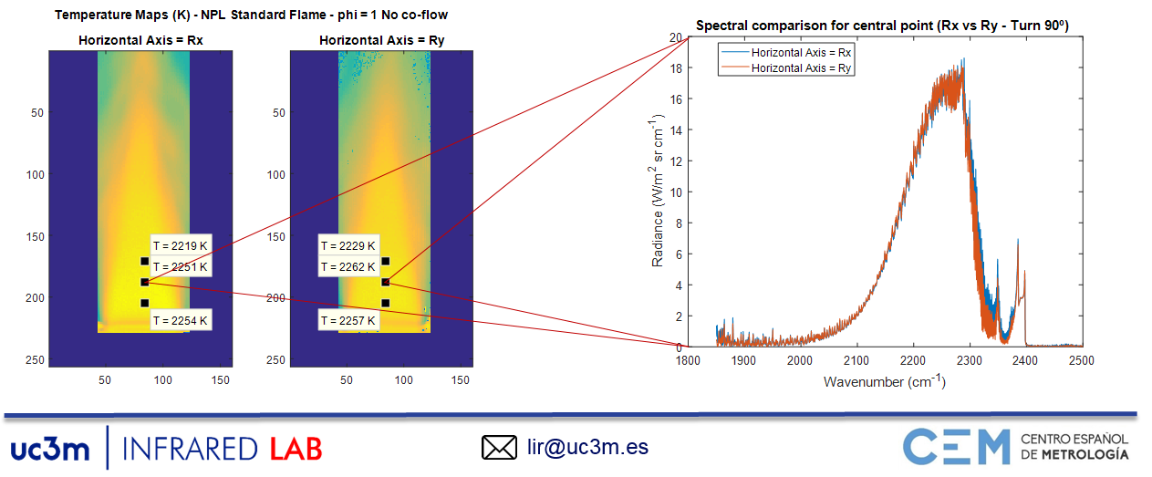
WP4: Traceable Combustion Temperature Measurement
UC3M/CEM: Hyper-spectral imaging (3)
Following final measurements, system returned to NPL and accurate post-calibration verified by NPL
Example measurements of standard flame turned 90º (change of horizontal axis):

Slide 14
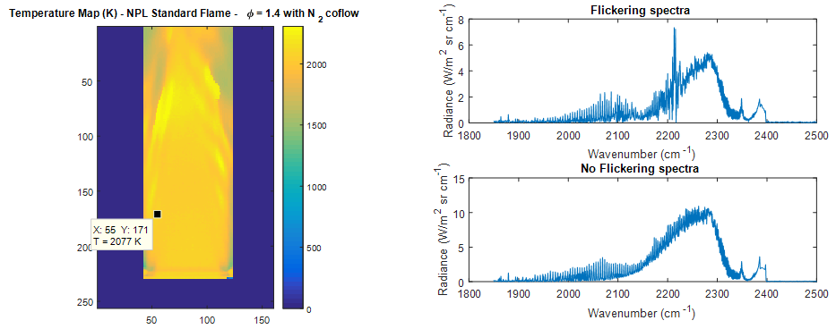
WP4: Traceable Combustion Temperature Measurement
UC3M/CEM: Hyper-spectral imaging (4)
Completion of analysis of measurements and conclusions
Avoid flickering effect on standard flame with φ = 1,4 (rich configuration)
Avoid N₂ co-flow – discrepancy between UC3M/NPL, source unknown
Measurement system and results will be presented in paper (lead by NPL)
Example data with flame flicker

Slide 15
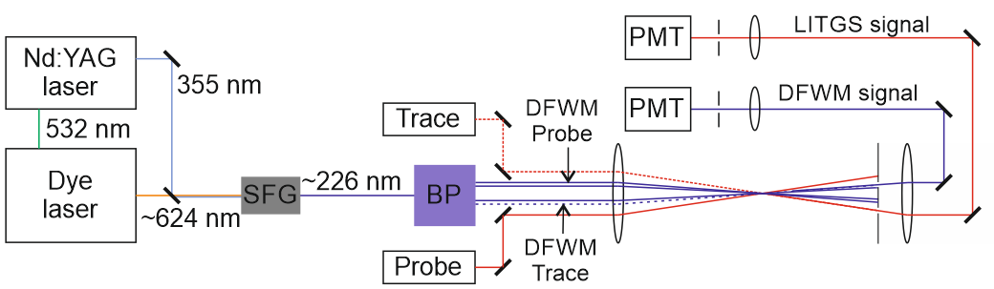
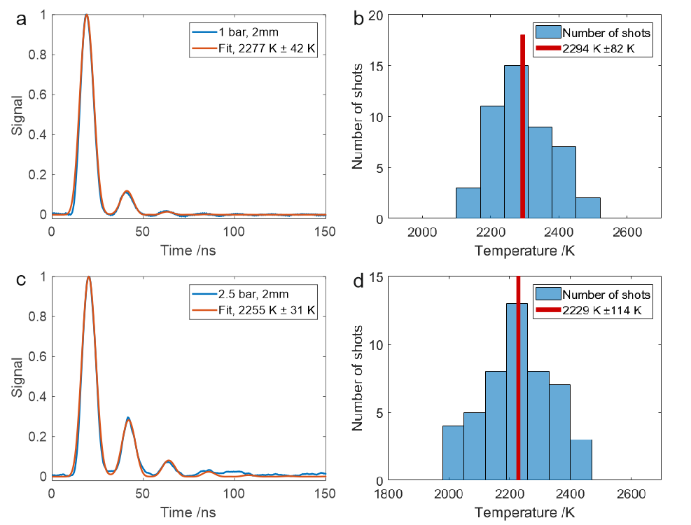
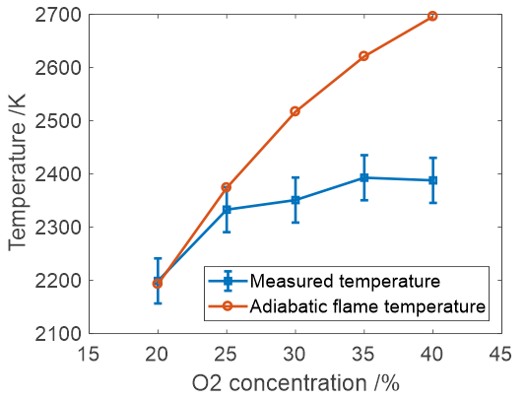
WP4: Traceable Combustion Temperature Measurement
UOX: Laser Induced Thermal Grating Scattering (LITGS) Thermometry in NO (1)
Experimental arrangement for LITGS
Burner
Preliminary measurements in methane/air slot burner: at λ = 226 nm
Temperatures at 2 cm HAB:
Measurements consistent with adiabatic flame temperature

Slide 16
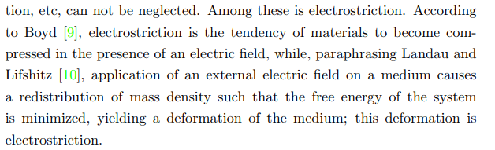
WP4: Traceable Combustion Temperature Measurement
UOX: Laser Induced Thermal Grating Scattering (LITGS) Thermometry in NO (2)
LITGS thermometry in NO: NPL Standard Burner
Stoichiometric propane/air flame,
adiabatic flame temperature ~2280 K
Derived temperature exceeds
adiabatic flame temperature!
Signal “distortion” by initial quenching process of LITGS at unknown rate.
Switch to Electrostrictive Grating
to avoid quenching effects.

Slide 17
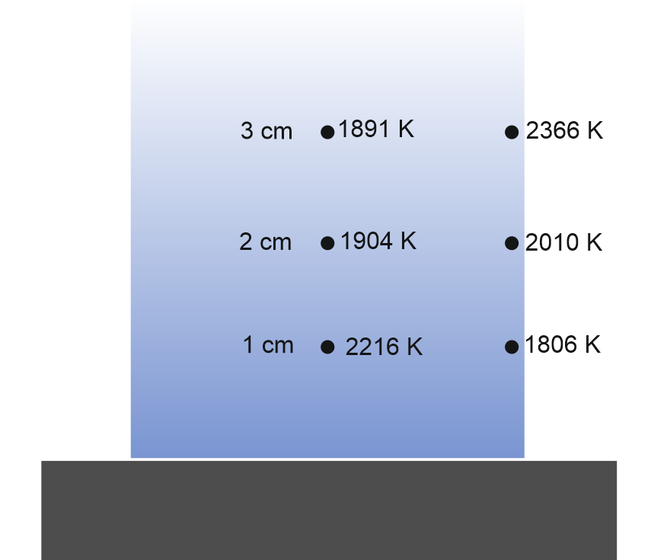
WP4: Traceable Combustion Temperature Measurement
UOX: Laser Induced Thermal Grating Scattering (LITGS) Thermometry in NO (3)
LIEGS signals (non-resonant)
Preliminary measurements in propane/air standard burner: at λ = 1064 nm
τ=17.39 ns, T=2216 K
Weak, short-lived signals:
Large errors probably due to thermal grating contribution from H₂O absorption?
High temperature, low pressure
environment is challenging for LIGS
Temperature vs position in flame

Slide 18
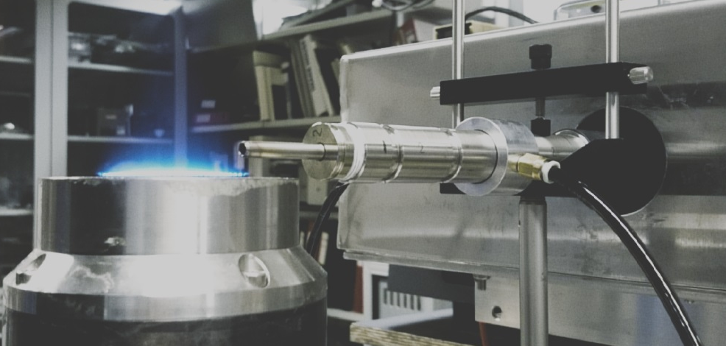

WP4: Traceable Combustion Temperature Measurement
DTU: Development of IR/UV spectroscopic flame thermometry systems (1)
IR measurements on NPL standard burner: set Up
STD flame installed at DTU
Optical set Up:
Gas radiation optical measurements with a FTIR spectrometer
Rx- single line-of-sight set up purged by N₂
Scanning in Rz and Ry directions
No CO₂ self-absorption: full CO₂(2340cm⁻¹) band coverage (+ CO + H₂O bands)
650-6000 cm⁻¹ spectral range with linearized high-sensitivity MCT
Fast FTIR scanning, moderate spectral resolution (1cm⁻¹ is enough, work with 4cm⁻¹ and 8cm⁻¹ as well)
Spectra calibrated with portable BB at 796.1 °C (BB calibrated at DTU)
Modelling
HITEMP2010 spectral database for CO₂/H₂O/CO modeling in 1500-2400 cm⁻¹
Major isotopologues, Lorentz line shapes for single lines, cut off at ±8 cm⁻¹ from line centers
RHT emission spectra forward calculations with NPL’s T_{gas} profiles
Emission spectra calculations at selected T_{gas} and CO₂ concentrations
Machine learning approach for T_{gas} profiles retrievals from single line-of-sight measurements tested
Measuring emission spectra of STD flame

Slide 19
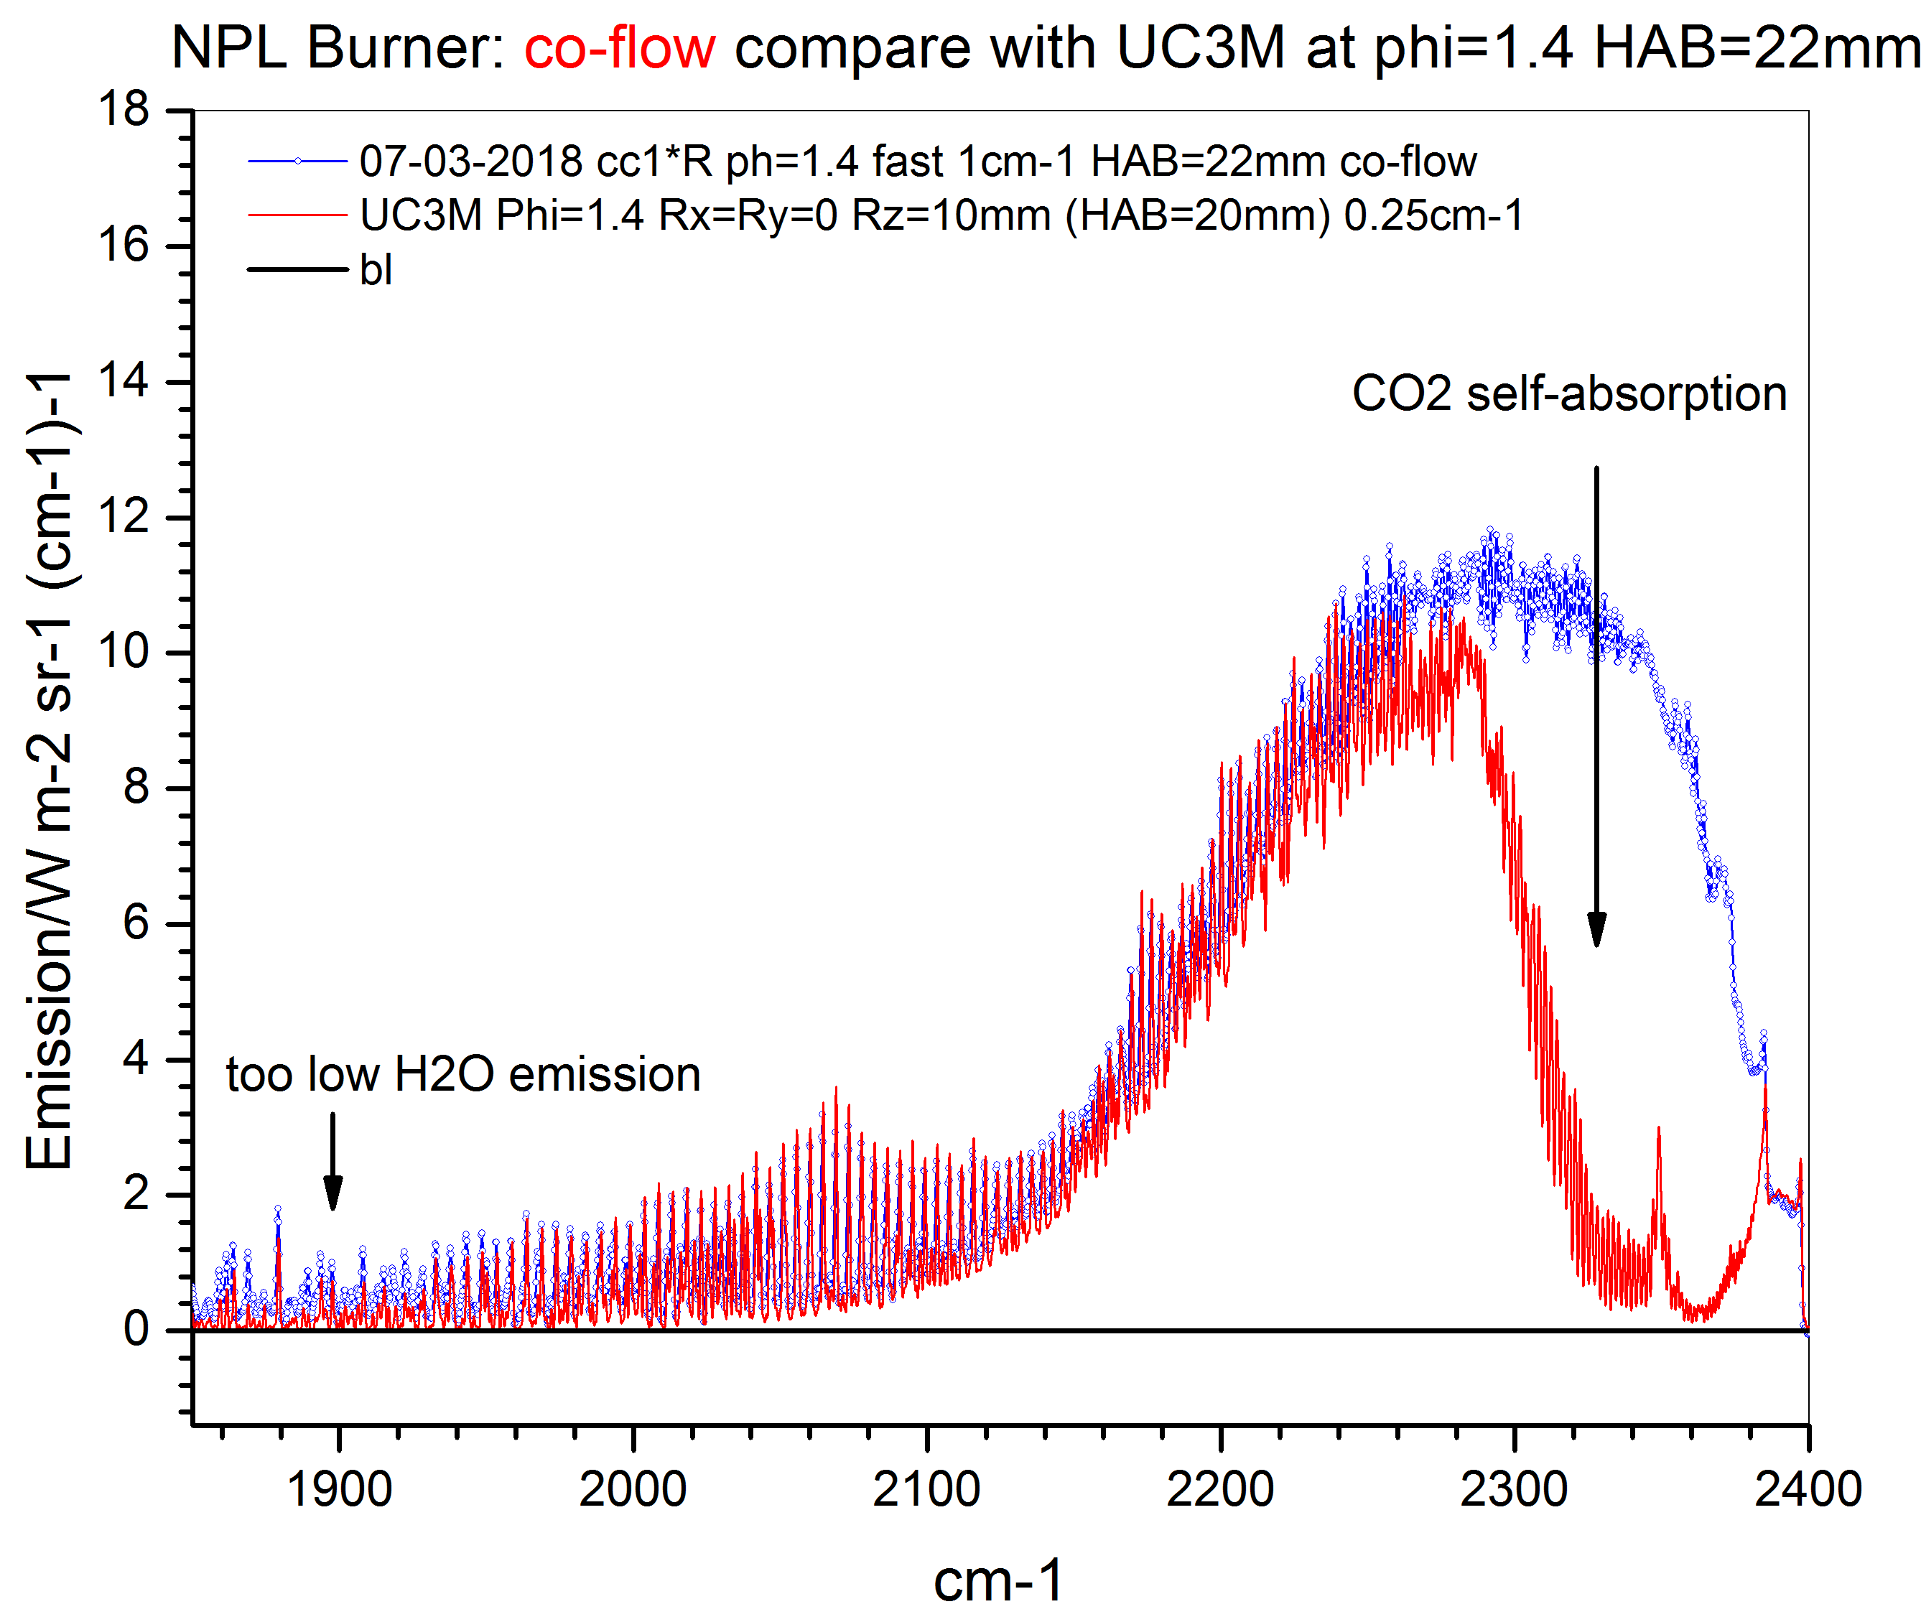
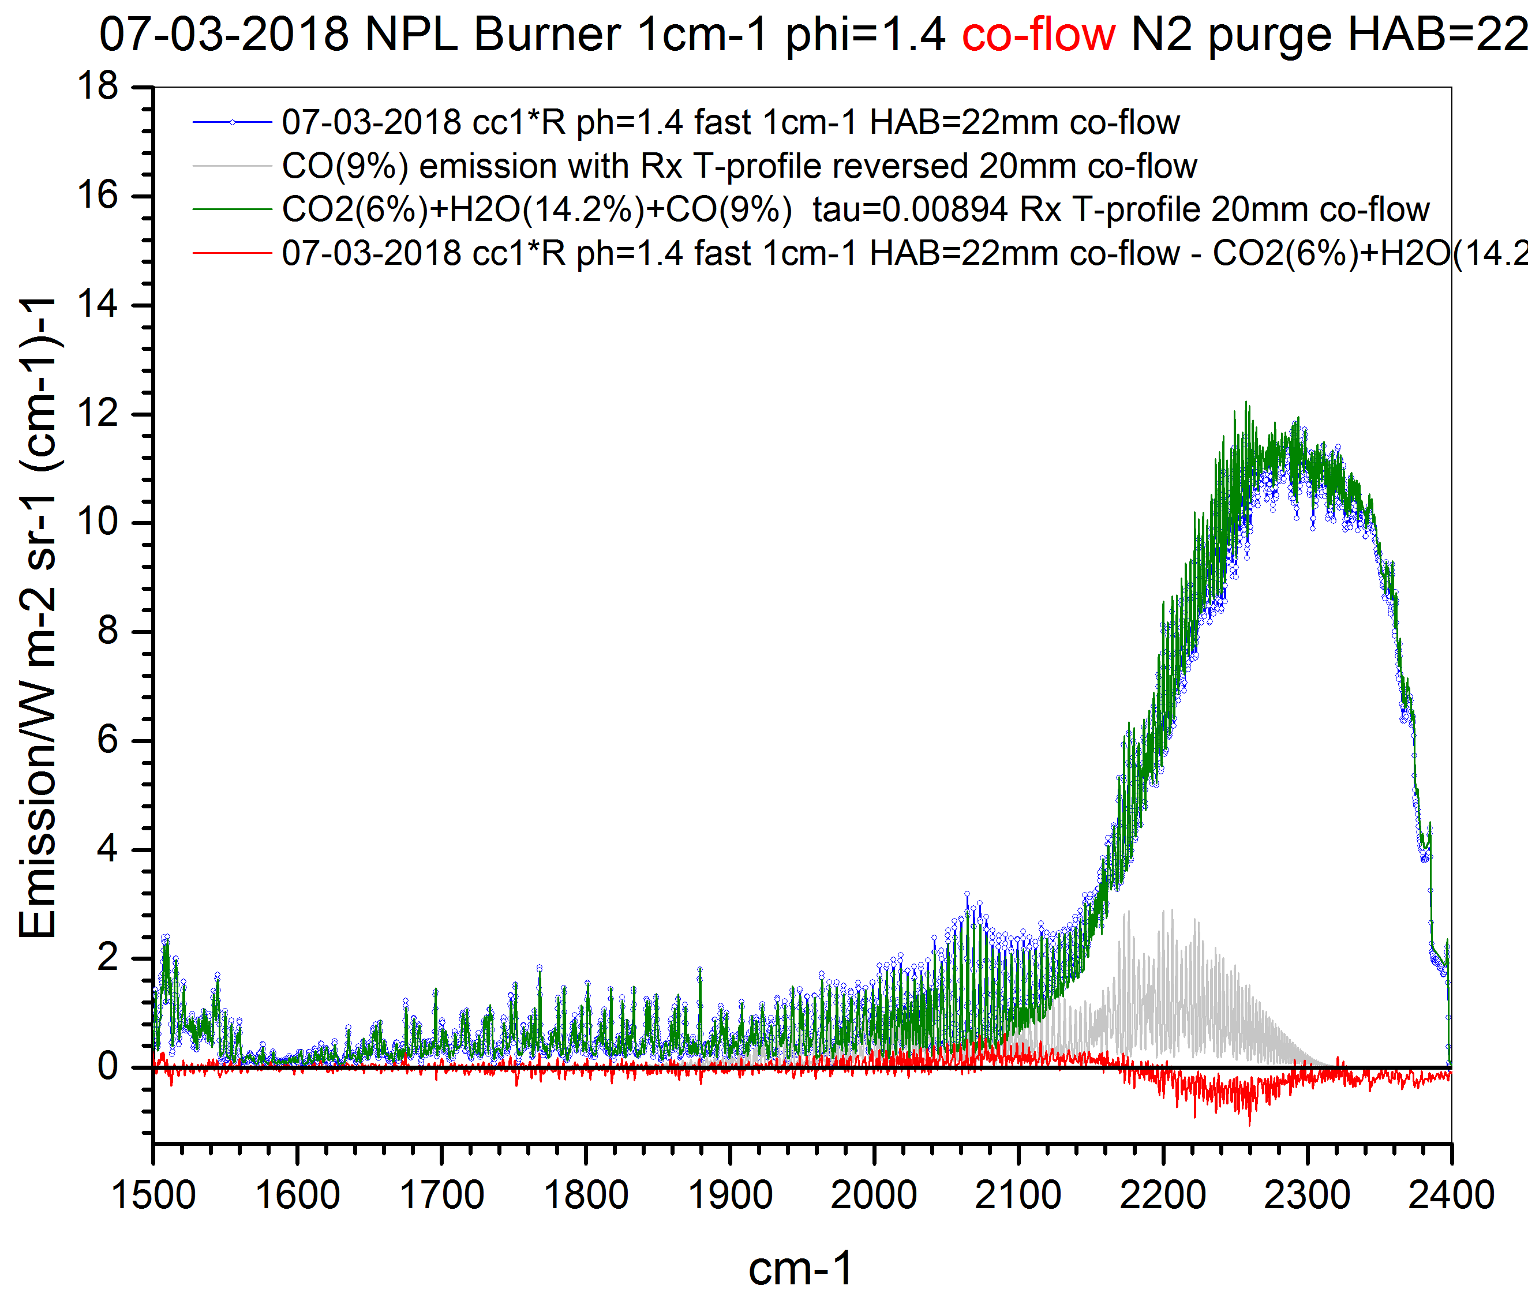
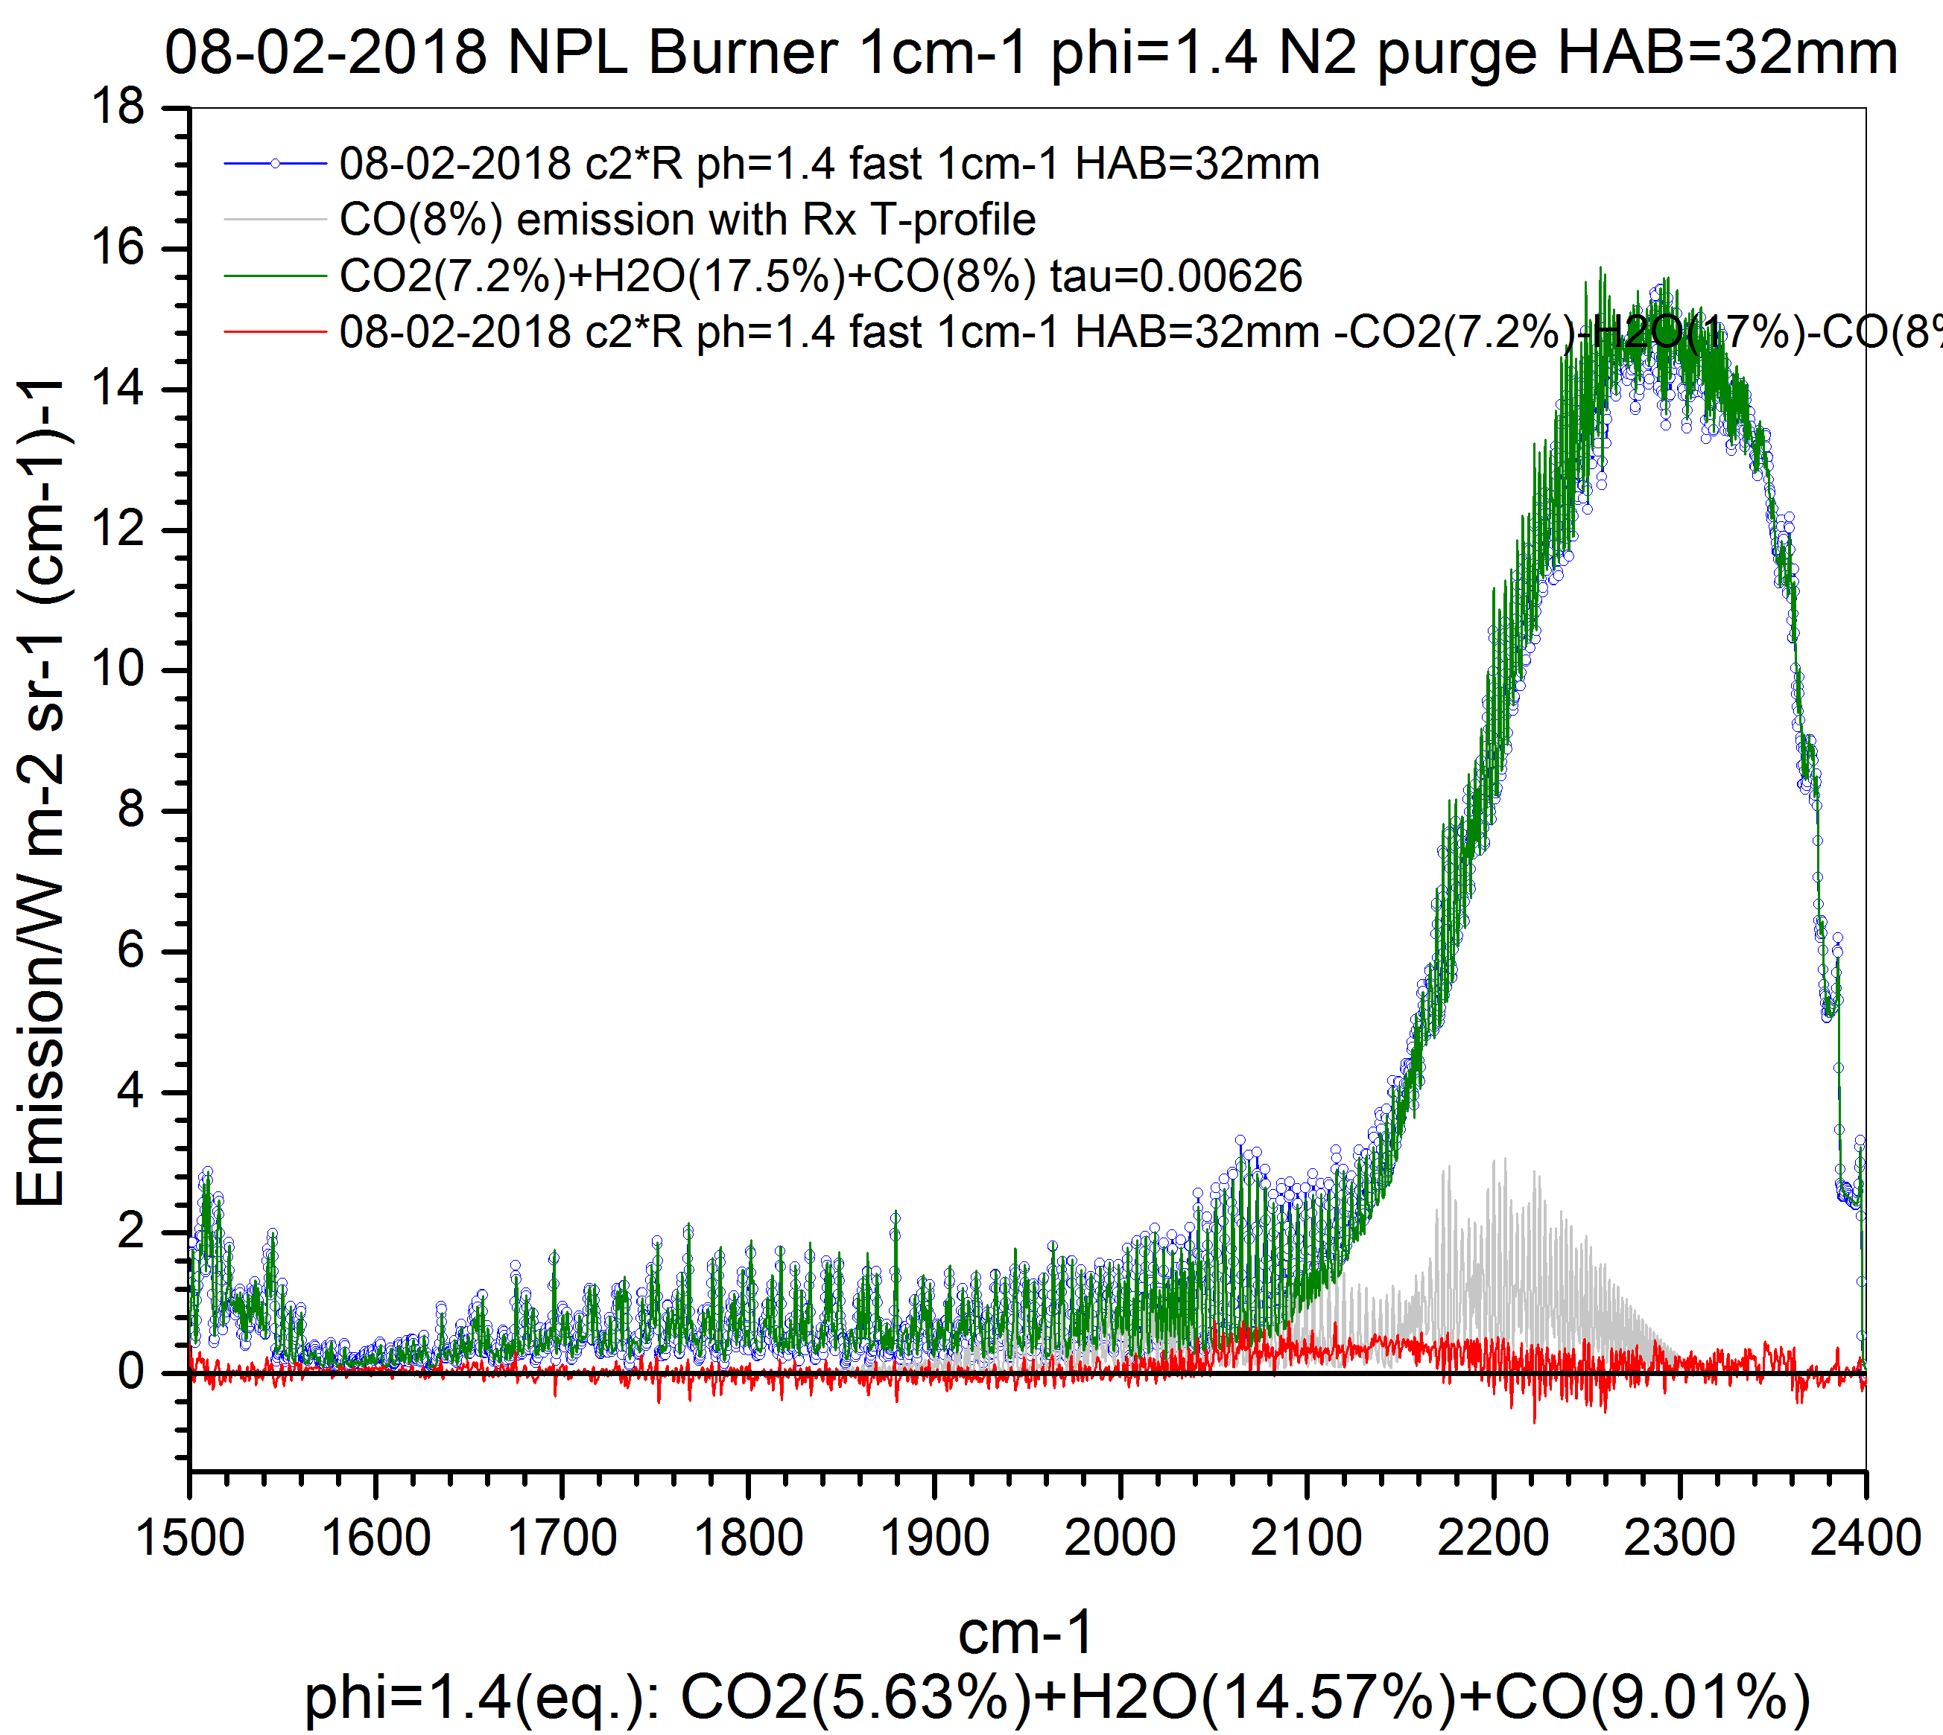
WP4: Traceable Combustion Temperature Measurement
DTU: Development of IR/UV spectroscopic flame thermometry systems (2)
IR measurements on NPL standard burner: N₂ co-flow issues
Most difficult case: phi=1.4 no/with N₂ co-flow at HAB=22mm and 32mm. Current data in blue.
N₂ co-flow: UC3M data (red) N₂ co-flow: fit with NPL’s T-profile (olive) No co-flow, fit with NPL’s T-profile fit (olive)
Blue – measured DTU
Red – measured UC3M
Blue – measured
Green – model, based on NPL T profile
Blue – measured
Green – model, based on NPL T profile
Excessive N₂ co-flow may cause cooling near edges of post-flame region
UC3M – N₂ co-flow may cause issue outside flame region
DTU – N₂ co-flow not an issue

Slide 20
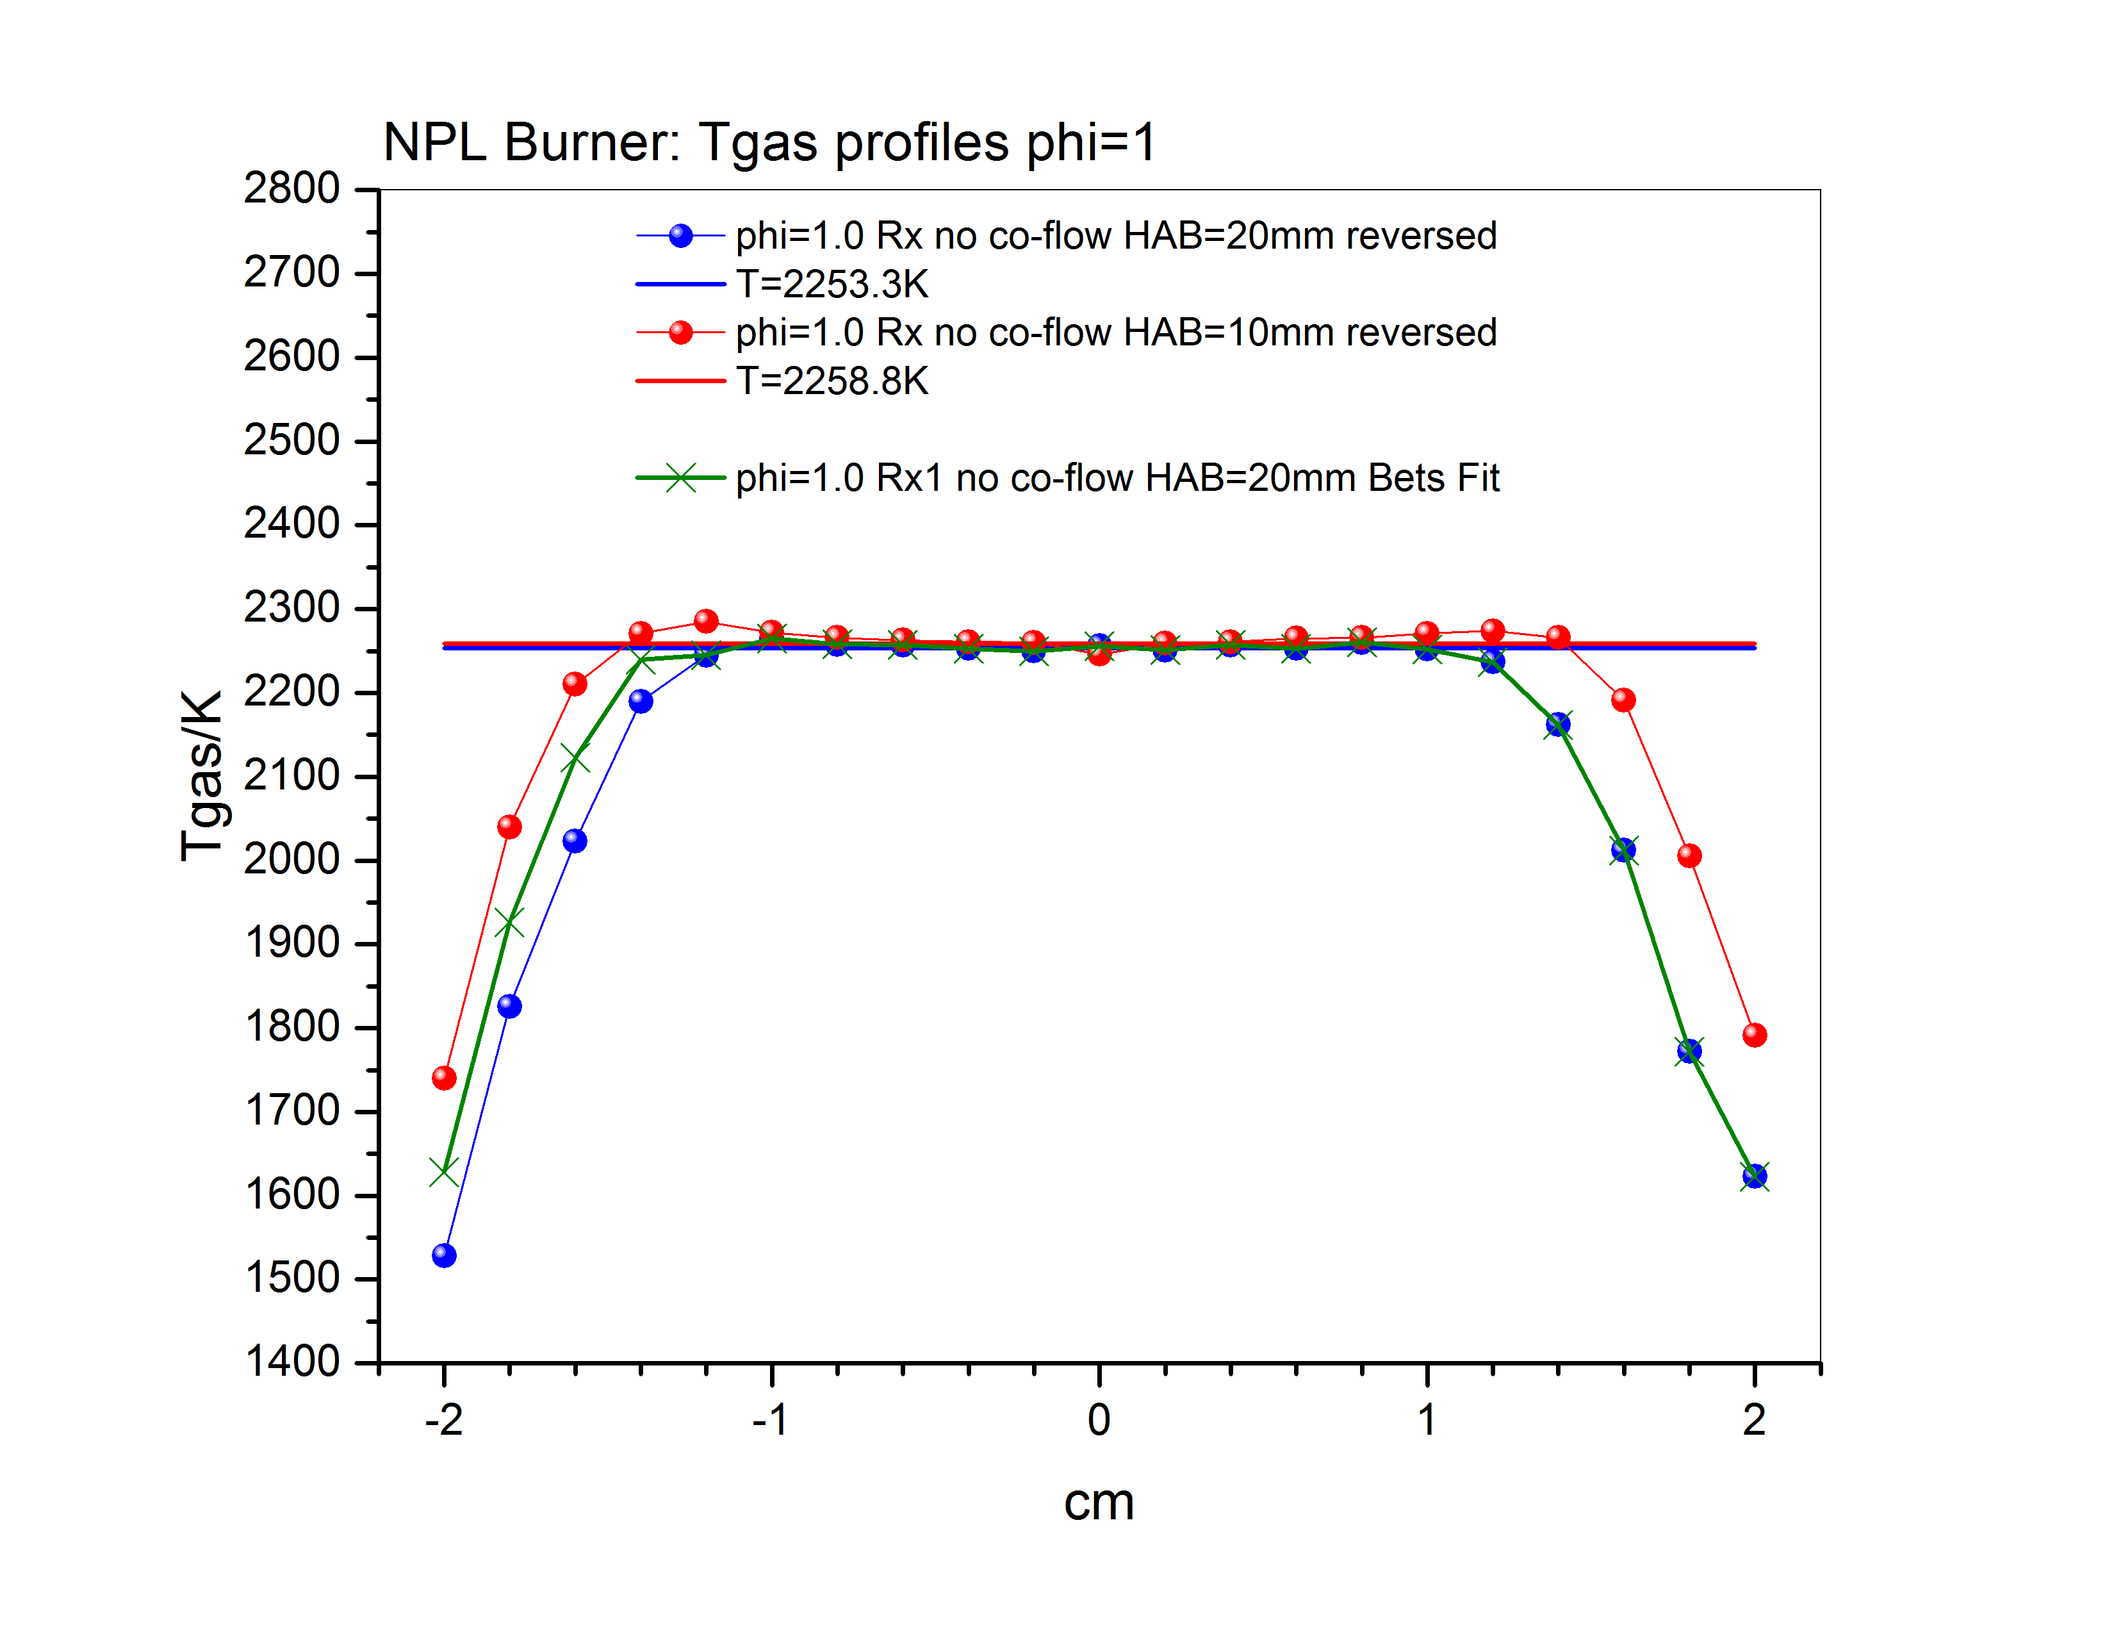
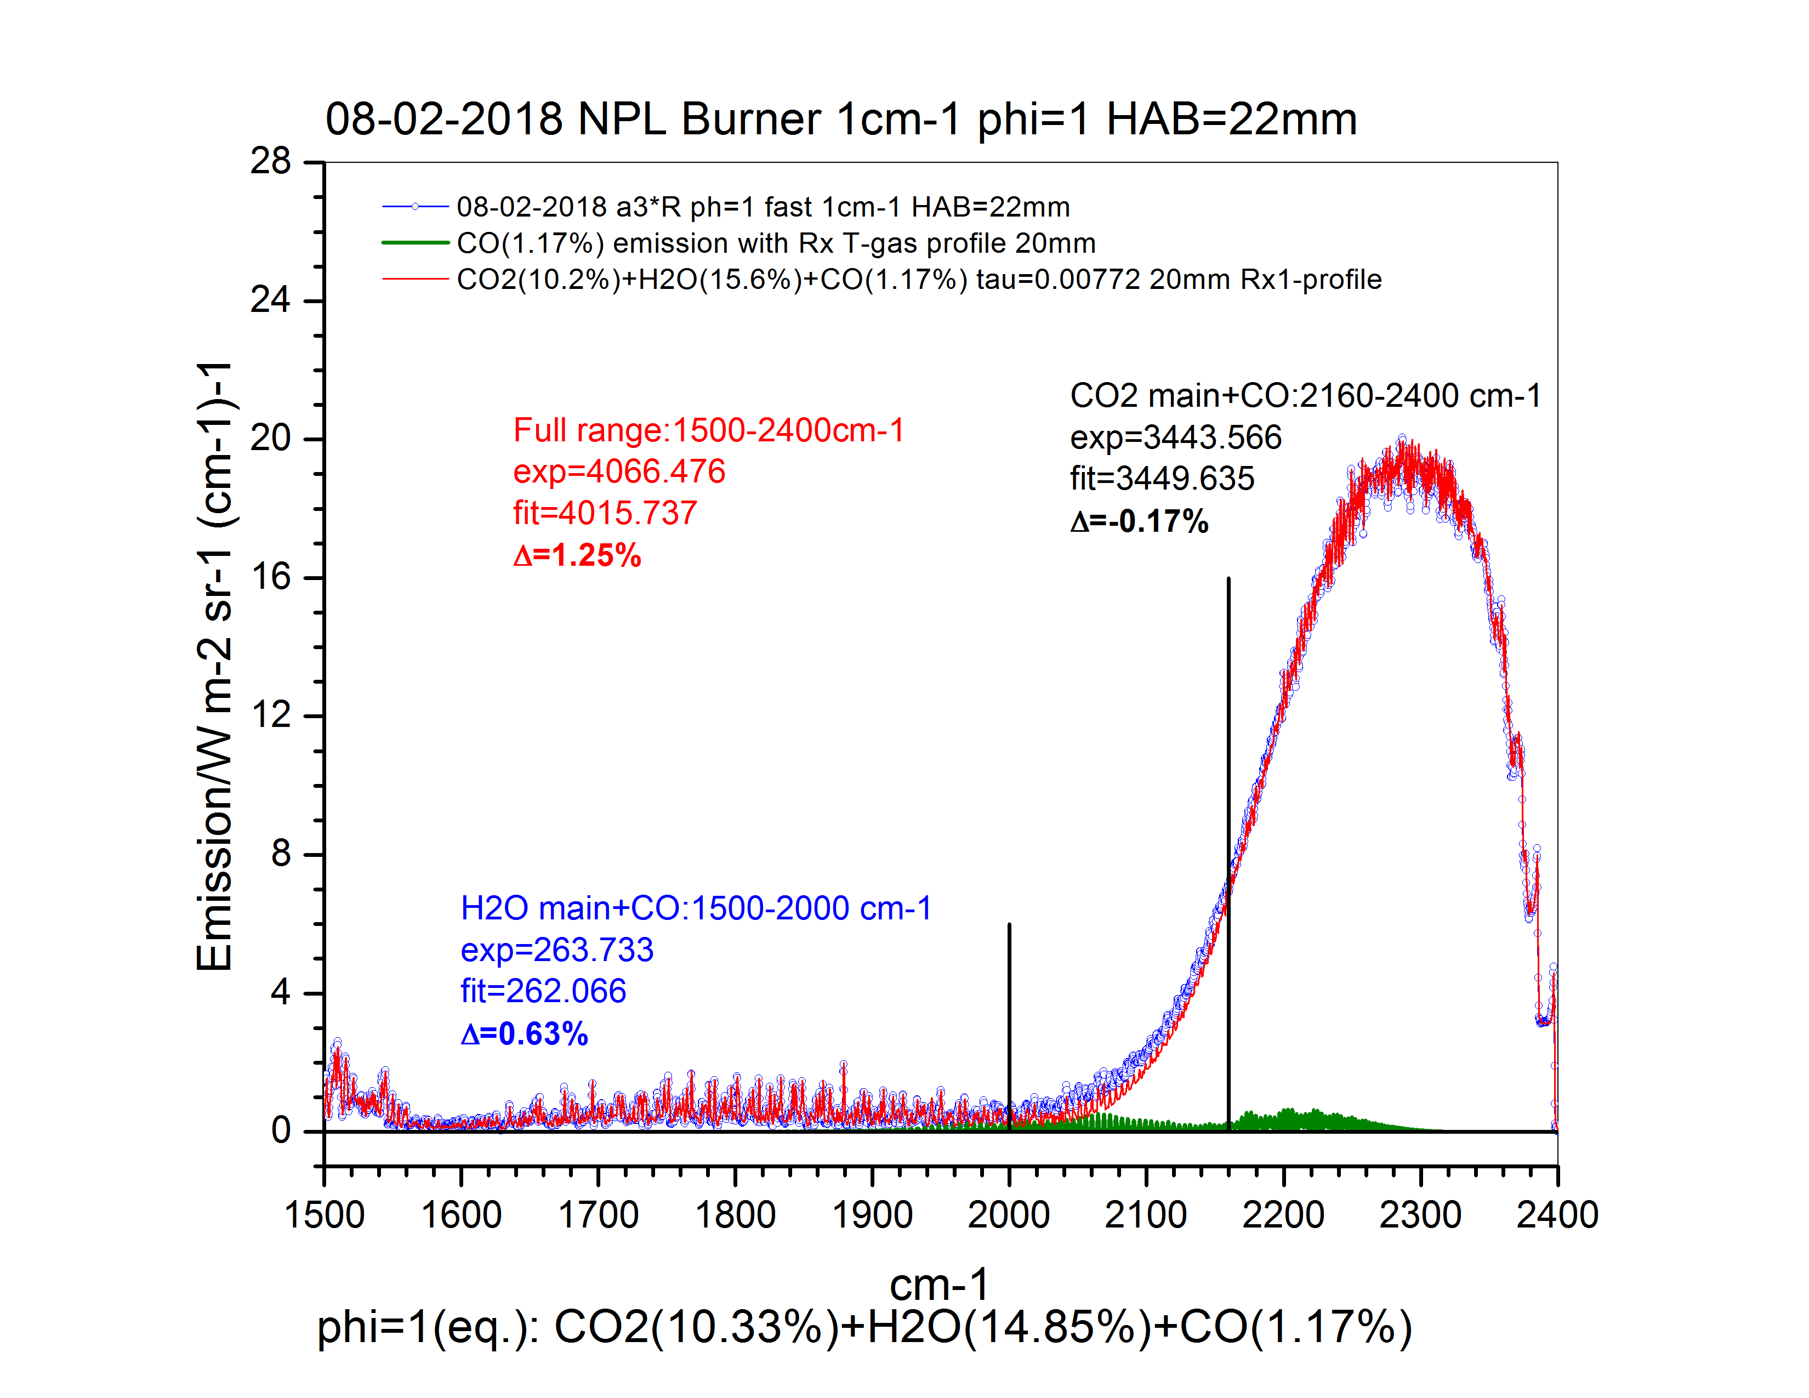
WP4: Traceable Combustion Temperature Measurement
DTU: Development of IR/UV spectroscopic flame thermometry systems (3)
IR measurements on NPL standard burner: HITEMP2010 database quality
HITEM2010 is very good for major part of CO₂(-0.17%), H₂O(0.63%) and CO bands (T≈2259K)
Very good agreement with NPL’s T-profile
No CO₂ self-absorption
Original (blue) and corrected (olive) T-profiles at phi=1 HAB=20mm; red: T-profile at HAB=10mm, phi=1
Experimental spectrum (blue) fitted with CO2(10.2%)+H2O(15.6%)+CO(1.17%) (red), phi=1, HAB=22mm
DTU – improve NPL T profile by minimising differences in spectra

Slide 21
WP4: Traceable Combustion Temperature Measurement
DTU: Development of IR/UV spectroscopic flame thermometry systems (4)
IR measurements on NPL standard burner
Key Results:
‘Clear’ flame emission spectra obtained at phi=0.8, 1 and 1.4 (no CO₂ self absorption)
Excellent agreement between measured and calculated spectra with NPL’s T-profile data at phi=1 and 1.4 at HAB=10mm and 30mm, no N2 co-flow
NPL’s T-profile at HAB=20mm (phi=1, no N2 co-flow) has been corrected at far-flame boundary (Rx > 12mm) to fit better the measured spectra
Excellent agreement between measured and calculated spectra with NPL’s T-profile data at phi=1.4 and HAB=30mm with N2 co-flow
Excellent agreement between retrieved and calculated (GASEQ) CO₂/H₂O/CO concentrations at phi=1, HAB=20mm assuming 40 mm absorption pathlength (with/without N₂ co-flow)
One spectrum fit [T_{gas}, CO₂ concentration] is not enough to fit an experimentally measured spectrum in entire CO₂ band - a full T-profile must be used
One fit [Tgas, CO₂ concentration] gives only T_{gas} in the center
In “colder” post-flames (e.g. at higher HAB and/or phi=1.4) error in fit becomes larger if a single [Tgas, CO₂ concentration] fit is used, i.e. emission from gas boundaries give more contribution to the total spectrum
Quality of the HITEMP2010 spectral database is very good for CO₂/H₂O/CO modeling in various spectral ranges
Machine learning approach for T-profile retrieval from single line-of-sight-measurements looks very promising, this will probably be used in coming EMPRESS2 project (collaboration with UC Merced, USA)

Slide 22
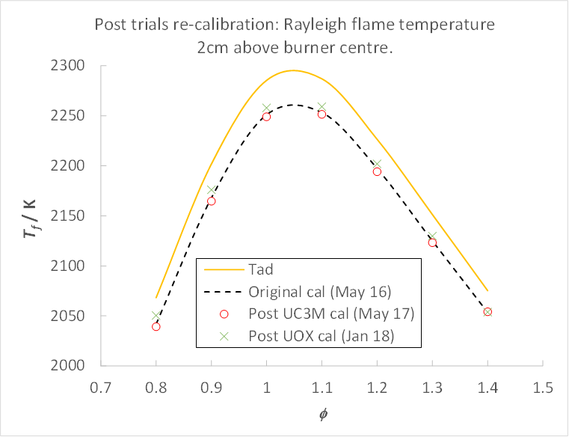
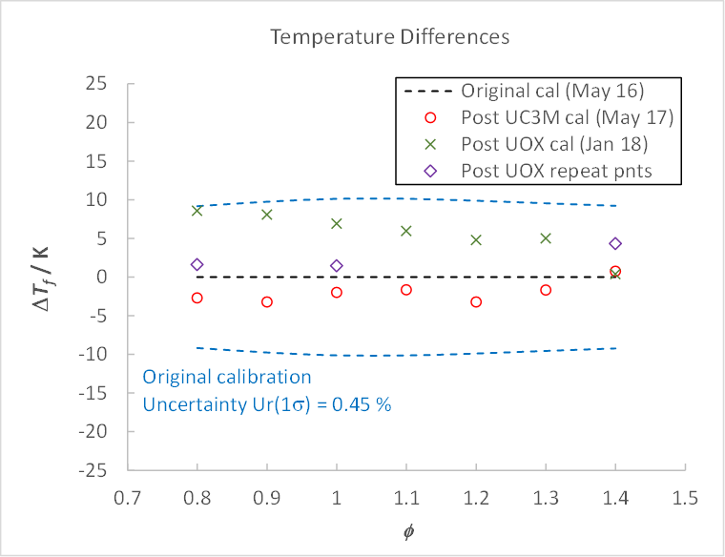
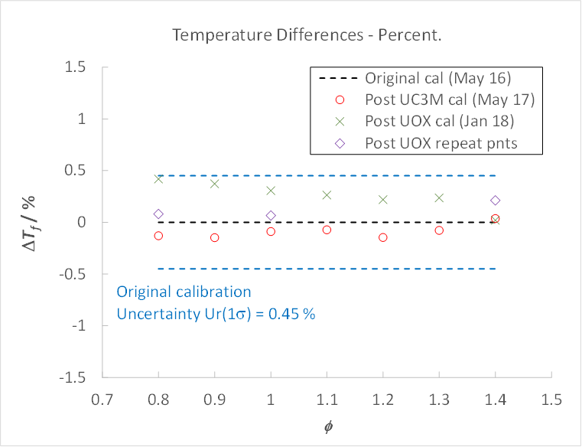
WP4: Traceable Combustion Temperature Measurement
NPL: STD flame calibration following Trials at UC3M and UOX
No evidence of drift in the STD flame system
Final re-calibration required following return of system from DTU

Slide 23
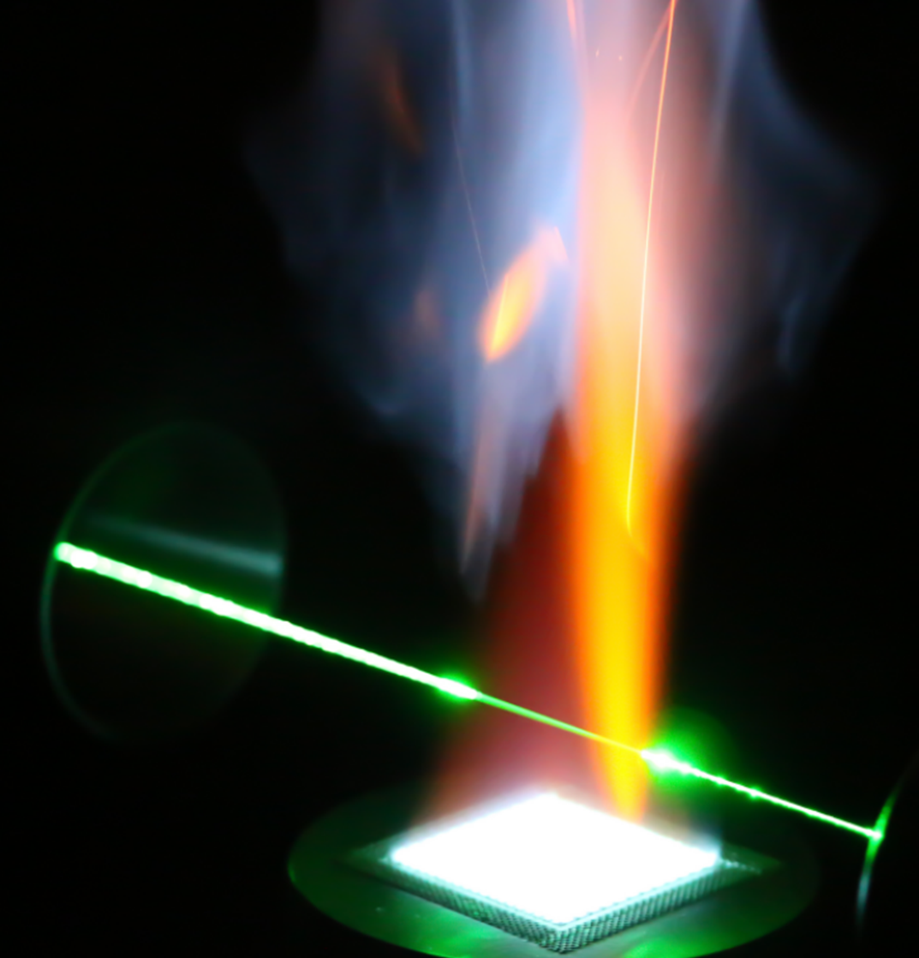
WP4: Traceable Combustion Temperature Measurement
Summary and outlook
  NPL:
  Portable STD flame developed
  Traceable Laser Rayleigh scattering thermometry system commissioned
  STD flame fully characterised – U_{r} (T) ≈ 0.5 %
  Peer review paper to be submitted: Evidence of 10 fold reduction in uncertainty
  UC3M:
  Demonstration of Hyperspectral imager in STD flame
  Good agreement with STD flame, low uncertainties achieved
  2D temperature and species profiles are possible
  Continue development in EMPRESS 2 → industrial instrument
  DTU
  Measurement of IR emission spectra on STD flame
  Excellent agreement with NPL STD flame, low uncertainties achieved
  Validation of HITRAN 2010 database (CO₂, H₂O, CO)
  Improvement of STD flame T profile measurements
  Continue development in EMPRESS 2 → industrial instrument
  UOX:
  LIGS demonstrated with flame generated NO (T ≈ 2300 K)
  Measurements on NPL STD flame were challenging
  Further development is needed for atmospheric pressure flames

Slide 24
Thank you!
This project has received funding from the EMPIR programme co-financed by the Participating States and from the European Union’s Horizon 2020 research and innovation programme.

