Slide 1
The re-definition of the kelvin
Why you should care, but not worry
Michael de Podesta
EMPRESS Workshop
18 April 2018
Notes:
NPL is highlighted on this slide to remind me to mention it upfront & always.

Slide 2
The re-definition of the kelvin
Measurement and the SI
The redefinition of the SI
The redefinition of the kelvin
Why has this taken so long!
Consequences
Why this matters
Notes:
2

Slide 3
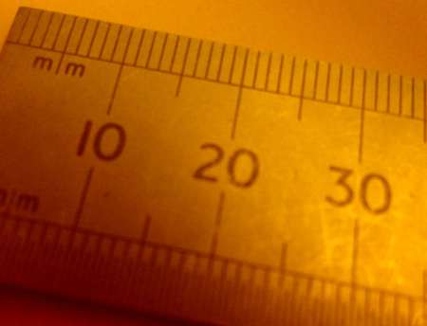
It is measurement that makes science scientific. Not Maths.
Notes:
3

Slide 4
Measurement is…
Quantitative Comparison
Unknown
…of an unknown quantity
with a standard quantity
Standard
Notes:
4
Frequently the standards are not available.
The aim of metrology is to enables accurate comparisons even when the standards are not immediately available.
The standards of the International System of units (The SI) are in practice, humanity’s choice of measurement standards.
The multiple steps could be calibrations steps for a voltmeter.
For a radiation dose measurement some of the comparisons could be with ionization chambers and some with calorimeters.

Slide 5
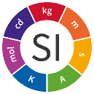
Measurement is…
Quantitative Comparison
Unknown
Standard
Grade #3 Copy
Grade #2 Copy
Grade #1 Copy
Even More
Time
&
Distance
More
Time
&
Distance
Time
&
Distance
Notes:
5
The key point here is that the perfection of a standard quantity represents a limit to how well anything can be measured.
SI represents that limit

Slide 6
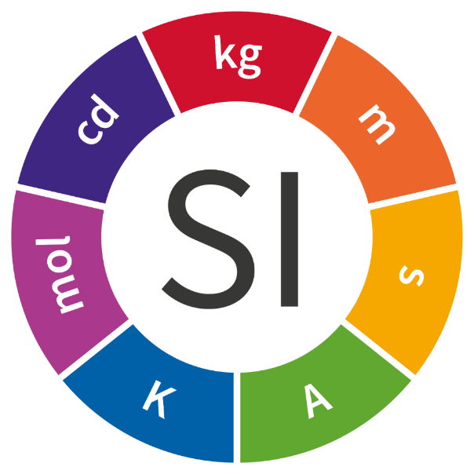
The International System of Units
kilogram
candela
metre
mole
second
kelvin
ampere
Notes:
A nice big picture of the SI roundel

Slide 7
The re-definition of the kelvin
Measurement and the SI
The redefinition of the SI
The redefinition of the kelvin
Why has this taken so long!
Consequences
Why this matters
Notes:
7

Slide 8
Measurement is…
Quantitative Comparison
Unknown
…of an unknown quantity
with a standard quantity
Standard
Could we choose our
standards more wisely?
Notes:
8
This is the question behind the re-definition

Slide 9
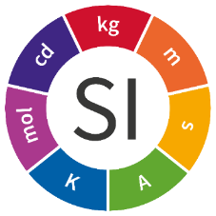
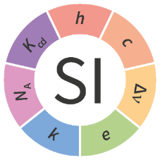
SI Base Units and Natural Constants
Unit Definitions
in terms of
Unit Definitions
Natural Constants
measure
realise
Notes:
9
Using the human based standards of the SI, we have measured natural features of the universe that appear to be constant: Natural Constants
Note: The phrase ‘natural constants’ has been carefully chosen. Avoid the use of ‘fundamental’ constants – they are not all fundamental.
Natural Constants appear to be more stable than ANYTHING human made – more later – they appear to be at least one million times more stable than the most stable human artefact – the kilogram.
The idea of the unit re-definitions is to base our system of units on these natural constants.

Slide 10
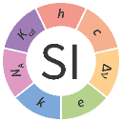
Measurement is…
Quantitative Comparison
Unknown
Realisation
Grade #3 Copy
Grade #2 Copy
Grade #1 Copy
Standard
Even More
Time
&
Distance
More
Time
&
Distance
Time
&
Distance
Definition
Notes:
10
This harks back to the earlier diagram showing how the constants are ‘abstracted’ and should never change.

Slide 11
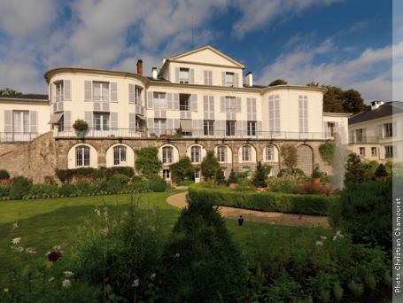



SI. The International System of Units
Administered from BIPM
  International Bureau of Weights & Measures
Run by the CIPM
International Committee for Weights & Measures
Agenda set by the CGPM
General Conference on Weights & Measures
Resolution 1: CGPM 2014
…Encourages continued efforts to determine h, e, k, and N_{A} with the requisite uncertainties,
DRAFT Resolution A: CGPM 2018
Should decide to make the change from 20th May 2019
Resolution 12: CGPM 2007
Recommends laboratories pursue the relevant experiments so that the International Committee can come to a view on whether it may be possible to redefine the kilogram, the ampere, the kelvin, and the mole
Start
Measure
Measure
Measure
Measure
Measure
Measure
Measure
Measure
Measure
STOP!
2007
2008
2009
2010
2011
2012
2013
2014
2015
2016
2017
2018
2019
Notes:
11
CGPM 13th November to 16th November 2018

Slide 12
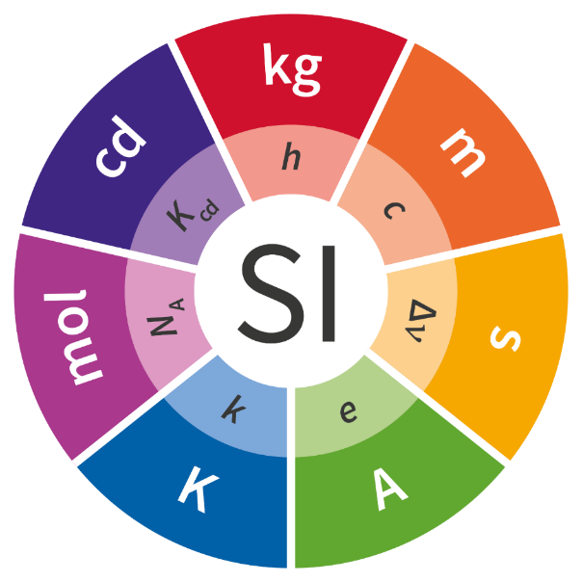
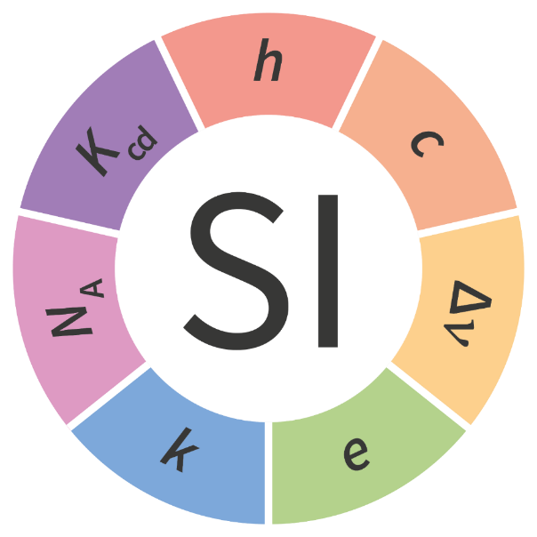

The New International System of Units
Notes:
Graphical illustration of the way the constants are represented along with the units in the logo.

Slide 13
The re-definition of the kelvin
Measurement and the SI
The redefinition of the SI
The redefinition of the kelvin
Why has this taken so long!
Consequences
Why this matters
Notes:
13

Slide 14
In the SI one kelvin is…
…the fraction ​¹⁄_{273.16} of the thermodynamic temperature of the triple point of water
In other words, it is defined such that the triple point of water is exactly 273.16 K exactly. i.e. 273.160 000 000 ….

Slide 15

A triple point of water ‘cell’
Glass vessel
273.16 K
1. Fill with ‘water’
2. Remove the air
3. Seal
4. Water Vapour fills the space
5. Chill the middle
6. Leave to equilibrate
Liquid Water
Water Vapour
Solid Water
All co-exist
in equilibrium

Slide 16
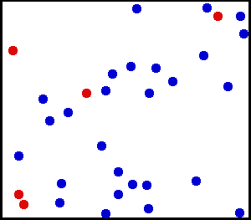
The definition of the kelvin…
…makes no reference to energy…
…yet we know that temperature is a measure of the average molecular energy

Slide 17



Thermal Physics
Exact
$$kB$$
$$±Δ$$
Triple Point of Water
Molecular
Motion
Boltzmann
Constant
(joules per kelvin)

Slide 18
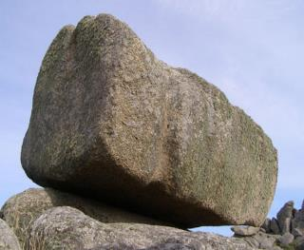
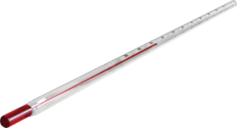

Thermal Physics
Molecular
Motion
Rock
Thermometer
How do we relate the number produced by a thermometer (e.g. 20 °C) to the basic physics describing the jiggling of molecules?

Slide 19

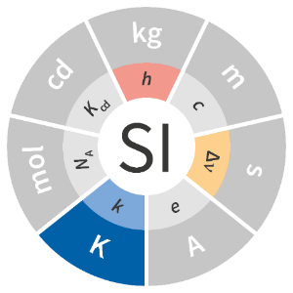
Re-defining the kelvin
Unit Definition:
kelvin
‘Energy per degree’,
Boltzmann constant, k_{B}
Unit Definition
in terms of the
realise
measure
Notes:
19

Slide 20
The re-definition of the kelvin
Measurement and the SI
The redefinition of the SI
The redefinition of the kelvin
Why has this taken so long!
Consequences
Why this matters
Notes:
20

Slide 21
Thermal pioneers
Anders Celsius (1710) and Daniel Gabriel Fahrenheit (1724)
  Allowed people to investigate the world
  Thermometers were useful
Jean-Baptiste Joseph Fourier (1807 - 1820)
  Breathtaking mathematical progress
  Distinction between thermal and mechanical quantities
No consensus on what thermometers measured!
Henri Victor Regnault (1840s)
  Established the superiority of the ‘air thermometer’ (CVGT)
John James Waterston (1845)
  Theory of Free and Perfectly Elastic Molecules in a State of Motion
John Tyndall (1865)
  Wrote the textbook: “Heat: a mode of motion”
James Clerk Maxwell (1859-1866)
Ludwig Boltzmann (1866)
Josiah Willard Gibbs(1901)
  The kinetic theory of gases
John Baptiste Perrin (1926)
  Nobel prize for finally demonstrating the existence of atoms

Slide 22
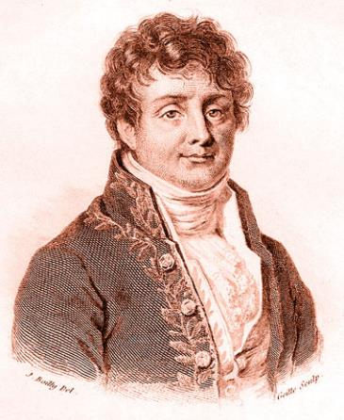
Jean Baptiste Joseph Fourier
Analytical Theory of Heat
Newton comprised the system of the universe. It is recognised that the same principles regulate all the movements of the stars, their form, the inequalities of their courses, the equilibrium and oscillations of the seas, the harmonic vibrations of the air and sonorous bodies, the transmission of light, capillary actions, the undulations of fluids…
But whatever may be the range of mechanical theories, they do not apply to the effects of heat. These make up a special order of phenomena which cannot be explained by the principles of motion and equilibrium.
Preliminary
Discourse
Notes:
By Original uploader was User:Bunzil at en.wikipedia - Originally from en.wikipedia; description page is/was here., Public Domain, https://commons.wikimedia.org/w/index.php?curid=3308441

Slide 23
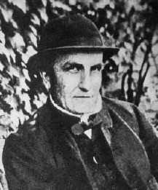
John James Waterston (1845)
On the Physics of Media that are Composed of Free and Perfectly Elastic Molecules in a State of Motion

Slide 24
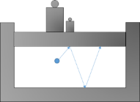
…we must imagine a vast multitude of small particles of matter, perfectly alike in every respect
“The paper is nothing but nonsense”
Referee 1845
…The quality of perfect elasticity being common to all the particles, the original amount of vis viva …of the whole multitude must forever remain the same… as unchanged as the matter that is associated with it.
The medium must in this way become endowed with a permanent state of elastic energy, or disposition to expand, uniformly sustained in every part and communicating to it the physical character of an elastic fluid.
“The omission to publish it at the time was a misfortune which probably retarded the subject by 10 to 15 years.”
Commentary by Lord Rayleigh in 1896
Pages 6 & 7

Slide 25
John Tyndall
HEAT: a Mode of Motion 1865
In the following Lectures I have endeavoured to bring the rudiments of a new philosophy within the reach of a person of ordinary intelligence and culture.
The first seven Lectures of the course deal with thermometric heat; its generation and consumption in mechanical processes; the determination of the mechanical equivalent of heat; the conception of heat as molecular motion; the application of this conception to solid, liquid and gaseous forms of matter; to expansion and combustion; to specific and latent heat and to calorific conduction..
Notes:
By Original uploader was User:Bunzil at en.wikipedia - Originally from en.wikipedia; description page is/was here., Public Domain, https://commons.wikimedia.org/w/index.php?curid=3308441

Slide 26
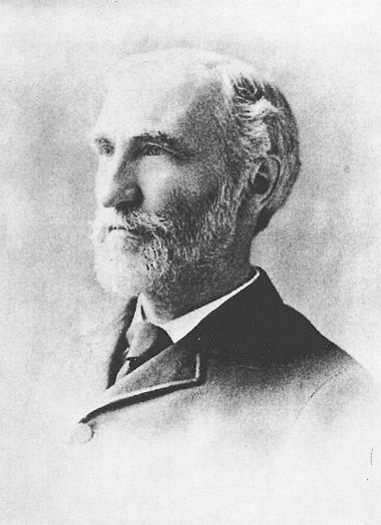
Josiah Willard Gibbs
Elementary Principles in Statistical Mechanics 1901
In the present state of science, it hardly seems possible to frame a dynamic theory of molecular action…
Even if we confine our attention to the phenomena distinctively thermodynamic, we do not escape difficulties in as simple a matter as the number of degrees of freedom of a diatomic gas. It is well known that while theory would assign to the gas six degrees of freedom per molecule, in our experiments on specific heat we cannot account for more than five. Certainly, one is building on an insecure foundation who rests his work on hypotheses concerning the constitution of matter.
Notes:
By Original uploader was User:Bunzil at en.wikipedia - Originally from en.wikipedia; description page is/was here., Public Domain, https://commons.wikimedia.org/w/index.php?curid=3308441

Slide 27
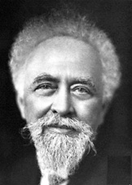
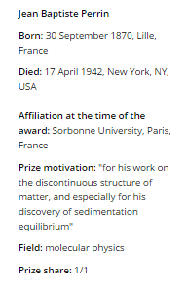
Jean Baptiste Perrin
Nobel Prize for Physics 1926
“for his work on the discontinuous structure of matter, and especially for his discovery of sedimentation equilibrium”.
The discovery of such relationships marks the point where the underlying reality of molecules becomes a part of our scientific consciousness.
Notes:
By Original uploader was User:Bunzil at en.wikipedia - Originally from en.wikipedia; description page is/was here., Public Domain, https://commons.wikimedia.org/w/index.php?curid=3308441
http://www.britannica.com/biography/Jean-Perrin

Slide 28
Now our ideas are clearer…
And we have progressed experimentally…
Notes:
28
The definition of the kelvin in the new SI: its rationale, implementation and implications

Slide 29
We have (slowly) got better at measuring k_{B}
Relative uncertainty in the Boltzmann constant
Relative reproducibility of practical temperature scales at ~ 100 °C
From White and Fischer: Metrologia 52 (2015) S213-S216
Notes:
29
The definition of the kelvin in the new SI: its rationale, implementation and implications

Slide 30
Why has this taken so long?
Temperature measurement became important for science and engineering before we understood what we were measuring!

Slide 31
The re-definition of the kelvin
Measurement and the SI
The redefinition of the SI
The redefinition of the kelvin
Why has this taken so long!
Consequences
Why this matters
Notes:
31

Slide 32
Consequences
For anyone who use the International Temperature Scale of 1990.
There are no consequences arising from the redefinition.
The redefinition of the kelvin is not intended to solve an existing problem.
The intention is to ‘lay foundations’ for possible future improvements.
Notes:
32
CGPM 13th November to 16th November 2018

Slide 33
Thermal Physics
Exact
$$kB$$
$$±Δ$$
Triple Point of Water
Molecular
Motion
Boltzmann
Constant
(joules per kelvin)

Slide 34

Possible future improvements
A measurement at 1500 °C
Now: Every temperature measurement is a comparison against the temperature of the triple point of water.
In the future: Every temperature measurement is a comparison of molecular energies with the Boltzmann constant.
Pyrometer Measurement
Compares brightness at unknown temperature with brightness at (say) freezing temperature of silver
Pyrometer Measurement
Compares brightness at unknown temperature with the Planck formula
$$kB$$
Freezing temperature of silver estimated using constant volume gas thermometry or Johnson noise thermometry in terms of the triple point of water.
Notes:
34
CGPM 13th November to 16th November 2018

Slide 35
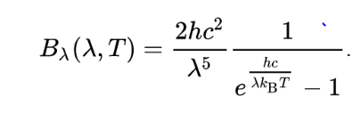

Possible future improvements
A measurement at 1500 °C
Now: Every temperature measurement is a comparison against the temperature of the triple point of water.
In the future: Every temperature measurement is a comparison of molecular energies with the Boltzmann constant.
Pyrometer Measurement
Compares brightness at unknown temperature with brightness at (say) freezing temperature of silver
Pyrometer Measurement
Measure absolute radiant intensity of source (Planck formula)
Freezing temperature of silver is estimated using constant volume gas thermometry or Johnson noise thermometry in terms of the triple point of water.
$$kB$$
Johnson Noise Measurement
Measure absolute value of electrical noise
Notes:
35
CGPM 13th November to 16th November 2018

Slide 36
The re-definition of the kelvin
Measurement and the SI
The redefinition of the SI
The redefinition of the kelvin
Why has this taken so long!
Consequences
Why this matters
Notes:
36

Slide 37

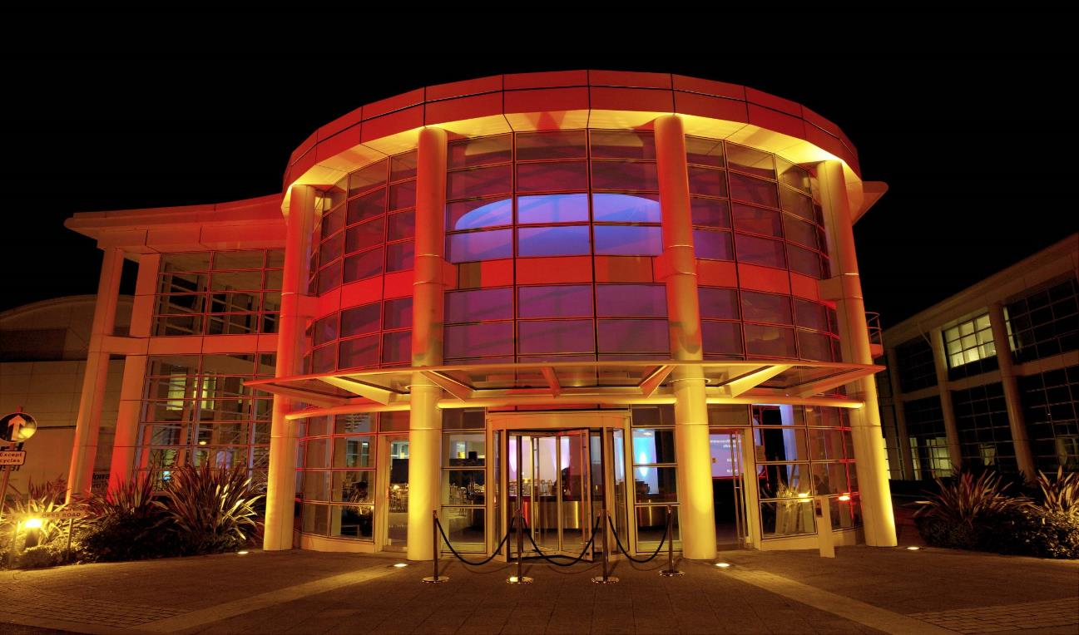


Precision Measurement…
…brings the world into focus

Slide 38

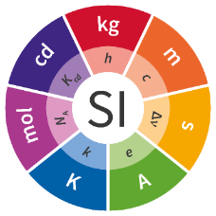
Thank you:
The National Physical Laboratory is operated by NPL Management Ltd, a wholly-owned company of the Department for Business, Energy and Industrial Strategy (BEIS).

Slide 39
Extra Slide
Notes:
39

Slide 40
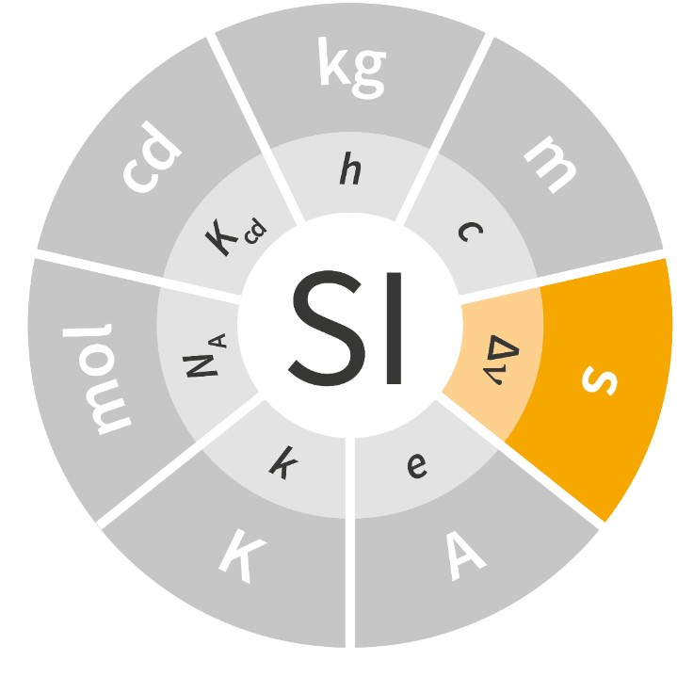
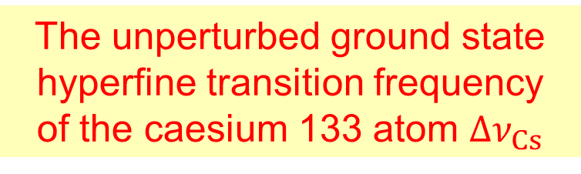
The second
The unperturbed ground state
hyperfine transition frequency
of the caesium 133 atom $Δν_{Cs}$
Notes:
The second is definition terms of the Delta nu-133

Slide 41

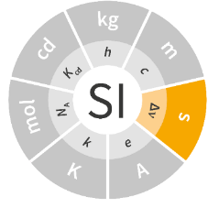
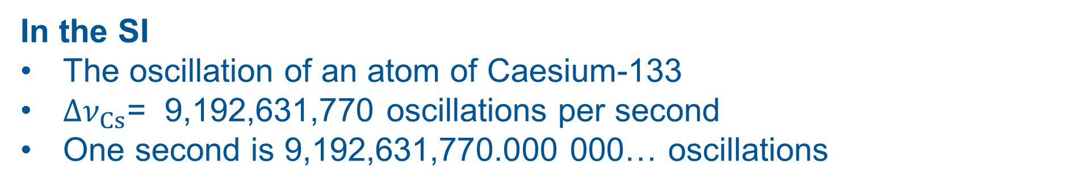
The second
We measure time by counting a periodic phenomenon
Historically
The orbit of the Earth around the Sun
​1 second = ¹⁄_{31,556,925.9747} of the year 1900
In the SI
The oscillation of an atom of Caesium-133
$Δν_{Cs}$= 9,192,631,770 oscillations per second
One second is 9,192,631,770.000 000… oscillations

Slide 42
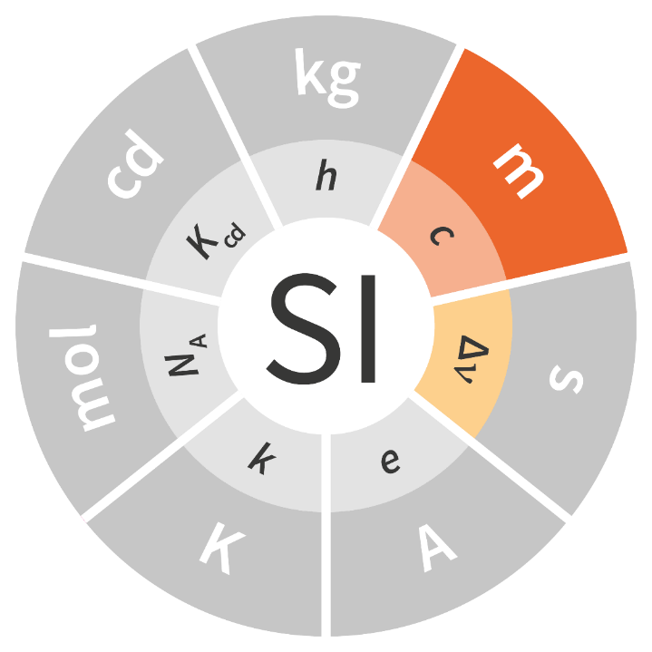
The metre
The speed of light in vacuum, c
The unperturbed ground state
hyperfine transition frequency
of the caesium 133 atom $Δν_{Cs}$

Slide 43
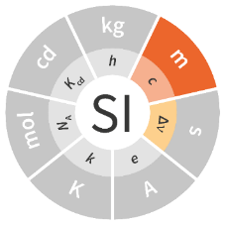

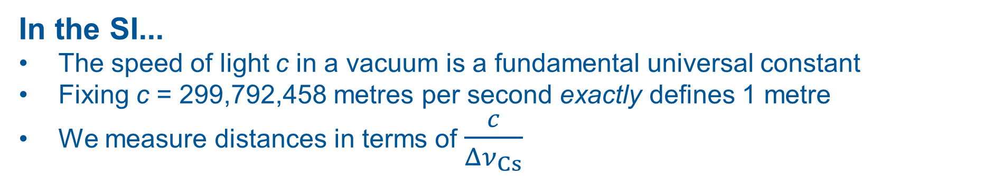
The metre
We measure distance by using a ‘standard length’
10,000,000 m
Historically
A standard fraction of the Earth’s size
In the SI...
The speed of light c in a vacuum is a fundamental universal constant
Fixing c = 299,792,458 metres per second exactly defines 1 metre
We measure distances in terms of $\frac{c}{Δν_{Cs}}$
In practice...
For light of a given frequency (colour) the wavelength is fixed
We can count wavelengths of light using an interferometer.
MIRROR
LASER

Slide 44
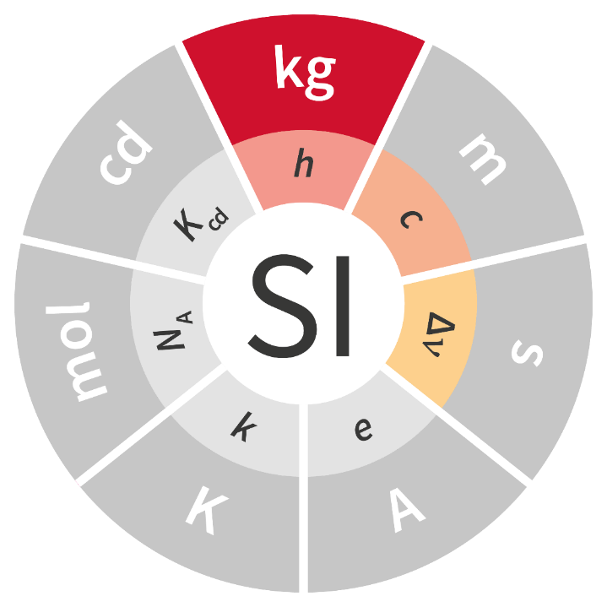
The kilogram
The Planck constant, h
The speed of light in vacuum, c
The unperturbed ground state
hyperfine transition frequency
of the caesium 133 atom $Δν_{Cs}$

Slide 45
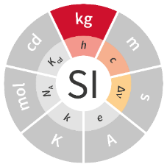

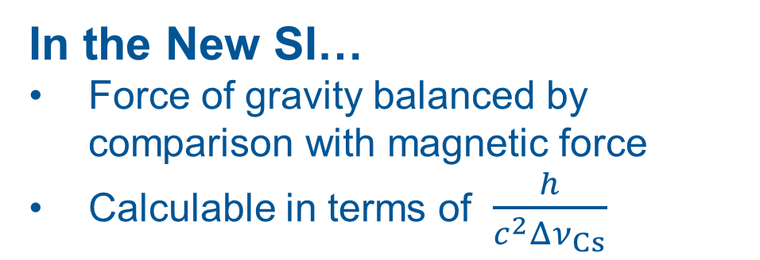
The kilogram
10 cm
10 cm
= 1 kg
Historically
The weight of standard container of water
10 cm
In the SI currently…
International Prototype of the Kilogram
Force of gravity balanced by comparison with standard mass
In the New SI…
Force of gravity balanced by comparison with magnetic force
Calculable in terms of $\frac{h}{c^{2}Δν_{Cs}}$
N
S
N

Slide 46
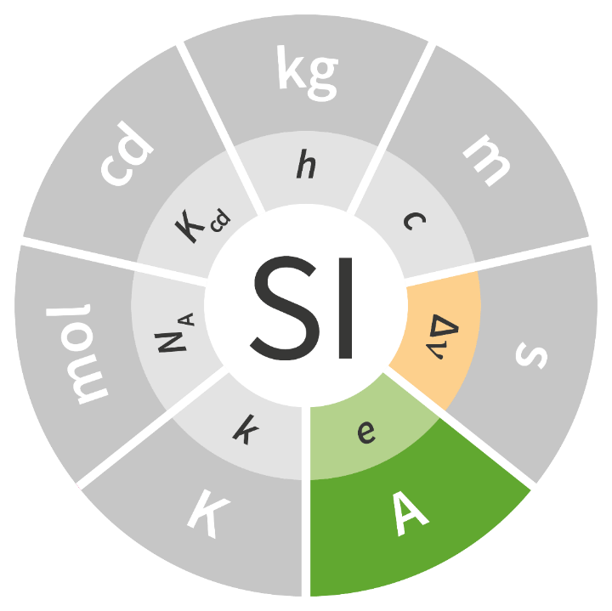
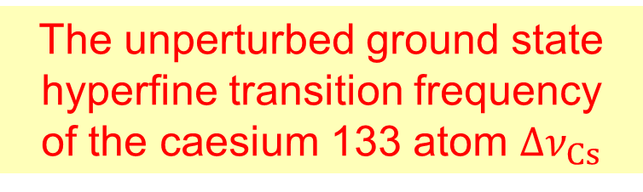
The ampere
The unperturbed ground state
hyperfine transition frequency
of the caesium 133 atom $Δν_{Cs}$
The elementary charge, e

Slide 47
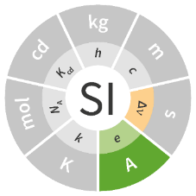
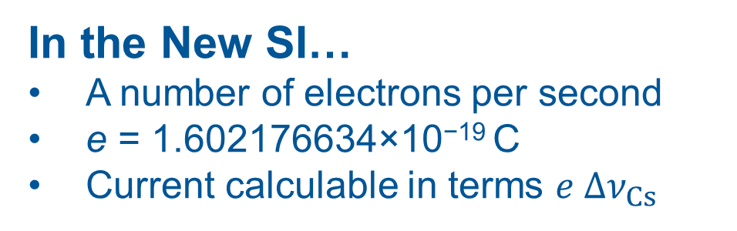

The ampere
Historically
the current that would deposit 1.118 milligrams of silver per second from a silver nitrate solution.
In the SI currently…
Defined by force between parallel wires
Actually force between coils
In the New SI…
A number of electrons per second
e = 1.602176634×10⁻¹⁹ C
Current calculable in terms $e Δν_{Cs}$
$$i=\frac{ne}{t}$$
1 metre

Slide 48
The ampere
A
Historically
the current that would deposit 1.118 milligrams of silver per second from a silver nitrate solution.
Notes:
1 ampere = 1 C/s
1 C = 1/1.6e-19 electrons
= 1/1.6e-19 atoms of silver
1 atom of silver = 107.87 g/ NA
Mass per second = 107.87 /(1.6e-19 * NA)
= 1.12 mg/s

Slide 49
The ampere
A
1 metre
In the SI currently…
Defined by force between parallel wires
Actually force between coils
Notes:
1 ampere = 1 C/s
1 C = 1/1.6e-19 electrons
= 1/1.6e-19 atoms of silver
1 atom of silver = 107.87 g/ NA
Mass per second = 107.87 /(1.6e-19 * NA)
= 1.12 mg/s

Slide 50
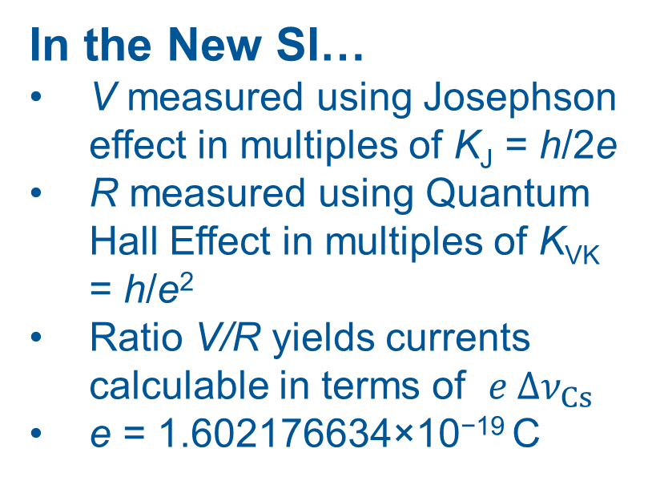
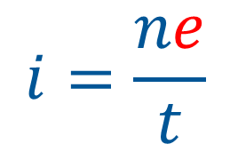
The ampere
Resistor
A
In the New SI…
V measured using Josephson effect in multiples of K_{J} = h/2e
R measured using Quantum Hall Effect in multiples of K_{VK} = h/e²
Ratio V/R yields currents calculable in terms of $e Δν_{Cs}$
e = 1.602176634×10⁻¹⁹ C
V
In the SI currently…
Defined by force between parallel wires
Actually force between coils
$$i=\frac{ne}{t}$$
Notes:
1 ampere = 1 C/s
1 C = 1/1.6e-19 electrons
= 1/1.6e-19 atoms of silver
1 atom of silver = 107.87 g/ NA
Mass per second = 107.87 /(1.6e-19 * NA)
= 1.12 mg/s

Slide 51
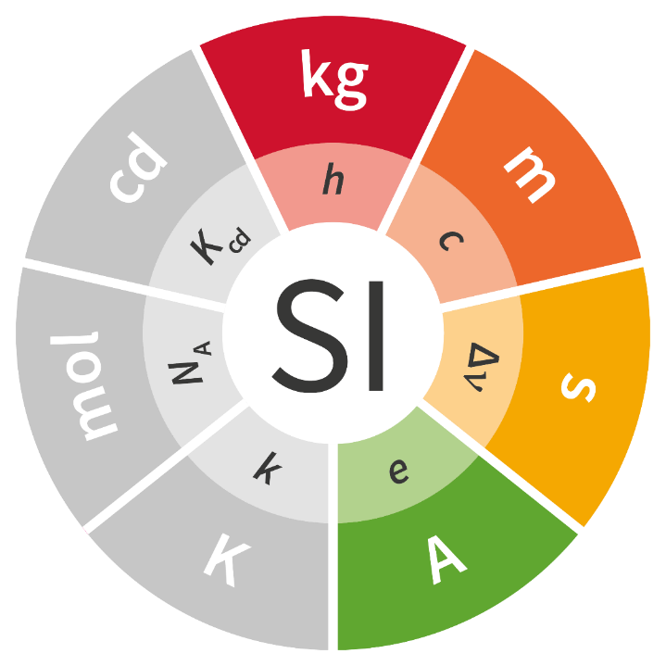
Defining constants
Notes:
Q: What is the difference between the MKSA (metre-kilogram-second-ampere) system of units and the SI
A: No difference really, but the SI has ‘people who care’
People who care are rare 1000 in 7 billion ~ 1 in 7 million ~ 1 pixel on this screen
This is the existing arrangement: Looks pretty but does not show structure

Slide 52
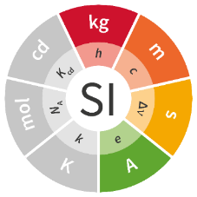

Defining constants
second, $Δν_{Cs}$
Constant of nature. But we could have chosen other atoms
metre, $Δν_{Cs}, c$
c appears to be a universal and fundamental constant of nature
kilogram, $Δν_{Cs}, c, h$
h appears to be a universal and fundamental constant of nature
ampere, $Δν_{Cs}, e$
e appears to be a universal and fundamental constant of nature
  $\frac{e^{2}}{hc}$ measured to be at least one million times more stable than the kilogram!
MKSA would be sufficient to define a system of units.
  SI is not designed to be a ‘minimal’ system
  It has been constructed to respond to human requirements

Slide 53
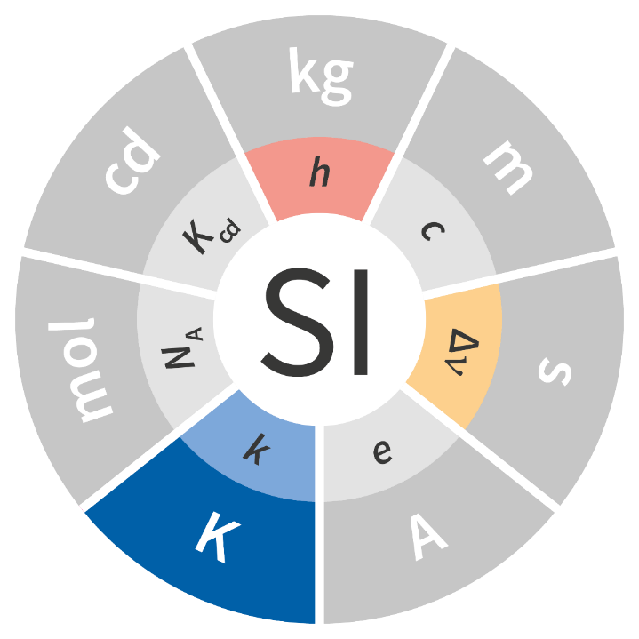
The kelvin
The Planck constant, h
The unperturbed ground state
hyperfine transition frequency
of the caesium 133 atom $Δν_{Cs}$
The Boltzmann constant, k

Slide 54

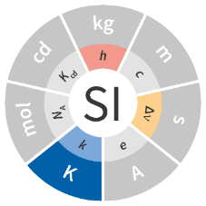
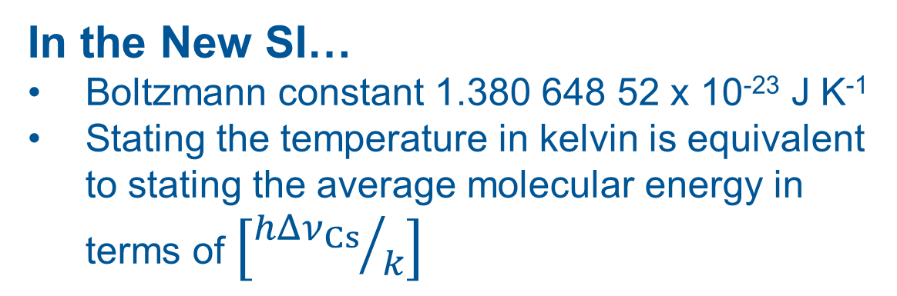
The kelvin
Historically
We did not know what temperature was until long after we learned to measure it!
In the SI currently…
A single ‘standard temperature’
The temperature of the triple point of water is 273.160 000 … K
In the New SI…
Boltzmann constant 1.380 648 52 x 10⁻²³ J K⁻¹
Stating the temperature in kelvin is equivalent to stating the average molecular energy in terms of $\left[{hΔν_{Cs}}/k\right]$

Slide 55
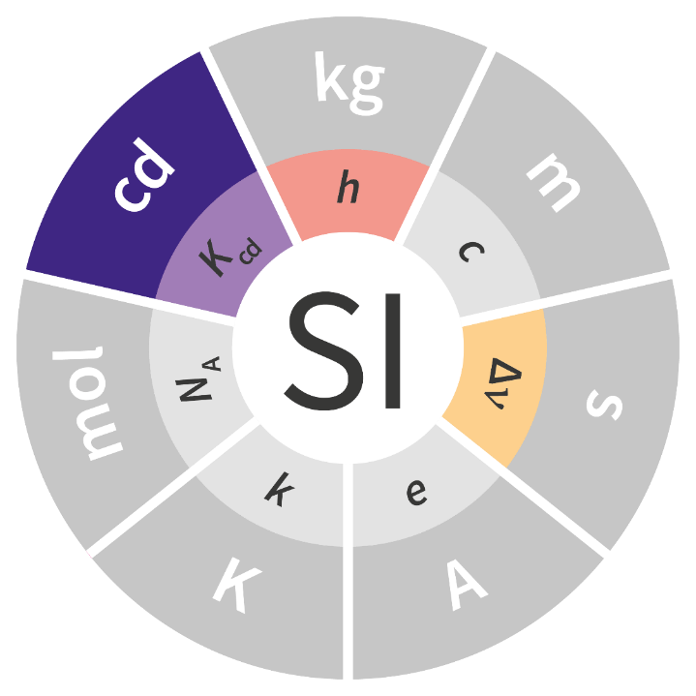
The candela
The Planck constant, h
the luminous efficacy of monochromatic radiation of frequency 540×10¹² Hz, K_{cd}
The unperturbed ground state
hyperfine transition frequency
of the caesium 133 atom $Δν_{Cs}$
Notes:
The luminous efficacy Kcd is a technical constant that gives an exact numerical relationship between the purely physical characteristics of the radiant power stimulating the human eye (W) and its photobiological response defined by the luminous flux due to the spectral responsivity of a standard observer (lm) at a frequency of 540×1012 hertz

Slide 56
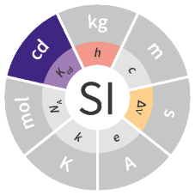

The candela
The unit of luminous intensity
How bright do lights appear to humans?
The only SI unit based on human perception
Historically
Based on Standard Candles – hence the name
In the SI
Defined at one colour – green light with a wavelength of 555 nm
This is close to the peak sensitivity of the human eye
1/683 watt per steradian

Slide 57
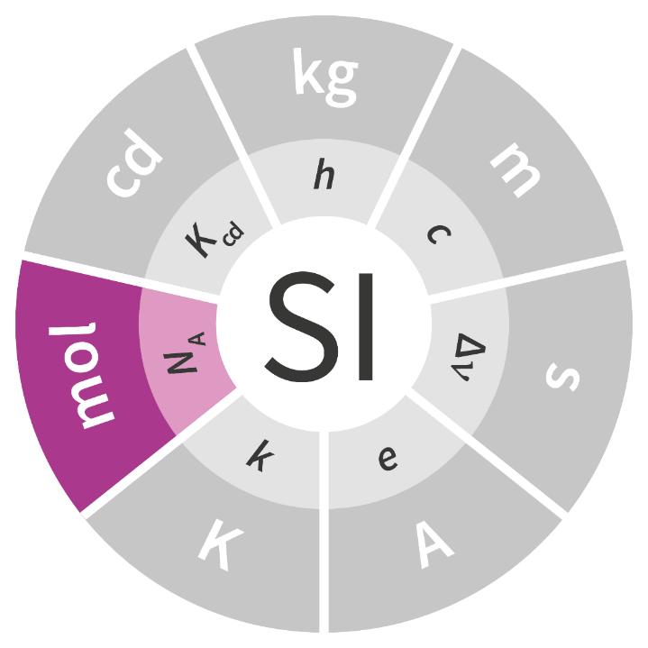
The mole
The Avogadro constant

Slide 58

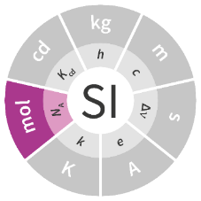
The mole
1 mole of oxygen molecules
Historically
Links chemical measurements to the SI
The Avogadro number of elementary entities, usually atoms or molecules
22,400 cm³
1 mole of lead
1 mole of copper
18.27 cm³
7.09 cm³
In the SI currently…
The number of atoms in 12 g of ¹²C.
Defined by weighing
In the New SI…
Avogadro constant defined exactly
N_{A}= 6.022140857×10²³ mol⁻¹.
Defined exactly: Realised by weighing

Slide 59
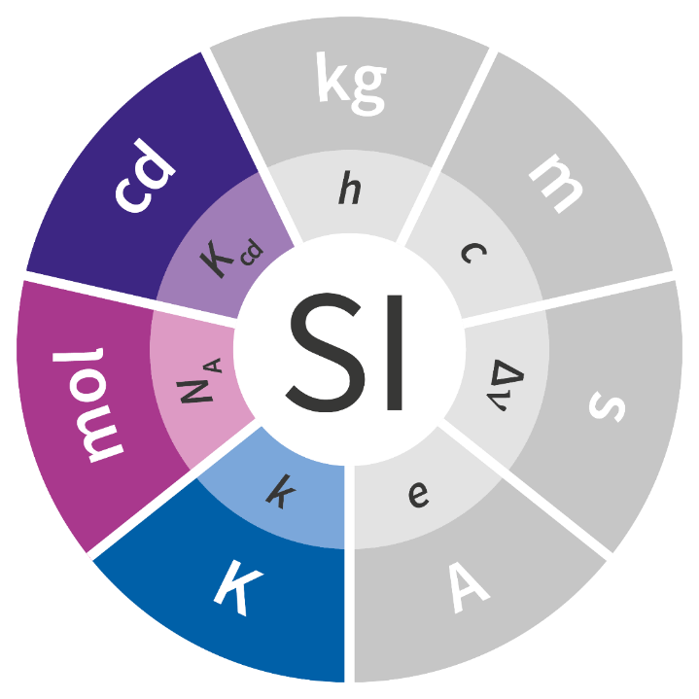
Defining constants

Slide 60


Defining constants
kelvin, $k$, $Δν_{Cs}, c, h$
The Boltzmann, k, constant is a scaling constant
It relates temperature to molecular energy
candela, K_{cd}$, Δν_{Cs}, h$
The candela constant K_{cd} is a technical constant
Sensitivity to light actually varies from one person to another
mol, $N_{A}$
The Avogadro constant N_{A} is a scaling constant
It relates moles to numbers of elementary entities
SI has been constructed to respond to human requirements

Slide 61


Defining constants

Slide 62
The Power of Measurement
The Power of Measurement
Measurement and the SI
The redefinition of the SI
Details of the SI base units
Brand new bright tomorrow
Notes:
62

Slide 63




Traceability
User 1
User 2
User 3
Calibration Lab
NMIJ
NIM
NIST
NPL
PTB
LNE-CNAM
KRISS
International Bureau of Weights and Measures, BIPM

