Slide 1
Ethnic disparities in sentencing: Refining ethnic minority measures and the role of pretrial detention Hilde Wermink & Sigrid van Wingerden
Hilde Wermink – EU Sentencing workshop, Leiden April 19th 2018

Slide 2
Dutch incarceration rate per 100,000
Source: Kalidien, 2016 (WODC / SPACE statistics)

Slide 3
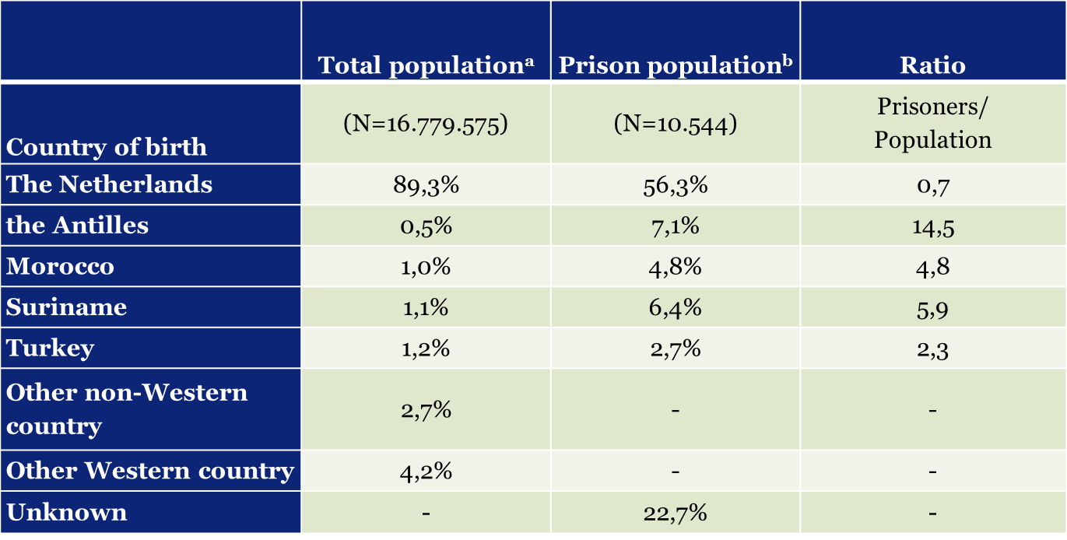
Share in total population and prison population in 2013 (by country of birth)
Source: ª CBS, 2014; ^{b} Linckens & De Looff, 2014

Slide 4
Viable explanations for the overrepresentation
Differential involvement:
Members of ethnic minority groups commit more serious crimes and have more serious criminal records
Differential treatment:
Members of ethnic minority groups are treated differently by court officials

Slide 5
What is (un)known?
“Most studies that examine the issue find young black, and to a lesser extent Hispanic, male defendants to be sentenced more severely (just a few examples are Curry & Corral-Camacho, 2008; Demuth & Steffensmeier, 2004b; Doerner & Demuth, 2009; Kautt & Spohn, 2002; Kramer & Ulmer, 2002, 2009; Spohn & Holleran, 2000; Steen, Engen, and Gainey, 2005; Steffensmeier & Demuth, 2000, 2001, 2006; Ulmer et al., 2007)”
(Ulmer, 2012, p. 18)
“Research on racial and ethnic disparities in criminal punishment … remains focused almost exclusively on the treatment of black and Hispanic offenders.”
(Johnson & Betsinger, 2009, p. 1045)
“… the research literature continues to focus overwhelmingly on the final sentencing stages”
(Baumer, 2013, p. 240)

Slide 6
“The fact that … African Americans and … Hispanics were more likely than whites to be sentenced to prison, even after taking crime seriousness and prior criminal record into account, suggests that racial discrimination in sentencing is not a thing of the past.”
(Spohn, 2009, p. 190)

Slide 7
Current study
7 ethnic groups
the Antilles, Morocco, Suriname, Turkey, other non- Western, Western, the Netherlands
Immigrant generations
Pretrial detention and final sentencing decisions

Slide 8
RISc-data
Nationwide data from the Public Prosecutor’s Office combined with pre-sentencing report data
All suspects between 2005-2007 (N=20,841)
Includes detailed information on offender’s personal circumstances

Slide 9
Controls
Offense severity
Offense type (14 dummies)
Number of index offenses
Denial
Court (18 dummies)
Sex
Age
Criminal history (prior crimes, prior prison sentences)
Offender’s personal circumstances, e.g. drug use, alcohol use, living conditions, education/work, attitude, social network

Slide 10
Pretrial detention (y/n)
 | Exp(B)
Dutch | (ref.)
1st Turks | 1.48 ***
1st Moroccan | 1.40 **
1st Surinamese | 1.35 ***
1st Antilleans | 1.16
1st Other Western | 1.34 **
1st Other non-Western | 1.23 *
2nd Turks | 1.92 ***
2nd Moroccan | 1.80 ***
2nd Surinamese | 1.23
2nd Antilleans | 1.32
2nd Other Western | 1.07
2nd Other non-Western | 1.53
* p < 0,05; ** p < 0,01; *** p < 0,001.

Slide 11
Imprisoned (y/n)
 | Exp(B)
Dutch | (ref.)
1st Turks | 1.64 ***
1st Moroccan | 1.74 ***
1st Surinamese | 1.25 **
1st Antilleans | 1.36 ***
1st Other Western | 1.47 ***
1st Other non-Western | 1.57 ***
2nd Turks | 2.04 ***
2nd Moroccan | 2.48 ***
2nd Surinamese | 1.73 ***
2nd Antilleans | 2.28 ***
2nd Other Western | 1.33 ***
2nd Other non-Western | 1.37
* p < 0,05; ** p < 0,01; *** p < 0,001.

Slide 12
Length of imprisonment
 | Exp(B)
Dutch | (ref.)
1st Turks | 1.37 ***
1st Moroccan | 1.02
1st Surinamese | 1.05
1st Antilleans | 1.14 ***
1st Other Western | 1.28 ***
1st Other non-Western | 1.06
2nd Turks | 1.05
2nd Moroccan | 1.17 ***
2nd Surinamese | 1.03
2nd Antilleans | 1.09
2nd Other Western | 1.01
2nd Other non-Western | 1.07
* p < 0,05; ** p < 0,01; *** p < 0,001.

Slide 13
Role of pretrial detention
> 2 times more likely to be imprisoned
Explained variance (Pseudo R2) +0.27
app. 1 year longer prison terms
Explained variance (R2) +0.21

Slide 14
Imprisoned (y/n) – including pretrial detention
 | Exp(B)
Dutch | (ref.)
1st Turks | 1.04
1st Moroccan | 1.30
1st Surinamese | 1.01
1st Antilleans | 1.26
1st Other Western | 1.11
1st Other non-Western | 1.24
2nd Turks | 1.70 **
2nd Moroccan | 1.35
2nd Surinamese | 1.36
2nd Antilleans | 1.62
2nd Other Western | 1.27
2nd Other non-Western | 0.93
* p < 0,05; ** p < 0,01; *** p < 0,001.

Slide 15
Length – including pretrial detention
 | Exp(B)
Dutch | (ref.)
1st Turks | 1.19 ***
1st Moroccan | 1.01
1st Surinamese | 1.02
1st Antilleans | 1.08 *
1st Other Western | 1.14 **
1st Other non-Western | 1.04
2nd Turks | 1.05
2nd Moroccan | 1.14 **
2nd Surinamese | 0.97
2nd Antilleans | 1.04
2nd Other Western | 0.99
2nd Other non-Western | 1.04
* p < 0,05; ** p < 0,01; *** p < 0,001.

Slide 16
Conclusion & Discussion
Ethnic disparities exist in earlier sentencing stages
Pretrial detention important predictor of sentencing outcomes
Ethnic disparities in the decision to incarcerate are conditional on pretrial detention

Slide 17
Conclusion & Discussion
Disparities more visible for first generation immigrants
Moroccans and Turks

Slide 18
Discussion * Why are ethnic minority suspects more often pretrial detained? * What can/should we do about this?

Slide 19
Thank you for your attention!

