Slide 1
Sentencing criteria in the criminal justice system of Moldova
Mihaela Vidaicu
Moldova State University

Slide 2
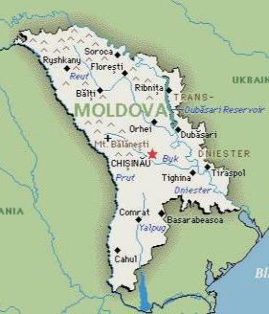
MOLDOVA
Population: 3.55 million
Bordered by Romania and Ukraine
Declared independence in 1991
Parliamentary republic

Slide 3
PRISON POPULATION
Prison population: 7 635
Female prisoners: 8,2%
Juvenile prisoners: 0,6%
Pre-trial detainees:17,6%

Slide 4
SENTENCING LEGAL FRAMEWORK
Criminal Code (effective as of June 12, 2003)
Purposes of criminal punishment
Categories of criminal punishments
Sentencing principles
Sentencing general and special criteria

Slide 5
GENERAL CRITERIA
seriousness of the crime
motive of committing the crime
offender’s personality
mitigating and aggravating circumstances
the influence of the punishment on reeducation of the offender
living conditions of offender’s family

Slide 6
SPECIAL CRITERIA
plea-bargaining
guilty plea
unfinished crime
recidivism
participation
plurality of crimes and plurality of sentences

Slide 7
ISSUES
Inconsistency of judicial practice and sentencing disparities
Poor reasoning of judicial decisions
Different approaches towards sentencing
Judges tendency to be on prosecutors side (relations among legal professionals)
Reduced trust in the justice system

Slide 8
SUPREME COURT OF JUSTICE
The authority of the Supreme Court of Justice to assure the consistency in sentencing
Sentencing explanatory decisions of the Supreme Court of Justice
Different approach towards starting point in sentencing process

Slide 9
Sentencing Guidelines Initiative
General sentencing recommendations (approved by the Supreme court in 2014)
Sentencing recommendations on specific criminal offences: homicide, trafficking in human beings, illegal circulation of drugs, theft, active/passive corruption

Slide 10
THANK YOU!

