Slide 1
3-Stage Trauma-informed HEI Service Framework
Equally Safe in Higher Education 2018
University of Strathclyde
equallysafe@strath.ac.uk

Slide 2
Herman’s three stage model for responding to survivors of trauma
Stage 1 - Safety
Stage 2 - remembrance and mourning
Stage 3 - reconnection
There are three ‘bottom lines’:
The survivor is at the centre of the process,
Their safety is paramount
It is recognised that their process might not be linear.

Slide 3
3-STAGE TRAUMA-INFORMED SERVICE FRAMEWORK IN AN HEI SETTING (Example)
 | Interpersonal | Interdisciplinary | Agency
 | Tasks | Departments, Services & Agencies involved | Departments, Service & Agencies with a role
Stage 1 | Crisis intervention Risk Assessment Safety planning Symptom management | First Responders Campus Security Services Student Services Student Union Residences Staff Rape Crisis Women’s Aid Emergency services, NHS e.g. A&E, Police | Police, ASSIST, University Security Housing/Accommodation Services, NHS (including GP Out of Hours, A and E) GP, Student Health Services, Student/Community Nurses, Rape Crisis Helpline/Crisis line, Archway, Women’s Aid,
Stage 2 | Therapeutic work Telling the story Processing and healing | GBV Support/Advocacy/Counselling/Therapeutic services Support Worker Student Health Services, Staff and Employee Counselling services, CMHT, Some Social Work Services, Women’s Aid, Rape Crisis Support Services. | GBV Support and Advocacy Services, Student Health Services, Staff and Employee Counselling services, CMHT, Some Social Work Services, Women’s Aid, Rape Crisis Support Services; My Body Back Health Services
Stage 3 | Moving on Positive Change Connecting to community, resettlement, Reducing isolation | Advocate/ Counsellor Personal Tutor Student Services H.R. Services Occupational Health | Student Services (including Student Health Services, Counselling), HR (Including Occupational Health, Employee Counselling Services), Student Unions, Employee Trade Unions, Residences/ Accommodation services, , VAW services, Academic Support/Personal Tutor, Support, University Careers service. Scottish Women’s Rights Centre,

Slide 4
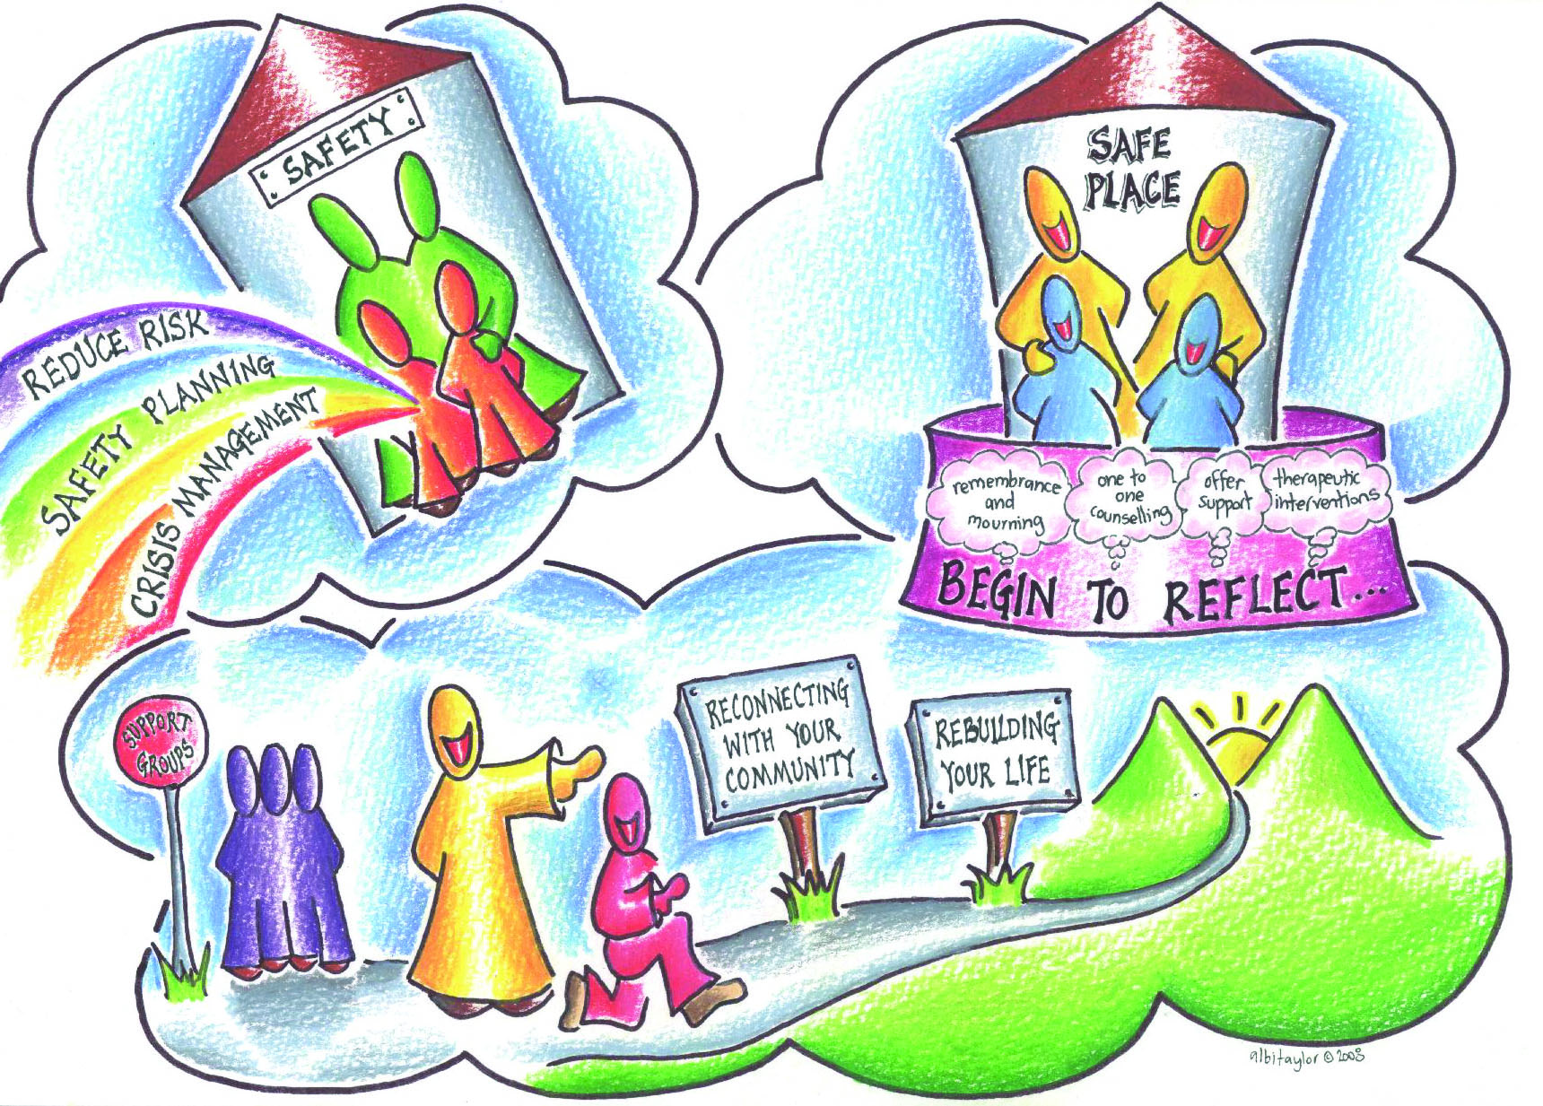
©AlbiTaylor www.albitaylor.com

