Slide 1


Commercial Sexual Exploitation

Slide 2
What is CSE?
Pornography
Prostitution – brothels/sauna/street
Sex Industry – lapdancing/sex lines/internet chat rooms/escort agencies
Lads Mags
Sex tourism
Forced marriage
Trafficking
Mail order brides

Slide 3
Pornography

Slide 4
Pornography
More and more young people are turning to the internet to find the answers to the questions they have……
What is sex?
What is a relationship?
What should I be doing with my girlfriend/boyfriend?
What’s normal?
Some search engines will show this when someone wants to know about sex…

Slide 5
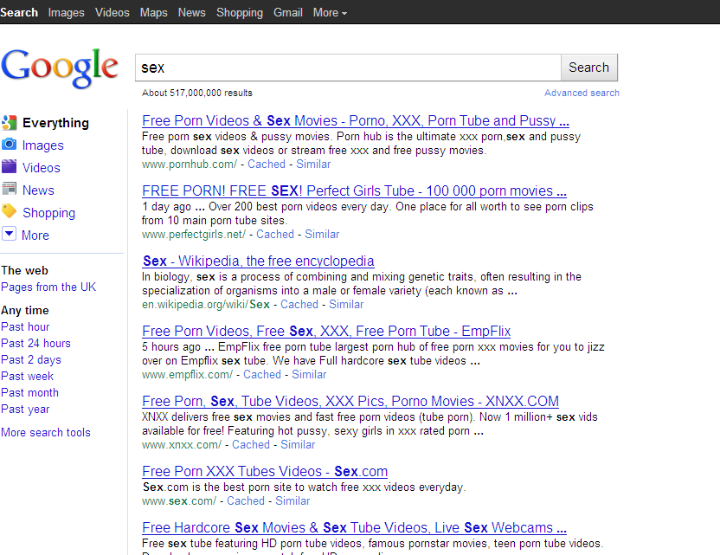

Slide 6
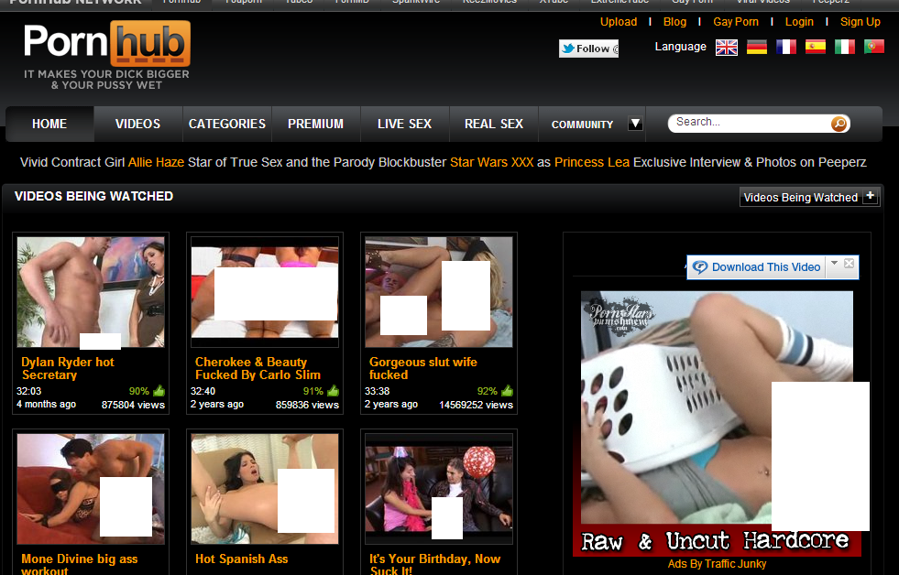
Pornography

Slide 7
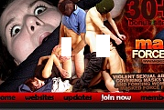
Rape Tube
One of the highest grossing genres of pornography on the internet is violent porn. Billions of pounds each year is spent by ordinary people (usually men/boys) to access pornography, increasingly the sites accessed depict forced and extremely violent sexual acts. One of the most ‘popular sites’ featuring and targeting young people is Rape Tube………….

Slide 8
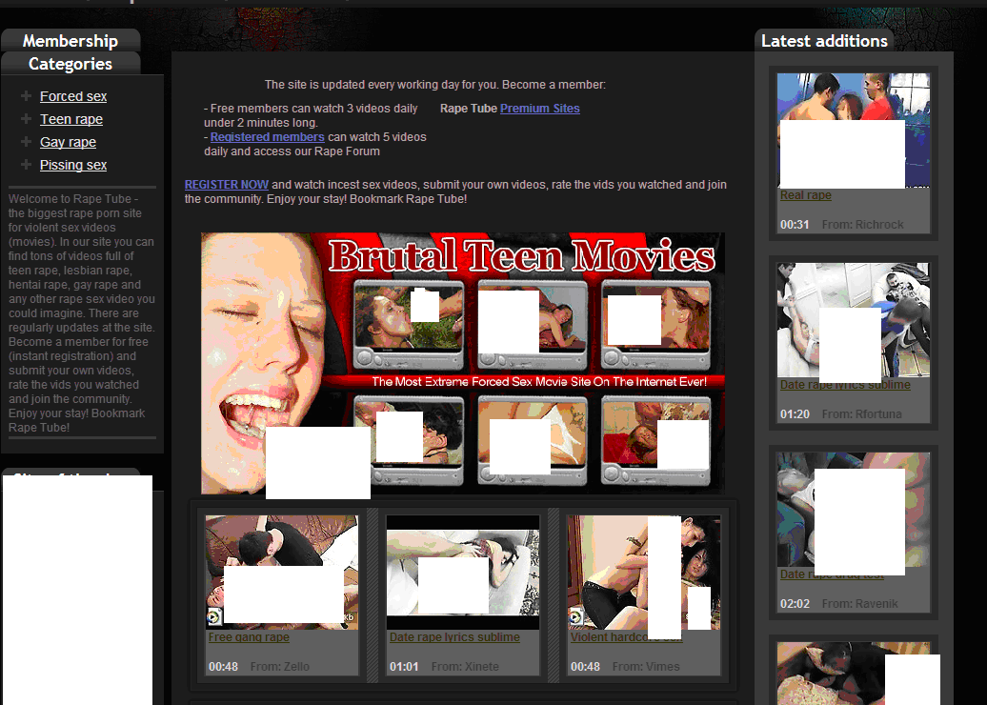

Slide 9
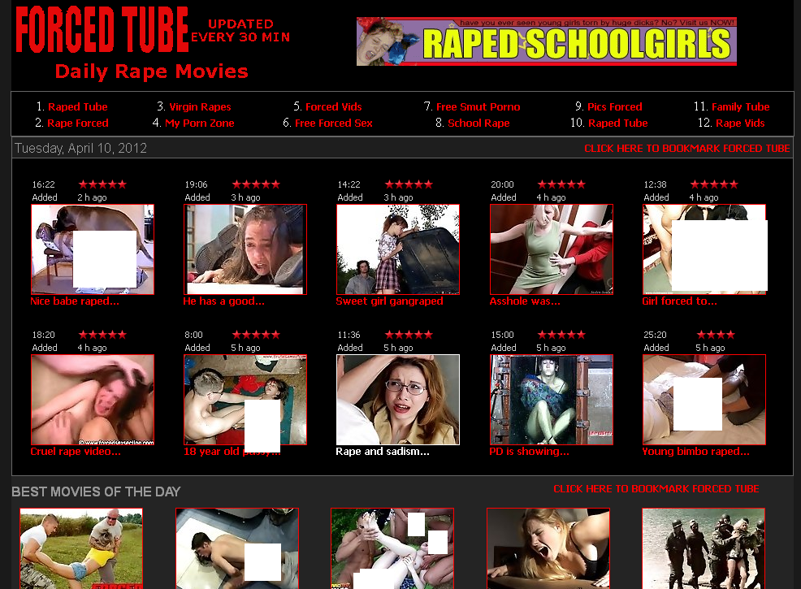

Slide 10
Prostitution

Slide 11
Prostitution
Street prostitution
Off-street prostitution
Brothels
Saunas
In Scotland prostitution itself is not illegal (the exchange of sexual services for money) what is illegal is the associated activities such as public solicitation, operating a brothel or other forms of pimping.
It is illegal to kerb crawl in Scotland but there are currently no laws that criminalise the buyer of sexual services. This has been raised in the Scottish Parliament but it has for the moment been rejected.

Slide 12
Prostitution
Study carried out by the Eaves Project in London – 2009
103 men took part in the study – 93% of them admitted that within the brothels or saunas that they used they were aware of the trafficking and coercive control issues that might be taking place but said this would not deter them from using them again.
Some quotes:
“You pay for the convenience, a bit like going to a public loo.”
“Prostitution is like masturbating without having to use your hand.”
“Prostitution is a last resort to unfulfilled sexual desires. Rape would be less safe, or if you’re forced to hurt someone or if you’re so frustrated you jack off all day.”
“No big deal, it’s just like getting a beer.”

Slide 13
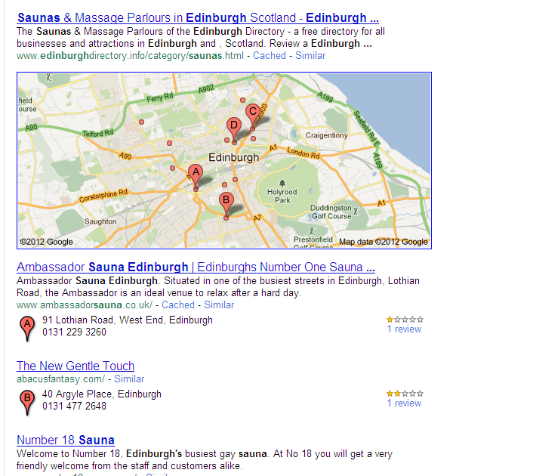

Slide 14
Sex Industry

Slide 15
Sex Industry
Although not illegal ‘jobs’ they can be damaging to people who work in them. There have been reports of prostitution and trafficking taking place in lapdancing clubs in the UK.
There can also be pressure on girls and women working in escort agencies to take part in prostitution in order to get and maintain work.

Slide 16
Reasons
There have been several reports over the years that a lot of young women get involved in the sex industry to fund their education.
Promoted as a ‘fun and easy way’ to make money, television adverts are often shown on digital channels in between popular teenage programmes for sex lines and internet chat rooms.
Poverty and drug use are also reasons for women getting involved in the sex industry.

Slide 17
Effects
Drug use can sometimes begin after a woman or girl has entered the sex industry so they can cope with the pressures and demand placed on them by both their ‘employer’ and the men who use the services.
Often with lapdancing and escorting there is a pressure to move on to prostitution, women and girls fear losing their job or getting less work if they don’t comply.
Often their lives can be blighted by trying to conceal their past; there are a lot of negative opinions about women who work in the sex industry.

Slide 18
Lad’s Mags

Slide 19

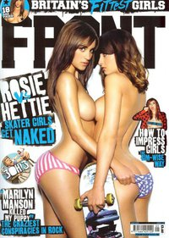


Slide 20
Lad’s Mags
‘Lads Mags’ or similar online images now seen as just harmless fun, they are often on shelves in shops at eye level of young people and children but what messages are young people getting from the images and ‘stories’ in these magazines.
What does it say about women and girls?
What might the effects be on society?
What attitudes could form?
What ‘choices’ do the women in the magazines have?

Slide 21
Sex Tourism

Slide 22
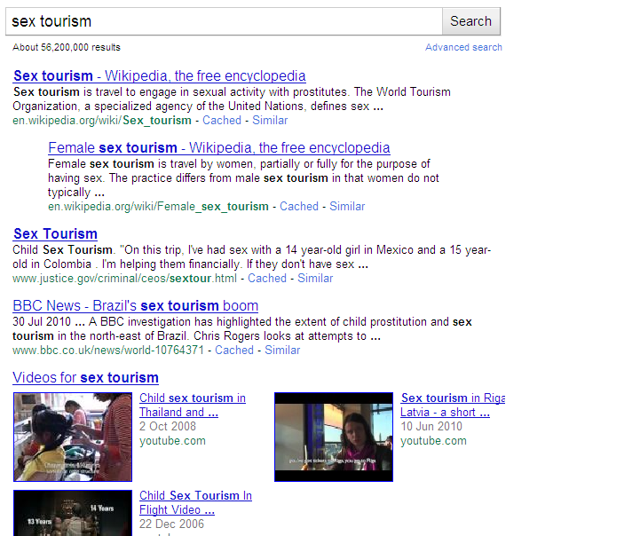

Slide 23
Sex Tourism
Most ‘popular’ destination countries are: Indonesia, Malaysia, the Philippines and Thailand. Closely followed by Mexico and Central America.
Factors supporting the child sex trade: poverty resulting from turbulent politics and unstable economies. Illiteracy, limited employment opportunities, bleak financial circumstances. Female children have fewer educational/employment opportunities. Consequently, they must find other ways of earning a living.

Slide 24
Sex Tourism
In the US there are laws that prohibit people from travelling to countries for the purposes of engaging in sexual activity with a minor. Successful prosecution requires the government to prove that an alleged child sex tourist from the United States formed the intent to engage in sexual activity with a child prior to meeting the child and initiating sexual contact.
Tourists from the United Kingdom
The Sexual Offences Act 2003 enables British citizens and residents who commit sexual offences against children overseas to be prosecuted in England, Wales and Northern Ireland. Similar provisions are in force in Scotland under the Criminal Law (Consolidation) (Scotland) Act 1995 Some of the offences carry penalties of up to life imprisonment and anyone found guilty will be placed on the Sex Offenders Register. The UK police and the Child Exploitation and Online Protection Centre (CEOP) and Interpol are actively involved in monitoring child sex tourists and do prosecute.

Slide 25
Forced Marriage

Slide 26

Forced Marriage
Forced marriage is when a bride, groom or both are forced into marrying by others, usually their families. Every year thousands of young people in the UK are forced to marry by their families.
Forced marriage became illegal in Scotland in 2010 (it was made illegal in England, Wales and Northern Ireland in 2008).
Forced marriage must not be confused with arranged marriage

Slide 27
Motivations
Controlling unwanted behaviour including: sexuality, sexual orientation, alcohol/drug use, wearing make-up, speaking to members of the opposite sex or behaving in what is perceived to be a ‘westernised’ manner
Preventing unsuitable relationships
Protecting ‘family honour’
Attempting to strengthen family links
Ensuring land, property & wealth remains in the family
Concerns that younger siblings may seem undesirable if older brothers & sisters are not married
Obtaining care for aging parents

Slide 28
Effects on the Victim
In Scotland forced marriage is seen as a form of Domestic Abuse, an abuse of human rights and when children are involved, child abuse.
Isolation
Trust issues
Limited English – making it difficult to get help
Stress
Mental Health Issues
Restricted Education (especially for young women)
Abuse – physical, emotional, sexual, financial

Slide 29
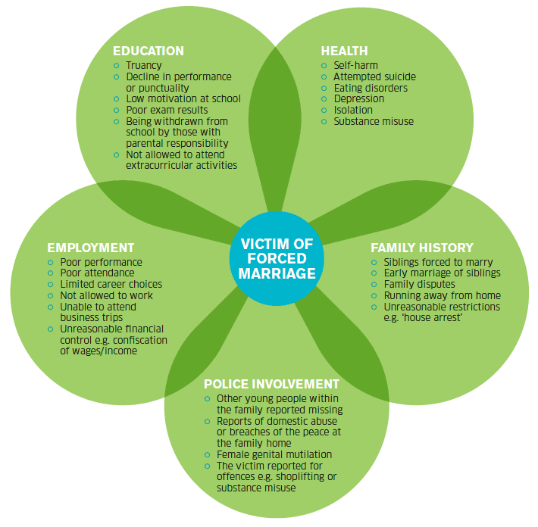

Slide 30
Human Trafficking

Slide 31
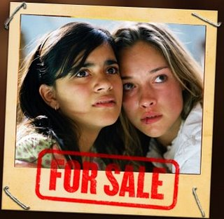
Human Trafficking
In Scotland trafficking is illegal under the Criminal Justice Act (Scotland) 2003. the maximum sentence is 14 years in prison. To date there have been no successful prosecutions under this legislation.

Slide 32
Human Trafficking
In Scotland there is an anti trafficking team who recovered people thought to be trafficked for a variety of purposes. 2007/2008 statistics show that after a police operation more than 60 people were recovered, 25 of them were women trafficked for prostitution.
35 individuals were arrested, 17 were prosecuted, mainly for immigration or prostitution offences.
No child victims were recovered during this operation in Scotland.

Slide 33
United Kingdom Human Trafficking Centre (UKHTC)
In 2008 the UKHTC launched their public awareness campaign Blue Blindfold www.blueblindfold.co.uk
The campaign raises awareness about all forms of human trafficking and the message is that it is happening in our local communities
The UKHTC helps co-ordinate victim care when people are recovered
In respect of the 2014 Commonwealth Games the Scottish Government worked with its partner organisations and the police to ensure that procedures were put in place to minimise opportunities for trafficking in human beings for forced labour during the construction phase and to tackle potential trafficking for sexual exploitation while the games are running
World sporting events attract the demand for prostitution therefor trafficking increases at these times.

Slide 34
Mail Order Bride

Slide 35
Mail Order Brides
Mail order brides work with international marriage agencies which is legal in most countries however some countries have introduced policies to protect women who may be abused once they are married due to a number of high profile cases of women who have been abused or murdered by their foreign husband.
The U.S. introduced stringent immigration laws to tackle the issue
The Philippines enacted an anti-mail order bride law in 1990
The Australian government introduced new policies in 2004 to eradicate ‘inappropriate immigration’ to tackle mail order bride issues
But you just have to Google ‘Mail Order Bride’ to see how easy it is to exploit vulnerable young women for money.

Slide 36
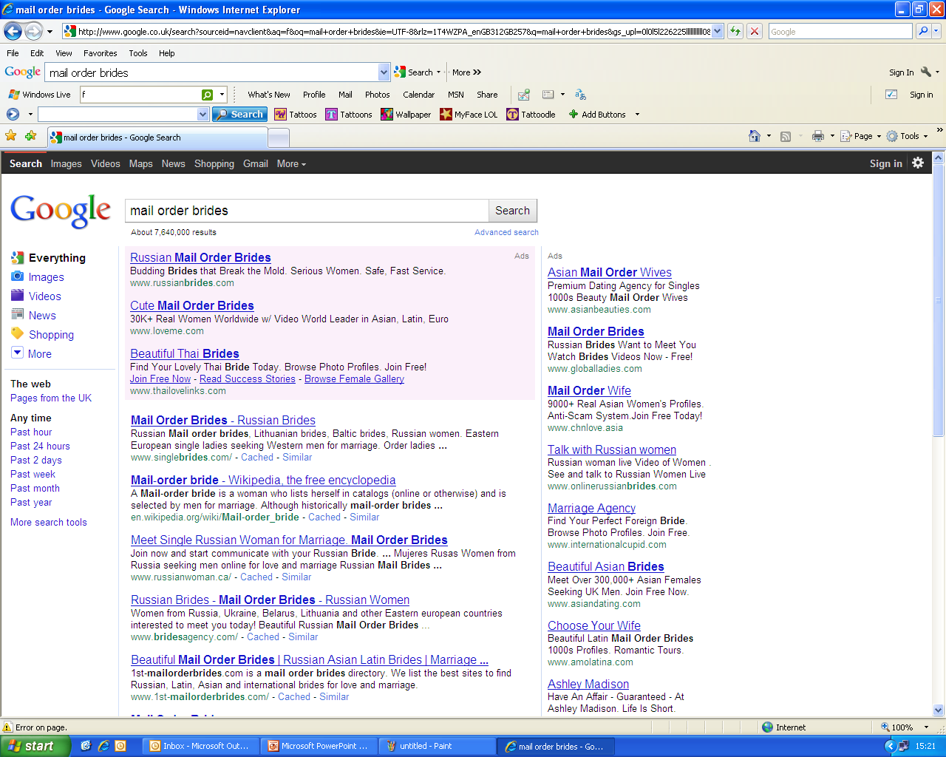

Slide 37
Contact
Contact: Paula Dunn
The Rosey Project & Glasgow & Clyde Rape Crisis
Helpline: 08088 00 00 14
Email: paula@rapecrisiscentre-glasgow.co.uk
Web: www.roseyproject.co.uk

