Slide 1


Slide 2


the Safe and Together™ model:
A Perpetrator Pattern-Based
Approach to Domestic Abuse Cases Involving Children
Motherwell, September 2015
Kyle Pinto, MSW
kylepinto@endingviolence.com

Slide 3
The ‘cardinal’ question
Given the totality of the system’s relationship with adult and child domestic violence survivors, is it likely that they see us as being on their side?
*adapted from Hodas, 2006

Slide 4
Continuum of Domestic Violence Practice
Domestic Violence Incapable
Domestic Violence Blindness
Domestic Violence Pre-Competence
Domestic Violence Proficiency
Domestic Violence Destructive
Domestic Violence Competence
Domestic Violence – Informed
Child Welfare Systems
Notes:
Perpetrator pattern, child centered, survivor strength based approach to child safety and well being issues related to domestic violence (literature and clinically based)
Specifically designed to move child welfare systems toward becoming domestic violence informed
Targets key child welfare competencies and tasks such as assessment, interviewing, documentation, case planning, supervision, decision-making and neglect filings.
Correlative data better identification of domestic violence, reduction in out of home placements without an increase in repeat maltreatments (Florida); changes in workers practice (Ohio)
Extensive, long term experience working with states to change practice and policy
Integrates and supports trauma informed practice; differential response; OSM
Is the specific pattern of behavior of the perpetrator described and is there an nexus established between that pattern and harm to children? (v. “family has history of domestic violence”)
Is a comprehensive lens used to describe the protective efforts of the domestic violence survivor and their impact on child safety and well-being?
Is the case being presented with a perspective that the perpetrator’s abusive behavior is a parenting choice?
What are the documented efforts to intervene with the perpetrator?
Is the case plan for the perpetrator behaviorally focused?
What are the documented efforts to partner with the domestic violence survivor?
What connections are being presented between substance abuse, mental health, basic needs, abuse issues, and the domestic violence?
Differential Response States & Efforts
Ohio: Certified Safe and Together model trainings (statewide DR add on)
Connecticut: Safe and Together mode consultants (statewide)
Colorado: Statewide training, policy technical assistance (statewide)
New York: Hotline training, support for co-located DV advocates, statewide training, region specific training (statewide)
Oregon: support for co-located advocates; other training (statewide)
Non-Differential Response States & Efforts
Florida: Subject Matter Experts, co-located advocates (statewide)
Kansas City, MO & Lincoln NB: Support for local domestic violence collaboratives
New Jersey: support for co-located domestic violence advocates
Other states: Wisconsin, Louisiana, Vermont, Tennessee, Maine
Other countries: England, Scotland, Ireland, Singapore, Australia

Slide 5
Moving Systems to Become More Domestic Violence-Informed
Perpetrator pattern
Child centered
Survivor strength-based

Slide 6
Strong Nexus Between
Perpetrator Pattern & Harm to Children
High Standards for Fathers
Foundation for perpetrator pattern-based approach to intersection of domestic violence and child maltreatment
Notes:
How does this traditional set of ‘batterer accountability’ interventions hold him accountable as a parent?
If we accept that he has the same legal responsibilities to his children as when he was living with them and also believe that he has the same legal responsibilities for those three young children as the mother, how is that being reflected in our interventions?
How are we approaching him about his children’s continuing basic needs like housing and food?
Who is talking to him in a sustained way about how his violence towards his partner, even if the children were not present, is a parenting choice?
Who is offering him support for his healthy parenting during this period while he’s out of the house, and beyond?

Slide 7
Domestic Violence Incapable
Domestic Violence Blindness
Domestic Violence Pre-Competence
Domestic Violence Proficiency
Domestic Violence Destructive
Domestic Violence Competence
Policy & Practice Training & Supervision Legal Services Coordination & Collaboration Integration & Institutionalization
Weak Nexus of Perpetrator Pattern & Harm to Children Strong
Incidents of violence Pattern of coercive control
Only about the adult s Integrated with child/family functioning
No/low expectations of fathers High standards for fathers
“Failure to Protect” Survivor strength approach
(c) 2014 David Mandel Associates LLC Do not reproduce or distribute without permission
Notes:
Goes beyond traditional batterer intervention– it’s a system change.

Slide 8
When Domestic Violence is the Concern……
The domestic violence perpetrator and his behavior* are the foundational source of the risk and safety concerns for children.
* not the adult survivor or her behavior
Notes:
Pregnancy
3-19% of women report perinatal domestic violence+
48% mothers in one home visitation program revealed reported experiencing IPV since the birth of their child**
Adverse Childhood Experience (ACES) Domestic Violence Data
As frequency IPV witnessing increased : “powerful graded increase in the prevalence of every category of ACE” and “positive graded risk for self-reported alcoholism, illicit drug use, IV drug use and depressed affect”
“It strengthens the idea that IPV is usually (95% probability) associated with some form of child abuse or neglect or other serious family dysfunction.
Moreover, the number of ACEs have been shown to have a positive graded relationship to negative outcomes during adolescence and adulthood including numerous health risk behaviors…., unintended pregnancy…., sexually transmitted diseases…, and many of the leading causes of death in the United States... “
“DV has a measurable and substantial association with caregiver and family functioning,which in tum have a substantial association with child health and behavior.”****
88% of a group of battered women described that their partner used their children to try to control her.***
Multiple studies indicate that child fatalities or critical incidents may have domestic violence as factor (as high as 2 out of 3)
Between 45-70% of children exposed to domestic violence are also victims of physical abuse
34% of all substantiated CPS investigations included exposure to IPV as the primary category of maltreatment (Canadian study)*
Recent data from National Survey of Child and Adolescent Well Being indicated that parents disclose rates of recent domestic violence (last twelve months) at a rate more than double what child welfare workers identified. (26% v. 12%)
NCTSN study of children in foster care and trauma
54% had domestic violence exposure
Of the complex trauma group, 72% had domestic violence (consistent with ACES study)

Slide 9
Multiple pathways to harm
Perpetrator’s Pattern
Harm to child
Effect on partner’s parenting
Energy goes to addressing perpetrator instead of children
Loss of authority
Interference with day to day routine and basic care
Effects on family ecology
Loss of income
Housing instability
Loss of contact with extended family
Educational and social disruptions
Depression/PTSD/anxiety/substance abuse
Coercive control toward adult survivor
Actions taken to harm children
Children’s Trauma
Seeing, hearing or learning about the violence
Behavioral, Emotional, Social, Educational
Victim of physical abuse
Developmental
Physical Injury
Notes:
Pregnancy
3-19% of women report perinatal domestic violence+
48% mothers in one home visitation program revealed reported experiencing IPV since the birth of their child**
Adverse Childhood Experience (ACES) Domestic Violence Data
As frequency IPV witnessing increased : “powerful graded increase in the prevalence of every category of ACE” and “positive graded risk for self-reported alcoholism, illicit drug use, IV drug use and depressed affect”
“It strengthens the idea that IPV is usually (95% probability) associated with some form of child abuse or neglect or other serious family dysfunction.
Moreover, the number of ACEs have been shown to have a positive graded relationship to negative outcomes during adolescence and adulthood including numerous health risk behaviors…., unintended pregnancy…., sexually transmitted diseases…, and many of the leading causes of death in the United States... “
“DV has a measurable and substantial association with caregiver and family functioning, which in tum have a substantial association with child health and behavior.”****
88% of a group of battered women described that their partner used their children to try to control her.***
Multiple studies indicate that child fatalities or critical incidents may have domestic violence as factor (as high as 2 out of 3)
Between 45-70% of children exposed to domestic violence are also victims of physical abuse
34% of all substantiated CPS investigations included exposure to IPV as the primary category of maltreatment (Canadian study)*
Recent data from National Survey of Child and Adolescent Well Being indicated that parents disclose rates of recent domestic violence (last twelve months) at a rate more than double what child welfare workers identified. (26% v. 12%)
NCTSN study of children in foster care and trauma
54% had domestic violence exposure
Of the complex trauma group, 72% had domestic violence (consistent with ACES study)

Slide 10
Intersectionality of DV perpetrator behavior and other issues
Cause
Interfere
Exacerbate

Slide 11
Perpetrator Pattern-Based Approach to Domestic Violence and Children
Looks at the perpetrator’s behavior, not the relationship or the survivor’s behavior, as the source of the domestic violence child risk and safety concerns
Beyond current relationship: 360 degrees assessment of perpetrator pattern
Strong nexus between domestic violence perpetrator’s behaviors child safety and well being
Highlights the choice(s) to be violent, abusive and controlling as parenting choices

Slide 12
Safe and Together™ model:
Better Outcomes for Families and Systems
Critical Components
Better Outcomes for Families: Safety, Well-being & Permanency
Foundation
Principles
Model Characteristics
Practice Tools
Better Assessment
Better Case Plans
Better Partnerships
Domestic Violence-Informed Child Welfare System
Improved Competencies
Improved Cross System Collaboration
Interventions
Advocacy Institute
Organizational Assessment
Training & Certification
Perpetrator Pattern-Based Approach

Slide 13
Model Characteristics
Fact based
Gender responsive
Strengths based
Integrative
& Inter-disciplinary
“Beyond Services”
“Removal is an option of last resort” approach
Child centered approach to domestic violence

Slide 14
Safe and Together™ Principles
1
Keeping child Safe and Together™ with non-offending parent
Safety Healing from trauma Stability and nurturance
2
Partnering with non-offending parent as default position
Efficient Effective Child-centered
3
Intervening with perpetrator to reduce risk and harm to child
Engagement Accountability Courts

Slide 15
Safe and Together™ Critical Components
Perpetrator’s pattern of coercive control
Actions taken by the perpetrator to harm the child
Full spectrum of the non-offending parent’s efforts to promote the safety and well being of the child
Adverse impact of the perpetrator’s behavior on the child
Role of substance abuse, mental health, culture and other socio-economic factors

Slide 16
Major Projects/Clients Highlights
Statewide certified trainers (Ohio & Michigan)
Training and integration with Safety Methodology (Florida)
Advocacy Institutes (National, Florida, New York)
Domestic Violence Consultant Network (CT)
Case Consultation (Florida & Queensland Australia)
300 minutes of video modeling (Florida)
Organizational Assessment (District of Columbia)
Core Safe and Together Certification (District of Columbia)
Safe and Together Integration with Differential Response and Structured Decision-Making (Nationally)
Other states: Oregon, New Jersey, Iowa, Vermont, Nebraska
International work: Australia, Canada, Scotland, Ireland, Singapore

Slide 17
Safe and Together Ohio Data
Ohio 3rd Party Evaluation: Study coordinated by Ohio IPV Collaboration with support from
  HealthPath Foundation
  NCALP
  ODJFS
Data collected from 12 of the counties trained during 2013, as well as 12 Ohio counties that had participated in Safe and Together training during previous years, and 7 local CPS from AR counties that had not yet participated in the training.
5 data collection activities:
  an online pre/posttest survey of 837 CPS caseworkers and supervisors
  semi-structured interviews with 16 supervisors;
  semi-structured interviews with 8 community stakeholders;
  desk reviews of 191 CPS case files; and
  review of written policies from 15 counties that had completed Safe and Together training. Exhaustive descriptions of each of these methods are appended to this report.”
Notes:
Connecticut
High utilization rate of domestic violence consultants-involved with 3000 unique cases/year (15,000 over five years)
Supervisor training (88 supervisors trained, 41% responded to the survey).
66% identified specific positive changes in their supervisory practice;
62% indicated positive change in their workers’ practice as a result of the training and
50% of the respondents indicated positive changes in outcomes for families.
MDT pilot
“100% of respondents indicated that their agency has benefitted from the teaming of serious domestic violence cases.
“100% of respondents indicated that increased skills and awareness regarding domestic violence positively impacted how they handled sexual and physical abuse cases.”
“Over 81% of respondents identified that they felt that teaming domestic violence cases resulted in increased safety for families.”
Colorado: A series of three-day Safe and Together model trainings for a diverse audience that included child welfare staff and domestic violence advocates.
Of the 125 people who responded to a survey a few months after the training, 89% rated their experience of the training positive, very positive or excellent and 82% said that the training impacted their practice.

Slide 18
Strong evidence that:
Mixed Evidence:
Little evidence that:
CPS staff increase their concern about, and documentation of the effects of children witnessing domestic violence.
CPS staff assign less blame to victims for staying in a violent relationship;
CPS staff increase their understanding of coercive control;
CPS staff enhance safety planning for victims and children;
CPS staff increase perpetrators’ accountability.
CPS agencies change written policies; and
Community stakeholders become more receptive to Safe and Together policies and principles.

Slide 19
Safe and Together Florida Data
Work with both child welfare and domestic violence advocates
  Multi-site work with DCF in Florida since 2008
  Relationship with Florida Coalition since 2006
  Different projects
    Subject Matter Experts
    Co-located Advocates
    Children’s Legal Services
    Cultural & Linguistically specific work
Panhandle
  Training and technical assistance for both child welfare and co-located domestic violence advocates

Slide 20
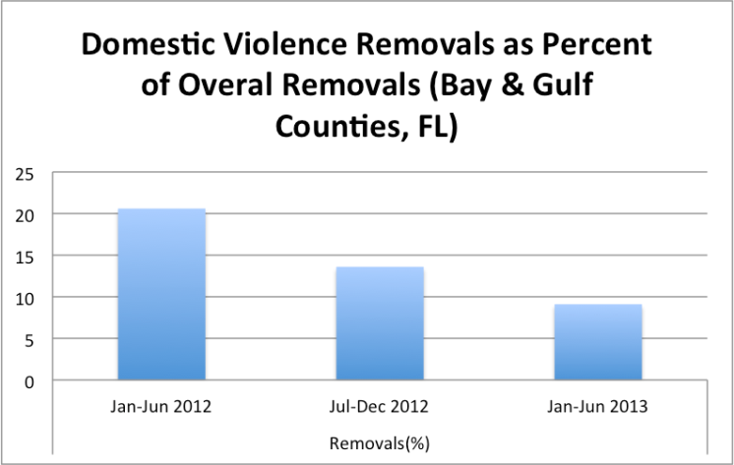

Slide 21
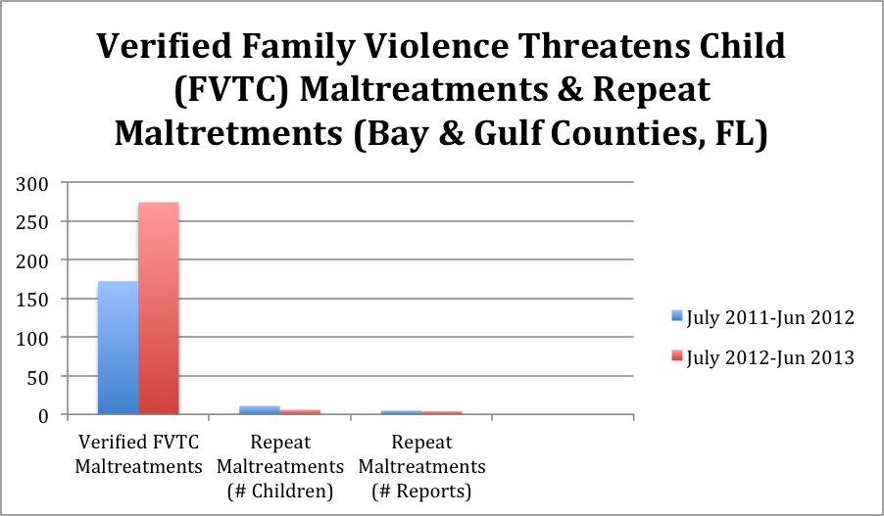
Notes:
Closed Investigations for FY 11/12:
172 verified maltreatments of FVTC
11 children had repeat maltrx within the FY (meaning they had 2 separate reports with verified FVTC
The 11 children were part of 5 families/5 reports of repeat maltrx
Closed Investigations for FY 12/13:
274 verified maltreatments of FVTC
6 kids had repeat maltrx within the FY (meaning they had 2 separate reports with verified FVTC)
The 6 children were part of 4 families/reports of repeat maltrx

Slide 22
Correlation between model implementation and keeping children in homes
In Jacksonville Florida, the child welfare department was able to track the number of filings and removals for cases where domestic violence was identified. The data indicated a significant drop in neglect petitions (approximately 70% decrease) and removals during a period (approximately 50% decrease) correlated with significant Safe and Together model training.

Slide 23

Safe and Together Model Resources & Educational Events
Open Events
  3rd National Safe and Together Children and Domestic Violence Symposium Orlando, Florida October 14-16, 2015
  Thursday Webinar Series
Resources
  Website: www.endingviolence.com
  YouTube: SafeandTogetherModel
  Blog: www.endingviolence.com/blog/
  Facebook: DavidMandelAndAssociates
  Twitter: SafeandTogether

