Slide 1


Sexting & Consent

Slide 2
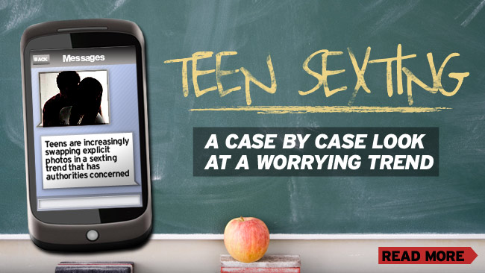
Sexting
What does it mean?

Slide 3
Sexting
Sexting is the act of sending
sexually explicit messages
and/or photographs, primarily
between mobile phones but also
includes emails

Slide 4
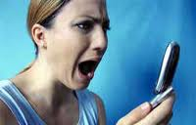
Once it’s out there…
A study by the Internet Watch Foundation (IWF) found that 88% of the self-generated, sexually explicit online images and videos of young people their analysts encountered had been taken from their original location and uploaded on to other websites.

Slide 5
Once it’s out there…
Most of the images and videos (88%) appeared on ‘parasite websites’, meaning they were taken from the original area where they were uploaded and made public on other websites.
These parasite websites had often been created for the sole purpose of offering sexually explicit images and videos of young people and therefore contained large amounts of sexually explicit content.
The young people in the following photos have no idea that their webcams have been hacked and these sites are taking photos of them without their consent and posting them on the child pornography sites

Slide 6

Parasite Pornography

Slide 7

Parasite Pornography

Slide 8

Parasite Pornography

Slide 9

Parasite Pornography

Slide 10
What Young People Say
“The photos were on a phone that was stolen around 2 years ago...the photos were taken when I was under 17 years old.”
“I came to regret posting photographs of myself naively on the internet and tried to forget about it, but strangers recognised me from the photographs and made lewd remarks at school. I endured so much bullying because of this photograph and the others...I was eventually admitted for severe depression and was treated for a suicide attempt.”

Slide 11
What Young People Say
“The photos were on a phone that was stolen around 2 years ago...the photos were taken when I was under 17 years old.”
“I came to regret posting photographs of myself naively on the internet and tried to forget about it, but strangers recognised me from the photographs and made lewd remarks at school. I endured so much bullying because of this photograph and the others...I was eventually admitted for severe depression and was treated for a suicide attempt.”

Slide 12

A Thin Line
1 in 5 sext recipients have passed/forwarded the sext to someone else.
50% of teenagers have shared the sext with multiple people.
(Source: A Thin Line, 2009)

Slide 13
When Sexting is a Problem
The person posing or sharing is under the age of 18 years old
Over 18:
Pressure or threats are involved
Coercion occurs
The image is shared without consent
Photo or video is taken without consent

Slide 14
When Sexting is a Problem
The person posing or sharing is under the age of 18 years old
Over 18:
Pressure or threats are involved
Coercion occurs
The image is shared without consent
Photo or video is taken without consent

Slide 15
The Law in Scotland
The Abusive Behaviour and Sexual Harm (Scotland) Act 2016
Passed in the Scottish Parliament on the 22nd March 2016
Came in to effect April 1st 2017
Non-consensual sharing of sexual images (age 18+)
Threatening to share sexual images
Carries up to 5 years in prison
You do not have to physically share the image or video, simply showing it on your phone or other electronic device to others is enough to break the law
It is always illegal to share sexual images or videos with anyone under the age of 18 years

Slide 16
NSPCC Research - February 2014
This report describes the experiences of 11-16 year olds on social networking sites and the strategies they use to deal with things that upset them online.
Researchers conducted an online self completion survey in December 2012 of 1,024 11-16 year olds in the UK.
The report found that 28% of children aged 11-16 with a profile on a social networking site have experienced something upsetting on it in the last year.

Slide 17
Findings
Other issues experienced by children who had been upset included: pressure to look or act a certain way (14%), cyber stalking (12%), aggressive and violent language (18%), encouragement to hurt themselves (3%), receiving unwanted sexual messages (12%), and requests to send or respond to a sexual message (8%).

Slide 18
Zero Tolerance Survey
Specific issues for female participants included:
Pressure both to engage and not to engage in sexual and/or sexualised behaviour, with a range of negative consequences for failing to negotiate the ‘appropriate’ balance.
Pressure to conform to unrealistic beauty standards and resulting negative body image.
Specific issues for male participants included:
Pressure to conform to heterosexual male ‘norms’ of watching and approving of pornography, sexualising women and girls, and pursuing sex. Consequences of not fulfilling these include being labelled ‘gay’ or not adequately masculine.
Pressure to appear sexually experienced, which may lead to a rejection of appropriate sex education

Slide 19

Sex & Consent
What is the definition of Rape
What is consent?

Slide 20
Definition of Rape
Definition of rape has changed since December 2010:
The Sexual Offences (Scotland) Act 2009
states that rape occurs when a person intentionally or recklessly
penetrates another person’s vagina, anus or mouth with their penis,
where the victim does not consent and the person responsible has no
reasonable belief that the victim is giving consent.
In circumstances where penetration is initially consented to but
consent is later withdrawn, the person responsible will have
committed rape.
The victim can be male or female.

Slide 21
Consent
Consent is defined as free agreement. The law is clear that consent can be withdrawn at any time, and that consent to one sexual act does not in itself mean consent to a different act
Consent cannot be given when:
Someone is intoxicated or unconscious as a result of alcohol or drugs
Someone is asleep
The person is mentally disabled
False representation of identity
Consent cannot be coerced

