Slide 1
The Scottish
Intervention Initiative
Bystander Training
Session 2: Healthy, Positive, Social Norms

Slide 2
We will learn & work together as a group in this programme.
Some of the material is sensitive & some of us will have personal experience of the things we discuss.
We will all be respectful of personal emotions as we learn.
Confidentiality
Appropriate language
Attendance
Communicating with the facilitator
Please be aware that we will be discussing sensitive issues that might have affected you or people you care about.
If you feel uncomfortable or upset it is fine to leave the space.
Facilitators will understand & are trained to help you.

Slide 3
Where We Are
Healthy & Positive Behaviour (Majority)
Problematic
Behaviour
Unacceptable Behaviour (Minority)

Slide 4
But from the perspective of those in the minority –
they believe they are in the majority (false consensus) and that their behaviour is not problematic.
Acceptable/Majority Behaviour

Slide 5
Where We Need to Get To
Unacceptable behaviour becomes SO socially rejected (clearly defined as unacceptable) that most people stop doing it.
Healthy & Positive Majority Behaviour

Slide 6
Range of Behaviours
Healthy, age-appropriate, mutually respectful, safe
Mutually flirtatious, playful
Situation- or age-inappropriate or non-mutual
Harassment
Sexually abusive & violent

Slide 7
How can we help to alter behaviour?
?

Slide 8
Not cool
Not okay
You’re better than that
This is making me uncomfortable
Don’t be an eejit

Slide 9
A student’s personal experience
“I was approached by a group of male students as I was walking out of my halls of residence and they were all shouting sexual things at me and then one of them approached me, grabbed me around the waist and then started to touch my breasts and bottom. He was saying things like ‘you know you want this’ and ‘you know you're up for this’.”
NUS (2011) p13

Slide 10
Do you empathise?
If this had happened to…
Your mother
Your best friend
Your girlfriend
Your sister
Your daughter
Your niece

Slide 11
IMPACT (of rape, attempted rape, sexual assault, sexual harassment)
“Throughout the ordeal, I was having nightmares, was afraid to go anywhere outside of my room, had splitting headaches and was on a course of Beta blockers and antidepressants. This seriously affected my relationships further into uni and screwed up my first year exams” (Cambridge 2014 p20)
“After the attempted rape, I thought I was fine. I got with every boy, but would freak if they touched me down there. I would get drunk every night. I drew away from my friends. I got addicted to prescription drugs. I contemplated suicide. It took me a year and a half to realise I needed help.” (Cambridge 2014 p20)
“It is playing a massive part in my life. I won’t go out alone after dark any more, which, as a part time student, is seriously affecting my studies and personal and social choices. It is also affecting me financially as I will take any possible precautions so as not to be alone in my local area in the dark. I’m taking anti-anxiety medication for the first time because of it and I feel like it’s slowly destroying me” (NUS 2011 p28)
“I find it difficult to go on dates with men without being wary of their intentions”
(NUS 2011 p28)

Slide 12
A student’s personal experience
“I was approached by a group of male students as I was walking out of my halls of residence and they were all shouting sexual things at me and then one of them approached me, grabbed me around the waist and then started to touch my breasts and bottom. He was saying things like ‘you know you want this’ and ‘you know you're up for this’.”
NUS (2011) p13
Cambridge study: CUSU (Cambridge University Students' Union) (2014). Cambridge Speaks Out. Cambridge: CUSU Women's Campaign. Online at: www.womens.cusu.cam.ac.uk/Cambridge%20Speaks%20Out%20Report%202014.pdf
NUS study: NUS (National Union of Students) (2011) (2nd Ed.). Hidden Marks. London: NUS. Online at: www.nus.org.uk/Global/NUS_hidden_marks_report_2nd_edition_web.pdf

Slide 13
A group of students (not an individual)
All shouting sexual things at me
One of them takes it further

Slide 14
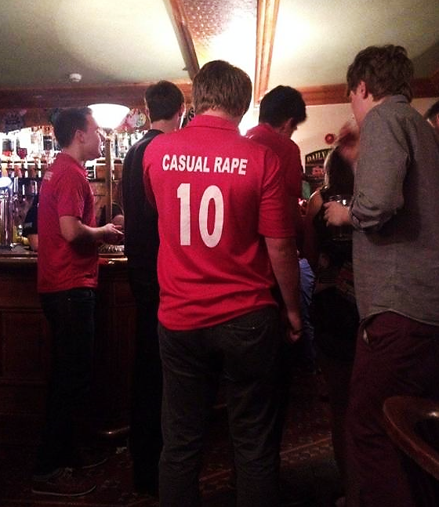
“Lad Culture”?
On Friday night at Syndicate a young female fresher passed out about 1am. Nobody moved to help her get up but four boys crowded around taking upskirt photos.
Freshers’ week at Bristol University September 2013 via Facebook
A rugby club at Oxford University has been banned from competing & had its leadership dismissed after organising a "free pussy" event, which instructed students to spike their dates' drinks.
Huffpo, 5/11/13
Aberystwyth University men's cricket club (AUMCC) social last year. The team were banned from playing & had their funding withdrawn.

Slide 15
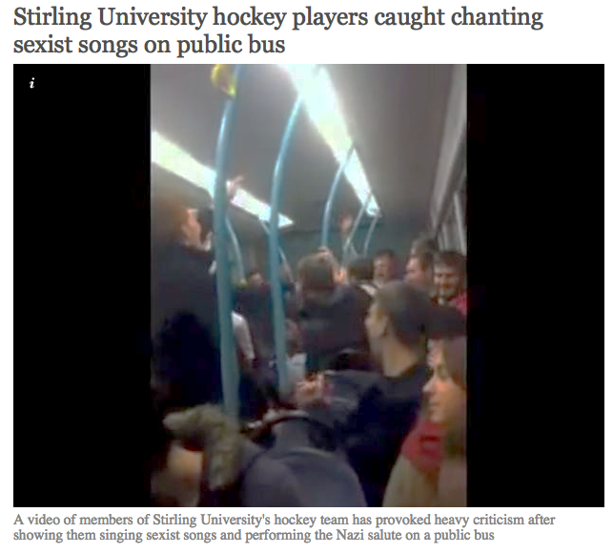
Edinburgh rugby players chant rape jokes at female students.
Boozed-up rugby players yelled jokes about “gang rape” at female students in the queue outside Edinburgh Students’ Union on Saturday night.
The Tab, 25/09/2014
“Lad Culture”?
The Times Higher Education Supplement, 8/3/2013
The Independent, 6/10/2014
‘I found photos of me in pyjamas in my bed on some boys’ WhatsApp group,’ student Rosie Wilcox says. ‘They did the same to one of my friends and she wasn’t wearing anything… They thought it was really funny but she was devastated’
The Guardian: “Campus Nightmare”, 11/10/2014
Government orders inquiry over violence against women at universities
The Guardian 6/9/15
The Independent, 15/11/2013

Slide 16
Being a “lad”
Not… all men
Not …“all the time”
Not …“all bad”
There is pressure to conform
From Oxford Good Lads Project
X
X
X

Slide 17
Where We Are
Healthy & Positive Behaviour (Majority)
Problematic
Behaviour
Unacceptable Behaviour (Minority)

Slide 18
“We are Man”
YouTube: https://youtu.be/ZYhaodUPqSU
“But what’s the problem with
a bit of harmless banter?
It’s only a joke”
Blurred Lines: The New Battle of the Sexes [television programme, online] 21:30 8/5/2014, BBC TWO, 60mins. https://ls-video2.ces.strath.ac.uk/View.aspx?id=10857~5i~adregWkf8q
Time on Clip (20.20-23.43)

Slide 19
bonding as a group
verbal harassment
sexual assault

Slide 20
HOMICIDE
SUICIDE
PHYSICAL EXPRESSION:
PHYSICAL/SEXUAL ASSAULT
CULTURAL MICROAGGRESSIONS (SUBTLE, INTENTIONAL OR UNINTENTIONAL): CULTURAL INVISIBILITY, SOCIAL EXCLUSION, MISPREPRESENTATION, VIOLENT PORN
VERBAL EXPRESSION:
SEXUAL HARASSMENT
MAKING SEXUAL JOKES
ATTITUDES & BELIEFS: RACISM SEXISM HOMOPHOBIA TRANSPHOBIA DISABLISM AGEISM
DISCRIMINATION
Ideas incorporated from ccasayourworld.com; McMahon & Banyard, 2012 DOI: 10.1177/1524838011426015

Slide 21
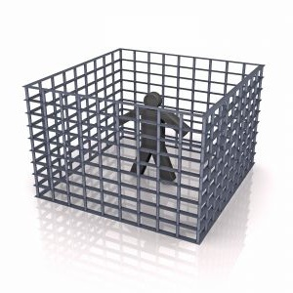

Slide 22
Being a Man?
“You have to show how masculine you are; you can’t show sensitivity – it is difficult to be different – you need to look and act a certain way.”
(young man, Year 11: EVAW: A Different World is Possible, p.6)
EVAW (End Violence Against Women Coalition) (2011). A Different World Is Possible. London: EVAW.
ISBN: 978-0-9558609-3-5 Downloaded from http://www.endviolenceagainstwomen.org.uk/data/files/resources/19/a_different_world_is_possible_report_email_version.pdf

Slide 23
Being a man?
X risk of substance abuse
X high-risk behaviours (proving toughness; not seeking medical help)
X criminality
X suicide
X experiencing violence
X exclusion from school & underachieving at school
X being incarcerated in prison

Slide 24
Social norm misperceptions among women
healthy eating & exercise behaviour
unhealthy eating/
dieting/
exercise
illness & exercise disorders

Slide 25
Research shows…
“Men … report that they do not personally believe in many societal myths about masculinity but believe that other men do”
(Fabiano et al., 2003)
Men often underestimate the extent to which other men are uncomfortable with stereotypical (negative) masculine behaviour.
(studies cited in Berkowitz, 2013)
Fabiano, P. M., Perkins, H. W., Berkowitz, A., Linkenbach, J., & Stark, C. (2003). Engaging men as social justice allies in ending violence against women: Evidence for a social norms approach. Journal of American College Health, 52(3), 105-112.
Berkowitz, A. (2013). A Grassroots’ Guide to Fostering Healthy Norms to Reduce Violence in our Communities: Social Norms Toolkit. USA: CDC. Online at http://www.alanberkowitz.com/Social_Norms_Violence_Prevention_Toolkit.pdf

Slide 26
I’m uncomfortable but I’m the only one
***
!!!
***

Slide 27
***
!!!
***
Don’t say stuff like that.

Slide 28
