Slide 1


The Scottish
Intervention Initiative
Bystander Training
Session 3: Rape & Sexual Assault

Slide 2

We will learn & work together as a group in this programme.
Some of the material is sensitive & some of us will have personal experience of the things we discuss.
We will all be respectful of personal emotions as we learn.
Confidentiality
Appropriate language
Attendance
Communicating with the facilitator
Please be aware that we will be discussing sensitive issues that might have affected you or people you care about.
If you feel uncomfortable or upset it is fine to leave the space.
Facilitators will understand & are trained to help you.

Slide 3
This is a bystander programme:
EMPOWERING YOU AS BYSTANDERS TO INTERVENE TO PREVENT VIOLENCE
4 Stages for Intervention
3. Feel responsible for dealing with it
2. Interpret it as a problem
1. Notice the event
4. Possess necessary skills to act
[Adapted from Berkowitz, A. (2009) Response Ability: A Complete Guide to Bystander Intervention, Beck & Co., p. 10]

Slide 4
Stage 1: Noticing behaviour or an event
We need to understand and learn about rape and sexual assault in order to be able to notice situations and see behaviours or events as potentially problematic.
Q.
What percentage
of rapes are committed by someone known
to the victim?
A.
35%
B.
71%
C.
85%

Slide 5
FACTS
Rape is rarely committed by strangers: 85 % of reported rapes are carried out by someone known to the victim.
(HMIC, 2007)
NUS survey found that the majority of perpetrators of stalking, sexual assault & physical violence were already known to the victim.
(NUS 2011 p.19)

Slide 6
Q.
A.
Agree
B.
Disagree
C.
Unsure
‘A rape victim will resist & fight the attacker & there will be signs of injury.
Victim Resistance …
How do victims of rape resist?
Physical resistance: fighting, hitting, struggling, running away
Verbal resistance: telling the perpetrator(s) to stop, persuasion, shouting, screaming
Not all victims resist. Why is this?
Fear (the ‘freeze fright’ response)
the use of weapons
multiple assailants or threats
I JUST FROZE – Rape Crisis Scotland
https://vimeo.com/205066680

Slide 7
A student’s experience: questions about masculinity?
‘My main problem was dealing with the fact that men can get raped too. Others said I should have beaten him up or been more of a man or that it was a lesson for being seen as a bit promiscuous at times.’
(Cambridge 2014 p.20)
Cambridge study: CUSU (Cambridge University Students' Union) (2014). Cambridge Speaks Out. Cambridge: CUSU Women's Campaign. Online at http://www.womens.cusu.cam.ac.uk/Cambridge%20Speaks%20Out%20Report%202014.pdf

Slide 8
Q.
A person who is drunk or using drugs…
A.
should be held responsible if they are sexually assaulted or raped.
B.
should be held partly responsible if they are sexually assaulted or raped.
C.
are NEVER responsible if they are sexually assaulted or raped.
Why rape is not the victim’s fault
Rape is a violation & act of violence with harmful consequences.
Responsibility only lies with the perpetrator.
Nobody has a right to your body without your consent, no matter what you do or how you behave.

Slide 9

Why does it matter if people hold inaccurate views about rape i.e. believe the ‘rape myths’?

Slide 10
For the victim / survivor…
Self-blame
Unlikely to disclose
Negative experience of disclosure
Unlikely to access support
May suffer mental & physical ill health

Slide 11
Being a man?
X risk of substance abuse
X high-risk behaviours (proving toughness; not seeking medical help)
X criminality
X suicide
X experiencing violence
X exclusion from school & underachieving at school
X being incarcerated in prison

Slide 12
Experiencing blame
‘I was raped in 2010 … walking back to college late at night. I took him to court and won - but the most harrowing aspect of having been raped was not the attack itself, but the experiences I had afterwards, both in court and with “friends”. I told very few people but I can't count amount of the times I was asked “what were you wearing”, “were you drunk”. Blame culture is despicable and prevalent in even those who think themselves to be well adjusted on such matters … Women, though were the worst. They were the main perpetrators of queries as to what I was wearing at the time, whether I'd led the man on, whether I was drunk.’
(Cambridge Speaks Out, 2014: www.cambridgespeaksout.org.uk/stories)

Slide 13
Criminal Justice System
No disclosure
Disclosure
Victim self-blame
If offender caught
No disclosure / reporting
PF decisions to prosecute or not
No Investigation (police unaware)
Jury decision-making (guilt or innocence)
Repeat offending
Judicial decision-making
BRINGING OFFENDER TO JUSTICE & PROTECTING THE PUBLIC

Slide 14
RAPE: Sexual Offences (Scotland) Act 2009 (s.1)
ANUS
VAGINA
MOUTH
INTENTIONAL PENETRATION by PENIS WITHOUT CONSENT
Max penalty:
life imprisonment

Slide 15
Sexual Offences (Scotland) Act 2009
FREEDOM
CHOICE
CAPACITY
CONSENT

Slide 16
What do you think
consent means?

Slide 17
Q.
If a woman does not clearly say NO to a man then…
A.
she should be held responsible if she is sexually assaulted or raped.
B.
she should be held partly responsible if she is sexually assaulted or raped.
C.
she is NEVER responsible if she is sexually assaulted or raped.
The absence of a No does NOT mean that sex is consensual.
Someone who is asleep or unconscious cannot consent to sexual activity.
Someone who is very drunk or drugged may not have capacity to give consent.

Slide 18
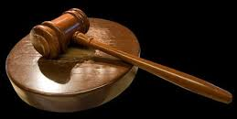
CONSENT: The Law
Sexual Offences (Scotland) Act 2009
http://www.legislation.gov.uk/asp/2009/9/part/2/crossheading/consent
‘Consent’ means free agreement
Circumstances in which conduct takes place without free agreements
(1) For the purposes of section 12, but without prejudice to the generality of that section, free agreement to conduct is absent in the circumstances set out in subsection (2).
(2)Those circumstances are—
(a)where the conduct occurs at a time when B is incapable because of the effect of alcohol or any other substance of consenting to it,
(b)where B agrees or submits to the conduct because of violence used against B or any other person, or because of threats of violence made against B or any other person,
(c)where B agrees or submits to the conduct because B is unlawfully detained by A,
(d)where B agrees or submits to the conduct because B is mistaken, as a result of deception by A, as to the nature or purpose of the conduct,
(e)where B agrees or submits to the conduct because A induces B to agree or submit to the conduct by impersonating a person known personally to B, or
(f)where the only expression or indication of agreement to the conduct is from a person other than B.

Slide 19
As a bystander you might look out for…
Slurred speech or inability to communicate
Falling over
Vomiting
Passing out/in and out of consciousness

Slide 20
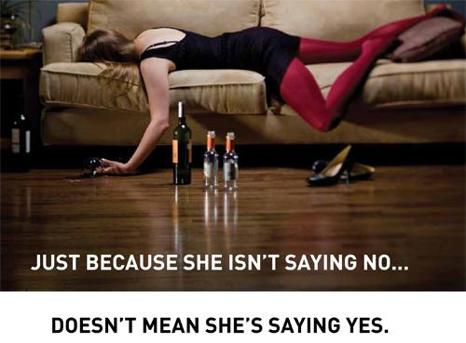

Credit: University of Warwick

Slide 21



8% of respondents to the student survey had had sexual intercourse ‘when they didn’t want to’ because they were, or felt, unable to say ‘no’
(NUS 2011 p.16)
NUS study: NUS (National Union of Students) (2011) (2nd Ed.) Hidden Marks. London: NUS. Online at http://www.nus.org.uk/Global/NUS_hidden_marks_report_2nd_edition_web.pdf

Slide 22
Sexual Assault by Penetration:
Sexual Offences (Scotland) Act 2009 (s.1)
ANUS
VAGINA
PENETRATION BY OBJECT OR OTHER BODY PART (E.G. FINGERS) WITHOUT CONSENT
Max penalty:
life imprisonment

Slide 23
Sexual Assault:
Sexual Offences (Scotland) Act 2009 (s.3)
Max penalty:
10 year imprisonment
SEXUAL TOUCHING WITHOUT CONSENT e.g. TOUCHING BREASTS, GROPING, KISSING.
but…..
The offence is triable summarily or on indictment. Where tried on indictment, the maximum penalty is life imprisonment.

Slide 24
Other behaviours experienced on campus
65% of respondents to NUS survey reported verbal harassment e.g. sexual comments, wolf whistling, catcalling
(NUS 2011: 12)
12% had experienced stalking
(NUS 2011: 11)
16% of student respondents have experienced some form of sexual assault
(NUS 2011: 11)
NUS study: NUS (National Union of Students) (2011) (2nd Ed.) Hidden Marks. London: NUS. Online at http://www.nus.org.uk/Global/NUS_hidden_marks_report_2nd_edition_web.pdf

Slide 25
3. The problem has not been solved
2. Violence is everybody’s problem
1.It goes on within your community
Stage 2: Interpreting Behaviour
or an Event as a Problem
3. It hurts all men because it makes women fear men or their motives
2. It hurts people who we care about
1. You are part of the solution
Stage 3: Feeling Responsible

Slide 26
The Impact on Victims
Short and longer-term reactions may include:
Self blame, depression, fear, avoidance of people or situations, self-harm, trying to ‘forget’ or normalise, leaving university.
Factors impacting on recovery include:
The reactions of other people, self-blame, the availability of support.

Slide 27
The Consequences of Offending Behaviour
Being labelled and known as an abusive person:
Facing friends, family and other students
Possessing a criminal record:
Getting a job and impacting future potential
Being on the sex offender register
Public disclosure of a criminal record by the police

Slide 28
Being a Friend…….
Watching out for a friend who could be a potential victim.
Watching out for a friend who might be unaware that what they are doing or about to do is a crime.
Making someone realise that their behaviour is not acceptable.

Slide 29
Social Norms
College Men overestimate other men’s…
…belief in rape myths
College Men underestimate other men’s…
…discomfort with language or behavior that objectifies or degrades women
…willingness to intervene to prevent a sexual assault
…willingness to use force to have sex
…desire to make sure they have consent when sexually active
(Adapted from Berkowitz, 2011: 167)

Slide 30
The result of misperceptions
1. Misperceptions inhibit bystander intervention. College men are less likely to intervene when they misperceive other men’s willingness to intervene
I’m uncomfortable but I’m the only one

Slide 31
2. Misperceptions may facilitate violent and abusive behaviour in those already pre-disposed to it
‘Overestimating the prevalence of sexual assault was associated with greater likelihood of engaging in sexual assault’ (Neighbors et al 2010 p.6)
‘[M]en who strongly believe in myths are more likely to act on them and perpetrate sexual assaults when they perceive their male peers to have similar attitudes … [and] less likely to act on them when they correctly perceive that other men are not in agreement.’ (Berkowitz 2013 p.21)
Everyone thinks it’s OK

Slide 32
You are Part of the Solution!

Slide 33

What can YOU do?
How might you challenge the cultural context?
What situations might you notice as they occur?
What situations might you prevent beforehand?

Slide 34

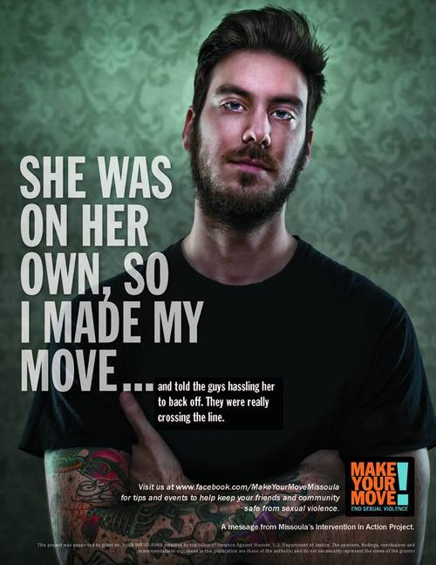

Slide 35
References
Berkowitz, A. (2013). A Grassroots’ Guide to Fostering Healthy Norms to Reduce Violence in our Communities: Social Norms Toolkit. USA: CDC. Online at: www.alanberkowitz.com/Social_Norms_Violence_Prevention_Toolkit.pdf
Berkowitz, A. (2011). “Using How College Men Feel about Being Men and ‘Doing the Right Thing’ to Promote Men’s Development” in Laker, J. and Davis, T., Masculinities in Higher Education: Theoretical and Practical Considerations. Routledge
Neighbors,C., Walker, D.D., Mbilinyi, L.F., O’Rourke, A., Edleson, J.L., Zegree, J., Roffman, R.A. (2010) “Normative misperceptions of abuse among perpetrators of intimate partner abuse”, Violence Against Women, 16(4), 370-386.
HMIC (2007). Without Consent: A report on the joint review of the investigation and prosecution of rape offences. London: HMIC. www.hmcpsi.gov.uk/documents/reports/CJJI_THM/BOTJ/Without_Consent_Thematic.pdf

