Slide 1


The Scottish
Intervention Initiative
Bystander Training
Session 4: Relationship Abuse

Slide 2

We will learn & work together as a group in this programme.
Some of the material is sensitive & some of us will have personal experience of the things we discuss.
We will all be respectful of personal emotions as we learn.
Confidentiality
Appropriate language
Attendance
Communicating with the facilitator
Please be aware that we will be discussing sensitive issues that might have affected you or people you care about.
If you feel uncomfortable or upset it is fine to leave the space.
Facilitators will understand & are trained to help you.

Slide 3
This is a bystander programme:
EMPOWERING YOU AS BYSTANDERS TO INTERVENE TO PREVENT VIOLENCE
Warning: Relationship abuse victims need specialist support – do not try to influence a victim’s decisions about staying in, or leaving, an abusive relationship.

Slide 4
Relationship Abuse
By this we mean abuse between people who may be in an intimate relationship.
This may also be referred to as Domestic Abuse.
Stage 1: Noticing behaviour or an event
We need to understand and learn about relationship abuse in order to be able to notice situations and see behaviours or events as potentially problematic.

Slide 5
Dictator
What does the dictator control?

Slide 6

A student writes…
“I was in a violent relationship for 3 years and felt totally alone; there is a stigma that violence happens only to people of a certain demographic…”
(NUS 2011 p.25)
Domestic abuse can happen to anyone, regardless of age, social background, gender, religion, sexuality or ethnicity
It happens in all kinds of relationships: heterosexual, lesbian, gay, bisexual & transgender
Statistics show the vast majority of domestic abuse incidents are carried out by men & experienced by women
(www.refuge.org.uk)

Slide 7
Scottish Government Definition
Controlling behaviours
Emotional / psychological
Physical
Domestic abuse is gender based violence
Current / ex partners
pattern of coercive control often escalating in frequency and severity over time
Financial
Sexual

Slide 8

Physical violence experienced by a student: “All of the first four [pushed, slapped, shoved or had hair pulled; something thrown at you; kicked, bitten, hit with a fist; choked, dragged, strangled or burnt] have happened to me whilst living with my ex- boyfriend during my 1st and 2nd year of uni, but I considered being choked the most dangerous. He also threatened me.” (NUS 2011 p.16)
Physical violence: punching; slapping; hitting; biting; pinching…
Identifying
Abuse…
There are many other forms of abuse
!! Remember !! it can be any incident or PATTERN of incidents of behaviour

Slide 9
Some subtle and not so subtle signs of abuse. Is your friend…
… being stopped from seeing friends & family?
… having their movements monitored (being checked up on)?
… having their phone & social media monitored?
… having their finances controlled?
… being put down in public?
… being told what to wear, how to behave?
… “walking on eggshells”?
… being coerced to have sex?
… being physically hurt?

Slide 10
**WARNING **
some people may find this video clip
quite difficult to watch
Hollyoaks “This is Abuse”
YouTube: https://youtu.be/r6G4BEfJ0pM
Recognising abuse: a student’s reflection
“I have had to...re-evaluate my thoughts about domestic violence in homosexual relationships. Although I am quite clear in my mind about what is violence and abuse in any…situation, I will admit that I failed to recognise the mistreatment that I was subjected to in an objective manner”
(NUS 2011 p.20)

Slide 11
Male victims report difficulties dealing with the emotional impact of abuse: “You’re used to not being open with your feelings. And it’s quite hard to communicate so you tend to keep things to yourself and they you know sort of eat away at you a bit so…” (p.14)
Lesbian/Gay/Bisexual victims report that their sexuality is used as part of abuse, e.g. with threats to 'out' them. (p.30)
Transgender victims of sexual violence identified it as a hidden issue in the trans-community, not talked about much, and was very unlikely to be reported. (p.31)
BME (Asian) women were anxious about reporting to support workers who were also Asian for fear that confidentiality would be breached to the wider community. (p.45)
LGBT and BME individuals feared potential homophobic or racist reactions from service providers. (p.49)
(Hester, Williamson et al 2012)

Slide 12
Online abuse:
“Most stalking now includes an online element and stalkers will assist their offline activities with online tools as well. Stalking by ex-partners accounts for the largest group of victims with the majority of victims being women” (Women's Aid, Virtual World, Real Fear, 2014)
Student survey found 12% of respondents victims of stalking (including social networking, 89% perpetrators were male (NUS 2011 p.3)
Student survey found that “approximately one quarter of stalking victims (27 per cent) reported that their mental health, studies & relationships had been affected.” (NUS 2011 p.27)
‘Revenge porn’ - sharing private sexually explicit photographs / films without consent with the intention of causing distress is now a criminal offence (The Abusive Behaviour and Sexual Harm (Scotland) Act)

Slide 13
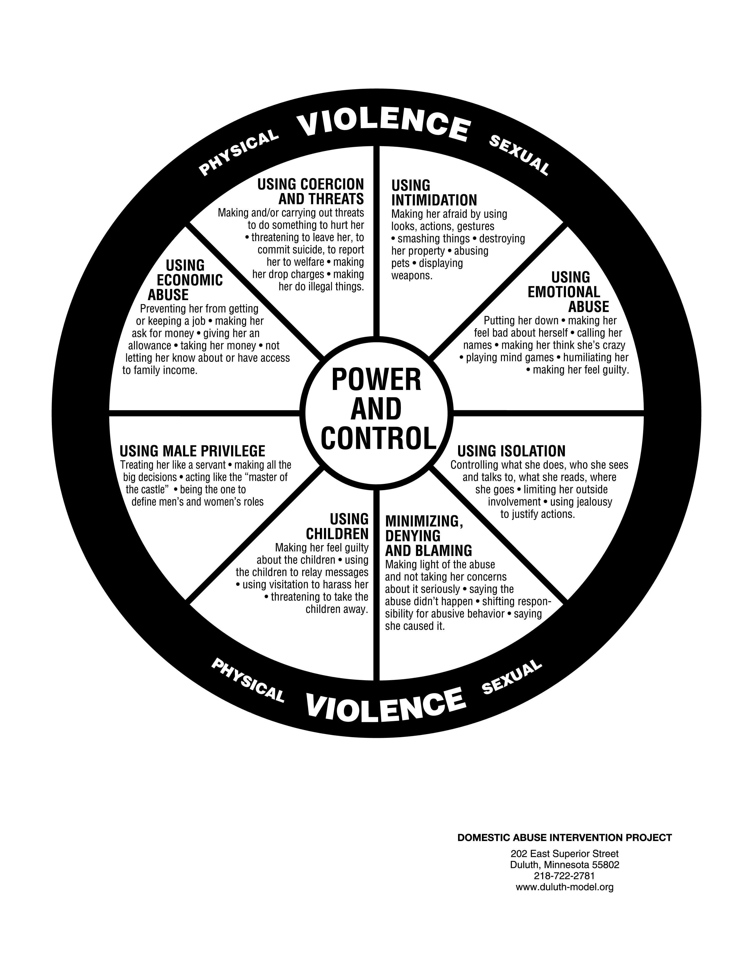
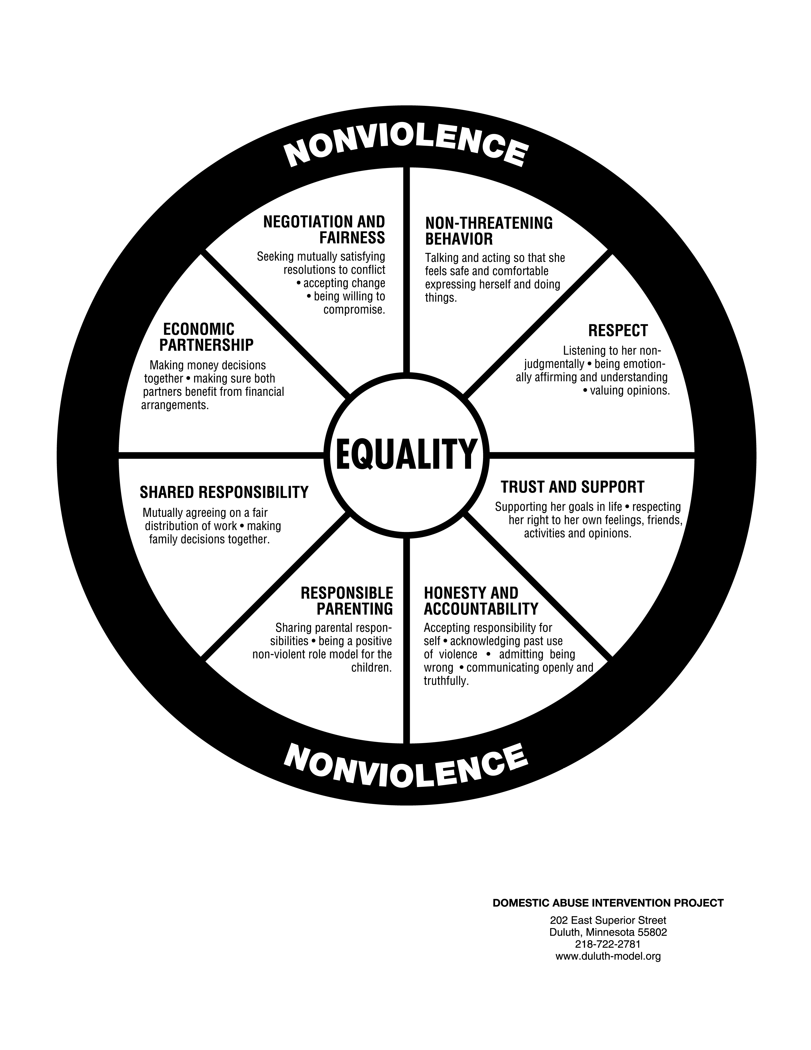
The Duluth Wheels

Slide 14
Statistics
1 in 4 women will experience domestic abuse at some point in their lives (Glasgow Women’s Aid)
Both men and women can be perpetrators.
Men more likely to be repeat offenders, men’s violence is more severe and tends to create a context of fear (Hester, 2013)
Women are also more likely to have experienced multiple incidents of abuse. Indeed, 89% of those individuals who have been subject to 4 or more incidents of DA (same perpetrator) since the age of 16 are women (Walby & Allen, 2004)
The average length of the abusive relationship is 5 years (CAADA, 2012).(http://www.caada.org.uk/policy/statistics.html)

Slide 15
consequences
Whilst domestic abuse is experienced by both women and men regardless of sexuality, there are some key differences
impact

Slide 16
IMPACT is gendered:
Teenage girls report much higher levels of negative impact on their welfare than boys (NSPCC, Barter , McCarry , Berridge and Evans 2009)
Differing Impact of Partner Abuse by Gender
Scotland | Men | Women
 | % Victims
psychological or emotional problems | 29% | 47%
fear, anxiety and panic attacks | 11% | 27%
scratches and minor cuts | 22% | 10%
four or more psychological effects* | 5% | 20%
three or more physical effects | 2% | 10%
Source: Scottish Crime and Justice Survey 2012/13: Partner Abuse (2014) statistically significant

Slide 17
CONSEQUENCES are gendered:
Women are much more likely to be high risk victims:
96% of all high risk of serious harm or murder cases referred to MARAC (multi-agency risk assessment conference) were women (57,900 in 2012-2013) .
(http://www.hmic.gov.uk/wp-content/uploads/2014/04/improving-the-police-response-to-domestic-abuse.pdf (pp.28,30)

Slide 18
Q.
A.
South Africa
B.
UK
C.
South America
Where in the world are 2 women a week killed by their partner or
ex-partner?*
* http://kareningalasmith.com/counting-dead-women

Slide 19
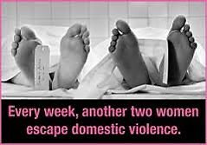
Q.
A.
South Africa
B.
UK
C.
South America
Where in the world are 2 women a week killed by their partner or
ex-partner?*
Shockingly, 2 women a week are killed by their partner or ex-partner in the UK
www.refuge.org.uk
* http://kareningalasmith.com/counting-dead-women

Slide 20
Escalation
Domestic abuse is rarely a one-off. Incidents generally become more frequent and severe over time
(www.refuge.org.uk; Scottish Government, 2014 )

Slide 21
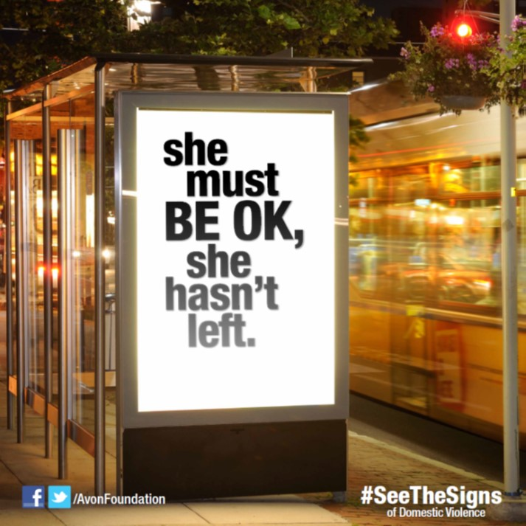
“So why doesn’t she just leave?”

Slide 22
Reasons it can be extremely difficult to leave an abusive partner:
Fear what partner will do if they leave
Practical considerations (money, housing, children, language, isolation, where to go)
Women from different cultures can find it particularly difficult to leave an abusive man as this would bring shame on both themselves and their family. They may feel like they are betraying their community if they contact the police.
The self-esteem of a person being abused will have been steadily worn down so may feel there are no other options or cannot manage alone.
Feel ashamed of what has happened and believe the abuse is their fault.
Hope that partner will change (investment in relationship)
(Adapted from Refuge and Women’s Aid)

Slide 23
Domestic abuse victims need specialist support
“Don’t tell her to leave or criticise her for staying. Although you may want her to leave, she has to make that decision in her own time. It is important to remember that research shows an abused woman is at most risk at the point of separation and immediately after leaving an abusive partner.”
(UK National Domestic Violence helpline)
“I won’t judge you”

Slide 24
A student on being judged:
“I was in a violent relationship for 3 years and felt totally alone; there is a stigma that violence happens only to people of a certain demographic ….When I spoke to my friends I always felt slightly judged, the classic ‘you are clever, why didn’t you leave’. Only now have I come to see that this was not my fault for being weak. ” (NUS 2011 p25)
One respondent explained why she had not told family members that her boyfriend was physically abusing her:
“You never think it will happen to you and I always thought if it did I would be defiant and hit him back. When it did happen to me, I didn't know how to react. I still haven't told my family because I don’t want them to be disappointed in me.” (NUS 2011 p.26)

Slide 25
Stage 2: Interpreting it as a Problem
It is going on all around you, in your community
The increase in online abuse means the problem is going to get worse
Domestic abuse is not a problem that has been solved!
VIOLENCE & ABUSE IS EVERYBODY’S PROBLEM
YOU ARE PART OF THE SOLUTION!

Slide 26
Young people are at risk
Appendix table 4.09: Percentage of adults aged 16 to 59 who were victims of intimate violence^{1,2} in the last year, by headline categories, personal characteristics³ and sex, 2012/13 CSEW (Crime Survey for England and Wales, Office for National Statistics)
England and Wales | Adults aged 16 to 59
 | Any domestic abuse |  | Partner abuse (non-sexual) |  | Family abuse (non-sexual) |  | Sexual assault |  | Stalking |  | Unweighted base⁴
 | Men | Women | Men | Women | Men | Women | Men | Women | Men | Women | Men | Women
ALL ADULTS | Percentage victims once or more⁵
 | 4.4 | 7.1 | 2.8 | 4.0 | 1.5 | 2.2 | 0.5 | 2.0 | 1.9 | 4.1 | 4,285 | 5,237
Age group
16-19 | 7.5 | 11.3 | 3.6 | 6.3 | 3.9 | 5.5 | 1.2 | 7.0 | 2.6 | 4.7 | 258 | 246
20-24 | 6.9 | 12.5 | 5.1 | 7.4 | 2.3 | 3.5 | 0.3 | 4.3 | 1.5 | 6.9 | 334 | 433
25-34 | 4.8 | 7.0 | 3.3 | 4.3 | 1.8 | 1.6 | 1.0 | 1.8 | 1.4 | 4.2 | 914 | 1,245
35-44 | 3.1 | 6.9 | 1.8 | 3.6 | 0.5 | 2.5 | 0.0 | 0.8 | 2.2 | 4.1 | 1,057 | 1,389
45-54 | 3.4 | 4.7 | 2.3 | 2.6 | 1.1 | 1.4 | 0.4 | 1.1 | 2.3 | 3.1 | 1,184 | 1,327
55-59 | 2.4 | 2.7 | 1.1 | 1.5 | 0.9 | 0.7 | 0.0 | 0.5 | 1.3 | 2.0 | 538 | 597

Slide 27
STAGE 3: Feeling Responsible
*You are part of the community in which this is taking place*
We all have a responsibility to speak out
Domestic abuse is a crime. It must not be ignored.
Domestic abuse is protected by people's silence. If we do not speak out against it, we become part of the problem.
It hurts people who we care about.
Domestic violence affects us all
Many victims suffer in silence. By reaching out to a friend, you can help break their isolation.
People being abused need their friends more than ever.
People being abused often do not realise that what they are experiencing is domestic abuse. You can help your friend to recognise the signs and be safe.
(www.refuge.org)

Slide 28
A student writes:
“Preconceptions of domestic violence are so deeply-rooted that people think it doesn't happen in student relationships. It also means that people generally have no idea how to handle the situation. I can now forgive friends who didn't know where to stand at the time, but educating students is vital if we wish to fully support sufferers.”
(http://www.theguardian.com/education/mortarboard/2014/mar/07/domestic-violence-students-universities)

Slide 29
Mental Health Impact of Domestic Abuse:
Studies affected
Relationships affected
Post-traumatic stress
Anxiety
Depression
Panic attacks
Sense of isolation
Loss of confidence
Suicidal thoughts
Adapted from:
Horley, S. (2001). Power & Control. London: Random House;
NUS (2011) Hidden Marks report;
WHO (2005) Multicountry Study on Women’s Health and Domestic Violence Against Women.

Slide 30
Cost to society:
Domestic abuse costs the Scottish economy £2.3 billion a year and the UK tax payer an estimated £15.7bn per year (Scottish Government; Walby, 2009)
2015-16 - 58,104 DA incidents recorded by Police Scotland (Scot Gvt, 2016)
Domestic Abuse related crime is
8% of total crime
11% of all recorded sexual offences
33% of all recorded assault with injury crimes
49% of all recorded harassment crimes
On average every 30 seconds someone contacts the police for assistance with domestic abuse 2012-2013
(http://www.hmic.gov.uk/wp-content/uploads/2014/04/improving-the-police-response-to-domestic-abuse.pdf - p.28)

Slide 31
Impact on offender
Domestic Abuse (Scotland) Act 2018
The offence is committed when three specific conditions are met.
the perpetrator engages in a course of behaviour that is abusive of their partner or ex-partner.
a reasonable person would consider the course of behaviour to be likely to cause their partner or ex-partner to suffer physical or psychological harm.
the perpetrator either intends to cause the victim to suffer harm or is reckless as to whether the course of behaviour causes the victim to suffer harm.
Massive consequences for future potential

Slide 32
BEING A FRIEND:
Noticing signs that a friend is being abused and reaching out
Noticing signs that a friend is engaging in problematic behaviour and making them realise that their behaviour is not acceptable and they may be committing an offence.

Slide 33
Social Norms
(Neighbors, C., Walker, D. D., Mbilinyi, L. F., O'Rourke, A., Edleson, J. L., Zegree, J., & Roffman, R. A. (2010). Normative misperceptions of abuse among perpetrators of intimate partner violence. Violence Against Women, 16(4), 370-386. DOI: 10.1177/1077801210363608 (p. 376))

Slide 34
The result of misperceptions
Misperceptions inhibit bystander intervention.
I’m uncomfortable but I’m the only one

Slide 35
2. Research has found that the more male perpetrators of intimate partner violence overestimate other men’s violent and abusive behaviour, the more they report engaging in psychological abuse and physical violence.
(Neighbors et al 2010 p.6)
Most people thinks it’s OK

Slide 36
You are Part of the Solution!

Slide 37

What can YOU do?
How might you challenge the cultural context?
What situations might you notice as they occur?
What situations might you prevent beforehand?

Slide 38
References
Hester, M., Williamson,E., Regan, L., Coulter, M., Chantler, K., Gangoli, G., Davenport, R., & Green, L. (2012) Exploring the service and support needs of male, lesbian, gay, bi-sexual and transgendered and black and other minority ethnic victims of domestic and sexual violence, University of Bristol.
Hester, M. (2013) “English police records Who does what to whom? Gender and domestic violence perpetrators”, European Journal of Criminology 10: 623
Barter, C., McCarry, M., Berridge D., and Evans, K. (2009) Partner exploitation and violence in teenage intimate relationships, NSPCC.

