Slide 1


The Scottish
Intervention Initiative
Bystander Training
Session 1: Introducing the Bystander

Slide 2

We will learn & work together as a group in this programme.
Some of the material is sensitive & some of us will have personal experience of the things we discuss.
We will all be respectful of personal emotions as we learn.
Confidentiality
Appropriate language
Attendance
Communicating with the facilitator
Please be aware that we will be discussing sensitive issues that might have affected you or people you care about.
If you feel uncomfortable or upset it is fine to leave the space.
Facilitators will understand & are trained to help you.

Slide 3
Who is a Bystander?
Not involved in the event (not a victim or perpetrator)
Witnesses a situation

Slide 4
Type of Bystander?
Passive bystander
(does nothing)
Active or prosocial
bystander (intervenes)

Slide 5
It’s a lovely sunny day and you are sitting by the river on your own, no one else is around. Suddenly you hear splashing and screaming for help. A person is caught in the current and drowning.
You are the bystander. There is no mobile phone signal. You can swim. There is a life ring on the riverbank.
What do you do?
[Adapted from Crapser, B. G., & Stewart, A. L. (2014). Men's Project: Sexual assault prevention program for college men program manual. Storrs, CT: University of Connecticut,pp.26-27]

Slide 6
A bystander can intervene to stop events before they happen or while they are happening
a bystander can PREVENT the potential outcome as well as deal with an outcome.

Slide 7
Not laughing at a joke
What is an Intervention?
Distraction
Interruption
Facebook post
Body language signaling disapproval
Being supportive to friends
Its not all about confrontation!

Slide 8
4 Stages for Intervention
3. Feel responsible for dealing with it
2. Interpret it as a problem
1. Notice the event
4. Possess necessary skills to act
[Adapted from Berkowitz, A. (2009) Response Ability: A Complete Guide to Bystander Intervention, Beck & Co., p. 10]

Slide 9
Reasons for non-intervention
1. Social influence / identity
2. Audience inhibition
3. Diffusion of responsibility
4. Fear of retaliation
5. Pluralistic ignorance
[Adapted from Berkowitz, A. (2009) Response Ability: A Complete Guide to Bystander Intervention, Beck & Co., p.18]

Slide 10
But from the perspective of those in the minority –
they believe they are in the majority (false consensus) and that their behaviour is not problematic.
Acceptable/Majority Behaviour

Slide 11
Where We Need to Get To
Unacceptable behaviour becomes SO socially rejected (clearly defined as unacceptable) that most people stop doing it.
Healthy & Positive Majority Behaviour

Slide 12
How can we help to alter behaviour?
?

Slide 13
Not cool
Not okay
You’re better than that
This is making me uncomfortable
Don’t be an eejit

Slide 14

Only intervene when it is safe for you to do so. If not safe, in an emergency, dial 999.

Slide 15

This programme is
specifically about
bystander intervention
in sexual violence &
domestic abuse.

Slide 16
Why? Evidence shows that:
77% students have experienced sexual harassment
(Cambridge 2014 p.6)
91% of perpetrators of sexual assault were men
(Cambridge 2014 p.6)
Women aged 16-24 have higher risk of experiencing domestic abuse (ONS 2013)
12% women students subjected to stalking
(NUS 2011 p.3)
28.5% students experienced sexual assault
(Cambridge 2014 p.6)
85% experienced a negative impact on their mental health
(Cambridge 2014 p.6)
7% women students experienced a serious sexual assault
(NUS 2011 p.3)
References at end of slide show

Slide 17
Key Points
Domestic abuse, sexual coercion & rape in student populations are a serious and widespread problem.
Anyone can experience the trauma of being in an abusive relationship or situation & anyone can be an abuser.
However…
The majority of harm is experienced by women & the majority of people who do the harming are men.
But…
This doesn’t mean that ‘most men’ or ‘all men’ are offenders or that ‘no women’ are offenders!

Slide 18
How does this make you feel?
Research indicates that:
“Prevention messages can be heard by some…as defining all men as perpetrators only and women only as victims”
(Powell 2011)

Slide 19
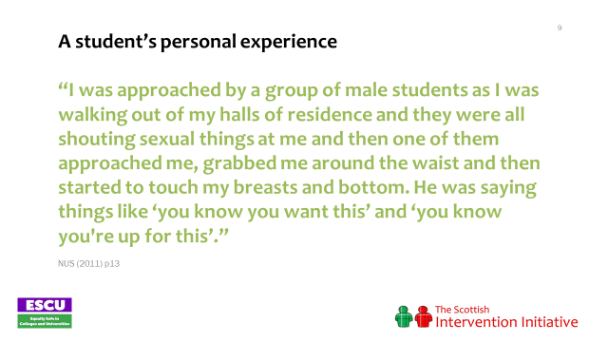

Slide 20
Stage 1: Noticing behaviour or an event
We need to understand and learn about rape and sexual assault in order to be able to notice situations and see behaviours or events as potentially problematic.
Q.
What percentage
of rapes are committed by someone known
to the victim?
A.
35%
B.
71%
C.
85%

Slide 21
FACTS
Rape is rarely committed by strangers: 85 % of reported rapes are carried out by someone known to the victim.
(HMIC, 2007)
NUS survey found that the majority of perpetrators of stalking, sexual assault & physical violence were already known to the victim.
(NUS 2011 p.19)

Slide 22
Q.
A.
Agree
B.
Disagree
C.
Unsure
‘A rape victim will resist & fight the attacker & there will be signs of injury.
Victim Resistance …
How do victims of rape resist?
Physical resistance: fighting, hitting, struggling, running away
Verbal resistance: telling the perpetrator(s) to stop, persuasion, shouting, screaming
Not all victims resist. Why is this?
Fear (the ‘freeze fright’ response)
the use of weapons
multiple assailants or threats
I JUST FROZE – Rape Crisis Scotland
https://vimeo.com/205066680

Slide 23
A student’s experience: questions about masculinity?
‘My main problem was dealing with the fact that men can get raped too. Others said I should have beaten him up or been more of a man or that it was a lesson for being seen as a bit promiscuous at times.’
(Cambridge 2014 p.20)
Cambridge study: CUSU (Cambridge University Students' Union) (2014). Cambridge Speaks Out. Cambridge: CUSU Women's Campaign. Online at http://www.womens.cusu.cam.ac.uk/Cambridge%20Speaks%20Out%20Report%202014.pdf

Slide 24
Q.
A person who is drunk or using drugs…
A.
should be held responsible if they are sexually assaulted or raped.
B.
should be held partly responsible if they are sexually assaulted or raped.
C.
are NEVER responsible if they are sexually assaulted or raped.
Why rape is not the victim’s fault
Rape is a violation & act of violence with harmful consequences.
Responsibility only lies with the perpetrator.
Nobody has a right to your body without your consent, no matter what you do or how you behave.

Slide 25
RAPE: Sexual Offences (Scotland) Act 2009 (s.1)
ANUS
VAGINA
MOUTH
INTENTIONAL PENETRATION by PENIS WITHOUT CONSENT
Max penalty:
life imprisonment

Slide 26
Sexual Offences (Scotland) Act 2009
FREEDOM
CHOICE
CAPACITY
CONSENT

Slide 27
Q.
If a woman does not
clearly say NO to a man then…
A.
she should be held responsible if she is sexually assaulted or raped.
B.
she should be held partly responsible if she is sexually assaulted or raped.
C.
she is NEVER responsible if she is sexually assaulted or raped.
The absence of a No does NOT mean that sex is consensual.
Someone who is asleep or unconscious cannot consent to sexual activity.
Someone who is very drunk or drugged may not have capacity to give consent.

Slide 28



8% of respondents to the student survey had had sexual intercourse ‘when they didn’t want to’ because they were, or felt, unable to say ‘no’
(NUS 2011 p.16)
NUS study: NUS (National Union of Students) (2011) (2nd Ed.) Hidden Marks. London: NUS. Online at http://www.nus.org.uk/Global/NUS_hidden_marks_report_2nd_edition_web.pdf

Slide 29
Sexual Assault by Penetration:
Sexual Offences (Scotland) Act 2009 (s.1)
ANUS
VAGINA
PENETRATION BY OBJECT OR OTHER BODY PART (E.G. FINGERS) WITHOUT CONSENT
Max penalty:
life imprisonment

Slide 30
Sexual Assault:
Sexual Offences (Scotland) Act 2009 (s.3)
Max penalty:
10 year imprisonment
SEXUAL TOUCHING WITHOUT CONSENT e.g. TOUCHING BREASTS, GROPING, KISSING.
but…..
The offence is triable summarily or on indictment. Where tried on indictment, the maximum penalty is life imprisonment.

Slide 31
Other behaviours experienced on campus
65% of respondents to NUS survey reported verbal harassment e.g. sexual comments, wolf whistling, catcalling
(NUS 2011: 12)
12% had experienced stalking
(NUS 2011: 11)
16% of student respondents have experienced some form of sexual assault
(NUS 2011: 11)
NUS study: NUS (National Union of Students) (2011) (2nd Ed.) Hidden Marks. London: NUS. Online at http://www.nus.org.uk/Global/NUS_hidden_marks_report_2nd_edition_web.pdf

Slide 32
Dictator
What does the dictator control?

Slide 33
A student writes…
“I was in a violent relationship for 3 years and felt totally alone; there is a stigma that violence happens only to people of a certain demographic…”
(NUS 2011 p.25)
Domestic abuse can happen to anyone, regardless of age, social background, gender, religion, sexuality or ethnicity
It happens in all kinds of relationships: heterosexual, lesbian, gay, bisexual & transgender
Statistics show the vast majority of domestic abuse incidents are carried out by men & experienced by women
(www.refuge.org.uk)

Slide 34
Scottish Government Definition
Controlling behaviours
Emotional / psychological
Physical
Domestic abuse is gender based violence
Current / ex partners
pattern of coercive control often escalating in frequency and severity over time
Financial
Sexual

Slide 35

Physical violence experienced by a student: “All of the first four [pushed, slapped, shoved or had hair pulled; something thrown at you; kicked, bitten, hit with a fist; choked, dragged, strangled or burnt] have happened to me whilst living with my ex- boyfriend during my 1st and 2nd year of uni, but I considered being choked the most dangerous. He also threatened me.” (NUS 2011 p.16)
Physical violence: punching; slapping; hitting; biting; pinching…
Identifying
Abuse…
There are many other forms of abuse
!! Remember !! it can be any incident or PATTERN of incidents of behaviour

Slide 36
Some subtle and not so subtle signs of abuse. Is your friend…
… being stopped from seeing friends & family?
… having their movements monitored (being checked up on)?
… having their phone & social media monitored?
… having their finances controlled?
… being put down in public?
… being told what to wear, how to behave?
… “walking on eggshells”?
… being coerced to have sex?
… being physically hurt?

Slide 37
Male victims report difficulties dealing with the emotional impact of abuse: “You’re used to not being open with your feelings. And it’s quite hard to communicate so you tend to keep things to yourself and they you know sort of eat away at you a bit so…” (p.14)
Lesbian/Gay/Bisexual victims report that their sexuality is used as part of abuse, e.g. with threats to 'out' them. (p.30)
Transgender victims of sexual violence identified it as a hidden issue in the trans-community, not talked about much, and was very unlikely to be reported. (p.31)
BME (Asian) women were anxious about reporting to support workers who were also Asian for fear that confidentiality would be breached to the wider community. (p.45)
LGBT and BME individuals feared potential homophobic or racist reactions from service providers. (p.49)
(Hester, Williamson et al 2012)

Slide 38
Online abuse:
“Most stalking now includes an online element and stalkers will assist their offline activities with online tools as well. Stalking by ex-partners accounts for the largest group of victims with the majority of victims being women” (Women's Aid, Virtual World, Real Fear, 2014)
Student survey found 12% of respondents victims of stalking (including social networking, 89% perpetrators were male (NUS 2011 p.3)
Student survey found that “approximately one quarter of stalking victims (27 per cent) reported that their mental health, studies & relationships had been affected.” (NUS 2011 p.27)
‘Revenge porn’ - sharing private sexually explicit photographs / films without consent with the intention of causing distress is now a criminal offence (The Abusive Behaviour and Sexual Harm (Scotland) Act)

Slide 39
Statistics
1 in 4 women will experience domestic abuse at some point in their lives (Glasgow Women’s Aid)
Both men and women can be perpetrators.
Men more likely to be repeat offenders, men’s violence is more severe and tends to create a context of fear (Hester, 2013)
Women are also more likely to have experienced multiple incidents of abuse. Indeed, 89% of those individuals who have been subject to 4 or more incidents of DA (same perpetrator) since the age of 16 are women (Walby & Allen, 2004)
The average length of the abusive relationship is 5 years (CAADA, 2012).(http://www.caada.org.uk/policy/statistics.html)

Slide 40
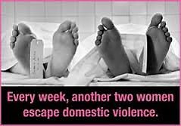
Q.
A.
South Africa
B.
UK
C.
South America
Where in the world are 2 women a week killed by their partner or
ex-partner?*
Shockingly, 2 women a week are killed by their partner or ex-partner in the UK
www.refuge.org.uk
* http://kareningalasmith.com/counting-dead-women

Slide 41
Escalation
Domestic abuse is rarely a one-off. Incidents generally become more frequent and severe over time
(www.refuge.org.uk; Scottish Government, 2014 )

Slide 42
STAGE 3: Feeling Responsible
*You are part of the community in which this is taking place*
We all have a responsibility to speak out
Domestic abuse is a crime. It must not be ignored.
Domestic abuse is protected by people's silence. If we do not speak out against it, we become part of the problem.
It hurts people who we care about.
Domestic violence affects us all
Many victims suffer in silence. By reaching out to a friend, you can help break their isolation.
People being abused need their friends more than ever.
People being abused often do not realise that what they are experiencing is domestic abuse. You can help your friend to recognise the signs and be safe.
(www.refuge.org)

Slide 43
A student writes:
“Preconceptions of domestic violence are so deeply-rooted that people think it doesn't happen in student relationships. It also means that people generally have no idea how to handle the situation. I can now forgive friends who didn't know where to stand at the time, but educating students is vital if we wish to fully support sufferers.”
(http://www.theguardian.com/education/mortarboard/2014/mar/07/domestic-violence-students-universities)

Slide 44
Mental Health Impact of Domestic Abuse:
Studies affected
Relationships affected
Post-traumatic stress
Anxiety
Depression
Panic attacks
Sense of isolation
Loss of confidence
Suicidal thoughts
Adapted from:
Horley, S. (2001). Power & Control. London: Random House;
NUS (2011) Hidden Marks report;
WHO (2005) Multicountry Study on Women’s Health and Domestic Violence Against Women.

Slide 45
Cost to society:
Domestic abuse costs the Scottish economy £2.3 billion a year and the UK tax payer an estimated £15.7bn per year (Scottish Government; Walby, 2009)
2015-16 - 58,104 DA incidents recorded by Police Scotland (Scot Gvt, 2016)
Domestic Abuse related crime is
8% of total crime
11% of all recorded sexual offences
33% of all recorded assault with injury crimes
49% of all recorded harassment crimes
On average every 30 seconds someone contacts the police for assistance with domestic abuse 2012-2013
(http://www.hmic.gov.uk/wp-content/uploads/2014/04/improving-the-police-response-to-domestic-abuse.pdf - p.28)

Slide 46

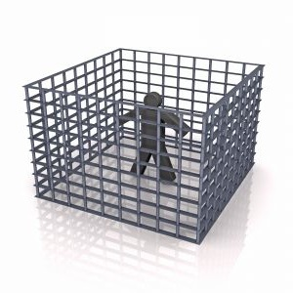


Slide 47
“We are Man”
YouTube: https://youtu.be/ZYhaodUPqSU
“But what’s the problem with
a bit of harmless banter?
It’s only a joke”
Blurred Lines: The New Battle of the Sexes [television programme, online] 21:30 8/5/2014, BBC TWO, 60mins. https://ls-video2.ces.strath.ac.uk/View.aspx?id=10857~5i~adregWkf8q
Time on Clip (20.20-23.43)

Slide 48
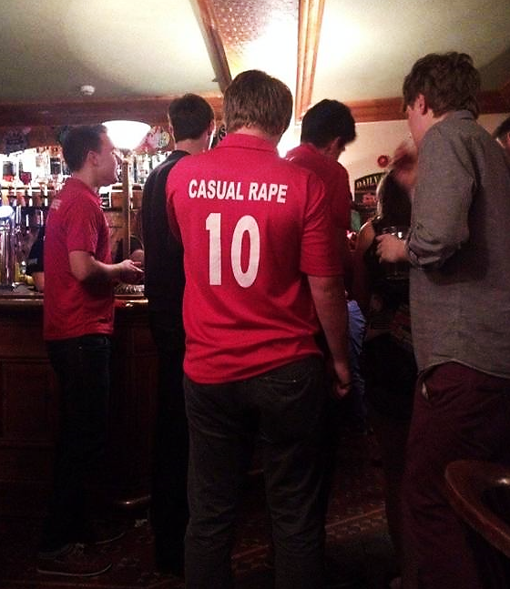
“Lad Culture”?
On Friday night at Syndicate a young female fresher passed out about 1am. Nobody moved to help her get up but four boys crowded around taking upskirt photos.
Freshers’ week at Bristol University September 2013 via Facebook
A rugby club at Oxford University has been banned from competing & had its leadership dismissed after organising a "free pussy" event, which instructed students to spike their dates' drinks.
Huffpo, 5/11/13
Aberystwyth University men's cricket club (AUMCC) social last year. The team were banned from playing & had their funding withdrawn.

Slide 49
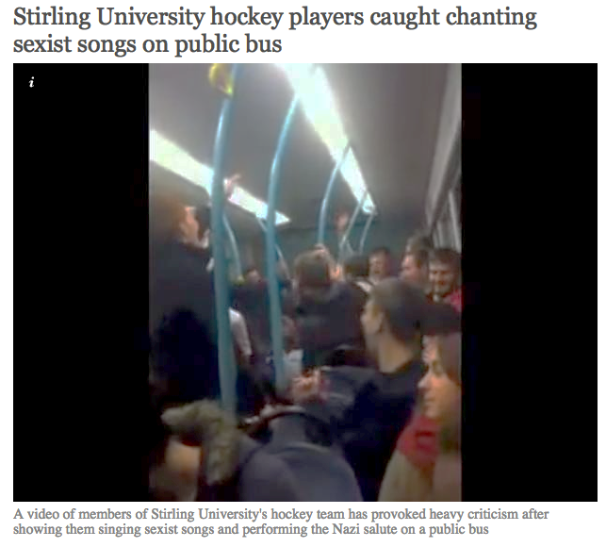
Edinburgh rugby players chant rape jokes at female students.
Boozed-up rugby players yelled jokes about “gang rape” at female students in the queue outside Edinburgh Students’ Union on Saturday night.
The Tab, 25/09/2014
“Lad Culture”?
The Times Higher Education Supplement, 8/3/2013
The Independent, 6/10/2014
‘I found photos of me in pyjamas in my bed on some boys’ WhatsApp group,’ student Rosie Wilcox says. ‘They did the same to one of my friends and she wasn’t wearing anything… They thought it was really funny but she was devastated’
The Guardian: “Campus Nightmare”, 11/10/2014
Government orders inquiry over violence against women at universities
The Guardian 6/9/15
The Independent, 15/11/2013

Slide 50
HOMICIDE
SUICIDE
PHYSICAL EXPRESSION:
PHYSICAL/SEXUAL ASSAULT
CULTURAL MICROAGGRESSIONS (SUBTLE, INTENTIONAL OR UNINTENTIONAL): CULTURAL INVISIBILITY, SOCIAL EXCLUSION, MISPREPRESENTATION, VIOLENT PORN
VERBAL EXPRESSION:
SEXUAL HARASSMENT
MAKING SEXUAL JOKES
ATTITUDES & BELIEFS: RACISM SEXISM HOMOPHOBIA TRANSPHOBIA DISABLISM AGEISM
DISCRIMINATION
Ideas incorporated from ccasayourworld.com; McMahon & Banyard, 2012 DOI: 10.1177/1524838011426015

Slide 51
Research shows…
“Men … report that they do not personally believe in many societal myths about masculinity but believe that other men do”
(Fabiano et al., 2003)
Men often underestimate the extent to which other men are uncomfortable with stereotypical (negative) masculine behaviour.
(studies cited in Berkowitz, 2013)
Fabiano, P. M., Perkins, H. W., Berkowitz, A., Linkenbach, J., & Stark, C. (2003). Engaging men as social justice allies in ending violence against women: Evidence for a social norms approach. Journal of American College Health, 52(3), 105-112.
Berkowitz, A. (2013). A Grassroots’ Guide to Fostering Healthy Norms to Reduce Violence in our Communities: Social Norms Toolkit. USA: CDC. Online at http://www.alanberkowitz.com/Social_Norms_Violence_Prevention_Toolkit.pdf

Slide 52
Where We Are
Healthy & Positive Behaviour (Majority)
Problematic
Behaviour
Unacceptable Behaviour (Minority)

Slide 53
I’m uncomfortable but I’m the only one
***
!!!
***

Slide 54
***
!!!
***
Don’t say stuff like that.

Slide 55
Social Norms Feedback 1
Students at Strathclyde rate themselves as less supportive of sexual violence and rape myths than their peers.
“Would stop sexual activity when asked to even if aroused”
NORM
Actual (self) | Perceived (Peers)
88.4% | 79.9%
Agree: “When girls go to parties wearing slutty clothes they are asking for trouble”
NORM
Actual (self) | Perceived (Peers)
2.1% | 30%
Agree: “If a girl doesn’t physically resist sex – even if protesting verbally - it really can’t be considered rape”
NORM
Actual (self) | Perceived (Peers)
2.6% | 18%

Slide 56
Strathclyde students: Perceived peer norm
Who Agree: If a girl doesn’t physically resist sex – even if protesting verbally – that it really can’t be considered rape?
Disagree
82%
Agree
18%

Slide 57

Strathclyde students: ACTUAL norm
Who Agree: If a girl doesn’t physically resist sex – even if protesting verbally – that it really can’t be considered rape?
Disagree
97.4%
Agree
2.6%

Slide 58
The Result of Misperceptions
I’m uncomfortable but I’m the only one
***
!!!
***
Don’t say stuff like that.
Strathclyde students think more people hold problematic views about sexual violence than is actually the case: Your views are the majority, healthy positive views.

Slide 59
Social Norms Feedback 2
and... for helping behaviour (positive bystander behaviour) we think others are less likely to help than we are ourselves.
Likely to approach a friend in an abusive relationship to offer help
NORM
Actual (self) | Perceived (Peers)
96% | 84%
Do something to help a person who appears intoxicated being taken upstairs at a party
NORM
Actual (self) | Perceived (Peers)
2.1% (Men) | 30% (Men)
87% (Women) | 81% (Women)

Slide 60
Social Norms
(Neighbors, C., Walker, D. D., Mbilinyi, L. F., O'Rourke, A., Edleson, J. L., Zegree, J., & Roffman, R. A. (2010). Normative misperceptions of abuse among perpetrators of intimate partner violence. Violence Against Women, 16(4), 370-386. DOI: 10.1177/1077801210363608 (p. 376))

Slide 61
The result of misperceptions
Misperceptions inhibit bystander intervention.
I’m uncomfortable but I’m the only one

Slide 62
2. Research has found that the more male perpetrators of intimate partner violence overestimate other men’s violent and abusive behaviour, the more they report engaging in psychological abuse and physical violence.
(Neighbors et al 2010 p.6)
Most people thinks it’s OK

Slide 63
You are Part of the Solution!

Slide 64
**WARNING**
Some viewers may find this clip difficult
to watch
New Zealand Bystander Video
YouTube: https://youtu.be/iUj2OHLAG3w

Slide 65
Bystander Intervention Options
Decide to Intervene
Indirect (to the Bystander)
During the Incident
Direct (to the Offender)
OR
After the Incident
Assess norm
Engage allies & bystanders
Make a plan
Develop a support for next step
Offer support to the victim
Confrontation:
Set limits or express feelings
Change the focus:
Non-participation
Change the subject
Interrupt / distract
Change the person/shift attitudes
Adapted from Berkowitz, A. (2013). A Grassroots’ Guide to Fostering Healthy Norms to Reduce Violence in our Communities: Social Norms Toolkit. USA: CDC. Online at: http://www.alanberkowitz.com/Social_Norms_Violence_Prevention_Toolkit.pdf

