Slide 1
Training for Trainers

Slide 2
We will be learning and working together as a group in this programme
Some of the material we will be discussing will be sensitive and some of us will have had personal experience of the things we discuss
We will all be respectful of personal emotions as we learn
Confidentiality
Appropriate language
Attendance
Communicating with the facilitator
Please be aware that we will be talking about sensitive issues and issues that might have affected you or people you care about. If you feel uncomfortable or upset it is fine to leave the space. Facilitators will understand and are trained to help you.

Slide 3
Facilitators
Name of facilitator 1
Contact details
Name of facilitator 2
Contact details

Slide 4
Do you have any thoughts, questions, and concerns about The Scottish Intervention Initiative and delivering it?

Slide 5
Aims of the Course
To equip you to deliver the Scottish Intervention Initiative to university staff and students

Slide 6
Learning Outcomes
3. To respond safely and sensitively to disclosures and know where and when to access appropriate support
2. To define the role of the facilitators and gain skills and confidence in facilitating
1. To understand the context and rationale for delivering The Scottish Intervention Initiative
4. To respond to tricky situations and questions in a sensitive and confident way

Slide 7
Session One
Context and Rationale of the Scottish Intervention Initiative

Slide 8
Evidence shows that:
77% students have experienced sexual harassment
(Cambridge 2014 p.6)
Women aged 16-24 have higher risk of experiencing domestic violence (ONS 2013)
12% women students subjected to stalking
(NUS 2011 p.3)
91% of perpetrators of sexual assault were men
(Cambridge 2014 p.6)
28.5% students experienced sexual assault
(Cambridge 2014 p.6)
85% experienced a negative impact on their mental health
(Cambridge 2014 p.6)
7% women students experienced a serious sexual assault
(NUS 2011 p.3)

Slide 9
Evidence also shows that:
20% of sexual crimes are ‘communicating indecently’ and ‘viewing sexual activity or images’; often cyber-enabled (Scottish Government, 2017)
27.1% women (13.2% men) experienced domestic abuse since age 16
(Office for National Statistics, 2016)
18.6% women aged 18–24 (5.3% men) experienced sexual victimisation in childhood
(Radford, Corral, Bradley & Fisher, 2013, UK)
52% women (63% aged 18-24) have experienced some form of sexual harassment at work
(TUC, 2016)
54% and 17% working women experienced sexual harassment by a colleague or direct manager, respectively
(TUC, 2016)
79% of ‘other sexual crimes’ include female victims (59% under 16)
(Scottish Government, 2017)

Slide 10
Gendered Analysis
Violence against women is regarded as both cause and consequences of women’s inequality
Mostly affects women for being women
Historic roots of women’s subordination reinforced through men’s use of physical and sexual violence
Continuum of violence against (mostly) women permeates throughout society still today and maintains unequal power relations which encourage further violence
Women and men use and experience violence differently
Gender inequality
Gender-based violence

Slide 11
Gendered Analysis
https://www.youtube.com/watch?v=oky4Ge1_CCc

Slide 12
Background for Delivering The Scottish Intervention Initiative
2014-2016 Mott & Fenton (University of the West of England) adapted the ‘Get SAVI’ project by Scottish Women’s Aid to develop The Intervention Initiative
2016-2019 Adapted to the Scottish context and renamed as TSII by the University of Strathclyde and delivered with Rape Crisis Scotland to university students and staff
since 2018 Delivered to colleges and universities across Scotland in response to the Scottish Government’s agenda Equally Safe to tackle gender based violence in colleges and universities

Slide 13
Rationale of The Scottish Intervention Initiative
To promote change in the social environment that facilitates rape, sexual assault and domestic violence in University and Further Education settings
Fenton, R.A., Mott, H.L. and Rumney, P.N.S. (2015) The Intervention Initiative: Theoretical Rationale. 2nd Edition. Bristol: University of the West of England [online]. Available from: http://eprints.uwe.ac.uk/27671/1/Theoretical-rationale.pdf (Accessed 08 October 2019)

Slide 14
Rationale of The Scottish Intervention Initiative
Advantage to other prevention programmes
encourages proactive intervention to stop violence and abuse
responsibility for change is with the whole community
positive approach: inclusivity, empowerment, skills training and ‘being part of the solution’
gives men a positive and active role in the prevention of violence
teaches theory and practical skills of bystander intervention
corrects misperceptions of GBV
Fenton, R.A., Mott, H.L. and Rumney, P.N.S. (2015) The Intervention Initiative: Theoretical Rationale. 2nd Edition. Bristol: University of the West of England [online]. Available from: http://eprints.uwe.ac.uk/27671/1/Theoretical-rationale.pdf (Accessed 08 October 2019)

Slide 15
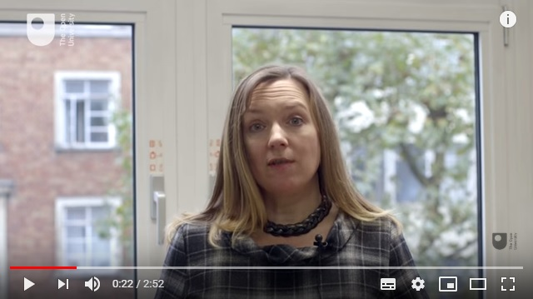
Helen Mott: The Intervention Initiative
https://www.youtube.com/watch?v=0Xdk9SnAY3Q

Slide 16
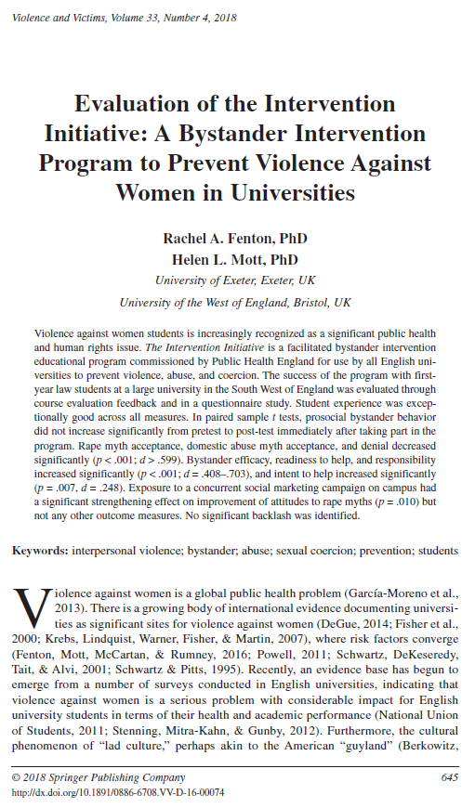
Evidence Base
empirical results for social norms interventions in related fields and other bystander programs
evidence for impact of The Intervention Initiative
ê rape myth acceptance; ê domestic abuse myth acceptance; ê denial
é bystander efficacy, é readiness to help, and é responsibility increased
é intent to help increased significantly
prosocial bystander behaviour did not increase significantly
Fenton, R. and Mott, H. (2018a) ‘Evaluation of the Intervention Initiative: A bystander intervention program to prevent violence against women in universities’, Violence and Victims, 33(4), p645-662.

Slide 17
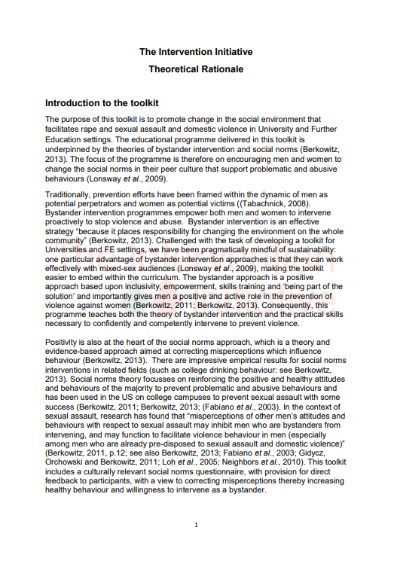
Group Activity
Read Fenton & Mott’s introduction to The Intervention Initiative ‘Theoretical Rational’
Discuss in small groups: What are the benefits of the programme, The Intervention Initiative?


Slide 18
Any questions?

Slide 19
Session Two
Role of the Facilitator

Slide 20
Role of the Facilitator
To support participants’ learning by creating a safe learning environment
Can you think of a time when you did / did not feel safe in a learning environment (e.g., school, training, lectures)?

Slide 21
Support Participants’ Learning
Knowing your participants
Who are the participants?
What do they know and don’t know about the topic?
How do they learn?

Slide 22
Who are the Participants in The Scottish Intervention Initiative?
University staff and students
Diverse group (age, gender, sexuality, ethnicity, nationality, dis/ability)
All have been active as well as passive bystanders in distressing situations on some point
Some victims/survivors of gender-based violence on or off campus
Some perpetrators of gender-based violence on or off campus

Slide 23
What Do Participants Already Know and Don’t Know?
(+)
Experience of university life
Experience of discrimination, harassment or violence due to protected characteristics
Experiences of ‘bystanding’ in distressing situations
Some lived experiences of gender based violence
(--)
Limited knowledge and awareness of gender based violence and on being a bystander – to different degrees
Limited skill and confidence of being an active and safe bystander

Slide 24
How Do Participants Learn Individually?
Active experimentation
Concrete experience
Kolb’s Learning Cycle
Abstract conceptualisation
Reflective observation
Kolb, D. (1984) Experiential learning: Experience as the source of learning and development. Englewood Cliffs, N.J.: Prentice-Hall

Slide 25
Creating a Safe Learning Environment
Role-modelling good relationships:
(1) Introducing yourself and participants
(2) Setting ground rules
(3) Attuning to participants; responding to verbal and non-verbal cues
(4) Repeating information
(5) Allowing spontaneous conversations
(6) Running on time
(7) Steering discussions back to topic
(8) Redirecting to group when participant dominates discussion

Slide 26
Creating a Safe Learning Environment
Role-modelling good relationships:
(9) Defusing difficult situations
(10) Encouraging quiet people to participate
(11) Providing space with a few seconds of silence
(12) Overcoming your nervousness with preparation
(13) You don’t have to know the answer to everything.

Slide 27
Pre-Course Preparation
¦
Timetable: 8 x 1 hour, 4 x 2 hours, or 1.5 days
Promotion to target audience in multiple formats at various locations and repeated reminders
Group size: 15-25, over-recruiting
Room booking
Access to course material
Always two trained facilitators
U
Ñ
¨

Slide 28
Exercise: Facilitating Activities
Do you have questions about delivering an activity?
Choose an activity to practice facilitating it
Discuss your experience of delivering and receiving this material. (What worked well, and why? What didn’t, and why? Any other concerns?)
Then, feed back your experience to the whole group
Activities:
Fielding questions
Reflecting on and reviewing videos
Delivering exercises (e.g., empathy exercise, social norms questionnaire)
Facilitating role plays

Slide 29
Any questions?

Slide 30
Session Three
Safeguarding, Disclosures and Support

Slide 31
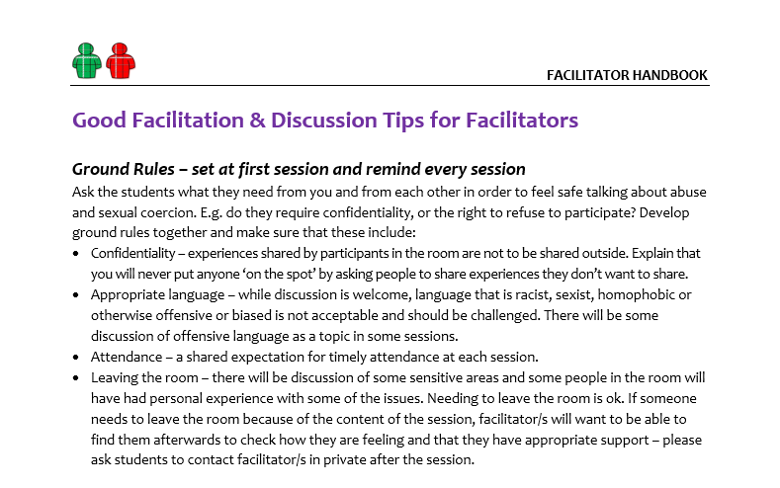
Setting Ground Rules
Confidentiality
Appropriate language
Attendance
Communicating with the facilitator

Slide 32
Relational Approach
How we are with the person and how we relate to them is central.
7.8 years (average) before survivors disclose¹
26-28% of survivors never disclose²
You are not expected to be an expert but you can be key in empowering abuse survivors seek help.
1. Allnock, D. and Miller, P. (2013) Non one noticed, no one heard: A study of disclosures of childhood abuse, NSPCC [online]. 2. Kogan, S. M. (2004) ‘Disclosing unwanted sexual experiences: Results from a national sample of adolescent women’, Child Abuse & Neglect, 28(2), p147–165.

Slide 33
Handling Disclosures
Acknowledge their experience
Believe and reassure them
Listen actively
Give them control
Ask if they feel safe
Explain your role and encourage towards specialist support
Universities Scotland (2018) Psychological, emotional, physical and sexual abuse can take many forms [online]. Available at: https://www.endgbv.uk/

Slide 34
Managing Discussions Based on Personal Experience
How did people around you react?
How did it make you feel?
During a group discussion, a student in your TSII group discloses:
“A friend and I were on the bus the other evening. A big group of lads in sports tops got on the bus. They were singing songs and laughing. A couple of people in the group started shouting to some of the other people on the bus “nice tits love, you’d get a raping” “Yeah I’d rape that”. The people they were talking to looked uncomfortable but did not engage with the group of lads.”
How does it make the group feel?
What consequences did you or others experience?
How would they have reacted in a similar situation?
What would you have liked to have happened in the best scenario?
What tools of the bystander training can be applied?

Slide 35
Responding to Disclosures of Risk of Serious Harm
Only if the person or someone they mention is at risk of serious harm do you tell anyone else and only do so in discussion and agreement with the person who has disclosed.

Slide 36
Responding to Disclosures of GBV
Do not ask for more details.
Do not offer or agree to arrange support for them.
Do not offer counselling or discuss the person’s experience.
In agreement, keep a brief anonymous record of the disclosure in a secure folder.
If a perpetrator is named, explain that you will speak to your line manager and ask person for contact details.

Slide 37
Disclosure Protocol
Explicitly state boundaries of facilitator role & limits of confidentiality
If risk of serious harm disclosed explain duty of care to tell someone. Explain that decisions will be made with participant.
Facilitator to share with project lead/manager who will refer to disclosure pathway in GBV policy.
If staff/student is name as perpetrator explain that this information will be passed on to project lead/manager. Refer to disclosure pathway in GBV policy.
Information on formal report procedures (to institution and/or police) given.
Information on support services given.
If participant is at immediate risk, give police number.
Ensure safety measures in place for participant (e.g., call friend/relative to pick them up).
McCarry M., Donaldson A., McCullough A., McGoldrick R. and Stevenson K. (2018) Equally Safe in Higher Education Research Toolkit: Guidance for Conducting Research into Gender-based Violence in Scottish Higher Education Institutions. Glasgow: University of Strathclyde [online].

Slide 38
Looking After Yourself
Recognise that disclosures and tricky situations can sometimes be very emotional. It’s okay to feel upset, and seek support yourself.

Slide 39
Looking After Yourself
What are the most challenging aspects to being a facilitator?
How do you set your own boundaries, for example, at work or home?
What are your ideas of looking after yourself after a disclosure?
What possible organisational/professional supports can you identify?

Slide 40
Group Discussion
How do you feel about dealing with disclosures?
Explicitly state boundaries of facilitator role & limits of confidentiality
If risk of serious harm disclosed explain duty of care to tell someone. Explain that decisions will be made with participant.
Facilitator to share with project lead/manager who will refer to disclosure pathway in GBV policy.
If staff/student is name as perpetrator explain that this information will be passed on to project lead/manager. Refer to disclosure pathway in GBV policy.
Information on formal report procedures (to institution and/or police) given.
Information on support services given.
If participant is at immediate risk, give police number.
Ensure safety measures in place for participant (e.g., call friend/relative to pick them up).

Slide 41
Any questions?

Slide 42
Session Four
Responding to Tricky Situations and Questions

Slide 43
What Tricky Situations Might Happen?
A person discloses that they harassed or abused a person in the past or participated in encouraging their mates to harass or abuse.
A discussion between participants becomes heated.
A person challenges statistics and others’ experiences of gender-based violence and gender inequality.
A person quietly leaves the room in the middle of a session and does not return.

Slide 44
How to Respond to Tricky Situations?
1.
2.
3.
4.
5.
6.
Stay calm!
If someone is dominating the discussion, summarise and invite others’ feedback.
If a person seems hostile or antagonistic, asked to repeat what they have said to reframe it in a positive way.
Stay informed about current GBV research, statistics, news and intervention practices.
Involve the group in responding to tricky questions or scenarios.
Frame your responses positively. Focus on behaviour or contextual factors rather than people.

Slide 45
Group Activity: Tricky Scenarios and How to Respond
Statements bystander participants might say:
Scenario 1: “Men don’t experience GBV. It’s women’s problem.”
Scenario 2: “All the media reports about false allegations of rape/sexual assault show that most women just make it up.”
Scenario 3: In response to student A (female) disclosing being sexually harassment by male student, participant B (male) said: “If I had been there I would have beaten him up!”
Scenario 4: “But women are also abusive towards men.
Scenario 5: “My mates made bets on who would take the most drunken girl/guy home after a party.”
Scenario 6: “Women are perfectly able to choose … It’s not just men who are the problem.“

Slide 46
Any questions?

Slide 47
Learning Outcomes Achieved
3. To respond safely and sensitively to disclosures and know where and when to access appropriate support
2. To define the role of the facilitators and gain skills and confidence in facilitating
1. To understand the context and rationale for delivering The Scottish Intervention Initiative
4. To respond to tricky situations and questions in a sensitive and confident way

Slide 48
Thank you for participating
Your feedback is important to us.
We would appreciate if you complete our feedback form.
Any further questions?

?

