Slide 1

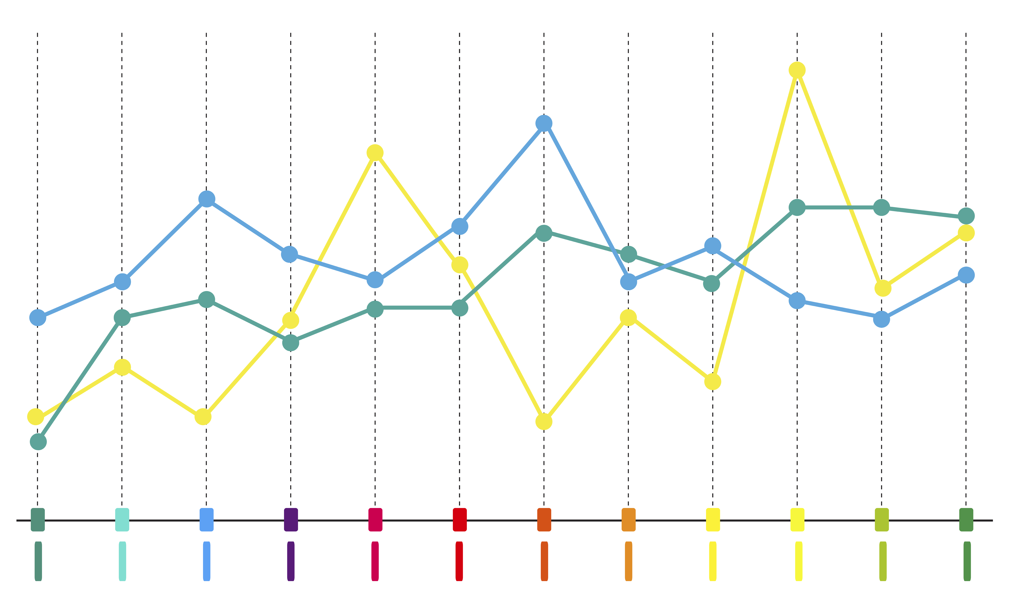

A2 Presentation
Provided by Strathclyde Print
How to use this Poster Template
You can use this presentation template to make a poster for your presentation and include snapshots of your research, data collection, analysis, etc. The layouts etc, are for example only, be sure to change all the data to make this poster your own!
You can also put data-driven charts, images, slides and illustrations on each component.
Text Formatting
Try to avoid using ONLY CAPITAL LETTERS and stick to easy-to-read fonts. Make special focus in choosing a good combination of colours to produce a high contrast between the text and backgrounds.
The font can be changed, and you can pick any desired font in PowerPoint. It is recommended to follow a consistency in Font, text size, captions, etc. For A2 we recommend 20-32pt for Headings, and 16-24pt for body text.
Images
It is recommended to insert images with a resolution of at least 150 dpi to keep a good quality level once printed. PNG images work best and avoid low resolution JPEGS if possible!
Use Insert -> Image to insert a new image into any of the available columns. Then, drag the image to any desired position making sure that the borders are aligned with the text.
This is a caption. You can replace the image and edit this text here.
Convert PowerPoint to PDF
When submitting to us for print, it’s best to save your poster as a PDF. To do this go to..
File > Save As
and select "PDF" from the "Save as type" dropdown menu
Once exported to PDF, locate the new file and try to open it just to make sure the process worked as expected. Make sure to check your poster for any mistakes and view your images at 100% to ensure everything looks clear!
In any case, it is recommended to keep a digital version of the presentation poster file as a PowerPoint presentation or Google Drive in case you need to make modifications in the future.
print.enquiries@strath.ac.uk
0141 548 2829

