Slide 1
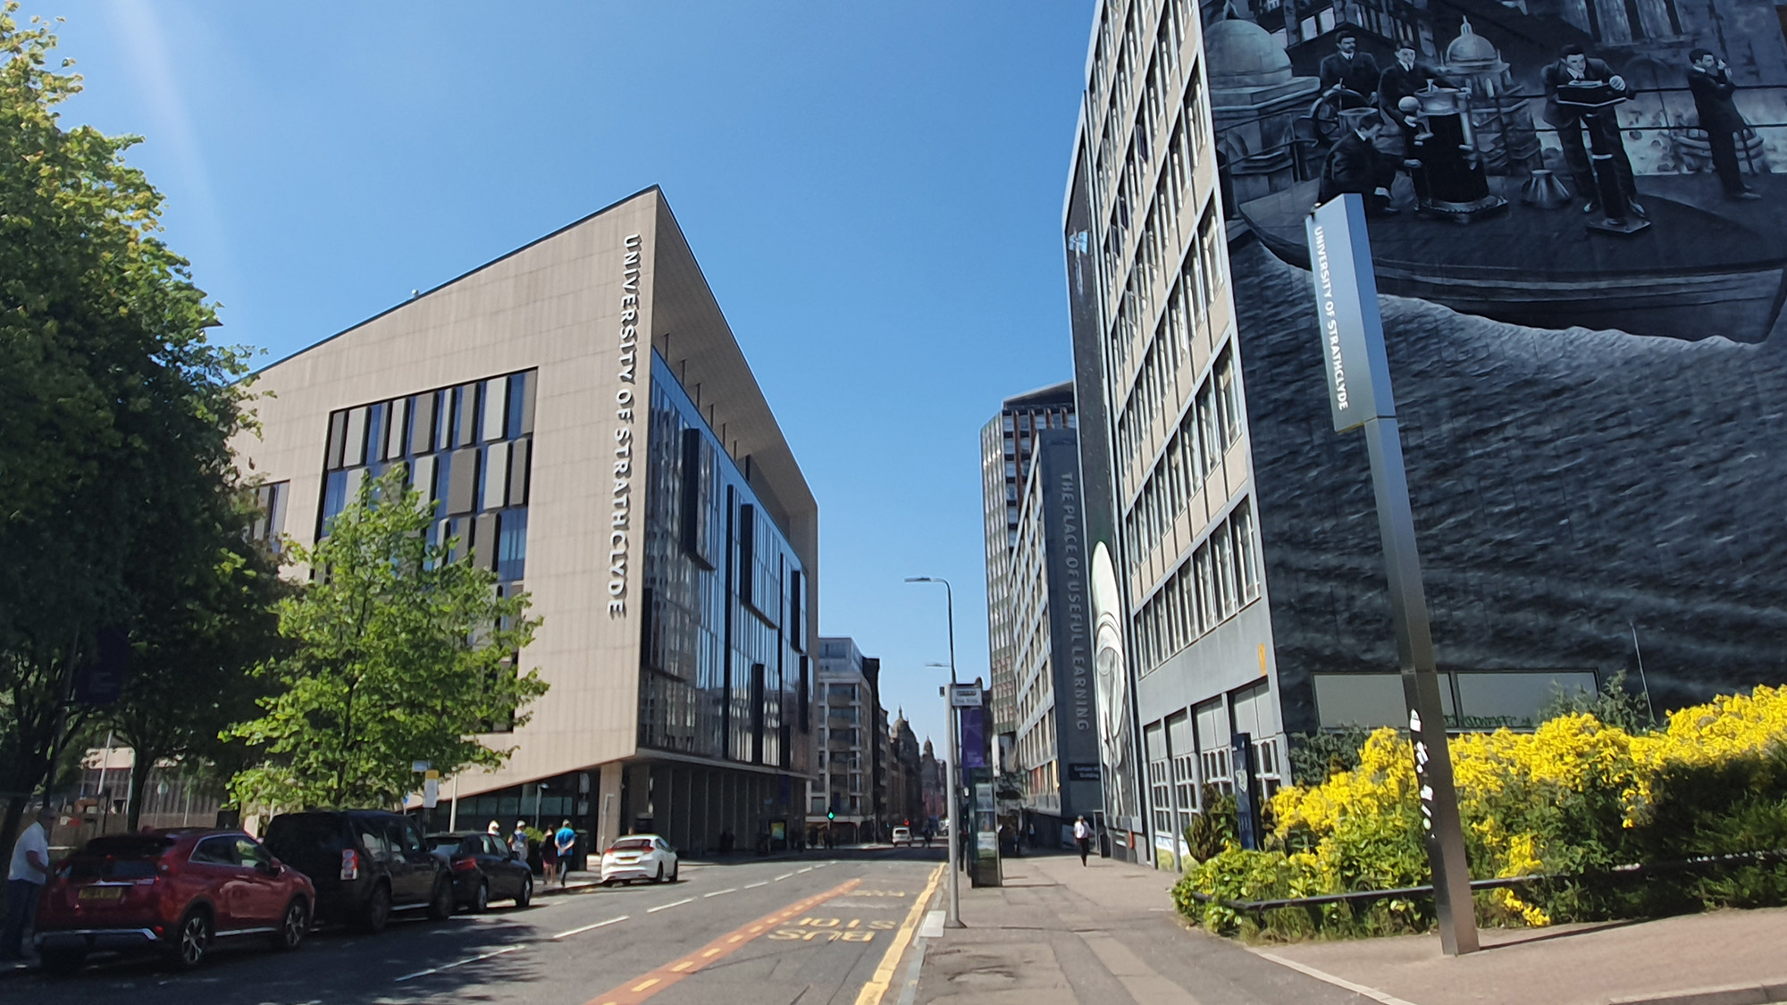
THE UNIVERSITY
OF STRATHCLYDE
X THE PLACE OF USEFUL LEARNING
www.strath.ac.uk

Slide 3
UNIVERSITY TEMPLATE
Select slide(s) from those provided and delete those that aren’t required.

Slide 20
X THE PLACE OF USEFUL LEARNING

