Slide 1
Mandarin and Learning for Sustainability

Slide 2
Mandarin in a National and Global Context

Slide 3
Education for Sustainable Development
The United Nations Decade of Education for Sustainable Development:
The launch of the United Nations Decade of Education for Sustainable Development (DESD) marked the start of a collective global effort to integrate the principles, values and practices of sustainable development into all aspects of education and learning, in order to address the social, economic, cultural and environmental problems we face in the 21st century. (Education Scotland)
https://www.youtube.com/watch?v=cBxN9E5f7pc

Slide 7
http://worldslargestlesson.globalgoals.org/languages/

Slide 8
British Council Core Skills for LfS
Critical thinking and problem solving
Creativity and imagination
Collaboration and communication
Digital literacy
Student leadership
Citizenship

Slide 9
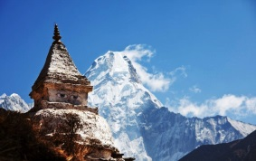
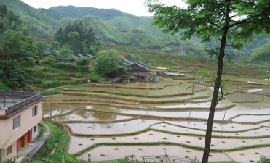
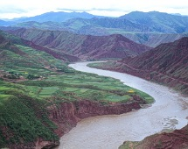
Helpful Links for Ideas
https://www.youtube.com/watch?v=1gmLGCQUbzM
http://www.channel4.com/programmes/china-between-clouds-and-dreams/episode-guide/
https://www.youtube.com/watch?v=INu1Z5xHeWQ
https://schoolsonline.britishcouncil.org/about-programmes/connecting-classrooms
http://learningforsustainabilityscotland.org/
https://www.youtube.com/watch?v=F3s8Xrl2Ffw

Slide 10
Creative Approaches to Achievement with Mandarin and Learning for Sustainability

Slide 11
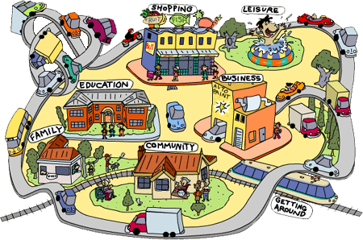
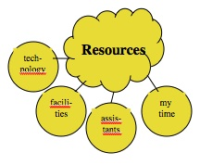
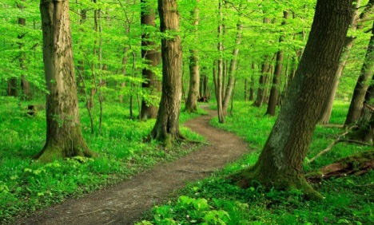
When planning ask yourself:
Which resources do I have around me?
What does my class enjoy?
Are there cross-curricular links?
Are there community links or who else may be involved?
What progression is there for children beyond this?

Slide 12
Discuss the language and cultural element with your learners to get their ideas/perspective
Use the language in your planning: routines, simple adjectives with gestures for what learners prefer or a slightly more detailed questionnaire for planning the learning together, or basic mind maps, labelling – consider stage, progression, enjoyment
Have an idea of the words and sentences you would like learners to develop as you proceed
Allow for spontaneous learning and sharing too
Play with word patterns and sounds – literally!!!
Consider materials, games, songs, displays
Involve parents/other colleagues in a showcase event

Slide 13
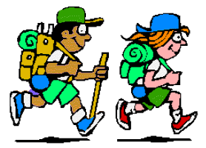
John Muir Award, Discovery Level
Discover a wild place, explore its wildness, conserve a
wild place, share your experiences
Equivalent of 4 days outdoors – can be divided up
https://www.johnmuirtrust.org/john-muir-award
https://www.dropbox.com/s/69c0k04toesqy99/WL%20R
cord%20Book%20Final.pdf?dl=0
https://www.dropbox.com/s/cwlbkkpc96tlxbh/ME_Joh
%20Muir_Cymraeg2507.pdf?dl=0

Slide 14
The John Muir Award – A Scotland/China Project
This project aimed to have students from a Chinese school and students from a Scottish school achieving level one of the award, using their foreign language and sharing their journeys with each other from two different educational and environmental settings across two different countries.
It allowed them to:
Develop and use their language skills in a new context
Think and use their language creatively
Become aware of their surrounding environments
Become aware of the nature, creativity and wildness of their surroundings
Develop an awareness of the differences and similarities they experience in their environmental space across the two countries
Share their learning and enhance intercultural understanding

Slide 15
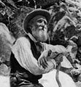
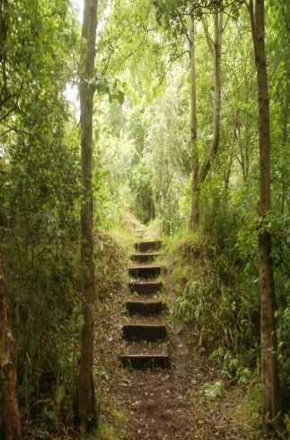
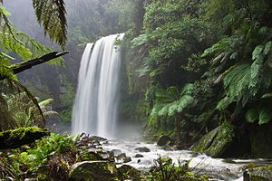
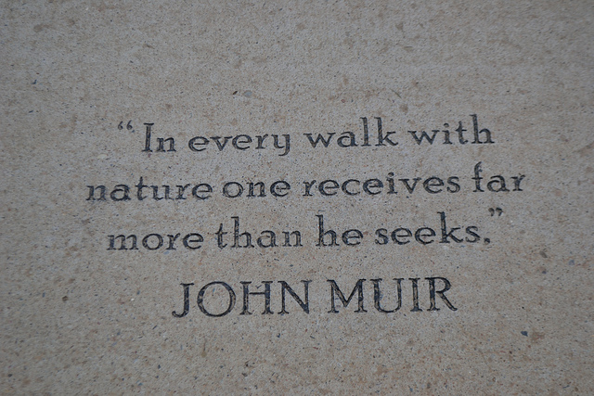
Who was John Muir?
John Muir, born in 1838 in the East Lothian Town of Dunbar in Scotland, was a Scottish-American naturalist, an environmental philosopher and an author. He was very passionate about preserving the wilderness and protecting the environment and he wrote and published many studies about explorations of natural settings
Each participant engaged in a range of activities that embraced the
following four Challenges:
Discover a wild place
Explore its wildness
Conserve your wild place
Share your experiences

Slide 17
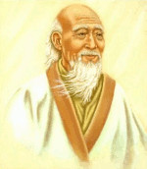
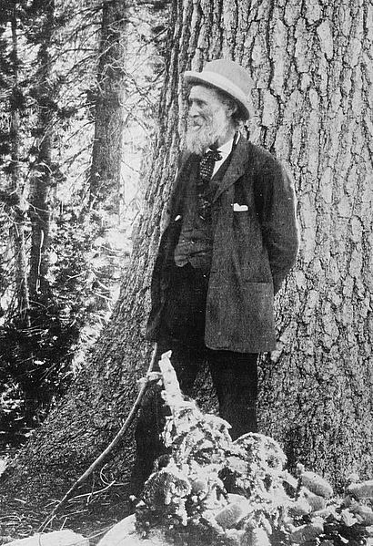
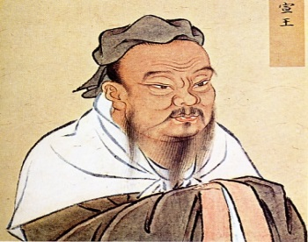
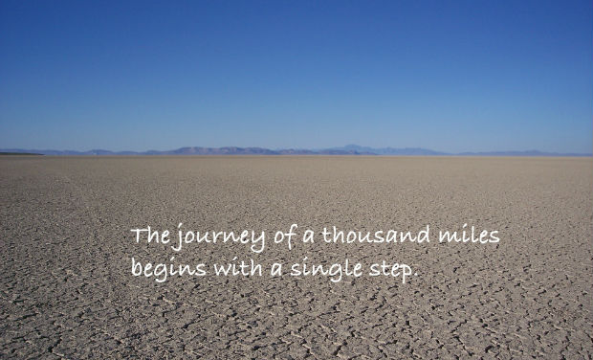
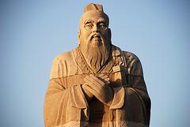
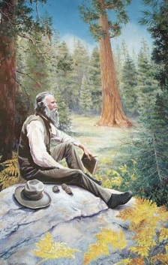

Slide 18
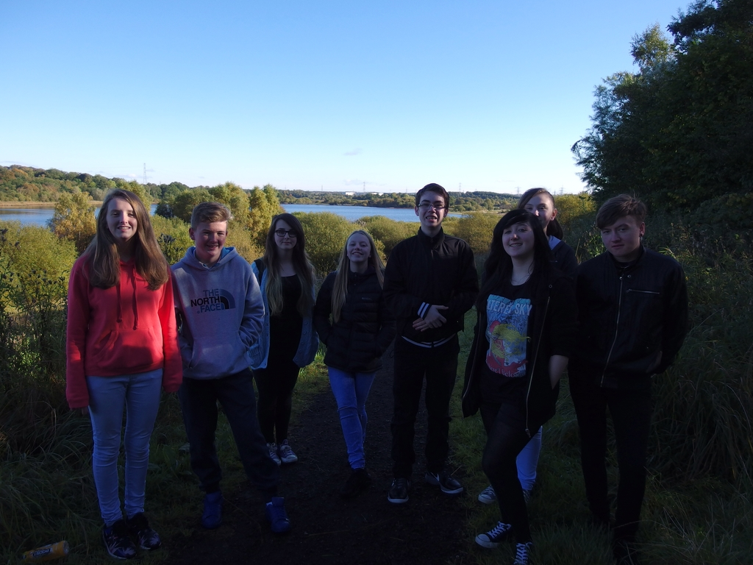
Lochend Community High School – China Club

Slide 19
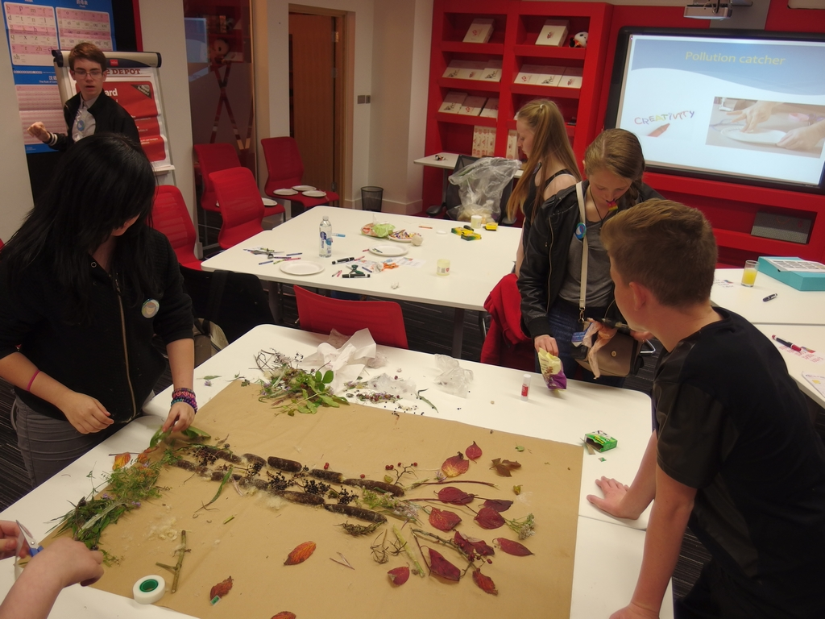

Slide 20
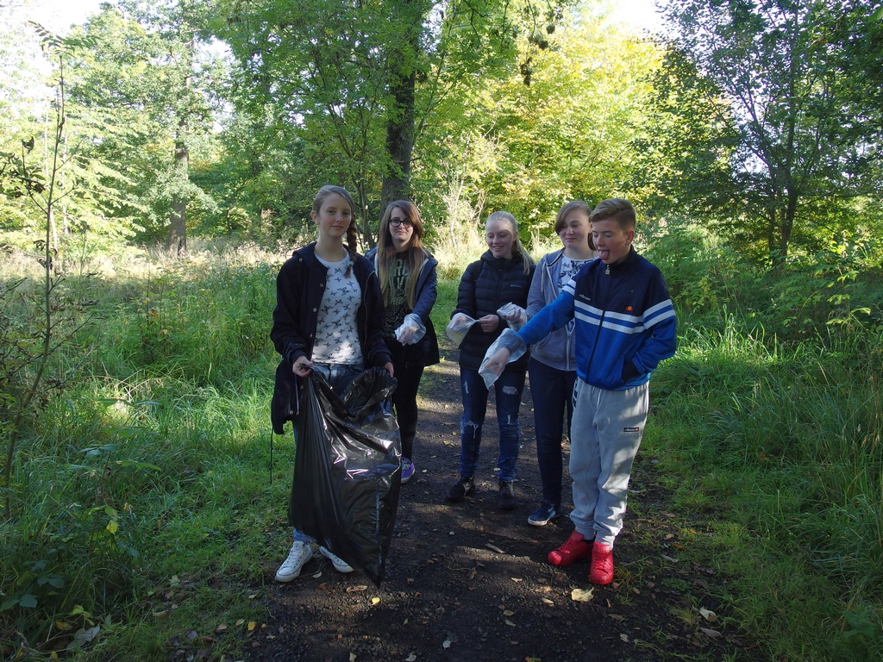

Slide 21
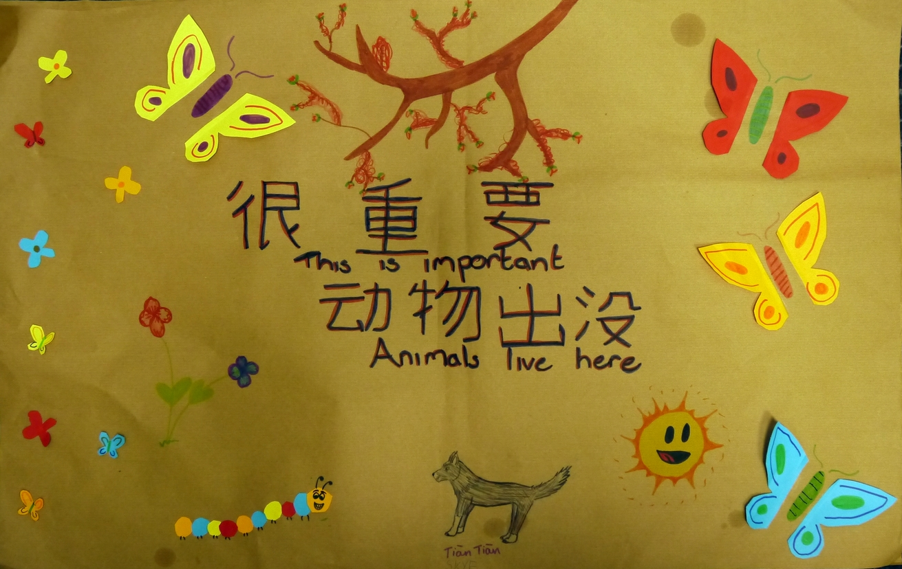

Slide 22
Huisen Middle School, China

Slide 27
Chinese teacher comments:
“Teaching outdoors can make students more active, more
cooperative and eager to learn more than usual.”
“We get closer to nature so we have more emotion about the
environment.”
“Creativity and imagination, problem solving and student
leadership were skills my learners developed.”
“I have a new teaching experience. I feel comfortable when teaching
outdoors. I feel happy when I see students’ smiling face.”

Slide 28
Chinese learner comments:
“I felt very happy and I have learned a lot. That was a good experience to learn
language and the outdoor learning let me know how to protect the environment.”
“In China, most people do not know the importance of protecting the
environment. But people in Scotland know more than us. We can learn from the
students in Scotland and we will protect the environment of the earth.”
“Outdoor learning can enrich our language learning environment, learning to
broaden our thoughts, let us closer to real life. Let us feel the charm of language”
“These things are what we don't usually do, so we are in the process of
cleaning, there will be a puzzled glance to us.”
“It is a good experience to combine the two together. We learn through outdoor
activities and when we are doing our job we have to communicate and that is how
language is used and learned.”

Slide 29
Challenges:
Language – training teachers in China
Mind sets – the challenges of outdoor learning
Time – finding time to be outside
Time to share
Consistency of teacher

Slide 30
Future
Increase learner access to language and outdoor learning linked to wider
achievement
Facilitate more projects between schools in Scotland and China
Continue to build intercultural understanding and language skills for a
sustainable global future

Slide 31
JASSING up Mandarin!!!

Slide 32
Junior Award Scheme for Schools
JASS is an accredited learning scheme designed to help teachers deliver the objectives of a Curriculum (for Excellence)
JASS helps children develop new skills and interests and expand their knowledge in a fun and rewarding way
JASS is very flexible and is easy to deliver either in school and outside
It assists with pupil profiling
It is a great way of evidencing the variety of work done within a school
JASS is also used with school refusers and SEN learners

Slide 33
Facts about JASS
JASS was developed as a pilot exercise in 2010 by FOTA (Friends of the Duke of Edinburgh Award in Edinburgh and the Lothians) and City of Edinburgh Council
JASS is now used by 60% of primary schools, 48% of secondary schools and 86% of special schools in the LEA – over 5000 children in 2013
JASS is also being used by schools throughout Scotland in both public and private sectors and has been piloted by schools in England and Northern Ireland

Slide 34
Important Details!
There is a minimum participation time for each section
Each section has to be signed off by a teacher or mentor:
Get Active Stay Active = 8hours
My Interests = 8 hours
Me and My World = 8 hours
Adventure = 3 hours

Slide 35
Get Active Stay Active
Which sports are relevant to China?
Learn to talk about/sing about the sports in Mandarin
Try an exercise routine each day in Mandarin
Make up a dance routine to a Chinese song – learners
teach it to the community/ their peer group
The daily mile – record miles in the language/label the
route in the language
The list is endless…

Slide 36
My Interests
Mandarin Passport
Cultural Arts
Calligraphy
Chinese Food/Cooking
Traditions and Festivals
Cultural Crafts
Chinese music or dance You decide…

Slide 37
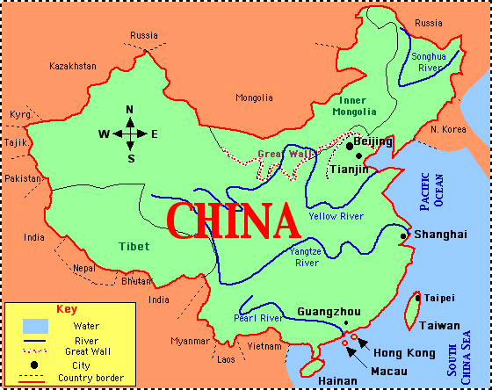
Me and My World
John Muir Award / outdoor learning
Raise money for a class activity or materials
Plan, advertise and prepare a Chinese show case with
songs/role play, traditional tales, speaking Mandarin
Visiting places of interest/carol singing in Mandarin
An environmental or community project
Make a Chinese cultural garden/display
Teach younger learners/parents/teachers Mandarin

Slide 38
Adventure
John Muir Award
School camp/outdoors
Treasure hunts and hikes: could keep a record of what you see in Mandarin/tick off the characters Problem solving – orienteering around the school – find different words/riddles to solve about a country

Slide 39
Support for Teachers and other mentors on the website www.jasscotland.org.uk Leaders Guide Programme Planner template Activity Planner templates Opportunities Directory Hints and Tips for delivery of JASS Information for Parents Template letters Case Studies

Slide 40
Thank you!
Contact: judith.mckerrecher@strath.ac.uk
Twitter: @JMcKerrecher

