Slide 1
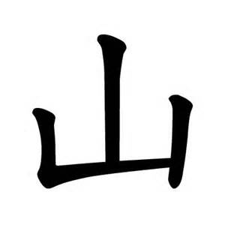
Mountain
shān

Slide 2


Sun
Rì
Notes:
application of grammatical knowledge, increasing flexibility, developing relevant ideas, etc

Slide 3
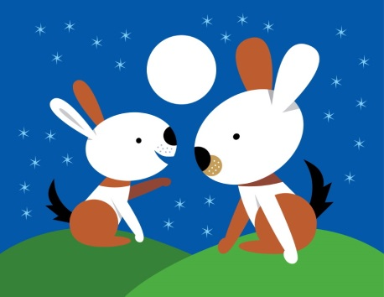
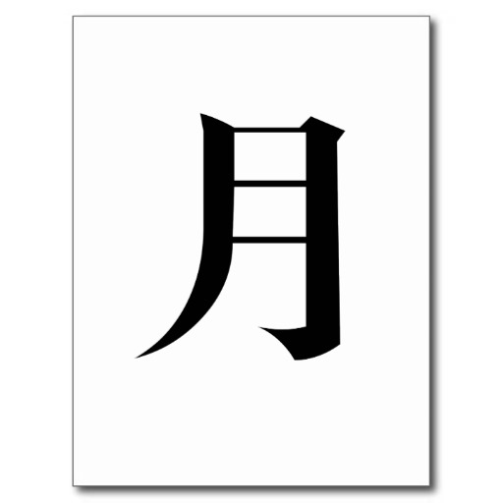
Moon
yuè

Slide 4
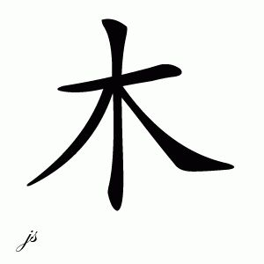
Tree
mù

Slide 5
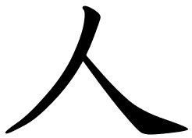
Person
ren

Slide 6

Mouth
Kou

Slide 7

Rice
mĭ

Slide 8
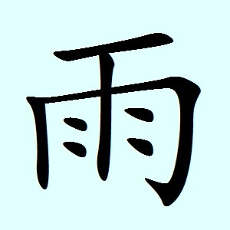
Rain
Yu

Slide 9

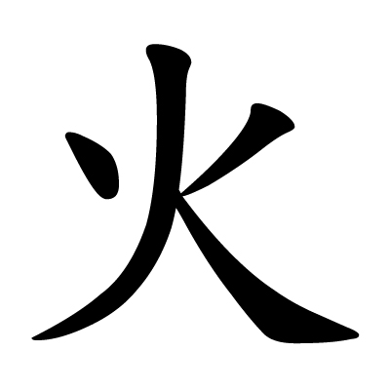
Fire
huŏ

Slide 10
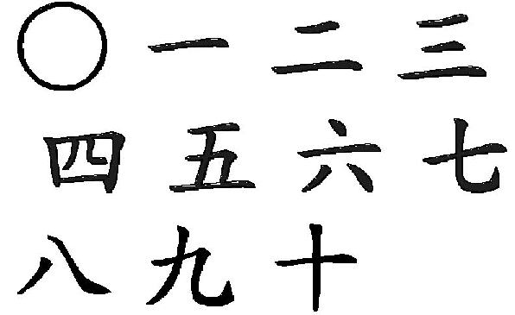
Numbers one to ten

