Slide 1
Linking Mandarin and SDGs

Slide 2
Planning:
You can plan around the goals. Use your school context
and priorities to select the goals most relevant to you at
the present time.
Print of a table of the goals. Cut each goal into 17
separate squares.
Choose your top three. Note them.
Order the rest in terms of priority.

Slide 3
Example:

Slide 4
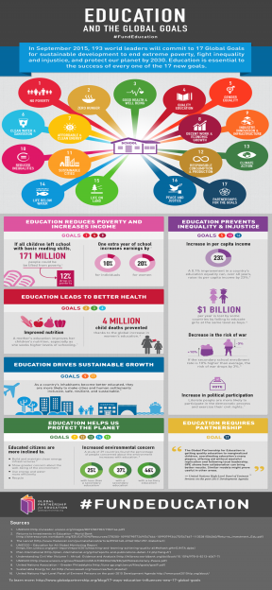
Plan around the goal:
Quality Education:
Find out about school in China - research
Compare with Scotland - Discuss
Basic vocabulary to do with school – identify vocabulary
Find out about children who can’t go to school - research
Look at statistics - Look at daily routine - Discuss/display
How do children get to school in China? – research
Meal times and recreation

Slide 5
Language opportunities:
Numbers in Mandarin for each goal – match them up
Find out the Mandarin equivalent for some of the goals
School and school subjects – you tube clips
Daily routine and time – role play
Hobbies/sport opportunities/interest –survey
Transport – create memory hooks/design models
Asking questions – basic introductions – role play
Learning the different countries in Mandarin - characters
Extend into meals, food, meals in Scotland and China

Slide 6
Sharing the learning
Show case
Displays
Film clips
Country profiles
Learning Passports
Class blogs
Raising money/ shoe box appeals/Christmas appeals

Slide 7
Peace and Justice:
Create a Chinese wishing tree
Wishes from the class for a better world
Display and discuss class wishes
Basic introductions
Numbers
Basic characters (tree, forest, wood, rest, follow)
Basic questions

Slide 8
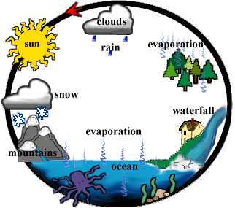
Protect the Planet, Life below Water, Life on Land
Plan around the goals:
Weather and climate
Animals
Endangered species (Panda resources)
Life in another country
Environments – park, garden, woods, oceans, deserts,
Forests
Items of rubbish

Slide 9
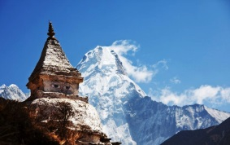
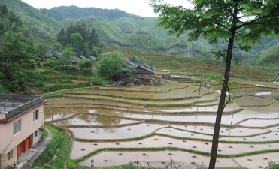
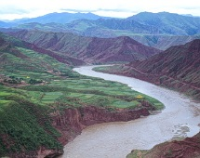
Helpful Links for Ideas
https://www.youtube.com/watch?v=1gmLGCQUbzM
http://www.channel4.com/programmes/china-between-clouds-and-dreams/episode-guide/
https://www.youtube.com/watch?v=INu1Z5xHeWQ
https://schoolsonline.britishcouncil.org/about-programmes/connecting-classrooms
http://learningforsustainabilityscotland.org/
https://www.youtube.com/watch?v=F3s8Xrl2Ffw

Slide 10
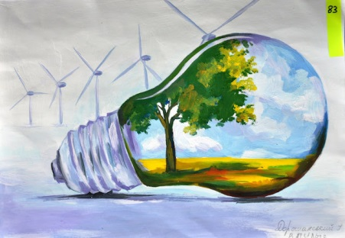
Responsible Consumption
https://www.youtube.com/watch?v=73sGgmZoMBQ
https://www.youtube.com/watch?v=bn8R_XqjjI0
https://www.youtube.com/watch?v=TjnNOCbuoCA
https://www.youtube.com/watch?v=zCfazf2gVuo
https://www.youtube.com/watch?v=rl0YiZjTqpw
https://www.youtube.com/watch?v=FAnDlYRycqs

Slide 11
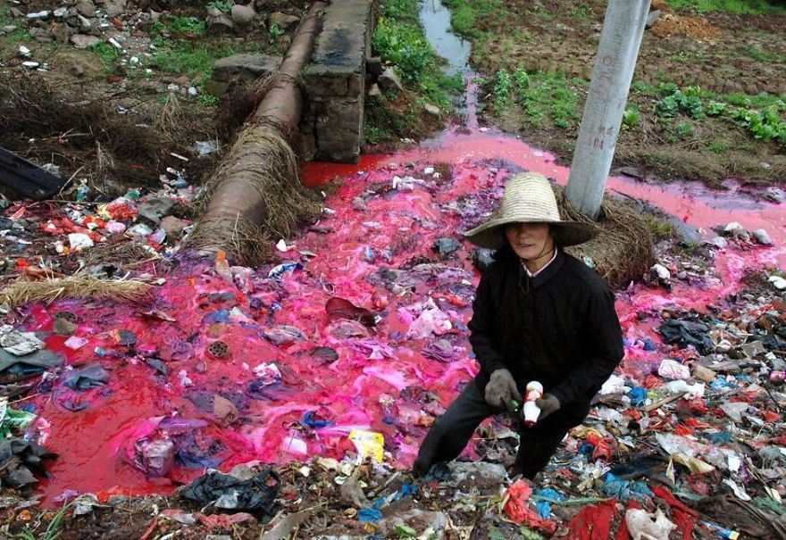
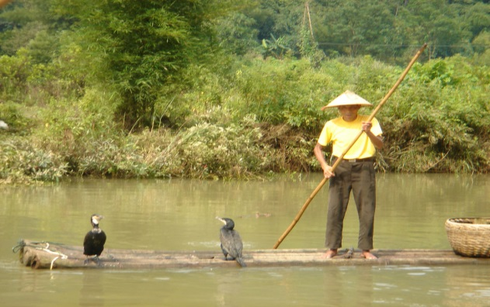
Act locally, think globally
Consider in a global context: (Basic Characters)
Mountain
Ice berg (ice-mountain)
Volcano (fire mountain)
Rain (umbrella)
Snow (snowman)
Fire
Water
Science experiment – float and sink

Slide 12
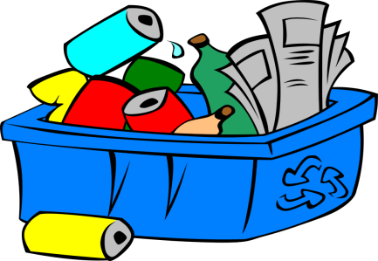
Create characters or a Chinese landmark from your rubbish/bottle tops
The Great Wall of Rubbish; how much do we throw
away?
Create opera masks from old materials and make a role
Play in Mandarin
Create a Chinese puppet show from items you would
normally throw away

Slide 13
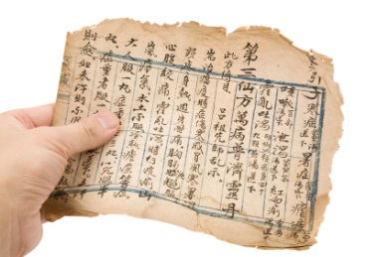
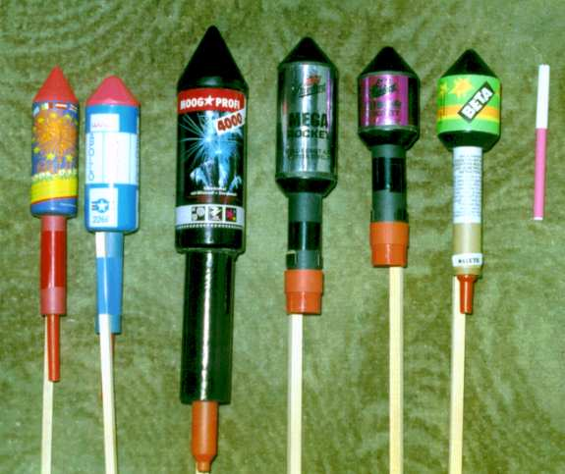
Innovation and Infrastructure:
Activities
Colours
North, South, East, West
Counting/numbers
Calligraphy

Slide 14
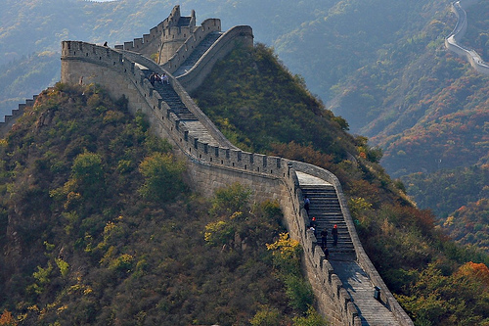
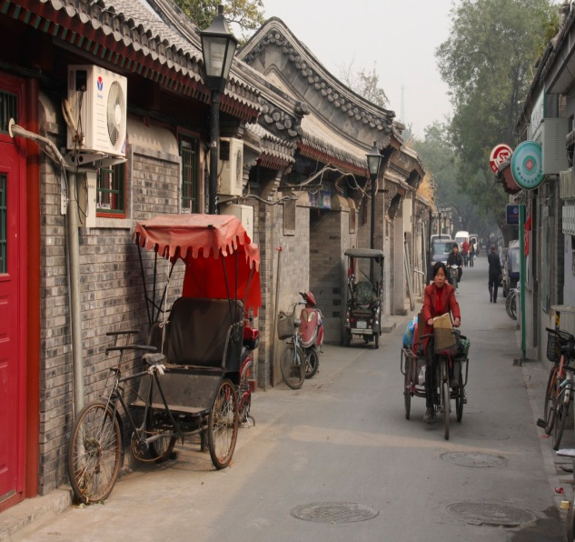
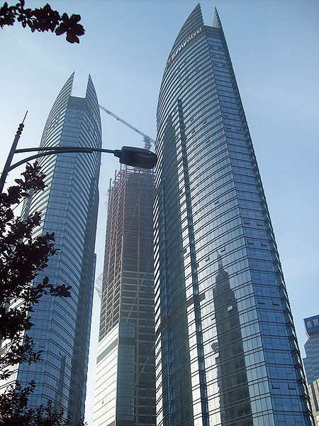
Landmarks and Geography:

Slide 15
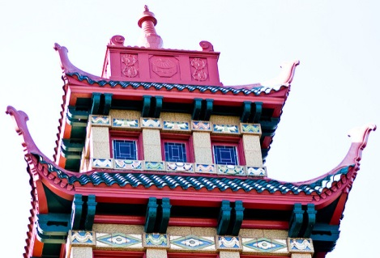
Activities
Geography e-book activities
Talking about where you live
Describing your area
Finding out (questions) about someone else’s area
Comparing with another country
Role play – choose to be a person from another country

Slide 16
Passport for the Goals and Progression in Mandarin

