Slide 1

Finance Forum
May 2018
Notes:
Housekeeping
No Fire Alarm test scheduled for today
Toilets at the back of the room
Tea /Coffee available throughout the morning
Finance Journey
Started 2012 – Unipart/Business Improvement
2013 – technical changes as well as BP changes
2015 – new Finance System
2016/2017 – Restructure
2018 – Physical changes

Slide 2
Agenda
Updates: Procurement
Overview of Finance Changes
Updates: Finance
Apps for Tasks
Finance Focus Group
Q & A

Slide 3
Updates: Procurement
Legislation and Guidance
Procurement Thresholds
FMS, Ordering and Invoicing
Notes:
Based on the principles of transparency, fair and equal treatment of suppliers and to obtain best value.
There is legislation and guidance covering the spending of public money.
Even though only a percentage of our income comes directly from Scottish Government - we are in terms of spending classed as a Public/Contracting authority therefore obligated to comply with the legislation
What are the thresholds? Processes are mainly based on aggregated spend or total value of the contract. I will go on to show these thresholds.
What other factors do we consider when making contracts? P2P and how the orders flow through the system . The contract is not complete without a method to pay your supplier. The stakeholder and the supplier should be comfortable with how these transactions will work.

Slide 4

Legislation and Guidance
Directive 2014/24/EU
The Public Contracts (Scotland) Regulations 2015
The Public Contracts (Scotland) Amendment Regulations 2016
The Procurement Reform (Scotland) Act 2014
Notes:
The University is subject to the rules that govern Public Sector Procurement.
These rules originated from a Directive of the European Parliament a number of years ago, the most recent directive is Directive 2014/24/EU for those of you who may want to light bedtime reading it is available online.
Following Europe's lead the UK government ratified these into national law. The most recent update follows the 2014 Directive in the form of The Public Contracts Regulations 2015 as amended in 2016.
Guidance also comes in the form of the PRSA 2014 which introduces a sustainable procurement duty amongst other duties.
Procurement Strategies and Annual Reports (s. 20)
Sustainable Procurement Duty (s. 10)
Community Benefit Requirements in Procurement (s. 26)
Selection of Tenderers and Award of Contracts (s. 29)
Procurement for Health or Social Care Services (s. 13)

Slide 5



Summary
All governed by EU Principles
Goods /Services
<£50k
Works
<£2m
Goods /Services
£50k to £181K
Works
£2m to £4.5m
Goods /Services
>£181k
Works
>£4.5m
Local Governance
Procurement Reform (Scotland) Act 2014
Procurement (Scotland) Regulations 2016
Public Contracts
(Scotland) Regulations 2015
Local procurement rules
E.g. 3 quotes
E.g. call off from framework
Regulated procurement rules
Additional Rules
Lower Level of Spend
EU Regulated procurement
Transpose EU Rules
Higher Level of Spend

Slide 6
What does this mean in practice?
Regulated procurements are now over £50k spend instead of £181k (EU threshold)
Mandatory use of electronic communication/ tendering above £50k
Award notices above £50k must be published on Public Contracts Scotland portal
Public bodies must maintain a contracts register for regulated procurements
Notes:
What do the regulations mean for the University?
Regulated procurements over £50k – means more transparency is required when the total value of a contract is over £50k. It is mandatory to use electronic tendering procedures and award notices must be published on the PCS portal. They must be added to a contract register.
A change for the University is award of negotiated contracts (or SSJs) and direct calls offs from existing frameworks when spend is over £50k must be awarded and reported.

Slide 7

FMS, Ordering and Invoicing

Slide 8
Setting up Suppliers
Procurement adds supplier to FMS when contract is awarded.
Suppliers are refused to be added when no contract in place
Supplier on FMS doesn’t mean there is a contract
Check supplier details are correct (e.g. Ltd, PLC, Group).
Notes:
If a contract has been placed by procurement the team will add the supplier to the system.
The first barrier to adding a supplier is procurement will check if there is a complaint contract in place.
Often staff see a supplier on the system and assume this means there is a contract therefore can buy from this supplier compliantly. This may not be the case!
If you have had an SSJ reviewed it is necessary to attach this to the new supplier request for audit purposes (internal and external for traceability) , this should avoid the need for extra timescales in establishing if a contract is in place.

Slide 9

No PO No Payment
The University has enforced this policy.
an organisation who receives Public funding & has an obligation to pay contractors in 30 days without a PO this may not happen!
Placing a purchase order is a fundamental procedure to adhere to.

Slide 10
Request For Payment (RFP)
Payments requested by cheque or direct payment
All recorded and reported
Bypassing the public funds procedures
Create risk for the organisation
Rule is that only exceptions will be allowed by RFP.

Slide 11
eInvoicing
EU legislation
New legislation will apply to Higher Education in 2020

Slide 12


Slide 13
Overview of Finance Changes
Hugh Darby
Director of Finance
Kirsty MacLeod
Deputy Director of Finance
Accounting Services
David Coyle
Chief Financial Officer
Post-award Research Contract Mgt
Courses & Conferences
Consultancies
Other Knowledge Exchange
Sandy Hall
Research Contracts Manager
Research Finance
Payroll
Pensions
Transaction Processing
Finance Helpdesk
Clare Urquhart
Deputy Director of Finance
Finance Operations
Finl A/cing+Rpting
Stat A/cing+Rpting
Statistical Returns
Treasury Mgt
PS Mgt A/cing
Capital Accounting
Budgetary Control
Project Appraisal
Laura Colquhoun
SBS
David Hogg
HaSS
Faculty Finance Business Partners
Paul McShane
Financial Systems Manager(ISD) Business Systems - Finance
Systems Support
Systems Development
Online Shop
Beth Lockhart
Science
Fiona Hart
Engineering
Fiona Hughes
Head of Procurement
Procurement
Procurement
Supplier Masterfile

Slide 14
Finance Operations
Deputy Director of Finance
Banking Team Leader
Senior Finance Asst
Helpdesk Advisers
Senior Finance Assts
Finance Assts
Income Collection Team Leader
Senior Finance Asst
Payments Team Leader
Senior Finance Assts
Finance Assts
Student Funding Team Leader
Senior Finance Assts
Payroll Officer
Deputy Payroll Officer
Senior Payroll Asst
Pensions Officer
Asst Pensions Supervisor
Finance Asst
Payroll Asst
Finance Assts
Helpdesk
Transaction Processing
Payroll & Pensions

Slide 15
Finance Helpdesk: Who’s Who
Jamie Wilson
Gail Roberstson
Kirsty Williamson
Rosie Keily
Clair McClelland
Dionne McKenna
Caroline McVey
Pauline Mitchell

Slide 16
Finance Team Leaders
Banking – Lynne O’Reilly
Payments- Dawn Hitchens
Student Funding – Carole Muir
Income Collection – Catherine Grant

Slide 17
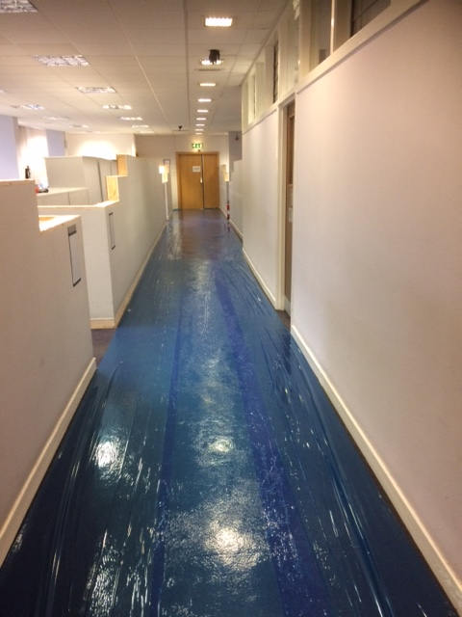
Finance is changing ……

Slide 18
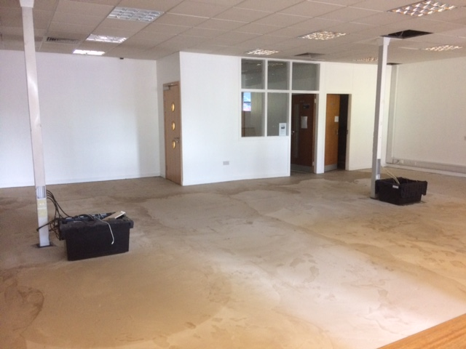
Phase 1 : New Helpdesk Team

Slide 19
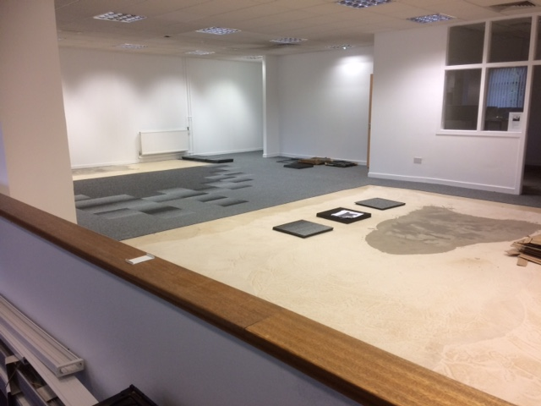
Making progress….

Slide 20
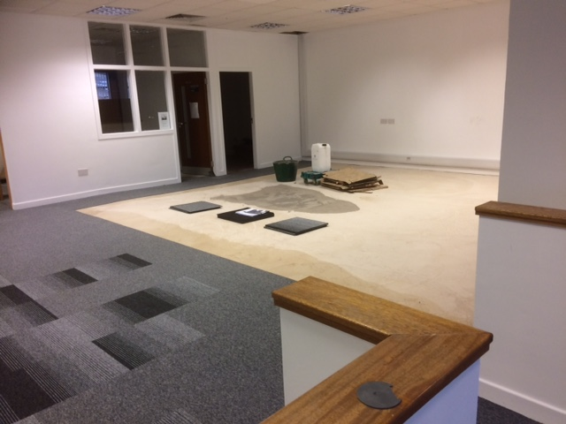
Almost there…….

Slide 21

Ready to Go !

Slide 22
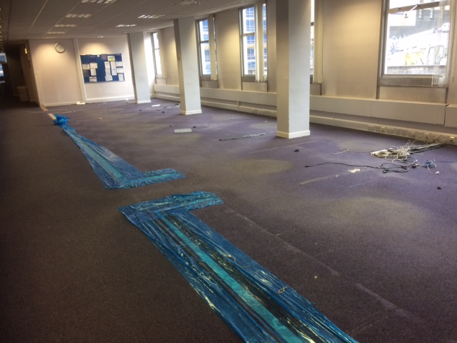
Phase 2 : Currently in progress

Slide 23
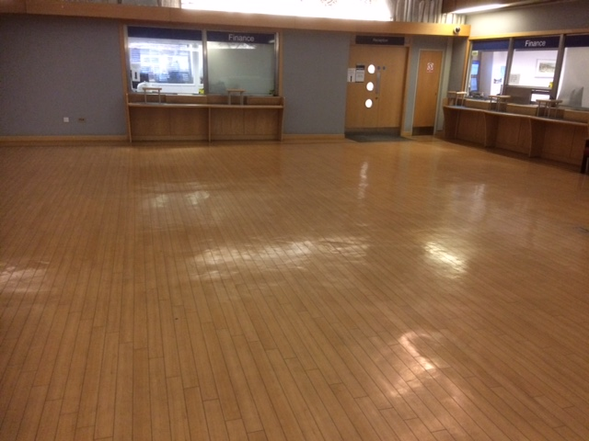
Changes outside too!

Slide 24
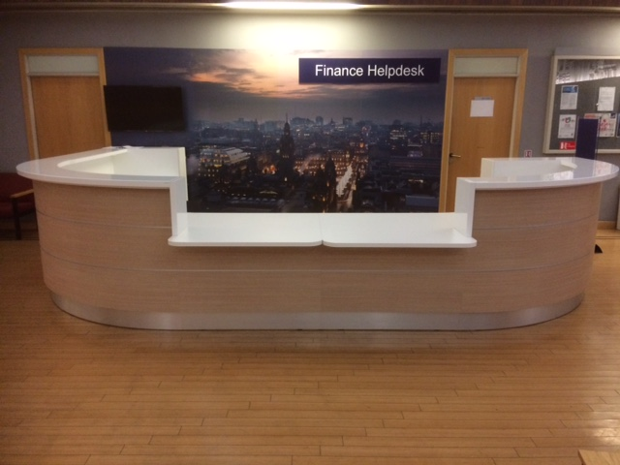
New ‘Front Door’
Agenda

Slide 25
Changes to come ………
Online payment methods
Petty cash ……..
Finance email addresses to be substantially refreshed
More documents to be received electronically ( e.g. non staff expenses)

Slide 26
Training
New Expenses & Purchasing sessions up and running – book onto waiting list via: https://bookings.strath.ac.uk
New sessions being finalised, dates to be confirmed soon….
Improvements made to training pages Inc. updated quick guides & new updates section –
https://moss.strath.ac.uk/developmentandtraining/FMS/Pages/Home.aspx
1-1 support or smaller group sessions available contact finance-fms-training@strath.ac.uk to arrange.

Slide 27
Updates: Finance
Knowledge Hub
Changes made to layout
    Guidance
    Training
    Updates
    Support
    FMS A-Z

Slide 28
Updates: Finance
Reports
  Budget Statement Drill Down Detail
    New report available under Standard Dept Reports
    Provides all transaction information (including budget, transfers, awaiting approval, approved amount, income and expenditure) in one report
    Removes need to use all the separate drill down reports
    Currently being reviewed by Focus Group
    Available to all users with access to Standard Dept Reports folder – any other feedback welcome

Slide 29
Updates: Finance
Reports (Cont)
  New Folders for Reports
    Will make it easier to find relevant reports
    Group related reports
    Will update ‘List of Reports for Web’ to reflect changes
    Currently being reviewed by Focus Group

Slide 30
Updates: Finance
Alerts
  Alerts for new Users
    Providing links to the Knowledge Hub and in particular pages for Introduction to FMS and Training
  Alerts for new Approvers (PM, SPM)
    Providing link to the Knowledge Hub and in particular new section re Guidance for Approvers

Slide 31
App for Tasks
  Allows users to approve expenses & requisition tasks on mobile
  Currently being piloted
  Proposed phased roll out
  If staff in departments are interested should request access in the normal way (financial-systems@strath.ac.uk)
  Information to be added to Knowledge Hub

Slide 32
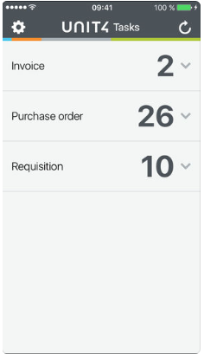
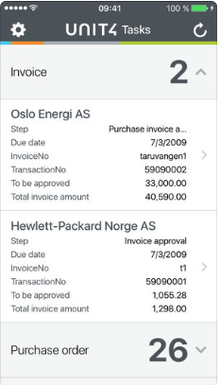
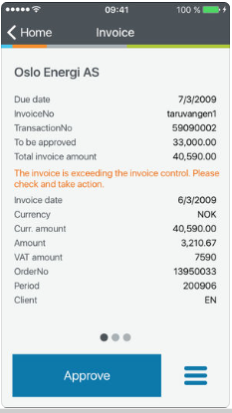
App for Tasks

Slide 33
Finance Focus Group
To help maximise the functionality in FMS for end users
To help enhance the surrounding financial business processes as a result of FMS changes
To have open two way conversation with Finance
To help inform some of the Finance Forum Agendas
Representatives from each Faculty and PS
Notes:
Forum for providing general feedback, raising issues
Two meetings to date, aim to meet every couple of months

