Slide 1

Finance Forum
November 2018

Slide 2




Slide 3

Agenda
Welcome & Introductions | Clare Urquhart | 2.15 – 2.20
Procurement | Sharon Griffin & Barry Allardice | 2.20 – 2.35
Research | Sandy Hall | 2.35 – 2.50
Payroll & Pensions | Clare Urquhart | 2.50 – 3.00
VAT | Jude Billcliffe | 3.00 – 3.10
Insurance | Jude Billcliffe | 3.10 – 3.20
FMS | Clare Urquhart | 3.20 – 3.30
Finance Helpdesk | Kirsty Ashley- Smith | 3.30 – 3.45
Finance Training | Claire Collins | 3.45- 4.00
Q&A | All | 4.00- 4.15

Slide 4

Procurement
Team Update
Finance related updates
General updates
Feedback on communications

Slide 5
The Procurement Team
Head of Procurement- Fiona Hughes
Lauren Leitch
(Estates)
Sharon Griffin
(IT/ Professional Services/ Labs)
Denise Kyle
Professional Services
HR Recruitment
Consultancy
Finance
Mikaela Bennet
Travel, Stationery
Library supplies and equip, print
Magda Bamford
Estates
Lab Equipment
Barry Allardice
Market Place
Supplier Content
P2P
Sarena Reid
New supplier requests
Requests for payments
Sharon Wallace
AFRC
Kimberley McNee
Furniture
Safety and Security
Utilities
Maureen McMillan
Catering, Hard FM
Soft FM
Neil Grant
IS
Hardware inclu MFD
Software
Telecoms

Slide 6
Update part 1
No PO No Payment
  Second round of supplier comms
  Update to internal comms issued
  confirmation orders (orders raised after an invoice is received)
Requests for Payments
  List of true exemptions now in place
  Process covers all payments including RKES contracts
  35% reduction on requests (Apr-Oct17 2575v Apr-Oct18 1676)
New supplier requests
  increasing numbers (594 requests Apr-Oct18 v 504 Apr-Oct17)
  generated when invoice is received
  Parking suppliers (value and commodity) (3786 active and 1268 parked) Report run every 6 weeks to park suppliers not invoiced in 18mths)
New SSJ Site
  Training for approvers
  New site launch

Slide 7
Update part 2
Key Travel Process for allocated Purchase Order - roll out within the next 24 weeks On line v off line bookings Training requirements Draft Travel Policy | Multi Functional Devices User Intelligence Group established (representatives from all Faculties) Offers currently being evaluated New contract due to go live Q1 (calendar) 2019
Mobile Phones New contract due to be signed (voice and data) Work on going with estates to pilot new process Rolled out by faculty | Recruitment of temporary staff Work being undertaken to identify best route to market Procurement will communicate outcomes to Procurement Contacts
Office Furniture New framework agreement in place Procurement undertaking a review of most economically advantageous supplier across campus Procurement contacts will be notified and others suppliers parked. | Water Coolers Centralised budgets Reports of issues with invoices

Slide 8
Communications
Procurement Contacts
Where to buy
Areas of Improvement
Next Steps

Slide 9
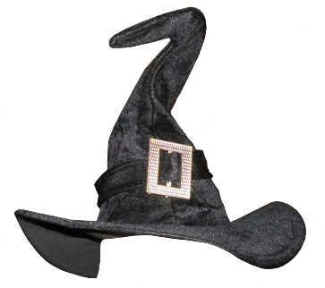
Research Finance Team
Sandy Hall Research Finance Manager
Linda Tuzcu Assistant Research Finance Manager
Katie Edward Assistant Research Finance Manager
Callum Nettleton
Other
Sharon Gibson
RCUK/ ATA
Michael Bonner
RCUK/ Project opening
Alastair Harvey
Knowledge Exchange
Julie Rattray
EU
Gordon Garrow
EU
Amanda Hart
KTP
Frances Hudson
Innovate UK
Helen Tracey
Other
Notes:
The role of the team is to provide guidance to the Research Community based upon funder specific contract requirements and the University’s financial regulations and expense guidelines. The team is working to daily deadlines driven by funder claim profiles with approximately 70% of the Teams time is focused on external funder requirements and audits.
Current Structure put in place following the Finance realignment in 2017.
Following realignment, 3.5 FTE from the original team remained.
Training and cross-skilling has been a primary focus for the team in order to maintain the University’s audit record with external funders such as the European Union and Research Council UK. Standard operating procedures have been put in place to assist with training.
Since the restructure we have increased our audit ranking with RCUK to the highest possible level, and achieved a 0% error rate on an Interreg audit (the first in the UK).

Slide 10
Research Finance Team
Some reminders –
Time sheets, Time sheets, Time sheets
Journal requests, please remember to include the original transaction number in the description of your journal
A journal can only be used to transfer expenditure that has been incurred. It is not possible to transfer a commitment. You must release the commitment and raise a new purchase order against the required subproject.
Where a journal relates to a calculation (e.g. salaries) please attach your calculation and workings to the journal.
Transferring multiple items as a single line – please attach a copy of the GL ledger report detailing the items and original transaction numbers.

Slide 11

Payroll
Contractual Changes
New Starts
Signed acceptance to HR- Starter Declaration to Payroll
Change in Hours
Inform HR asap to avoid an over/underpayment in salary
Leavers
Inform HR asap to avoid overpayment in salary and Termination Form should be completed for Grade 5 and under.

Slide 12
Payroll
Supplementary Payments System
Claims should be fully authorised no later than the 5th of the month
Claims should be submitted one month in arrears
P1/P2 Forms
Payments of overtime etc. should be made one month in arrears
Forms to HR no later than the 5th of the month
Full 23 budget code required (Payroll are not on FMS)
Check correct spelling of names

Slide 13
Payroll
Payslips/P60’s
Print off prior to leaving the University’s employment.
Bank Details
Inform Payroll as soon new bank details are available.
Blank bank mandate form available on Finance website.
AMS
Absence returns should be completed and returned to Payroll no later than the 5th of the month as late returns can effect salary payments.
Staff attending for jury service should download the appropriate forms and request Payroll complete prior to them attending court.

Slide 14
Payroll
Intermediaries Legislation (IR35)
Introduced April 2017
Employment Status for tax purposes
University makes assessment
Outcome drives payment method
Payment route (no deductions)
Payroll route (with deductions)
Different outcomes per dept possible

Slide 15
Payroll
International Payroll Payments
Contact HR/Payroll early
Different countries have different requirements
University needs to consider both Payment & Reporting obligations

Slide 16

Pensions
The University participates in three pension schemes
  Universities Superannuation Scheme (USS)
  Local Government Pension Scheme (LGPS)
  Scottish Teachers Pension Scheme. (STPS)
Membership is linked to start date of employment and grade assigned to that post.
Since January 2017 new staff joining on a post placed up to grade 5 are eligible to join the LGS. Staff placed on grade 6 and above are eligible for the USS
No new staff join the STPS as this a legacy scheme carried forward from Jordanhill College times

Slide 17
Pensions
New staff with a contract for fixed hours are entered into the scheme automatically, regardless of length of contract.
Staff with an ad hoc work based contract can opt in to the pension scheme.
The University also has to comply with Pensions Auto-enrolment.
In a typical month total pension contributions paid over to all three schemes amount to – Employee contributions - £838k. Employer contributions - £2m.
The University’s Pension Team is responsible for sending data to each of the schemes so that each member record is kept up to date and benefits can be calculated correctly.
Although full administration of the pension scheme is dealt with out with Finance, the Pensions Team help with queries from staff and can meet on a one to one basis to discuss membership. The Pensions Team are not authorised to provide financial advice.

Slide 18
Pensions
What would help
Departments submit data to HR/Finance regarding staff changes timely. For example, changes to working hours, absences due to sickness or unpaid leave, resignations. If a member of staff is in the pension scheme their record will need to be updated. If a pension record is not kept up to date there is a risk that benefits will be calculated incorrectly.
If the department have an induction process for new staff it would be really helpful to highlight that pension scheme membership is explained in their contract of employment and that this should be reviewed within the first three months of employment as membership of the scheme is not compulsory, members can opt out.

Slide 19

VAT and Insurance
Introduction
VAT
Common VAT queries relating to requisition/purchase
Where can you find guidance?
Who can help?
Insurance
Key points
Where can you find guidance?
Who can help?

Slide 20
Common Issues/Queries
Requisition/purchases
Which tax code should I select when I raise a requisition?
When raising a purchase requisition, the amount is entered net and the tax code is derived from the product, e.g. PS for standard rated products.
Key Tax Codes: | Description | Rate
PS | Purchase (input) – Standard Rate | 20%
PZ | Purchase (input) – Zero Rate | 0%
PR | Purchase (input) – EU & OS Services Reverse Charge | 20%
PE | Purchase (input) - Exempt | VAT Exemption
PL | Purchase (input) – Lower Rate | 5%
0 | Out of Scope –Non-business | Not in VAT system

Slide 21
Common Issues/Queries
Requisition/purchases
PS – Standard rate - 20%
This is used when we buy standard rated goods/services from a UK VAT registered supplier.
PZ – Zero rate - 0%
This is used when we purchase goods that are set at 0% for VAT by HMRC, for example books/ magazines, basic foods etc. Overseas goods also fall into this category as the VAT is captured when the goods come through Customs, the vat is paid by our courier and we then repay the courier.
PR – EU Goods/Services & Overseas services only reverse charge - 20%
When we purchase goods/services from an EU supplier the invoice will not include VAT. This is because the VAT becomes the customer’s liability rather than the suppliers. This is only applicable if the goods/service would normally fall under the standard rate category.
PE – Exempt – VAT Exempt
This is used when we purchase goods/services that are classed as VAT exempt by HMRC, a few examples would be medical/veterinary supplies, subscriptions, training/teaching provided to the University students by eligible bodies, i.e. other universities/colleges.
PL – Lower rate – 5%
This is used when we purchase goods that are at a reduced rate for example domestic fuel or power, children’s clothes etc.
O – Out of scope – Not in VAT system
This is used when we purchase goods from a non-VAT registered supplier or for charges for non business purposes for example donations, grant etc. This is also used for internal journal transfers.

Slide 22
Common Issues/Queries
Requisition/Purchases
Why is VAT charged when I buy goods/services from Overseas and EU suppliers where no VAT has been charged in the invoice?
Many purchases from EU and Overseas Purchases are under VAT reversal mechanism (Reverse charge), by applying PR (VAT reversal) Tax Code, FMS will be able to split VAT and net payment i.e. we pay supplier the Net amount and VAT is debited to your budget and the credit goes to HMRC in the quarterly VAT return.
I have amended the Tax Code to PE and the requisition is approved, why did the supplier still charge VAT?
This could be an error at the supplier’s side as not all Suppliers can download the attached Medical Exemption certificate, if you are charged VAT due to the missing VAT exemption certificate, it is the purchaser’s responsibility to provide the supplier with a copy of the exemption certificate (forms can be downloaded from the Knowledge Hub/VAT webpage).

Slide 23
Common Issues/Queries
Requisition/Purchases
What happens when the supplier disagrees with the VAT exemption application?
It is the purchaser’s responsibility to communicate with the suppliers and provide them with required information to help them make a sound judgement on VAT, if in doubt, contact Finance for help. However if the supplier doesn’t agree with the VAT exemption, we still have to pay their invoices (including VAT) as VAT relief is at the supplier’s discretion.
Why is my requisition rejected when I’ve amended Tax Code from PS to PE for medical exemption? This may be because:
the items you buy do not qualify for VAT exemption – not all items are eligible for VAT exemption. Most common allowable items are consumables for the lab, these are specified by HMRC.
the sub project paying for the purchase is sponsored commercially and VAT is fully recoverable from the normal VAT return – therefore VAT is not an extra cost and there is no need to apply for VAT relief.
your requisition has more than one line but you have only amended the Tax Code on the first line of your requisition, you have to ensure all lines are amended.

Slide 24
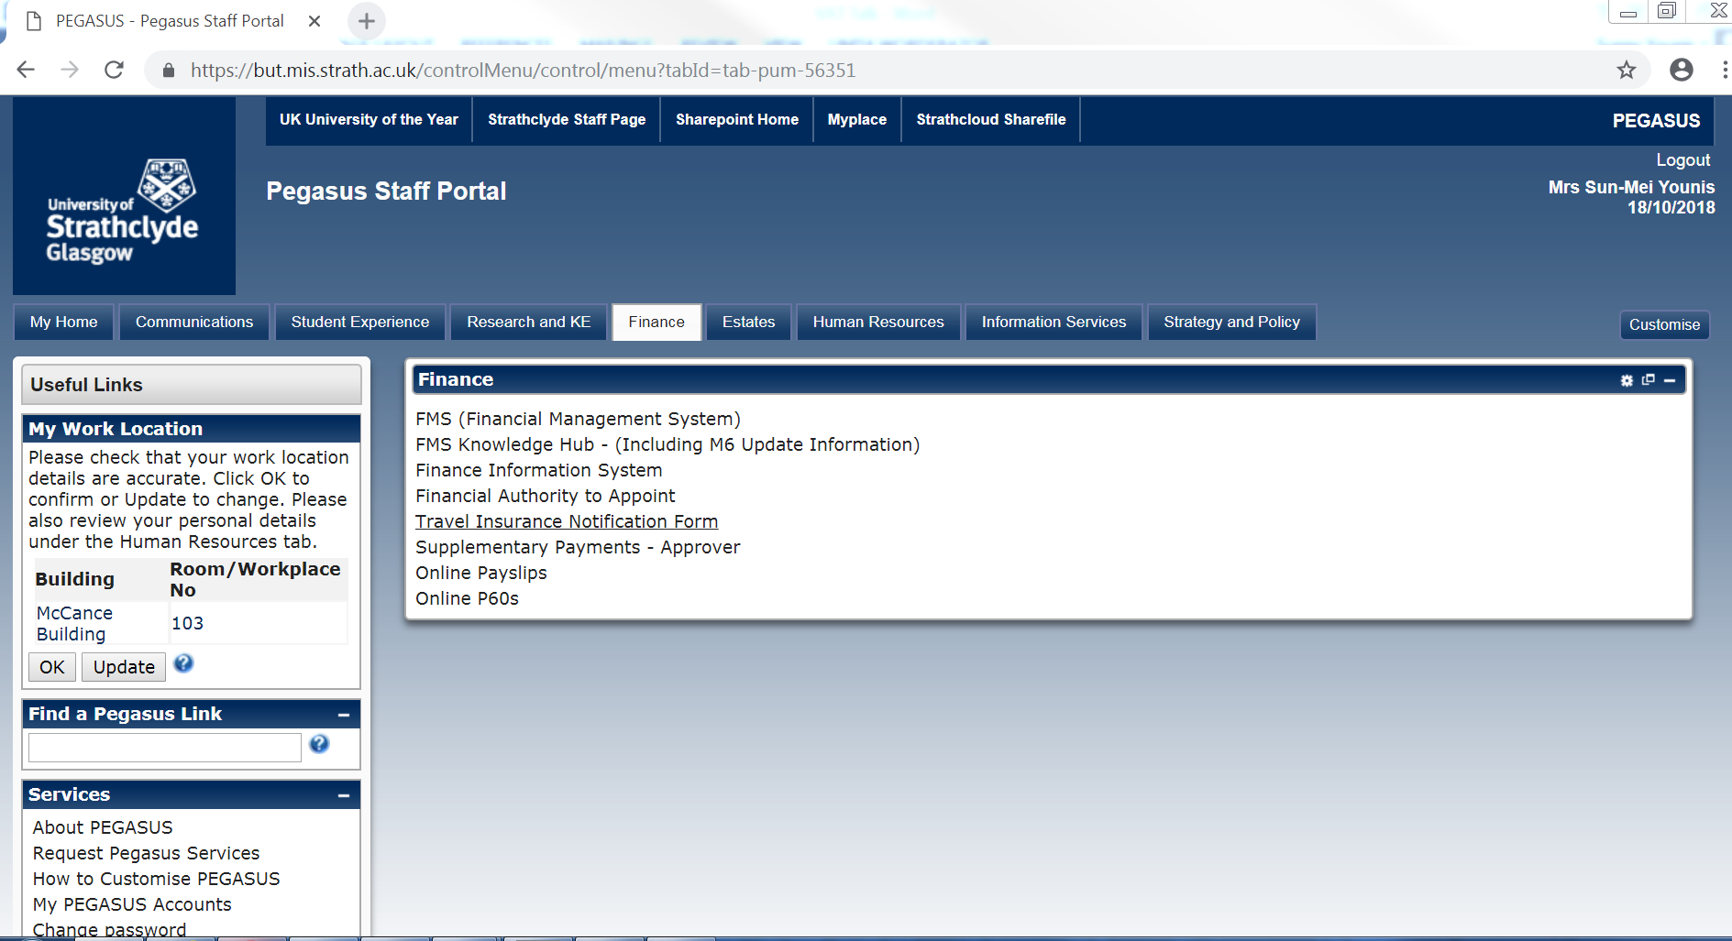
Where to find Guidance
More detailed VAT information can be accessed in Pegasus by following the link below:
https://www.strath.ac.uk/professionalservices/finance/financialservices/valueaddedtaxvat/
Or log into the Pegasus, choose the FINANCE tab and click on FMS Knowledge Hub

Slide 25
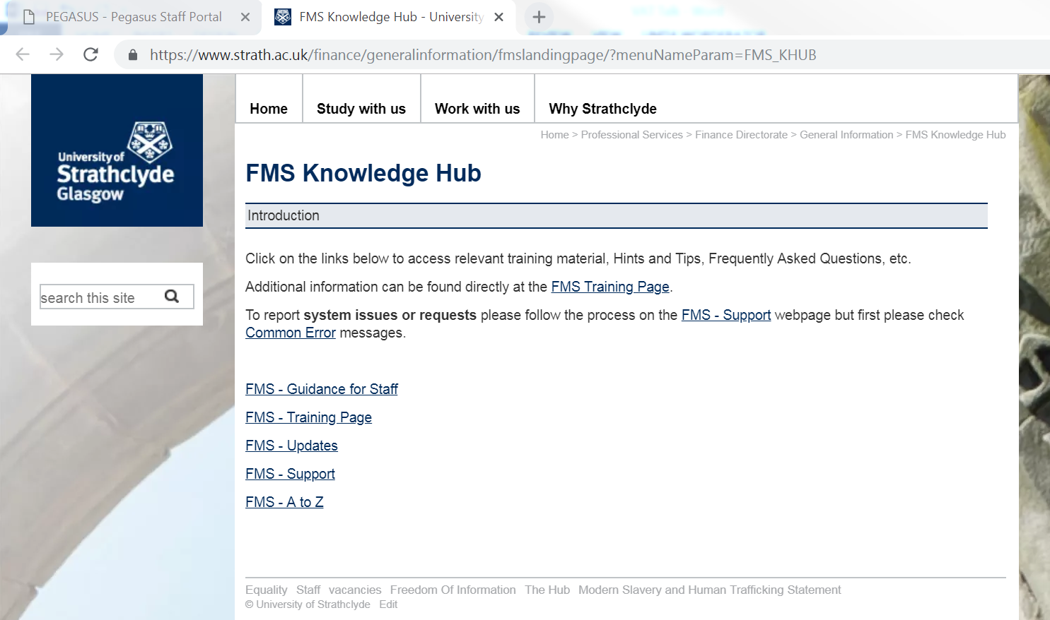
Where to find Guidance
Then choose FMS – A to Z

Slide 26
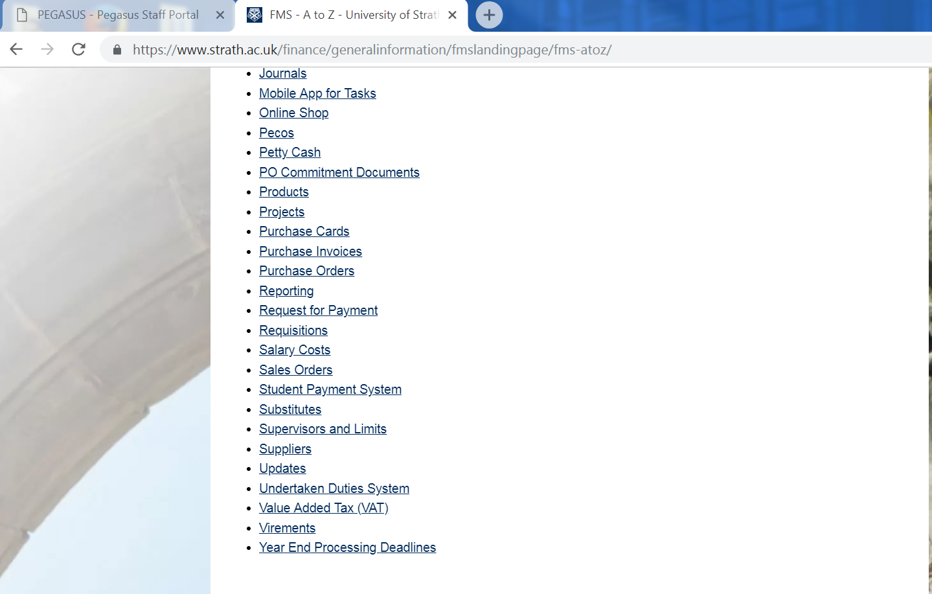
Where to find Guidance
At the bottom you will find Value Added Tax (VAT)

Slide 27
Who can help?
Included in the guidance are the following topics:
FMS Tax Codes and Tax Systems Explained
Detailed VAT Information
VAT FAQs
Key Contacts
If you don’t find an answer to your query from the above guidance then please send an email with your question/query to the VAT mailbox:
vat.enquiries@strath.ac.uk
Or contact Sunny Younis (x 2781) or Jude Billcliffe (x 2768)

Slide 28
Insurance - Key Points
Travel Insurance
To obtain cover for travel abroad, the staff/student should complete a basic travel insurance notification form, it’s found on Pegasus (under the Finance tab), this should be completed no later than five working days prior to departure. When the form is submitted the individual will receive an automatic email with a policy summary and emergency contact details for Global Response.
In an event of an emergency Contact Global Response when travelling abroad, this service is operated by a multi-lingual team available 24 hours a day, 365 days a year. Services available from Global Response include:
  Medical assistance including guarantees of payment, transfers and evacuations
  Arranging for up to two relatives or friends to travel out to you, if considered medically necessary
  Pre-trip medical advice and guidance on visas and inoculations
  Message relay services following an incident, accident or hospital admission
  Overseas support with lost luggage
  Referrals to foreign and commonwealth offices or embassies
  Legal referrals
  Security and safety advice
Claims should be submitted to the insurance mailbox within 30 days of a claim, all receipts should be kept including any medical expenses.

Slide 29
Key Points
Motor Vehicle Insurance
For all car purchases you must email the Insurance mailbox & Robert McKenna to inform them of the purchase. Failure to do so will result in the car not being insured. All cars have to be registered on the Motor Insurance Database and if we don’t know about them we can’t add them!
UK Long term Car hire (over 14 days) – Insurance for this follows the same rules as above.
UK Short term Car hire (under 14 days) - Insurance for this should be taken out with the Car hire Company. The Department hiring the vehicle is responsible for ensuring this is in place.
When a vehicle is hired outside the UK - Insurance for this should be taken out with the Car hire Company. The Department hiring the vehicle is responsible for ensuring this is in place.
Goods in Transit
For equipment under £60,000 automatic cover is provided.
For Goods over £60,000 please email the Insurance mail box with dates of movement, courier details, cost of all items and details of packaging. We will then contact our Insurer for the additional cover, the cost of this will be charged direct to the Department.

Slide 30
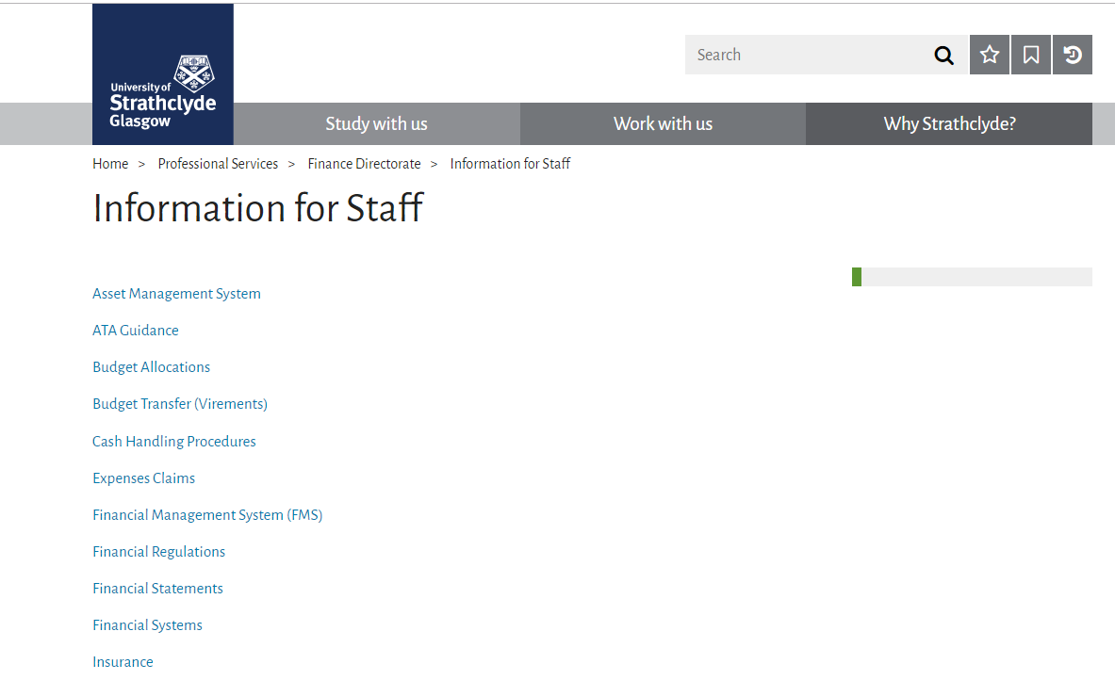
Where to find Insurance guidance
More detailed Insurance information can be accessed by following the link below: https://www.strath.ac.uk/professionalservices/finance/informationforstaff/
Or log in from our Home page - choose Professional Services/Finance Directorate/Information for Staff then click on Insurance.

Slide 31
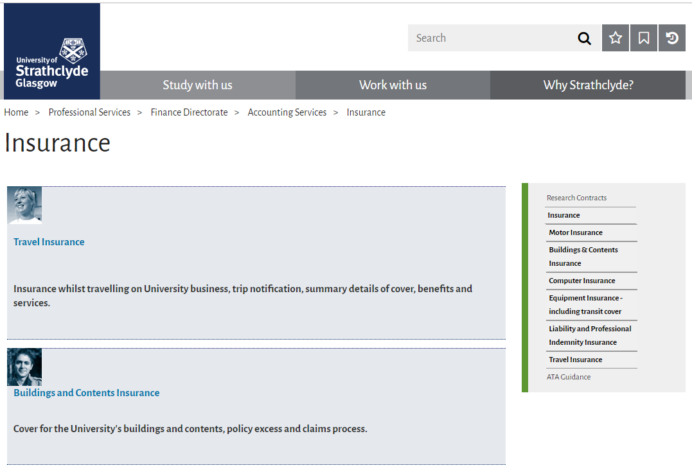
Where to find Guidance
Here you can choose which Insurance you want Guidance on and click on the link in BLUE

Slide 32
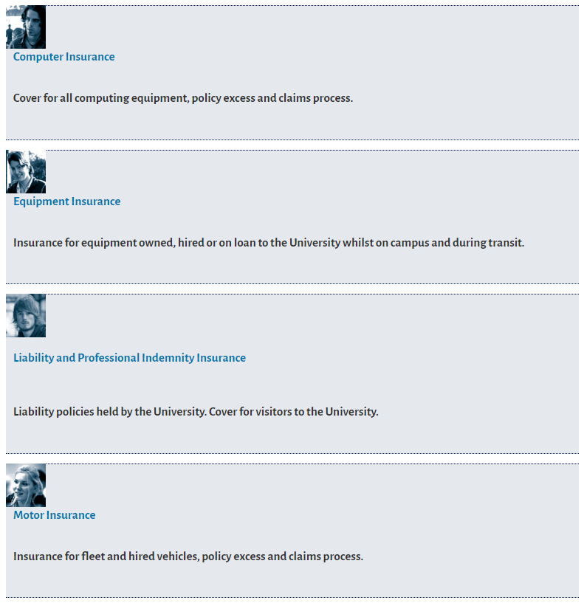
Where to find Guidance

Slide 33
Who can help?
Key Contacts
If you don’t find an answer to your question from any of the available guidance then please send an email with your question/query to the Insurance mailbox:
Insurance-services@strath.ac.uk
Please email all claim details to the above mailbox and you will receive a response from a member of the Insurance team Gillian MacDougall, Adam Greer or Jude Billcliffe.
Copies of the current year Insurance documentation can be found on the Insurance home page previously shared.

Slide 34

FMS Updates
Reports
  Reminder that ‘List of Reports for Web’ is available to help users identify the reports available
  Includes links to any specific training guides
  General reporting training guide also available on the Hub along with FAQs
  Specific training on reporting will be provided soon

Slide 35
FMS Updates
Commitment Review/Write-off
  Commitments should be reviewed regularly by departments to check they are still valid
  Where commitments are no longer required they can be removed
  Guidance on Hub regarding how to review and how to remove
  Removing commitments no longer required will free up budgets

Slide 36
FMS Updates
Automatic Commitment Write-off
  For Purchase Orders an automatic write off is possible where certain parameters are met
  Finance run process to identify commitments which meet parameters
  Alerts sent to Requisitioner to check if ok to write off
  Only written off if confirmed
  Exception is > 365 days outstanding and amount < £10k – written off automatically
  Process run quarterly (end Oct, Jan, Apr and Jul)

Slide 37
FMS Updates
Automatic Commitment Write-off – parameters
The write-off process will pick up any Purchase Order commitments which meet the following parameters:
There are no matched Invoices currently in workflow against the Purchase Order AND
order and the latest GRN are more than 90 days old
  AND outstanding % less than or equal to 10%
  AND outstanding amount less than or equal to £10,000
  Excludes call-off orders
OR order and the latest GRN more than 180 days old
  AND outstanding % less than or equal to 50%
  AND outstanding amount less than or equal to £50,000
  Excludes call-off orders
OR order and the latest GRN more than 365 days old
  Includes call-off orders

Slide 38
App for Tasks
  Allows users to approve expenses & requisition tasks on mobile
  Currently being piloted
  Proposed phased roll out
  If staff in departments are interested should request access in the normal way (financial-systems@strath.ac.uk)
  Information on Knowledge Hub

Slide 39
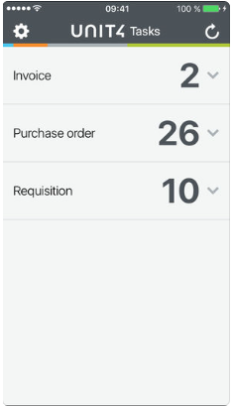
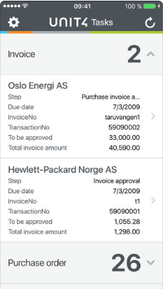
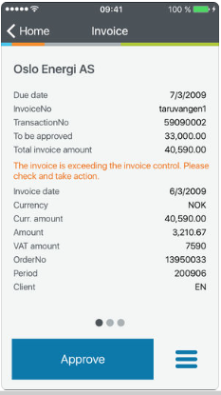
App for Tasks

Slide 40

Finance Helpdesk
Finance Enquiry Routes – Historical
Finance Enquiry Routes - Transition Period
New Front Helpdesk – Update
Finance Enquiry Routes – The future!

Slide 41
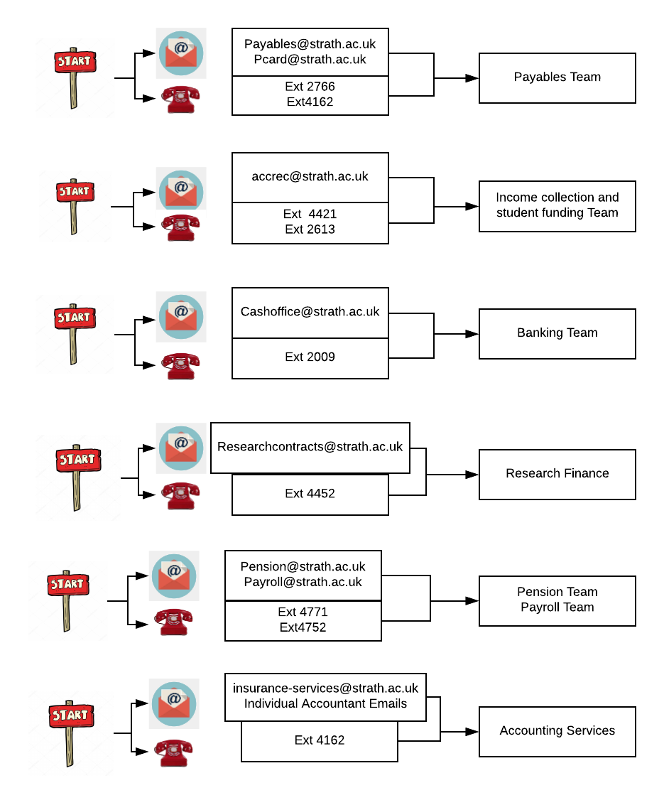
Finance Enquiry Routes (Historical)

Slide 42
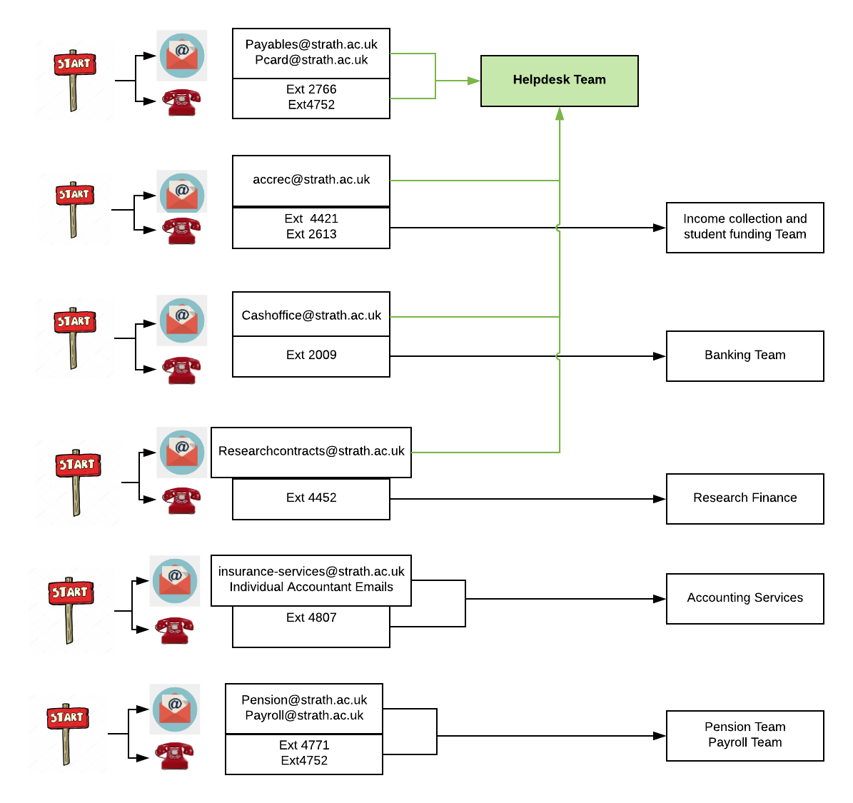
Finance Enquiry Routes (Transition period)

Slide 43
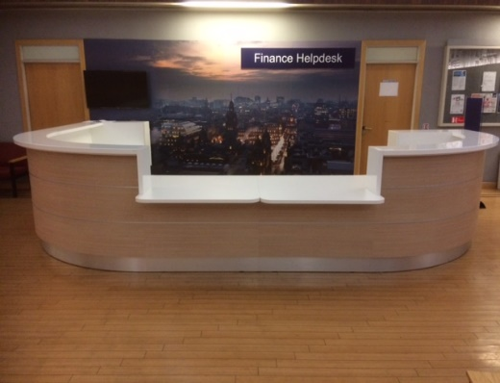
Finance Enquiry Routes – New Front Helpdesk

Slide 44
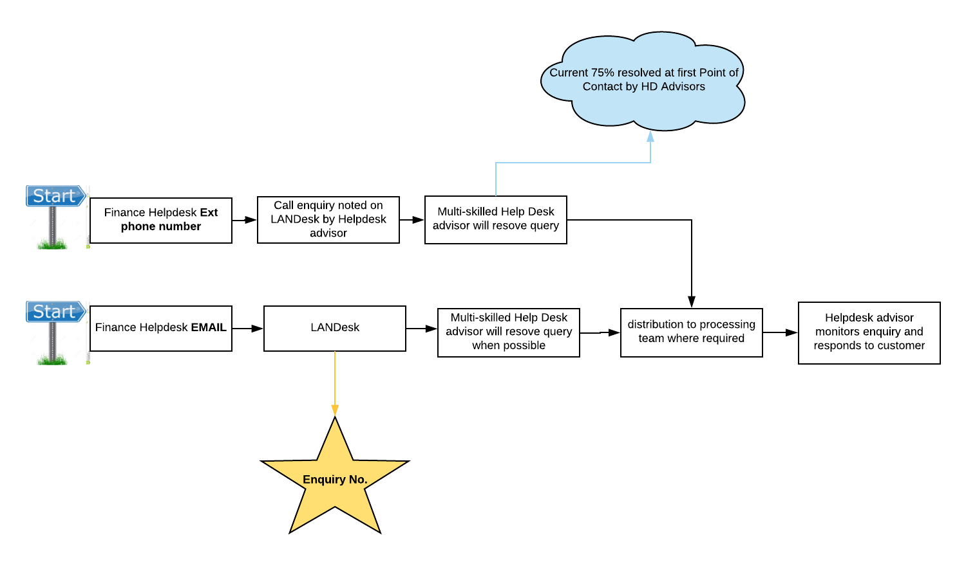
Finance Enquiry Routes (Future Jan-19)

Slide 45

Training Update
Delivered 1-1 sessions
Review of materials on Training Page
Supporting Helpdesk implementation
Supporting queries via Landesk

Slide 46
Training update
More 1-1 slots available for Nov & Dec
Training within finance – helpdesk/landesk
Finalisation of Generic FMS & Finance sessions
Creation of Webinar & E-learning Sessions

Slide 47
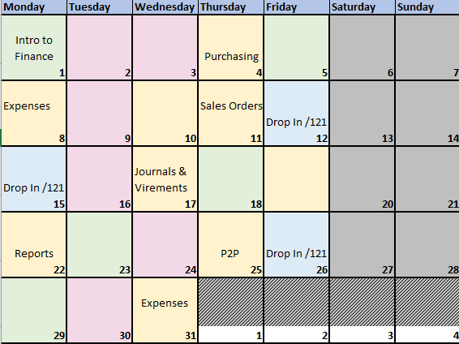
Training Calendar
Example

Slide 48



