Slide 1
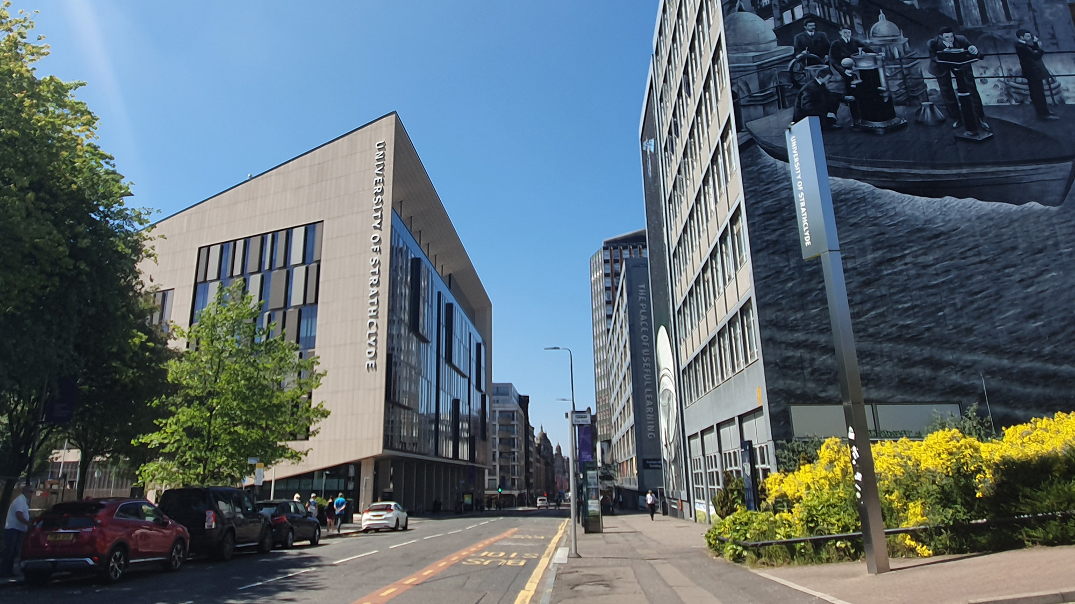
MENTAL HEALTH AWARENESS
X THE PLACE OF USEFUL LEARNING
This PowerPoint session has been designed as a resource to compliment the University of Strathclyde “Helping Students in Distress: A Guide for Staff” document.
Carla Rhodes, Disability & Wellbeing Service: September 2020. www.strath.ac.uk
Notes:
“University of Strathclyde Helping Students in Distress : A Guide for Staff” document: https://www.strath.ac.uk/professionalservices/media/ps/sees/disabilityservice/Helping_Students_in_Distress_A_Guide_for_Staff.pdf
References: Minding Our Future: Starting a Conversation about the support of student mental health. Universities UK, 2018.

Slide 2
SESSION AIMS AND LEARNING OUTCOMES
The health and welfare of all members of the University community is everyone’s concern. This PowerPoint provides advice on dealing with students in crisis, as well as guidance on supporting students in emotional distress. It is important to be prepared for emergencies, but also to be aware they occur rarely, and that expert help is always available.
Many people experience emotional and psychological difficulties at some point in their lives. Usually these difficulties can be resolved by talking them through with family and friends. Sometimes professional help is needed. If you are required to offer extra assistance to a student it is important to be mindful of your competence and capabilities, as well as the boundaries of your role.
This PowerPoint session has been designed as a resource to compliment the University of Strathclyde “Helping Students in Distress: A Guide for Staff” document. Both the PowerPoint and Guide have been produced to :
Raise awareness of issues relating to student mental health
Help you to recognise when a student may be in difficulty
Provide advice to help you respond/refer appropriately and effectively
Remind you of the sources of support within the University

Slide 3
STUDENT MENTAL HEALTH
Half of all young adults will access higher education by the time they are thirty. Students now form a significant group within the young adult population, and as numbers have grown, the student population increasingly resembles the wider young adult population in its diversity and characteristics. Support within our University communities needs to build from an understanding of the differing identities, characteristics and needs of the student population.
Students are at higher risk of developing mental health problems with research showing many people first experience mental health problems or first seek help when they are at university.
Students with mental health problems are more likely to experience disruption to their education through taking time off, attempting to continue their studies without the support they need, or dropping out altogether.
Minding Our Future: Starting a Conversation about the support of student mental health. Universities UK, 2018.
The number of students to drop out of university with mental health problems has more than trebled in recent years, official figures show a 210% increase.
Notes:
Minding Our Future: Starting a Conversation about the support of student mental health. Universities UK, 2018.

Slide 4
STATISTICS
The 2.3 million students studying at UK universities are an important mental health population, with distinctive characteristics and vulnerabilities. There is limited direct evidence on student mental health; the most reliable data is provided by proxy measures of disclosure and demand for services. The number of students disclosing a mental health condition to their higher education institution is increasing. Minding Our Future: Starting a Conversation about the support of student mental health. Universities UK, 2018.
2007–08
2010–11
2013–14
2016–17
PG: 2,185
UG: 14,325
PG: 3,925
UG: 25,450
PG: 8,040
UG: 49,265
PG: 1,260
UG: 8,415
Notes:
Minding Our Future: Starting a Conversation about the support of student mental health. Universities UK, 2018.

Slide 5
STUDENT POPULATION
Age: A large proportion of students are under 25 and around three-quarters of adults with a mental illness have their first episode before turning 25. The incidences of mood, anxiety, psychotic, personality, eating, and substance use disorders peak in adolescence and early adulthood: 50% of mental health problems are established by age 14 and 75% by age 24.
Stress: Becoming a student can be a stressful experience. Although stress isn't a mental health problem, it can lead to mental health problems like depression and anxiety.
Lack of support: Students may have left home for the first time, or just don't have enough time to see their friends and family. The loss of a support network can make them vulnerable to developing a mental health problem. Other factors involved in the increased prevalence of mental health illness within the student population:
Isolation
Drugs and Alcohol
Transient lifestyle
Lack of coping strategies
Change
Maturational Conflict
Financial pressures
High expectations – parents and competition for jobs
Poor housing
Academic expectations and deadlines
Coping with life events
First in the family to go to University
Notes:
Minding Our Future: Starting a Conversation about the support of student mental health. Universities UK, 2018.

Slide 6
THE MENTAL HEALTH CONTINUUM
Mental health is:
‘….the emotional and spiritual resilience which allows us to enjoy life and survive pain and disappointment and sadness. It is a positive sense of well-being and an underlying belief in our own, and others’, dignity and worth.’
Mental health influences how we feel about ourselves and others, and how we interpret the events that happen to us. It affects our capacity to learn, communicate, form relationships, deal with change, transitions, life events etc.
Our physical and mental wellbeing are closely linked - the World Health Organisation acknowledges that 'there is no health without mental health'. Wellbeing, sometimes called positive mental health, is about how we are in the world, and in our own lives. It includes how we feel about ourselves and others and the things that happen to us, how we make and maintain relationships, how we learn, how we work and how we deal with the challenges life brings us.
You may wish to watch this e-learning video on the Mental Health Continuum.
Mental health problems are disturbances in the way people think, feel, and behave. Mental health conditions may have an adverse effect on the persons ability to carry out normal day-to-day activities.
The types of mental health difficulties that students may experience include:
Mood disorders: Depression, Bipolar
Anxiety and stress disorders: Panic attacks, OCD, phobias
Psychotic illness including schizophrenia
Eating disorders: anorexia, bulimia
Personality disorders
Self harm
Dual diagnoses
Notes:
https://www.who.int/news-room/fact-sheets/detail/mental-health-strengthening-our-response

Slide 7
IMPACT ON STUDIES & ACADEMIC PERFORMANCE
Consider the impact that mental health can have on a students’:
Emotions
Thought Processes and Cognition
Physical Symptoms
Behaviours
Ability to complete activities of daily living
Ability to focus on their academic studies
Ability to engage with peers, academic staff and make connections.

Slide 8
ROLES, RESPONSIBILITIES AND LEGISLATION
Please see Page 3 of the Helping Students in Distress Guide.
IDENTIFYING SOURCES OF SUPPORT
It is not always possible to know what the best source of support might be. The student may have more than one problem, or the initial problem may not be the most central. What is important in the first instance is to refer the student to somewhere that is acceptable to them. A further referral can be made later, if appropriate.
OFFERING SUPPORT DIRECTLY If you offer support yourself, you must ensure that: You have sufficient time within the context of your other commitments to do this. It does not conflict with other aspects of your role. You have access to appropriate advice and support. You seek advice from colleagues or Student Support and Wellbeing services if you have persistent concerns. Remember — You are not solely responsible for a student’s emotional state.
LEGISLATION Duty of care to students Equality Act 2010 Health and Safety
WHAT YOU CAN DO
Listen
Give the student time to talk
Understand the situation from their point of view
Be sympathetic and not dismissive
Help the student to feel supported
Make appropriate referrals
WHAT YOU CAN’T DO
Solve all the student’s problems
Take responsibility for their emotional state or actions
Notes:
Please see Page 3 of the Helping Students in Distress Guide.
https://www.strath.ac.uk/professionalservices/media/ps/sees/disabilityservice/Helping_Students_in_Distress_A_Guide_for_Staff.pdf

Slide 9
CONFIDENTIALITY
Please see Page 3 of the Helping Students in Distress Guide.
Treat personal information about students with discretion, following the University’s GDPR policy where appropriate.
Do not promise absolute confidentiality; advise the student that you may have to consult a colleague or other services.
Do not disclose personal information about a student to anyone outside of the University, including parents, without the student’s explicit consent. If parents wish to contact a student, you can offer to forward a communication or tell the student they have been in touch.
The Disability and Wellbeing Service offers a confidential consultation service to all staff who may wish to discuss their concerns about students in difficulty or distress.
Notes:
Please see Page 3 of the Helping Students in Distress Guide.
https://www.strath.ac.uk/professionalservices/media/ps/sees/disabilityservice/Helping_Students_in_Distress_A_Guide_for_Staff.pdf

Slide 10
SIGNS AND SYMPTOMS
Please see Page 4 of the Helping Students in Distress Guide.
Recognising Early Warning Signs
Feeling – e.g. reduced self worth; sadness; elation; rapid mood change; anxiety; panic; fear; irritability and feeling wound up; feeling overwhelmed and out of control.
Thinking – e.g. difficulties with concentrating; being distracted; thoughts being disrupted, slower or faster than usual; difficulty in making decisions; negative thinking; blaming others; lack of confidence; thoughts of suicide; suspicious of others.
Behaviour – e.g. poor motivation; tearful; less active; disorganised; socially withdrawn; difficulty sleeping; poor life /work balance; agitation; difficult to relax, self harm, increased use of alcohol and drugs, changes in personality.
Physical – e.g. fatigue; lethargy; nausea; tremor; palpitations; difficulty breathing; losing or putting on weight.
Academic Changes:
Consistent late arrivals or frequent absences
Low morale
Disorganisation in completing work
Change in study habits and academic achievement
A general inability to communicate with others or lack of cooperation
Problems concentrating, making decisions, or remembering things
Missed deadlines, delays in completing assignments, poor exam grades
Making excuses for missed deadlines, or poor quality work
Decreased interest or involvement in class topics or the course in general
Altered perception of self and their ability
ASK YOURSELF:
Is the student’s behaviour causing concern?
How does the student seem?
Is any other Information available?
Is this different from your previous experience of this person?
Do you need more information from the student?
Do you need more information from other staff?
Would it be helpful to consult with someone else?
Notes:
Please see Page 4 of the Helping Students in Distress Guide: “How do you know there is a problem? Trusting your own judgement – check the following” chart
https://www.strath.ac.uk/professionalservices/media/ps/sees/disabilityservice/Helping_Students_in_Distress_A_Guide_for_Staff.pdf

Slide 11
OFFERING SUPPORT: NON-URGENT SITUATIONS
Please see Page 5 of the Helping Students in Distress Guide.
If you are required to offer extra assistance to a student it is important to be mindful of your competence and capabilities, as well as the boundaries of your role.
The majority of situations are non-urgent, although it may seem that the student is in distress or visibly upset.
Offering the student your time for a supportive discussion, and informing them of the supports available can make a big difference.
The Disability and Wellbeing Service offers a confidential consultation service to all staff who may wish to discuss their concerns about students in difficulty or distress.
The student may be displaying signs of emotional distress due to some of the following situations:
Depressed
Anxious
Having problems
Having health issues
Generally stressed with relationships
Homesick
Lonely and isolated
Bereaved
Self-esteem
Money problems
However, these situations should NOT be deemed urgent if you perceive no immediate risk to the student or others.
WHAT YOU CAN DO
Listen
Give the student time to talk
Understand the situation from their point of view
Be sympathetic and not dismissive
Help the student to feel supported
Make appropriate referrals
WHAT YOU CAN’T DO
Solve all the student’s problems
Take responsibility for their emotional state or actions
Notes:
Please see Page 5 of the Helping Students in Distress Guide.
https://www.strath.ac.uk/professionalservices/media/ps/sees/disabilityservice/Helping_Students_in_Distress_A_Guide_for_Staff.pdf

Slide 12
OFFERING SUPPORT: URGENT SITUATIONS
Please see Page 6 of the Helping Students in Distress Guide.
A situation may be URGENT if:
You believe the student may be at risk of harming themselves or others. You are concerned for one or more of the following reasons. The student:
May be at risk of serious self-harm
Has completely stopped functioning
Is violent or threatening violence to people or property
Seems very disorientated and out of touch with reality
Expresses suicidal thoughts/plans
Whether the student will accept help or not, in all situations of medical emergency where there is an immediate risk to the student’s life, i.e. overdose of drugs, serious self-harm, physical emergency:
Contact Security Services on 2222 for help in contacting emergency services.
In all situations:
Try to stay calm
Engage with the student if possible, but put safety first
Keep an accurate written record
Consider whether “Report and Support” is appropriate
Prioritise your own safety and that of others at the scene
Whenever possible, make sure that you have back –up available
Make sure that you get support by talking the situation through with your line manager, a colleague or one of the Support Services on Pages 7, 8 and 9 of the Guide
When dealing with urgent situations, it is important that any referrals or agreed action plans are followed up, preferably with the student directly.
Notes:
Please see Page 6 of the Helping Students in Distress Guide.
https://www.strath.ac.uk/professionalservices/media/ps/sees/disabilityservice/Helping_Students_in_Distress_A_Guide_for_Staff.pdf

Slide 13
SUPPORT FOR STUDENTS
Please see Pages 7, 8 and 9 of the Helping Students in Distress Guide.
University Policies and Procedures Academic Policies and Procedures (Appeals, Absence, Extensions, Personal Circumstances, Voluntary Suspension, Withdrawal etc.)
Sources of support within the University Community:
Academic Departments i.e. Adviser of Studies, Personal Development Adviser, Supervisor.
Accommodation Services
Careers Service
Chaplaincy
Disability & Wellbeing Service
International Student Support Team
Student Business
Student Financial Support Team
USSA Advice Hub
Sources of support external to the University: Family and Friends General Practitioner Local Support Services i.e. Bereavement, Addiction, Eating Disorder etc.
Disability & Wellbeing Service:
The Disability & Wellbeing Service has a range of advisers with specialist expertise in mental health, counselling, health and disability. We offer a broad range of support to students experiencing disability, mental health and wellbeing related issues, which includes, but is not limited to:
Assessment of needs
Ongoing review and support
Guidance on health, wellbeing & lifestyle
Guidance on university policies relating to health, wellbeing & disability
Supported Strath Sport Referrals
Referral for one-to-one counselling within the service
Cognitive Behavioural Therapy groups
Psycho-Educational programmes
Academic adjustments
Assistive Technologies
Mentoring You can find further information on our service, how to contact, and self-help resources on the Disability & Wellbeing Service website.
The Disability and Wellbeing Service offers a confidential consultation service to all staff who may wish to discuss their concerns about students in difficulty or distress.
Report & Support: A safe campus is the responsibility of everyone who is part of the University community: staff, students and visitors. If you are concerned about something that has happened, you can contact any of the services listed in this guide or use the online Report and Support service to let us know: https://www.strath.ac.uk/ studywithus/strathlife/reportsupport/
Notes:
See Pages 7, 8 and 9 of the Helping Students in Distress Guide.
https://www.strath.ac.uk/professionalservices/media/ps/sees/disabilityservice/Helping_Students_in_Distress_A_Guide_for_Staff.pdf

Slide 14
SUPPORT FOR STAFF
Line Manager
Employee Assistance Programme
Occupational Health
Silvercloud Free Online Cognitive Behavioural Therapy Package
General Practitioner
Friends and Family
The Disability and Wellbeing Service offers a confidential consultation service to all staff who may wish to discuss their concerns about students in difficulty or distress.

Slide 15
FURTHER TRAINING OPPORTUNITIES
The Disability & Wellbeing Service offer a wide range of training opportunities and courses relating to mental health and wellbeing, available to both staff and students. Some of the available courses include:
Mental Health First Aid (2 Day)
ASIST (Applied Suicide Intervention Skills Training) (2 Day)
SafeTALK: Suicide Alertness (Half Day)
To find out further information on training opportunities, how to book onto courses and online e-learning please visit the Disability & Wellbeing Bookable Wellbeing Programmes, Training and E-Learning webpage.
Notes:
https://www.strath.ac.uk/professionalservices/disabilityandwellbeing/mentalhealthwellbeingsupport/bookablewellbeingprogrammesandtraining/

Slide 16
CONTACT US
Disability & Wellbeing Service Room 4.36, Level 4, The Graham Hills Building 50 George Street Glasgow G1 1QE Email: disability-wellbeing@strath.ac.uk Website: www.strath.ac.uk/professionalservices/disabilityandwellbeing/

Slide 18
X THE PLACE OF USEFUL LEARNING

