Slide 1
Aurora Leadership Development Programme for Women
Equality & Diversity May 2026
University of Strathclyde

Slide 2
Today’s session
2026
What we will cover
Introduction to Aurora – Dr Matson Lawrence, Equality & Diversity Manager
Applying for Aurora – Dr Emma Compton-Daw, Researcher Development Manager
Experiences of Aurora – Dr Bożena Sojka, Urban Futures Research Fellow
Questions and discussion – All
There will be the opportunity to ask questions after each speaker.
Session is being recorded for colleagues unable to attend – if you do not wish to be recorded, save questions to the end!
Slides will be shared following the session.
Relaxed session – feel free to have your camera on or off, move around, stretch, stim, take breaks etc.

Slide 3
What is Aurora?
2026
Aurora is a leadership development initiative for women run by Advance HE.
Since its launch in 2013 more than 15,000 women from over 200 different institutions across the UK and the Republic of Ireland have participated in Aurora.
Aurora is for women from higher education institutions, up to senior lecturer level or the professional services equivalent, who would like to develop and explore issues relating to leadership roles and responsibilities
Why an initiative just for women? Aurora is an example of positive action provision to address inequalities faced by women in higher education that results in the underrepresentation of women in leadership roles.

Slide 4
What is Aurora?
2026
Involves 8 interlinked days, alongside self-directed learning and mentorship.
Runs in regional cohorts – Strathclyde is in the Scotland cohort.
Typically runs for 6 months, usually between September and February.
Led by a team of leadership experts, participants will explore four key areas associated with leadership success:
Identity, Impact and Voice
Politics and Influence
Core Leadership Skills
Adaptive Leadership Skills

Slide 5
What is Aurora?
2026
Participants are asked to:
Attend the introduction session which will introduce the aims and objectives of Aurora along with an inspirational guest speaker (1 session, online)
Attend each of the four development days and the two action learning set days (6 sessions, online)
Attend the final in-person development day (1 session, in-person – usually Edinburgh)
Undertake self-directed learning throughout Aurora, aligned with development interests
Commit to working with a mentor, found by delegates with the support of their institution
Be prepared to access leadership opportunities and champion for change.

Slide 6
Aurora Impact
2026
Aurora – the longitudinal study
5 year study (2015-2020) conducted at University of Loughborough
explored context of women in leadership in HE, as well as views and progression of Aurora participants.
8.6% of Aurorans said they had been promoted compared with 7.1% of comparison group.
25.1% of Aurorans reported receiving an accelerated or discretionary increment compared with 16.1% of the comparison group.
Three years or more after Aurora, Aurorans were more likely than comparison group to report receiving an increment in the last 12 months.
Qualitative responses were overwhelmingly positive, with many highlighting increased self-confidence in abilities and capabilities.

Slide 7
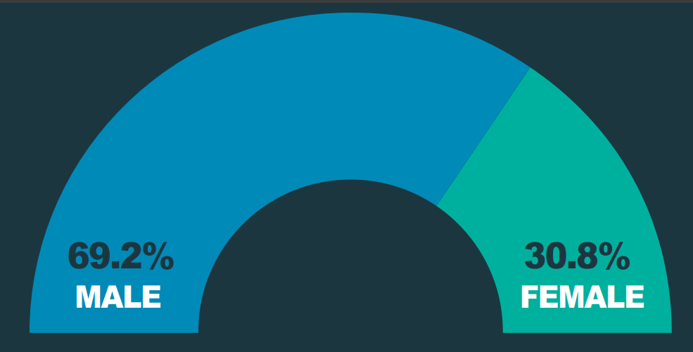
Sector context:
2026
Gender pay gap
Professors by gender
Advance HE (2024) Equality in higher education statistical reports

Slide 8
Sector context
2026
Bias (conscious and unconscious) and inequitable decision‑making structures can influence recruitment, promotion, and leadership appointments, leaving women underrepresented in senior academic and managerial roles.
The gender pay gap and occupational segregation (e.g. concentration of women in lower‑paid, teaching‑only, professional services, or fixed‑term posts) perpetuate economic inequality and restrict access to research‑intensive or leadership pathways.
Work‑life balance pressures and impacts of childcare and career breaks can make it more difficult for women to meet the demanding performance expectations required for advancement.

Slide 9
Sector context
2026
Limited mentoring, sponsorship, and leadership training opportunities can reduce women’s visibility and confidence in pursuing senior academic or administrative positions.
Organisational cultures that undervalue women’s contributions and tolerate subtle exclusion or harassment discourage retention and hinder the creation of genuinely inclusive environments.
These factors are compounded intersectionally if you are a woman who is disabled, a carer, racialised, LGBT+ , from a socio-economically disadvantaged background etc.

Slide 10

Who is Aurora for?
2026
Aurora is for women in grades 7-9* in academic, knowledge exchange, research, administrative and professional services, and technical roles who would like to develop and explore issues relating to leadership roles and responsibilities.
If you have not previously done any substantial leadership development training, this programme could be for you.
Notes:
*Colleagues who are Grade 6 may be considered in cases where their experience to date and career development goals meet the criteria. If you are unsure about whether to apply, you are welcome to seek advice from the Equality & Diversity Office.

Slide 11
Who is Aurora for?
2026
You should be:
enthusiastic about your own development.
able to attend all parts of the programme.
willing to engage in some self-directed learning.
engage productively with your mentor
willing to contribute to the University’s internal Aurora work and related initiatives such as the Women’s Staff Network, including mentoring future Aurorans.

Slide 12
Aurora at Strathclyde
2026
Strathclyde centrally funds a limited number of places each year via the Equality & Diversity Office. Departments can also locally fund additional places for their staff.
There will be approximately 15 centrally-funded places in 2026/27. Around 180 places have been funded by the University since 2013!
You will have mentorship for the duration of the programme – you are encouraged to identify a mentor at Strathclyde, however support is available if you do not have a mentor in mind.
There will be opportunities to meet and connect with other Strathclyde colleagues taking part in Aurora, and opportunities to get involved in related events and activities.

Slide 13
How to apply
2026
For a centrally-funded place at Strathclyde
Download and read the Selection Process and Criteria and Application Form documents outlining criteria for Strathclyde applicants and expectations of participants.
Complete the application form.
Return your completed application by email to equality@strath.ac.uk by 5pm on Friday 12 June 2025.
Copy in your line manager as confirmation that your participation in the programme has been discussed and approved.
The selection panel will consider applications then notify applicants of outcomes by the end of June.

Slide 14
Application Guidance
2026
Information to support your application for a centrally-funded place
The following section provides information about the application form – including information on what to consider and the kinds of things to include when completing the form.

Slide 15
Selection Criteria
Must meet all six points of the following selection criteria:
Selection Criteria | Description | Application Section
 | You should be…
Criteria 1 | A member of staff at the University of Strathclyde, usually in grades 7, 8 or 9. This includes those in Academic, Admin and Professional Services, Knowledge Exchange, Research, Teaching, and Technical roles. | Section 1
Criteria 2 | Interested in developing your leadership skills in order to further your career, particularly with regard to leadership skills and progression into a future leadership role. | Section 2
Criteria 3 | Able to demonstrate that participation in the Aurora programme specifically would benefit your future career aims and the aims of your department/the University. | Section 3
Criteria 4 | Able to demonstrate a record of applying learning from training or development opportunities to current or past job roles. | Section 4
Criteria 5 | Able to demonstrate that this is an appropriate time for you to participate in Aurora (in terms of career point, ambitions and learning and development to date). | Section 5
Criteria 6 | Supported in your application by your line manager. | See ‘How to apply’
Scoring:
0 = does not meet criteria 1 = partially meets criteria 2 = fully meets criteria 3 = exceeds criteria

Slide 16
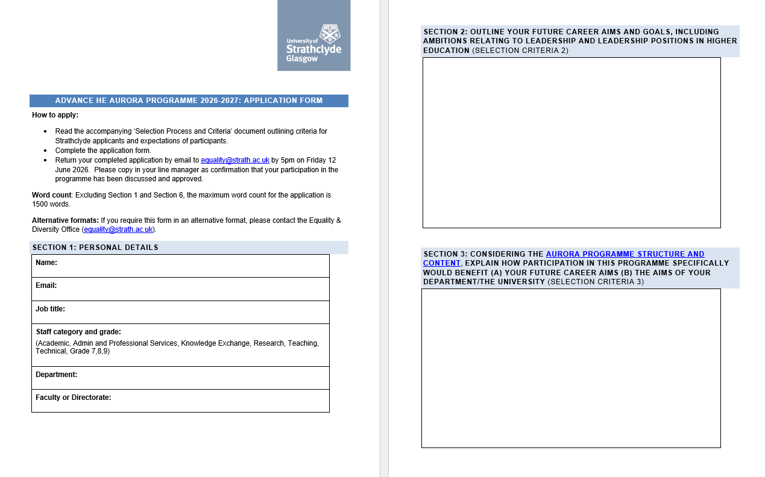
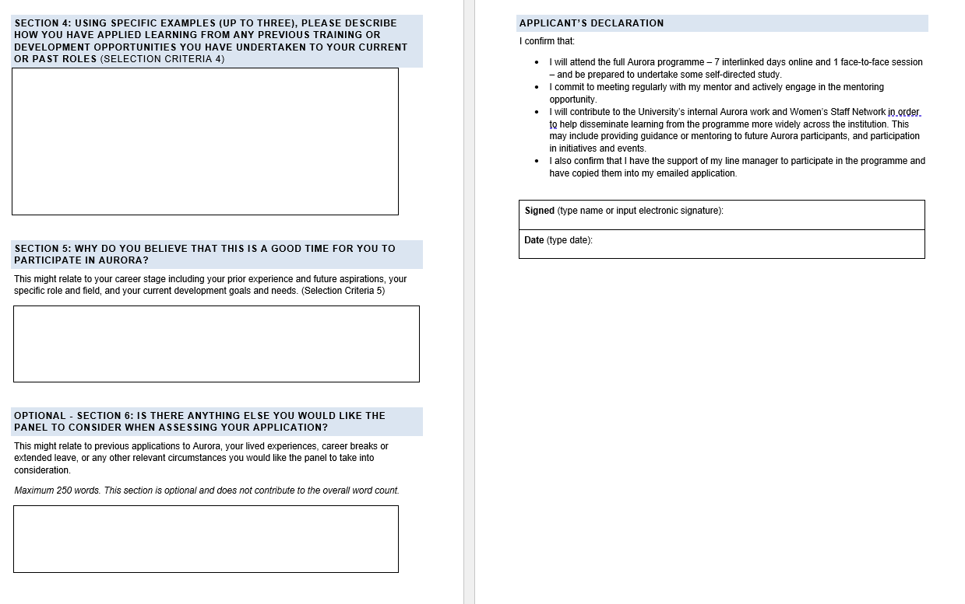
Application Form

Slide 17
Section 1: Personal Details
Identifying information redacted before scoring
SC1. A member of staff at the University of Strathclyde, usually in grades 7, 8 or 9. This includes those in Academic, Admin and Professional Services, Knowledge Exchange, Research, Teaching, and Technical roles.

Slide 18
Section 2: outline your future career aims and goals, including ambitions relating to leadership and leadership positions in higher education (Selection Criteria 2)
What would you like the next step in your career to be?
Why do you want to make move to a leadership role?
What does leadership look like for you within that ambition?
What would you like to change/influence for the better?
What are you currently doing and what have you done so far towards taking on more leadership?
Have you taken on additional responsibility, already leading a small team, taking part in committees or groups?
Are you not sure how to go about this and Aurora could help?
it’s okay to not know exactly!
This helps show you are serious about developing leadership skills in order to further your career
SC 2. Interested in developing your leadership skills in order to further your career, particularly with regard to leadership skills and progression into a future leadership role.

Slide 19
Section 3: Considering the Aurora programme structure and content, explain how participation in this programme specifically would benefit (a) your future career aims (b) the aims of your department/the University (Selection Criteria 3)
Spend some time looking at the information about Aurora and the Department/School/University aims
a) future career aims
How do you see the topics covered and opportunities provided supporting your leadership vision provided in Q2
What can you not do now that these will help you to do?
b) aims of the Department/School/University
How do you see the topics covered and opportunities provided supporting these aims or helping you to achieve them?
Answer A and B!
Make direct, explicit links rather than generic “it will help me be a better leader”
SC3. Able to demonstrate that participation in the Aurora programme specifically would benefit your future career aims and the aims of your department/the University

Slide 20
Section 4: Using specific examples (up to three), please describe how you have applied learning from any previous training or development opportunities you have undertaken to your current or past roles (Selection Criteria 4)
STAR Technique
What was the opportunity?
What learning have you applied and how?
What has changed for you/your department/school/university because of it?
State explicit outcomes eg better able to support colleagues, more confident, changed a process, etc
Egs of workshops, development programmes etc work best here
Situation & Task
Action
Result
The reviewers want to be sure the places go to people that will make good use of the programme
SC4. Able to demonstrate a record of applying learning from training or development opportunities to current or past job roles.

Slide 21
Section 5: Why do you believe that this is a good time for you to participate in Aurora?
This might relate to your career stage including your prior experience and future aspirations, your specific role and field, and your current development goals and needs. (Selection Criteria 5)
Why now?
How will Aurora help you move to your next role?
Demonstrate you are ready to take the next step
What have you done already?
How have you changed your current role to mean you’re ready to take the next step?
Detailed responses more helpful than generic statements
SC5. able to demonstrate that this is an appropriate time for them to participate in Aurora (in terms of career point, ambitions and learning and development to date)

Slide 22
Optional - Section 6: Is there anything else you would like the panel to consider when assessing your application?
This might relate to previous applications to Aurora, your lived experiences, career breaks or extended leave, or any other relevant circumstances you would like the panel to take into consideration.
This optional section enables you to reflect on any personal circumstances or experiences you wish the panel to take into consideration.

Slide 23
Answer the questions!
Give explicit examples – what does leadership look like for you, what will you change, do differently, lead…
Show you have thought about your leadership development and how you will make the most of this opportunity
Focus on leadership not operational detail

Slide 24
Thank you!
If you have any queries, contact the Equality & Diversity Office equality@strath.ac.uk
2026

