Slide 1
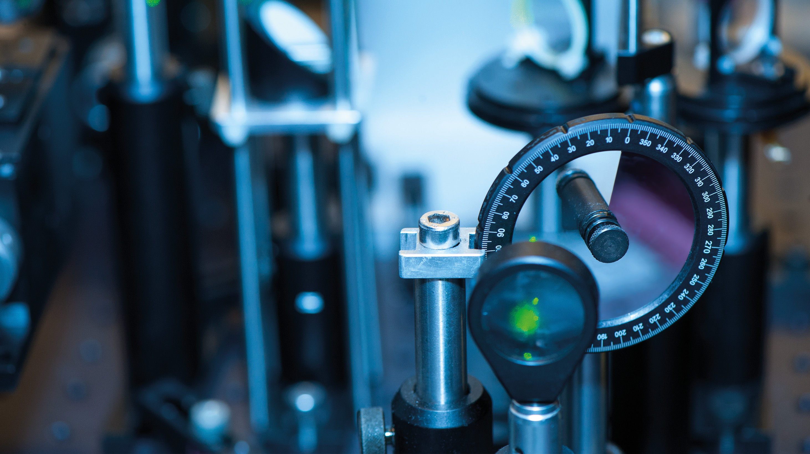
THE
FACULTY OF
SCIENCE
X THE PLACE OF USEFUL LEARNING
www.strath.ac.uk/science

Slide 2
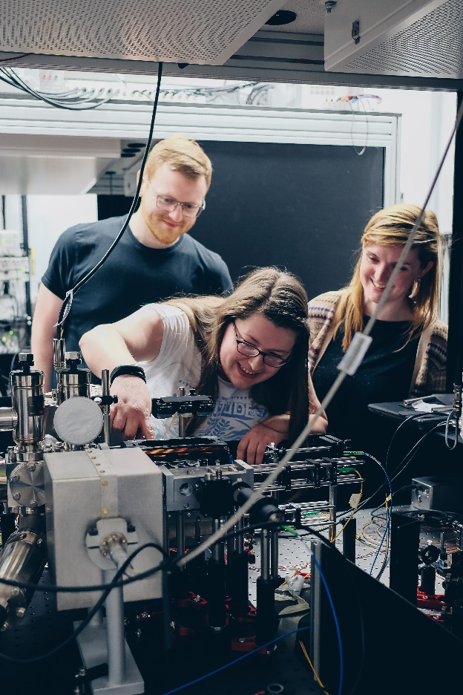
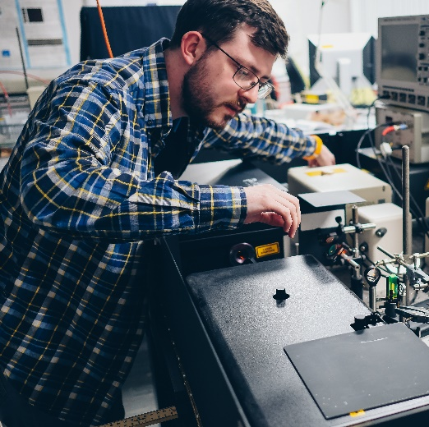
DEPARTMENT OF PHYSICS INFORMATION ON OUR COURSES (UG)
Prof. Rob Martin (Academic Selector)
physics-study-enquiries@strath.ac.uk

Slide 3
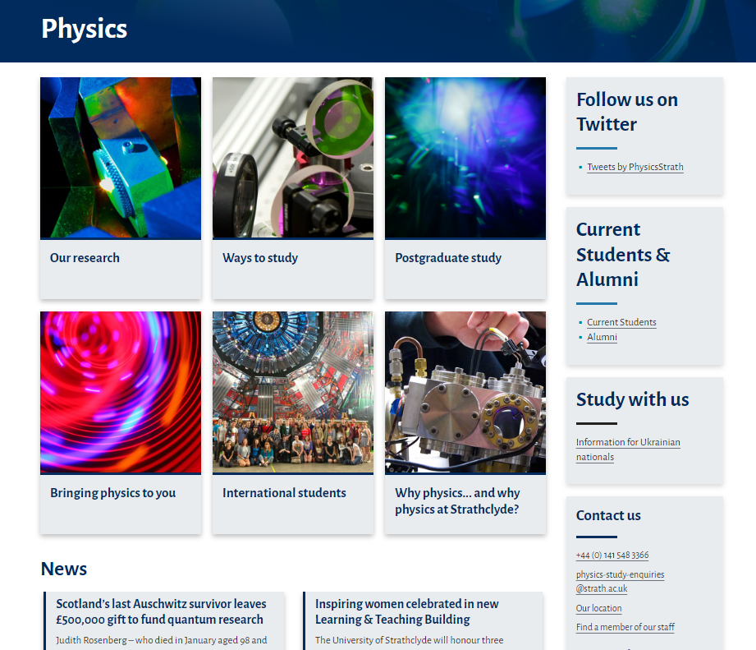
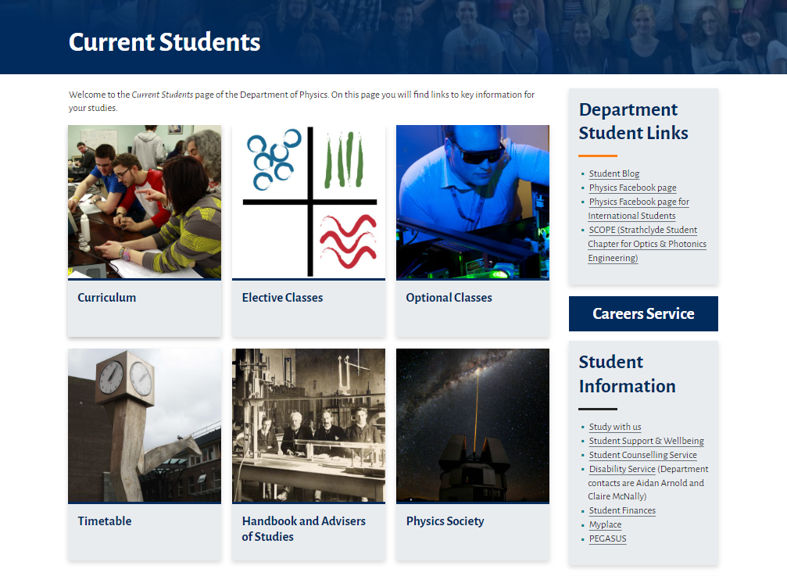
DEPARTMENT OF PHYSICS
We will have a “Q&A” discussion at the end of the presentation.
Questions about your offer email: physics-study-enquiries@strath.ac.uk
Web: https://www.strath.ac.uk/science/physics
Web: https://www.strath.ac.uk/science/physics/currentstudents/

Slide 4
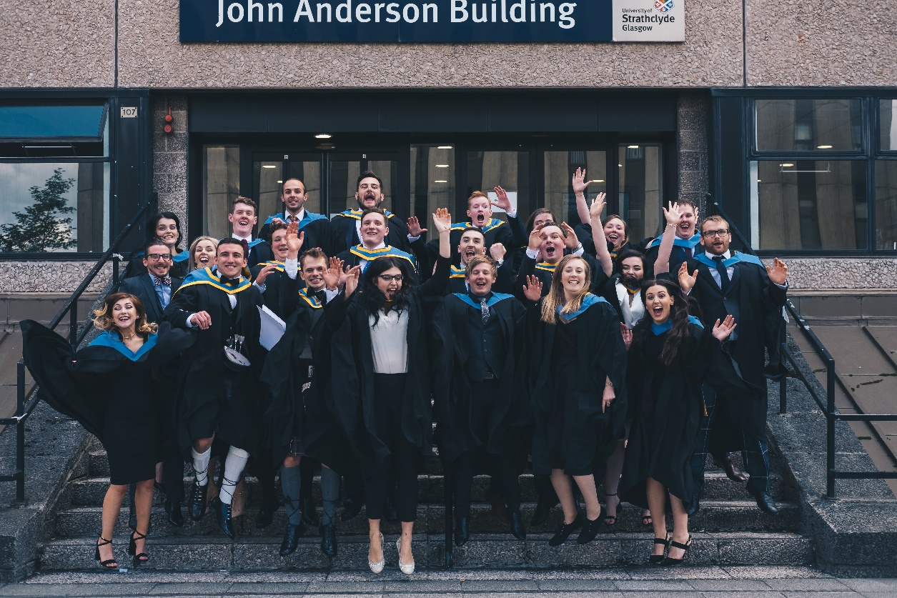
OVERVIEW OF PRESENTATION
The Department
Teaching through the years
Placement and overseas study
Student Support
Physics Society
Careers
Q & A

Slide 5
WHY PHYSICS AT STRATHCLYDE?
Develop skills that will enable you to become a successful physicist and maximise your career options
Learn from academics at the forefront of their research field
Opportunities for summer projects, placements, international exchanges
Courses accredited by the Institute of Physics

Slide 6
THE DEPARTMENT
37 Members of Staff
360 Undergraduate students
4 Research divisions
Annual research income ≈£11 million
World leading research informs teaching
All divisions contribute UG projects
All degrees accredited by Institute of Physics
Physics with Teaching accredited by the General Teaching Council for Scotland (GTC)

Slide 7
Teaching Through the Years
Award of degree determined by credits gained over period of study.
BSc (Hons) 4 years study – 480 credits
MPhys (Hons) 5 years study – 600 credits
Minimum of 120 credits per year
Level of degree determined by Faculty of Science degree algorithm (all students in Faculty are assessed in the same way).

Slide 8
TEACHING YEARS 1 & 2
Year 1 and 2 120 credit compulsory curriculum
Each year has
40 credits Mathematics
20 credits Mechanics and Waves
20 credits Electromagnetism and Quantum Physics
20 credits Experimental Physics
20 credits Programming and Skills
1st year introduction to Python
2nd year use Python for physics

Slide 9
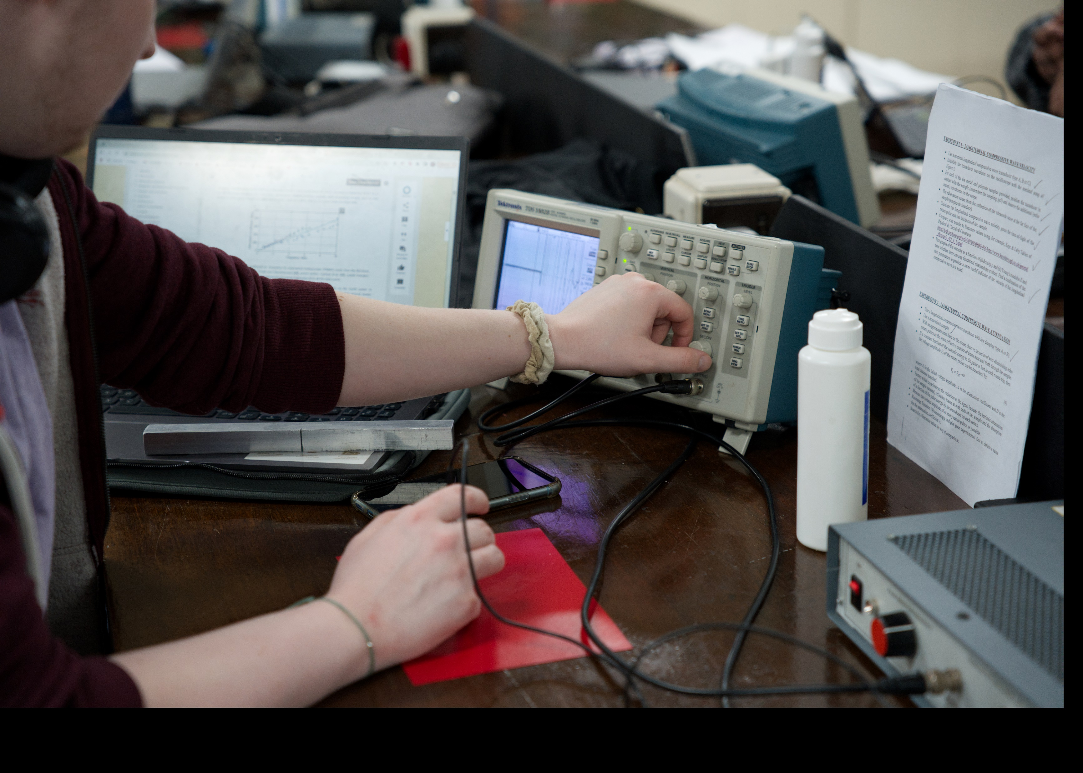
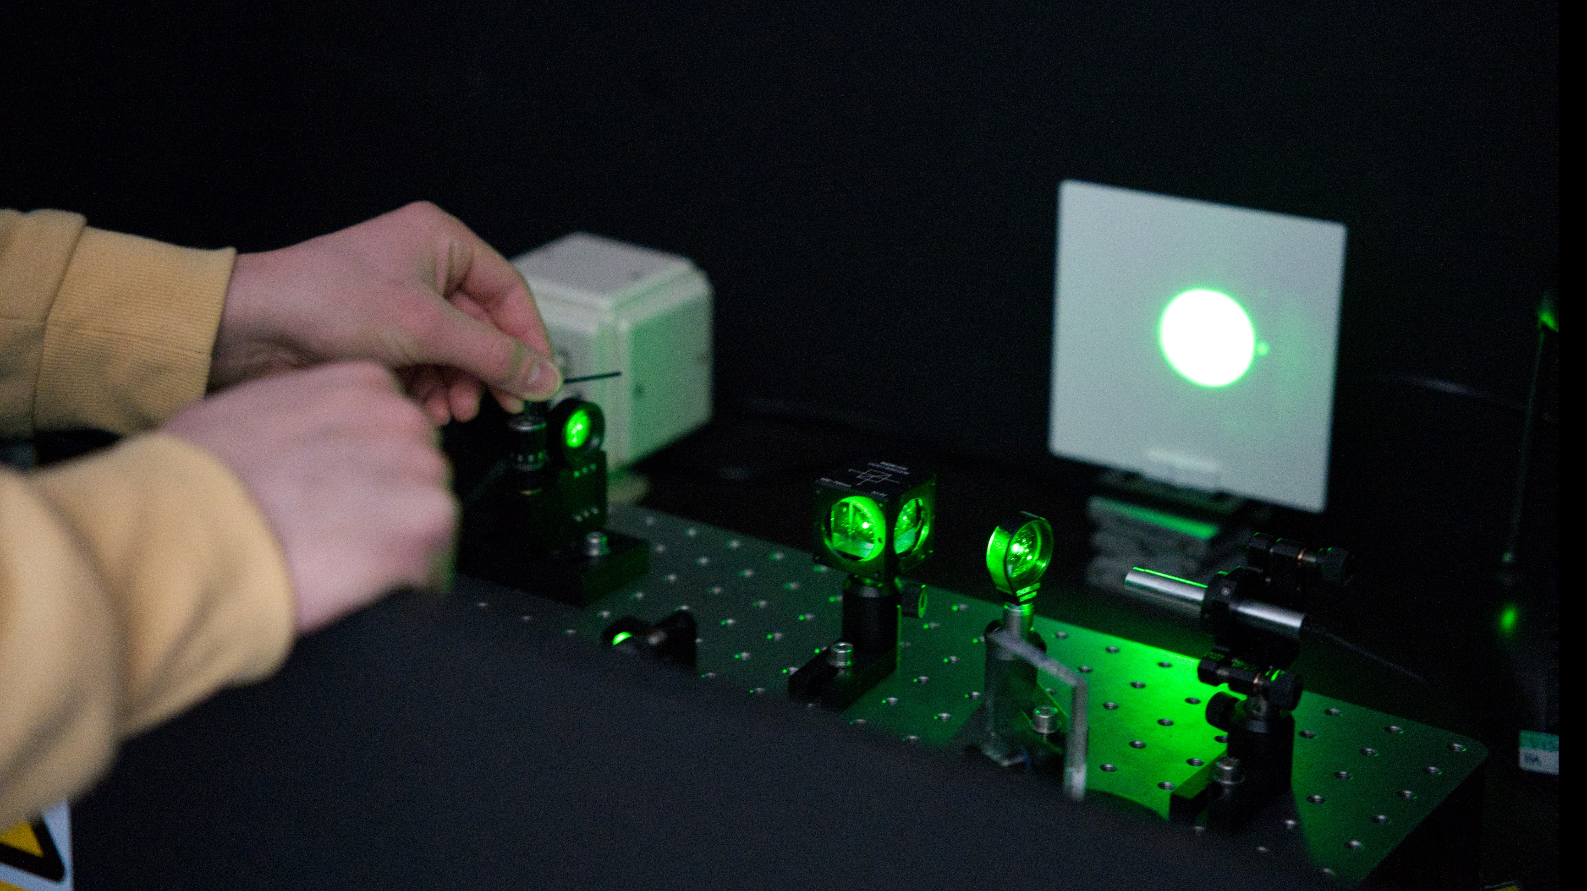
TEACHING YEAR 3
60 credits Compulsory
20 credits Electromagnetism and Quantum Physics
20 credits Thermal and Statistical Physics
20 credits Solid state physics
60 Credits optional/elective
20/40 credits Experimental Physics (must do one)
20 credits Mathematics
20 credits Advanced Programming
20 credits Communicating Physics
Photos from our 3rd year Experimental
Physics lab (about to start refurbishment)

Slide 10
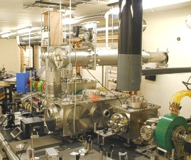
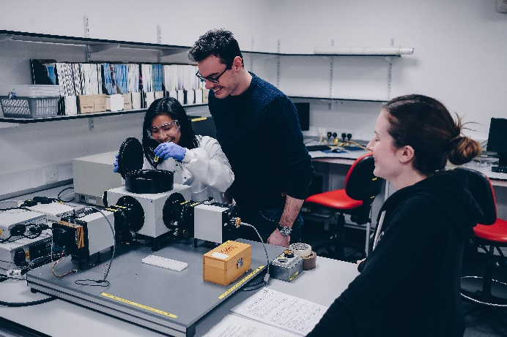
TEACHING YEAR 4 & 5 (BSc & Mphys)
Both years have a 40 credit compulsory project, starting in 4th year and continuing in 5th year (MPhys)
Year 4
80 credits optional modules which reflect our research interests
Year 5
20 credits compulsory Research Skills
60 credits optional modules which reflect our research interests and extend on Year 4 modules
Modules include – Quantum Optics, Solid State, Nanoscience, Photonics, Plasma Physics, Computational Physics

Slide 11
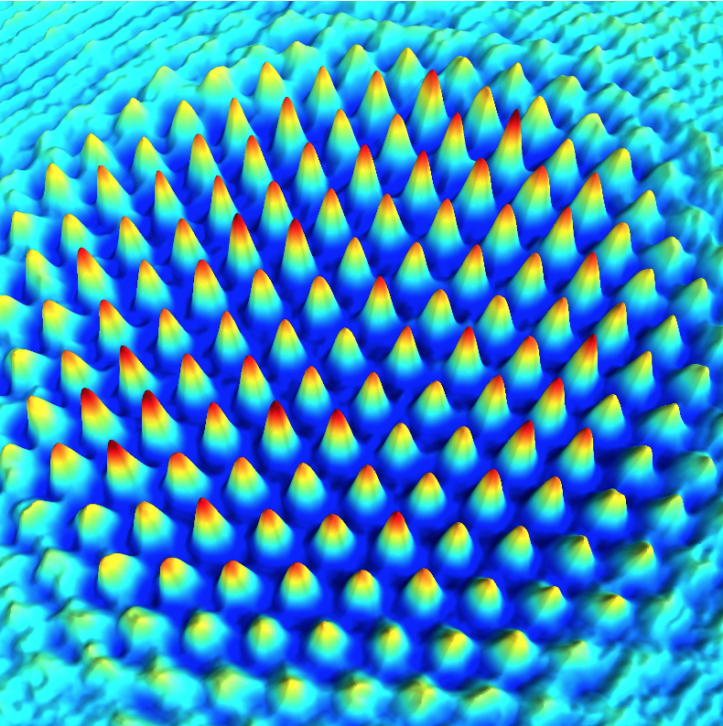
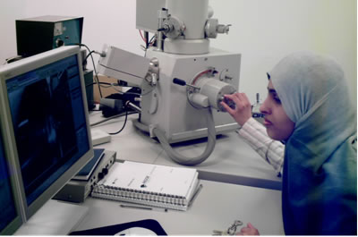
TEACHING YEAR 4 & 5 (Mphys Advanced Research)
Both years have compulsory project, starting in 4th year and continuing in 5th year (MPhys)
Year 4
40 credits project
20 credits compulsory Research Skills
60 credits optional modules
Year 5
100 credits project starts in August
60 credits optional modules which reflect our research interests and extend on Year 4 modules

Slide 12
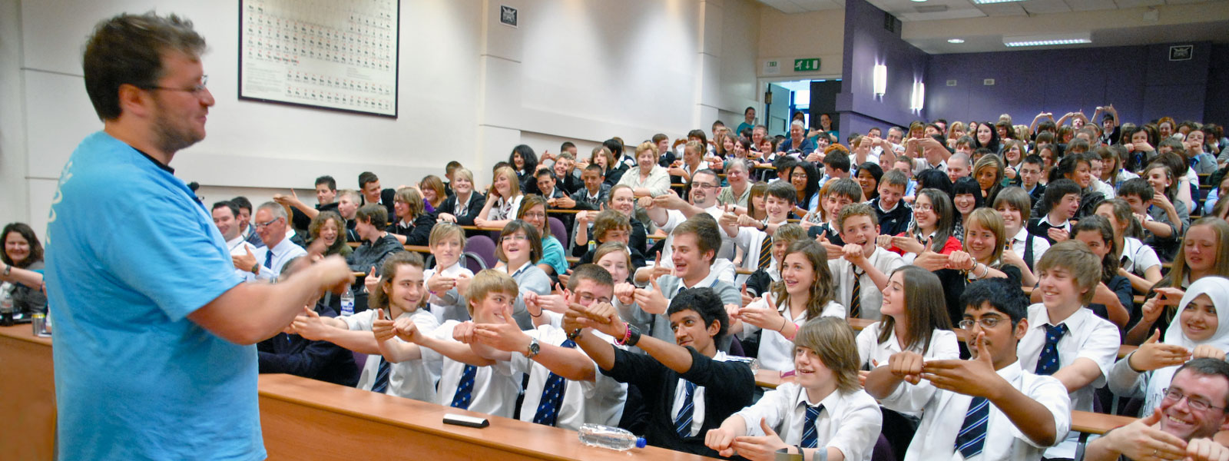
Physics with Teaching
Follows first three years of physics degrees
Year 4
School of Education following the PGDE in Physics.
18 weeks of School placements – both primary and secondary
Pedagogy of Teaching

Slide 13
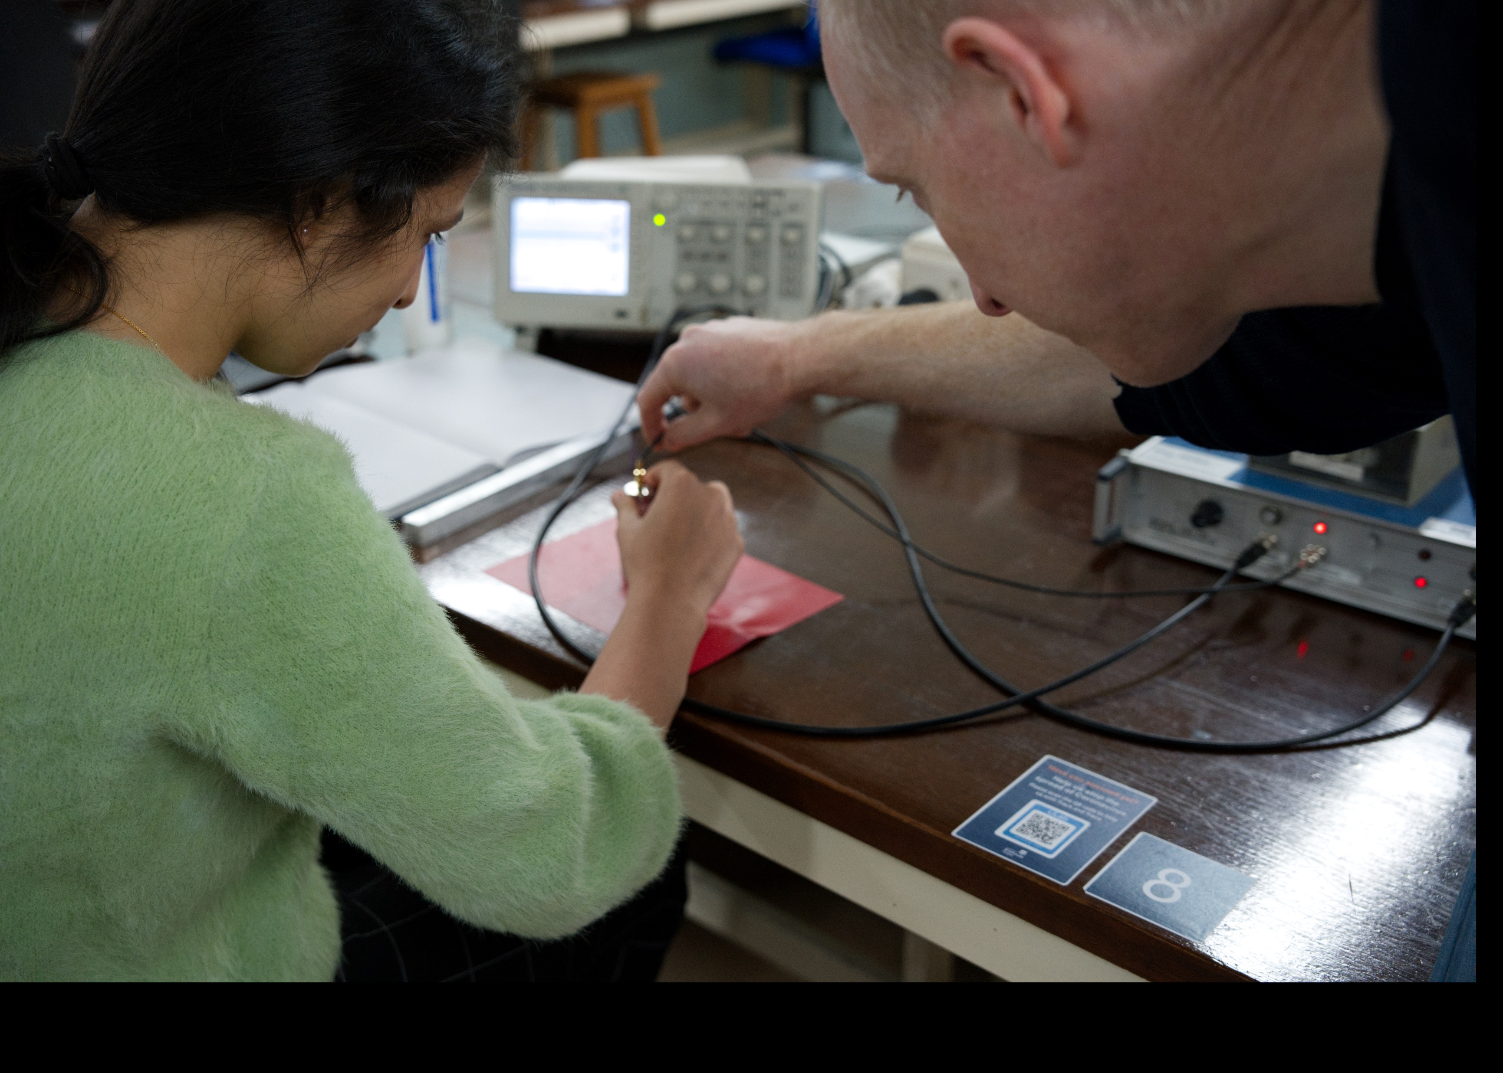
Teaching methods
Teaching
Core material – Lectures and tutorials
Tutorials contain group work
Labs
Group work supported by demonstrators
Programming
Group work supported by demonstrators
Self mark for feedback
Projects
Individual work supported by academic / researcher

Slide 14
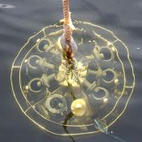
Transfer between Degrees
Transfer can be made during each academic year
Transfer is based on you meeting the necessary requirements for each degree
BSc – MPhys Class Weighted Average (CWA) 55 %
BSc/MPhys – MPhys Adv Res CWA 75 %
BSc/MPhys – Phys with Teaching CWA 45 % + H Eng C
Timing
BSc Physics – MPhys by end of Year 4
BSc/MPhys – Phys with Teaching by end of Year 3
MPhys – MPhys Adv Research by end of Year 3 with correct modules

Slide 15
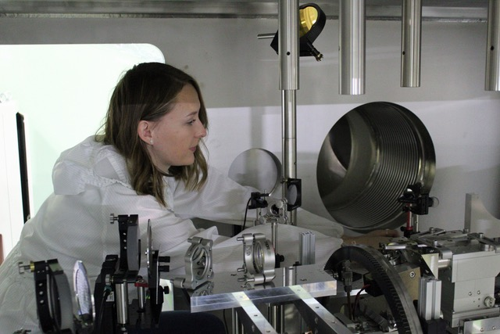
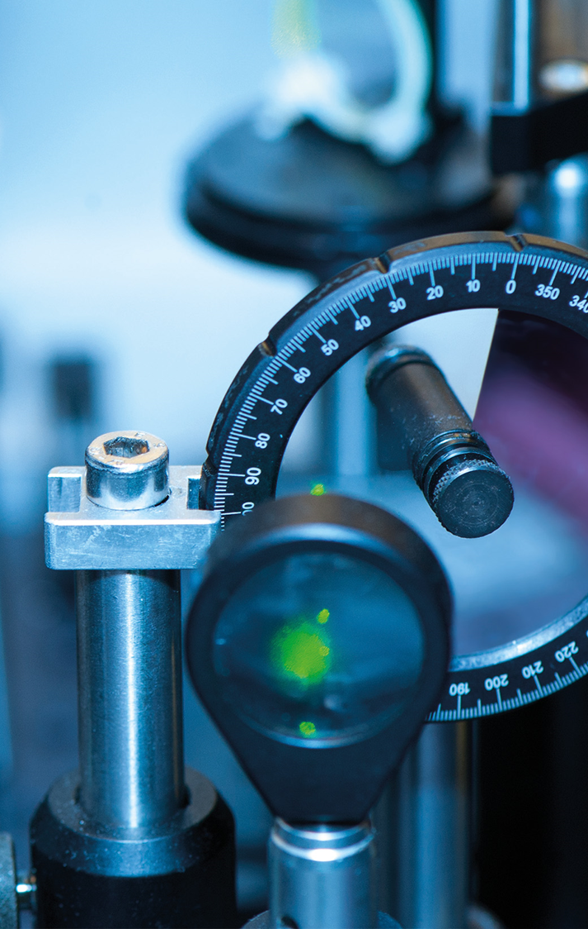
Internships
The Department offers opportunity for students to undertake funded internships.
Taken in a research group in the Department and can be funded through bodies such as
Nuffield, Carnegie, EPSRC and University
Normally in the vacation between Y3/4 or Y4/5
Some groups will also offer short term summer placements for students in Y1/2/3

Slide 16
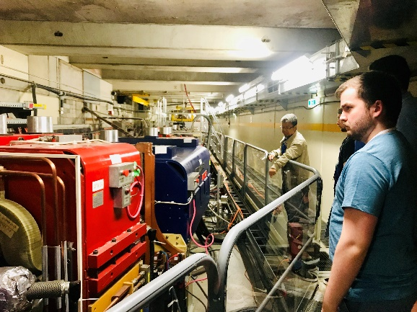
Placements
There are opportunities for students to study abroad or in industry. These are found by the student with help and support available from the Department.
Can graduate with degree that reflects this
Normally done in 4th year
Students studied in, for example:
Germany, France, Hong Kong, USA Canada
Students worked in industry, for example:
Thales, Coherent, Natural Power, CERN

Slide 17
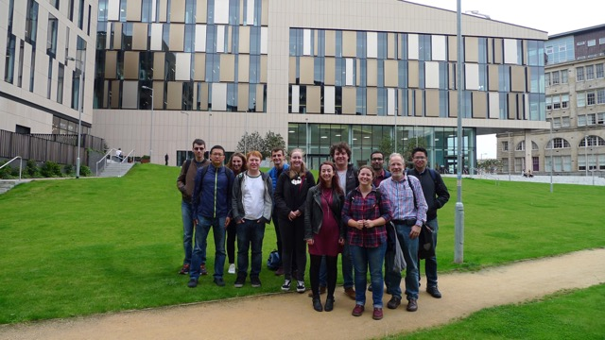
Student Support
Each student allocated a Personal Development Adviser - Meet twice a year, have academic family
Staff run “Open Door” policy
Student Staff Committee
2 meetings per semester
Chaired by student
Opportunity to raise ideas, concerns
Department has an active women’s group WiSPA

Slide 18
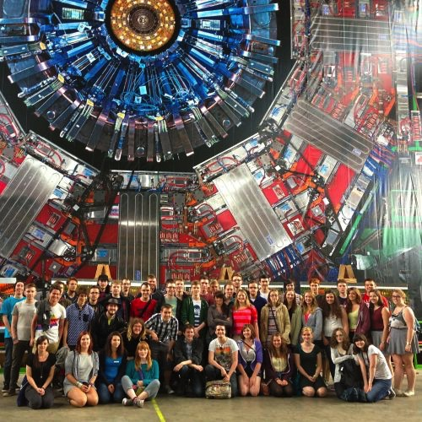
Physics Society
Run by the students for the students
Offer events
Quiz nights
Christmas Social events
Physics talks
Run drop-in centre which gives help with tutorial problems, explain physics etc
Run trips to visit places such as CERN, ESA and other such places.

Slide 19
Physics & Employment
Strathclyde Physics degrees are accredited by Institute of Physics
* Chartered Physicist after graduation
* Allows a fast-track route to Chartered Engineer status
Physics opens doors to some of the most exciting, cutting-edge, and rewarding jobs in the world.
Range of career choices:
Research
Motivation/
Curiosity
Opportunities
Teaching
Physics
degree
Engineering
I.T.
www.iop.org
& others

Slide 20
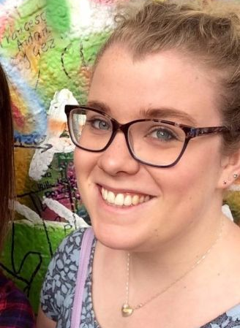
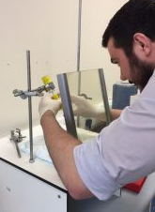
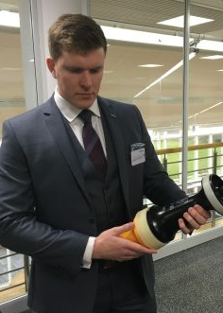
Physics & Employment
Strathclyde physics graduates are:
Chartered Accountant with Ernst & Young
NHS Medical Physics Scientist
Security Analyst for Worldpay Cyber Security
Engineering spin-out at Oxford Uni
Test & Process Engineer at Kaiam Corp.
Lens design, Hollywood (holds the 2nd most Oscars)
Medical Physicists
Engineers
Professors
Company Directors
Politicians
Games Programmers
Systems Engineers
Treasury Analysts
Patent Examiners
Software Engineers
Teachers and Education Advisers
Spacecraft Project Managers
Defence Scientists
Oscar winner
Product Managers
Senior Risk Managers
Business Development Managers
Pop Star
Bankers
and more….
https://www.strath.ac.uk/science/physics/alumni/

Slide 21
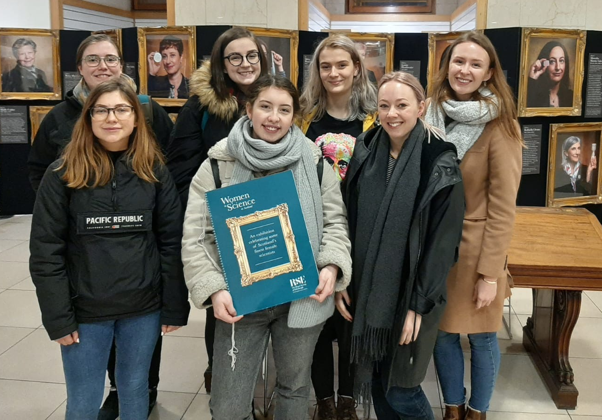
Any questions
We will try to answer now. Put questions in “Q&A”
After event
Email: physics-study-enquiries@strath.ac.uk
Web: https://www.strath.ac.uk/science/physics
@unistrathclyde
@UniStrathclyde
@unistrathclyde
@PhysicsStrath

Slide 22
CONTACT US
@unistrathclyde
Email: physics-study-enquiries@strath.ac.uk
Website: www.strath.ac.uk/science/physics
@UniStrathclyde
@unistrathclyde
@PhysicsStrath

Slide 23
X THE PLACE OF USEFUL LEARNING

