Slide 1
First choice for bereavement support

Slide 2
We are Scotland’s only
“open to all” bereavement charity

Slide 3
We provide support to bereaved adults & children across Scotland
This is regardless of when the death occurred or the cause of death

Slide 4
Our website received 51,218 hits in 2017-18
In 2017-18 our national Helpline received13,718 calls
And 853 early intervention sessions supported people in the first six months of bereavement

Slide 5
173 children and young people received direct bereavement support
A further 1022 were supported through their family via Cruse

Slide 6
The 5 main causes of death that result in requests for our support are:
  Cancer
  Heart Attack
  Suicide
  Pneumonia
  Dementia

Slide 7
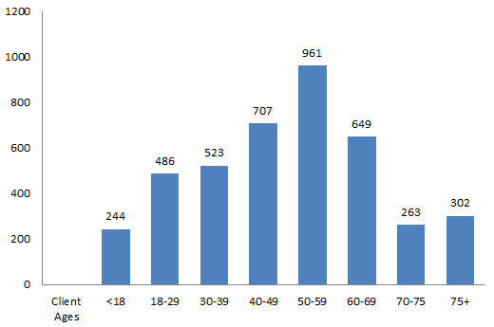
The age range of our clients is varied

Slide 8
0845 600 2227
National Helpline
Self referrals – information sought,
    Personal information
    Who, when, cause of death
    Family Support
    Other issues (permission)
General Practitioners, Family, internet, etc.
Need support and have previously made contact

Slide 9
Measuring our effectiveness (1)
WARWICK-EDINBURGH MENTAL WELLBEING SCALE
Used at first and last sessions to assess client progress

Slide 10
